Slide 1
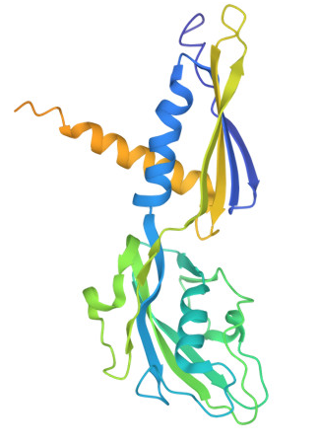
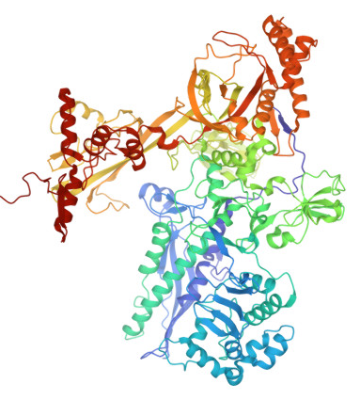
ComPPlete
Amino Acid Sequence
Amino Acid Sequence
Target 1
Protvec
Protvec
Disease Module Identification
Prioritization of Targets
Target 2
Decoder
Check DrugBank and similar databases to find targets with FDA-approved drugs
Human experience and expertise
Predicted Interactions
Experimental Interactions
… …
Parallel Development
Binding Probabilities

