Slide 1
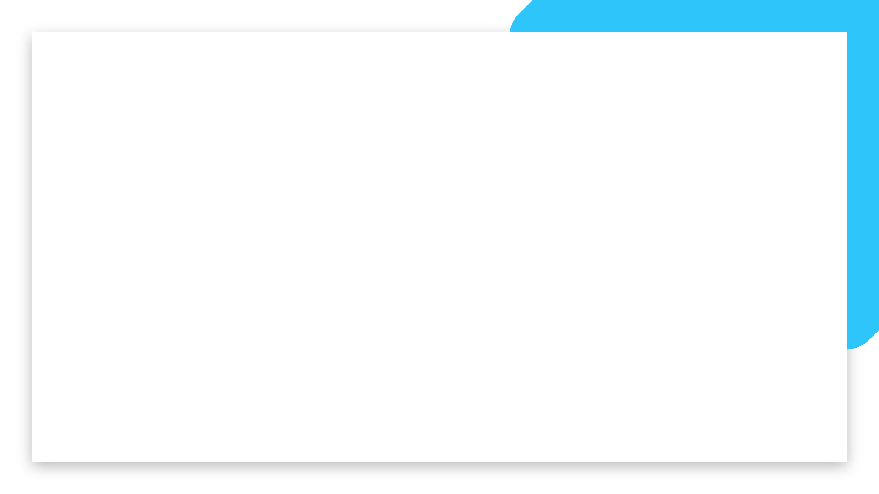
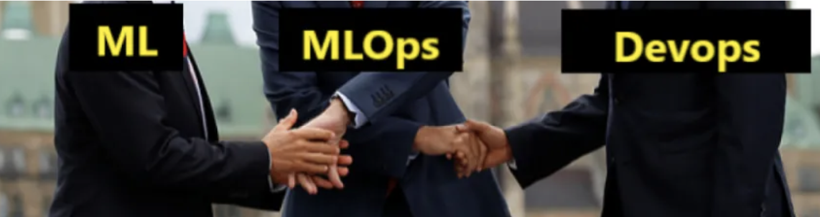


Alexandre, Rodrigo and Lydia
MLOps Project

Slide 2
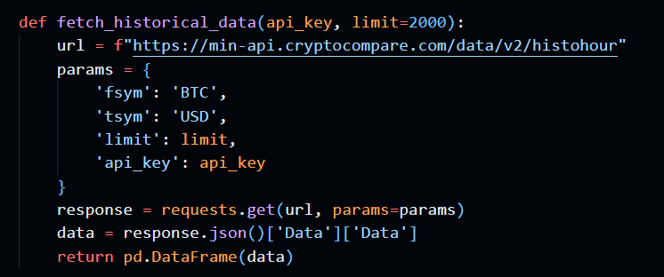
Step 1 - Connect to an API to Retrieve Cryptocurrency Information

Slide 3
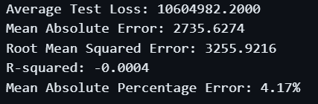


Step 2 - Build a Model to Predict BTC/USD on an Hourly Basis
Alex : LSTM - Terrible results
Lydia : ARIMA - Best results
Rodrigo : XGBoost - Terrible results

Slide 4
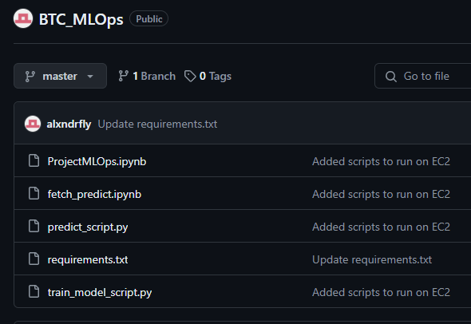
Step 3 - Deploy
Alex : Tried EC2 instance.
Settled on sagemaker notebooks
Live demo
Lydia : ARIMA - Best results
Rodrigo : XGBoost -

Slide 5

Deploying Models to Production with MLFlow and SeageMaker
set virtual environment
install req.txt
setup AWS IAM user and AWS CLI config
Mlflow (ML Lifecycle)
AWS CLI : manage AWS services
train.py :track metrics in mlflow

Slide 6
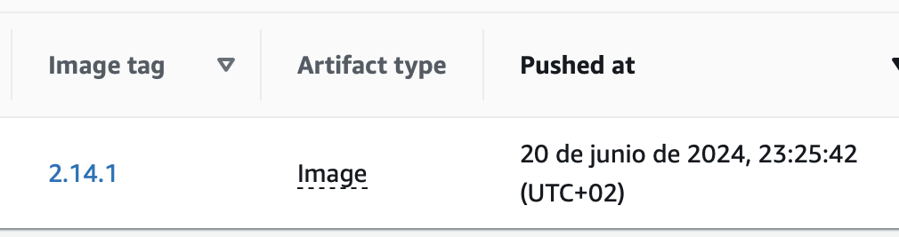
Deploying Models to Production with MLFlow and SeageMaker
train.py :track metrics in mlflow
Build a Docker image and push it to AWS ECR
artifact directory of the selected model in mlruns folder
arimadeploy.py : Deploy image to Sagemaker

Slide 7
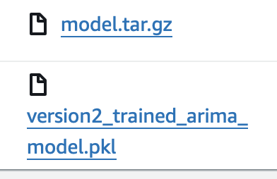
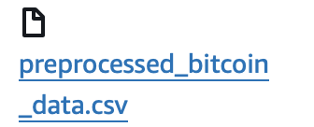
Deploying Models to Production with MLFlow and SeageMaker
test_model.py : use the stored data. Predict in based to that data; if R2 score < 0.80 retrain the model and save the new version of the model into s3
fetch_bucket.py:
Stores fetched btc data to a s3 bucket

Slide 8
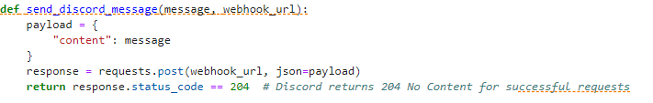
Alerting system on discord

Slide 9
Next Steps
-Use Lambda functions to automate the re-training

