Slide 1
大数据的处理框架： Hadoop MapReduce与PigLatin
徐葳
清华大学
本节部分内容翻译自 UC Berkeley “Great Ideas in Computer Architecture” 讲义
，Jeff Dean等人在SOSP 2004 关于MapReduce的讲稿，
Yahoo 研究院vChris Olston等人在SigMod 2008上关于Pig Latin的讲稿

Slide 2
本节课目标
数据并行
MapReduce编程模型
MapReduce的系统架构
MapReduce性能讨论
更高层的编程框架 – Pig Latin
Pig Latin语言
Pig Latin在Hadoop上的实现

Slide 3
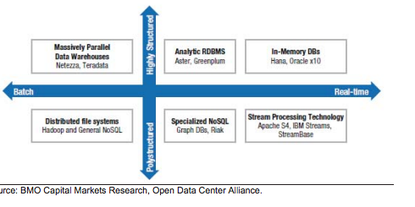
数据类型与分析工具

Slide 4
数据并行

Slide 5
复习：GFS里几个重要的观点
Data striped on hundreds/thousands of servers
Large data chunks reduces metadata overhead
Use commodity hardware -> Failures will be the norm
Failures are inevitable, buy cheaper hardware
No complicated consistency models
Single writer, append-only data
Avoid waiting for each other

Slide 6
Data-Level Parallelism (DLP)
Lots of data on many disks that can be operated on in parallel (e.g., searching for documents)
“Embarrassingly parallel”

Slide 7
Example: Word Frequency
scan
that that is is that that is not is not is that it it is ……
GFS已经解决的问题
数据分块存储
that
is
not
Parallel?
Global States

Slide 8
问题？
共享的状态
吞吐量（多个进程同时改变）
同步（同时修改需要锁）
小粒度的通讯让元数据管理变得更复杂
失败的机器

Slide 9
Example: Word Frequency
Local Count
Local Count
Local Count
scan
that that is is that that is not is not is that it it is ……
Parallel?
that
is
not
Global States

Slide 10
问题
共享的状态
吞吐量（多个进程同时改变）
同步（同时修改需要锁）
小粒度的通讯让元数据管理变得更复杂
失败的机器
共享的状态太大？

Slide 11
Example: Word Frequency
Local Count
Local Count
Local Count
scan
that that is is that that is not is not is that it it is ……
that
is
not
Distributed states

Slide 12
问题
共享的状态
吞吐量（多个进程同时改变）
同步（同时修改需要锁）
小粒度的通讯让元数据管理变得更复杂
失败的机器
共享的状态太大？
如果最终结果失败，重算？

Slide 13
其他问题
易用性
通用性
什么样的抽象？

Slide 14
Map reduce 的编程模型

Slide 15
Data-Parallel “Divide and Conquer” (MapReduce Processing)
Map:
Slice data into “shards” or “splits”, distribute these to workers, compute sub-problem solutions
Reduce:
Collect and combine sub-problem solutions
Easy to use
focus on problem
Map reduce system handles all the details

Slide 16
Map Reduce的基本编程模型
Map:
map(in_key,in_value)
->list(out_key,intermediate value)
Processes input key/value pair
Produces set of intermediate pairs
Reduce:
reduce(out_key,list(intermediate_value))
->list(out_value)
Combines all intermediate values for a particular key
Produces a set of merged output values

Slide 17
Example: Word Frequency
Distribute
that that is is that that is not is not is that it it is
Map 1
Map 2
Map 3
Map 4
that 2, is 1
is 1, that 2
is 2, not 2
is 2, it 2, that 1
Shuffle
is 1
is 1,1
that 2
is 1,1,2,2
it 2
that 2,2
that 2,2,1
not 2
Reduce 1
Reduce 2
is 6; it 2
not 2; that 5
Collect
is 6; it 2; not 2; that 5

Slide 18
Example: Word Frequency
Reduce sums all counts emitted for a particular word
map(String input_key, String input_value):
// input_key: document name
// input_value: document contents
localCount = CountLocally(input_value);
for each count:
Emit (word, count); // Produce count of words
reduce(String word, Iterator intermediate_values):
// word: the word (in the intermediate key);
// intermediate_values: a list of counts
int result = 0;
for each v in intermediate_values:
result += v;
Emit(word, result);

Slide 19
Types
map (k1,v1) ➔ list(k2,v2)
reduce (k2,list(v2)) ➔ list(v2)
Input keys and values from different domain than output keys and values
Intermediate keys and values from same domain as output keys and values

Slide 20
Map reduce 执行过程

Slide 21
Execution Setup
Map invocations distributed by partitioning input data into M splits
Typically 16 MB to 64 MB per piece
Depends on GFS data block size
Input processed in parallel on different servers
Reduce invocations distributed by partitioning intermediate key space into R pieces
User picks M >> # servers, R > # servers
Big M helps with load balancing, recovery from failure
One output file per R invocation, so not too many

Slide 22
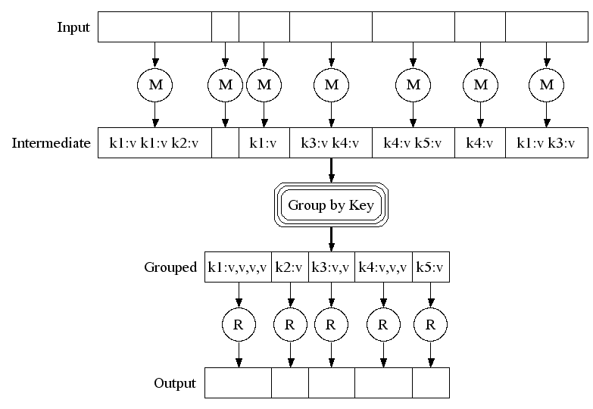
MapReduce Execution
Fine granularity tasks: many more map tasks than machines
Bucket sort
to get same keys
together
2000 servers => ≈ 200,000 Map Tasks, ≈ 5,000 Reduce tasks

Slide 23
The shuffle phase (group by key)
Map 1
emit(key, value)
Map 2
emit(key, value)
Partition function
# of Shards = # of reduce
shard_id = partition(key)
shard_id = partition(key)
Shard 1
Shard 2
Shard 3
…….
Shard 1
Shard 2
Shard 3
…….
that : 2
this : 2
is : 2
he : 66
this : 11
is : 33
me : 2
he : 1
that : 4
Remote Read
Reduce 1
Reduce 2
Reduce 3
Shard 1
Shard 1
Shard 2
Shard 2
that : 2
he : 66
this : 2
this : 11
he : 1
that : 4
Sort
that : 2, 4 ….
he: 1, 66 ….
this : 2, 11 ….

Slide 24
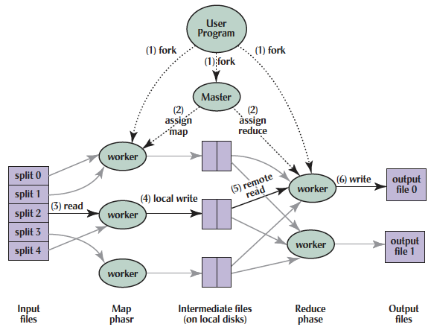
MapReduce Processing
Shuffle phase
Notes:
1. MR 1st splits the input files into M “splits” then starts many copies of
program on servers

Slide 25
MapReduce Processing
Shuffle phase
Notes:
2. One copy—the master— is special. The rest
are workers. The master picks idle workers and
assigns each 1 of M map tasks or 1 of R reduce tasks.
We subdivide the map phase into M pieces and the reduce phase into R pieces as described previously. Ideally, M and R should be much larger than the number of worker machines. Having each worker perform many different tasks improves dynamic load balancing and also speeds up recovery when a worker fails: the many map tasks it has completed can be spread out across all the other worker machines. There are practical bounds on how large M and R can be in our implementation since the master must make O(M+R) scheduling decisions and keep O(M*R) state in memory as described. (The constant factors for memory usage are small, however. The O(M*R) piece of the state consists of approximately one byte of data per map task/reduce task pair.) Furthermore, R is often constrained by users because the output of each reduce task ends up in a separate output file. In practice, we tend to choose M so that each individual task is roughly 16MB to 64MB of input data (so that the locality optimization described previously is most effective), and we make R a small multiple of the number of worker machines we expect to use. We often perform MapReduce computations with M=200,000 and R=5,000, using 2,000 worker machines.

Slide 26
MapReduce Processing
Shuffle phase
Notes:
3. A map worker reads the input split. It parses key/value pairs of the input data and passes each pair to the user-defined map function.
(The intermediate
key/value pairs produced by the map function are buffered in memory.)

Slide 27
MapReduce Processing
Shuffle phase
Notes:
4. Periodically, the buffered pairs are written to local disk, partitioned
into R regions by the partitioning function.
The locations of these buffered pairs on the local disk are passed back to the master who is responsible for forwarding these locations to the reduce workers.

Slide 28
MapReduce Processing
Shuffle phase
Notes:
5. When a reduce worker has read all intermediate data for its partition, it bucket sorts using inter-mediate keys so that occur-rences of same keys are grouped together
(The sorting is needed because typically many different keys map to
the same reduce task )

Slide 29
MapReduce Processing
Shuffle phase
Notes:
6. Reduce worker iterates over sorted intermediate data and for each unique intermediate key, it passes key and corresponding set of values to the user’s reduce function.
The output of the reduce function is appended to a final output file for this reduce partition.

Slide 30
MapReduce Processing
Shuffle phase
Notes:
7. When all map tasks and reduce tasks have been completed, the master
wakes up the user program. The MapReduce call
in user program returns back to user code.
Output of MR is in R output files (1 per reduce task, with file names specified by user); often passed into another MR job so don’t combine

Slide 31
Map reduce 执行过程演示

Slide 32
（这段重新根据新版的hadoop截屏做一下）

Slide 33
Show MapReduce Job Running
~41 minutes total
~29 minutes for Map tasks & Shuffle tasks
~12 minutes for Reduce tasks
1707 worker servers used
Map (Green) tasks read 0.8 TB, write 0.5 TB
Shuffle (Red) tasks read 0.5 TB, write 0.5 TB
Reduce (Blue) tasks read 0.5 TB, write 0.5 TB

Slide 34
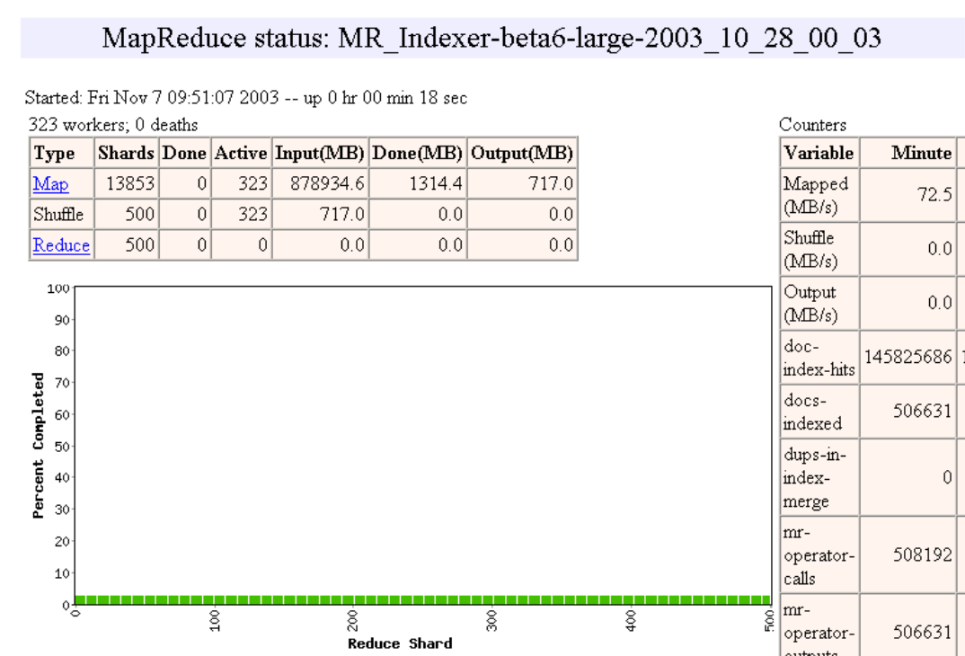

Slide 35
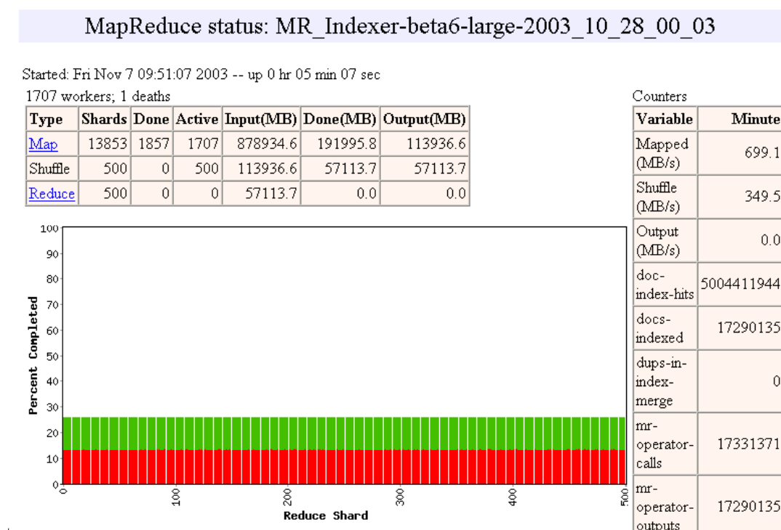

Slide 36
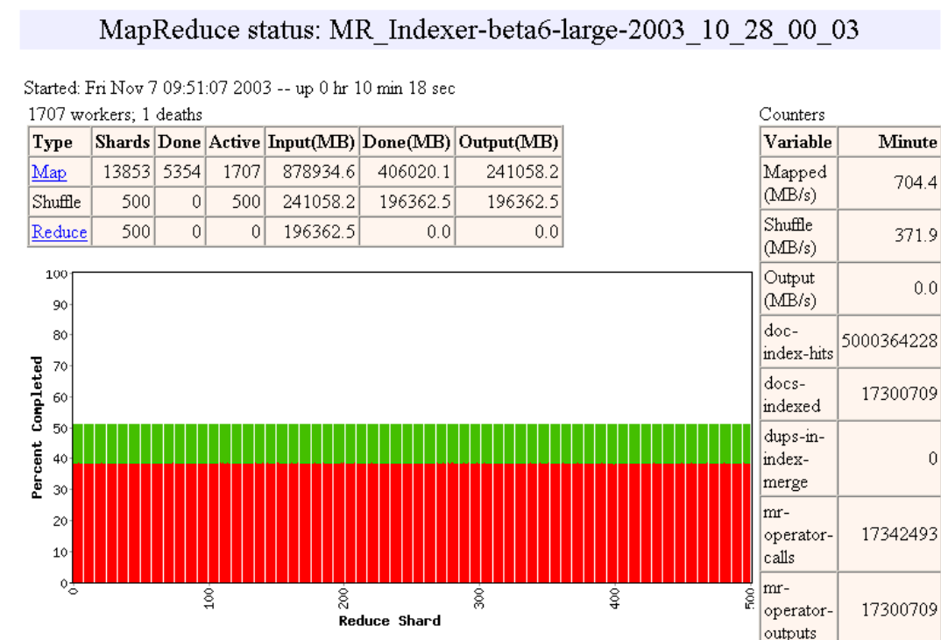

Slide 37
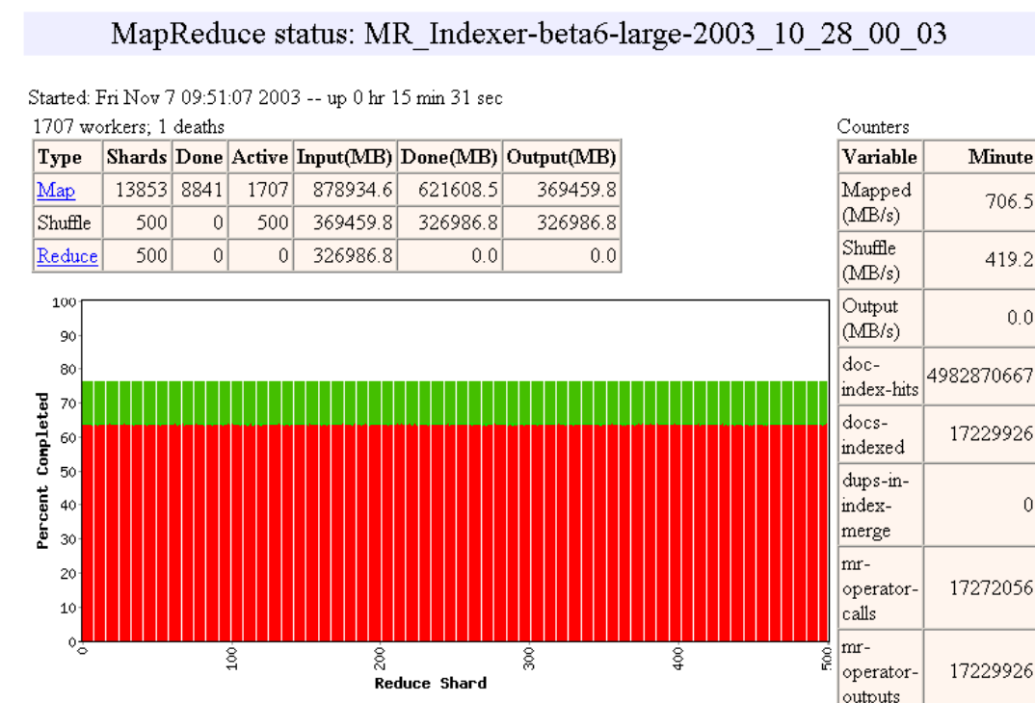

Slide 38
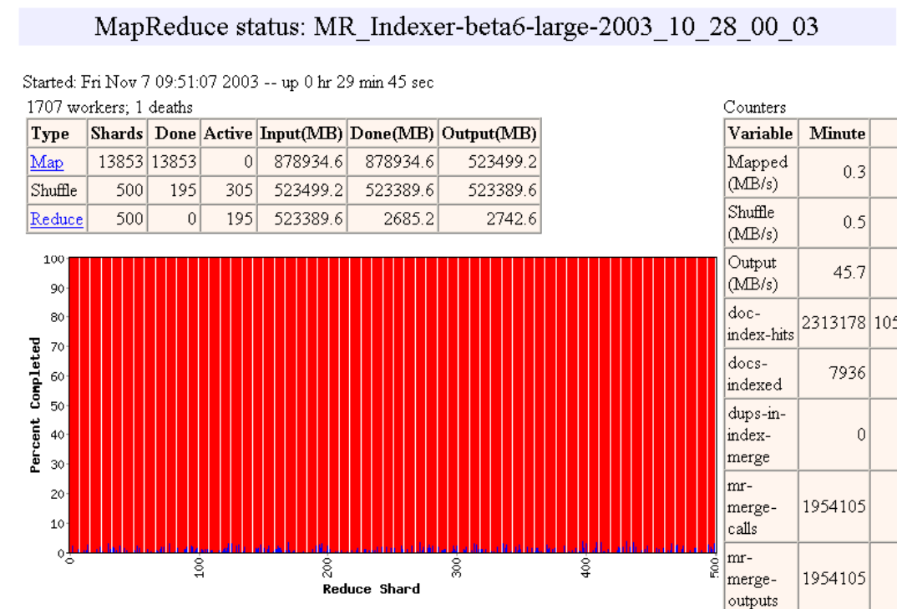

Slide 39
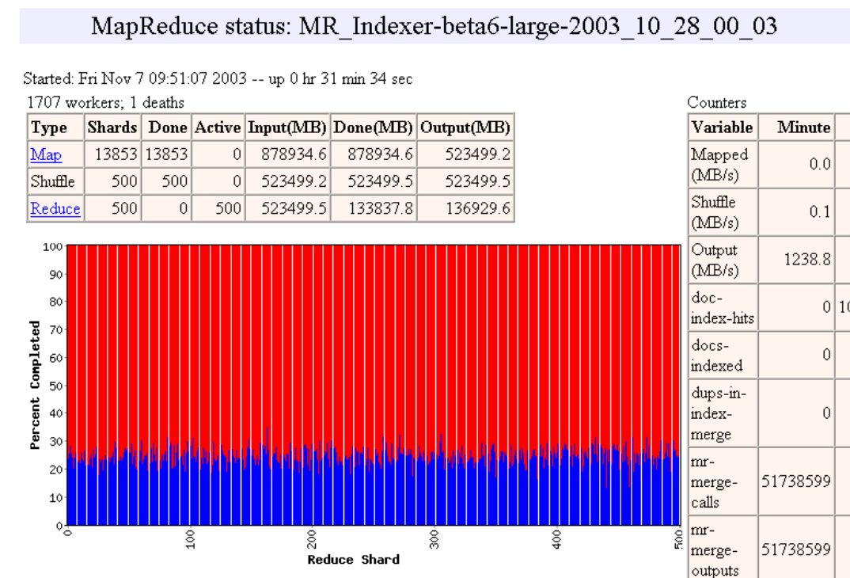

Slide 40
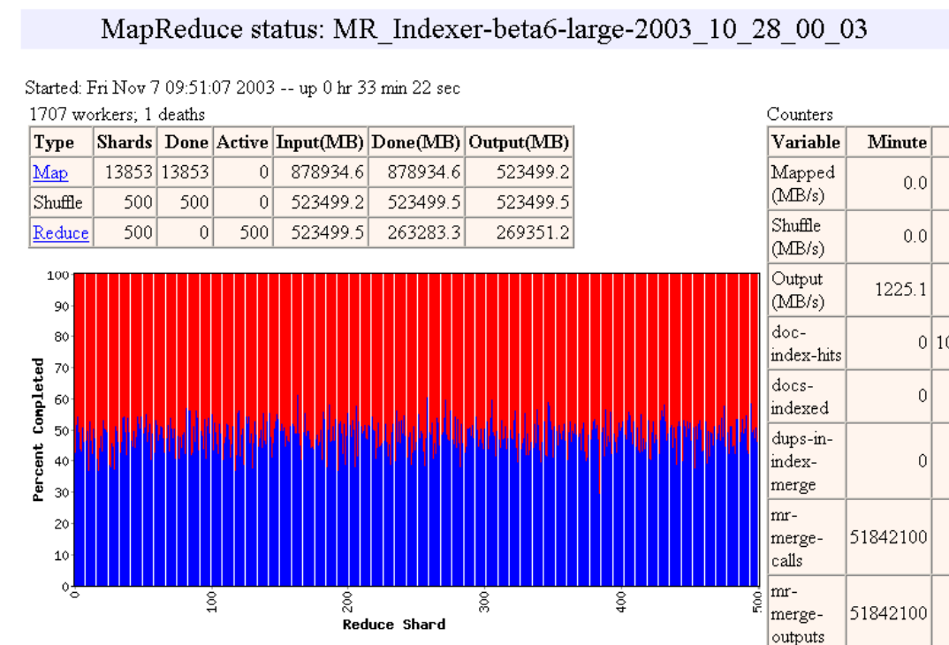

Slide 41
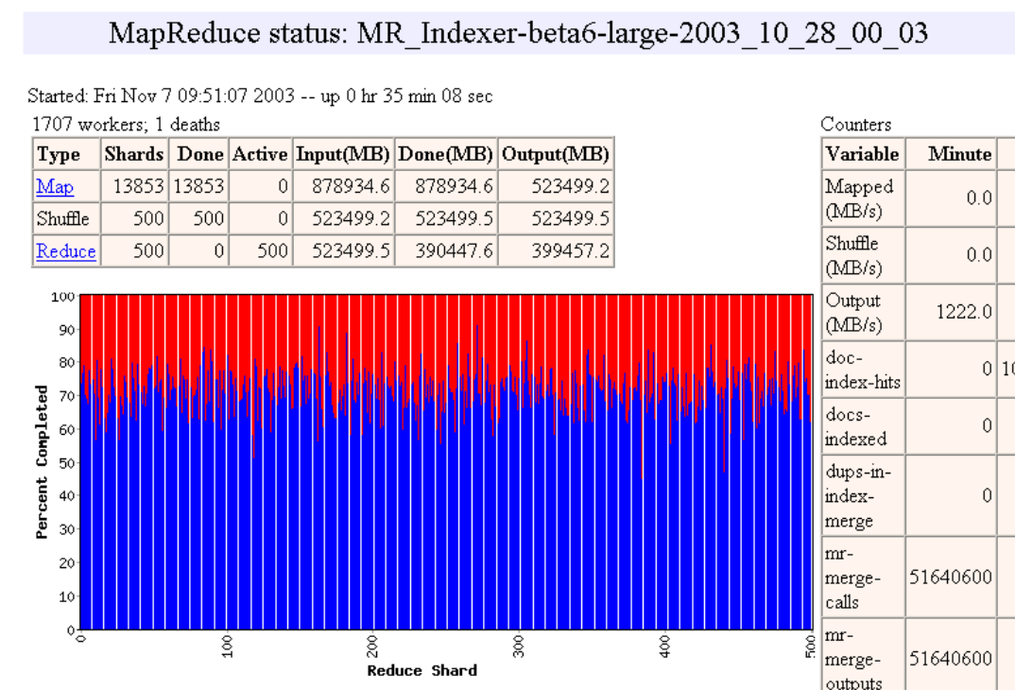

Slide 42
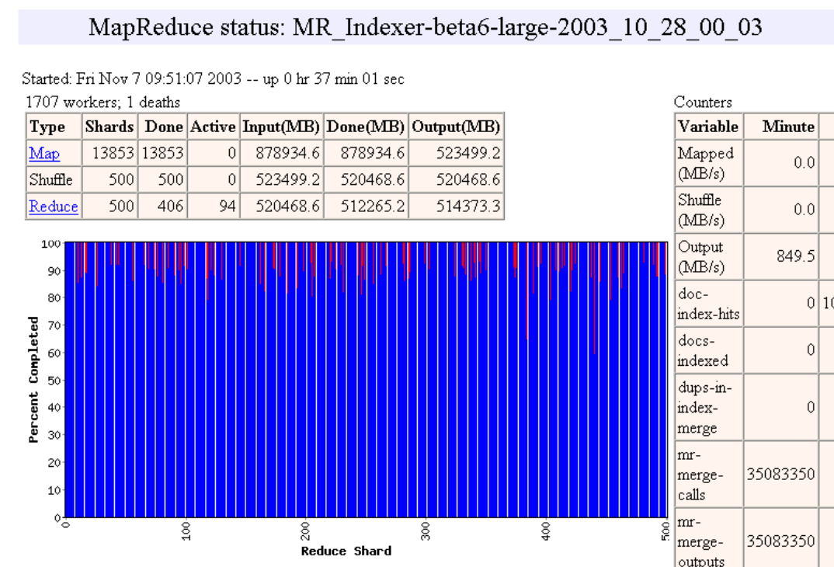

Slide 43


Slide 44


Slide 45
Map reduce一些性能优化讨论

Slide 46
MapReduce Redundant Execution
Slow workers significantly lengthen completion time
Solution: Near end of phase, spawn backup backup copies of tasks
Whichever one finishes first "wins"
Effect: Dramatically shortens job completion time
3% more resources, large tasks 30% faster
Independent
Idempotent

Slide 47
MapReduce Failure Handling
On worker failure:
Master detect failure via periodic heartbeats
Re-execution
Master failure:
Could handle, but don't yet (master failure unlikely)
Robust: lost 1600 of 1800 machines once, but finished fine

Slide 48
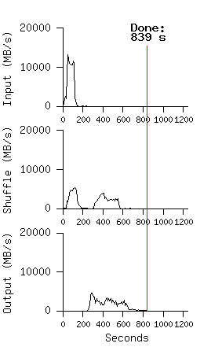
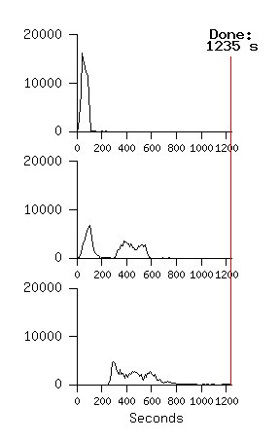
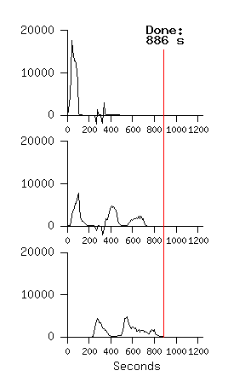
Impact on Execution of Restart, Failure for 10B record Sort using 1800 servers
No Backup Tasks
(44% Longer)
Kill 200 workers
(5% Longer)
Notes:
Figure 3 (a) shows the progress of a normal execution of the sort program.
The top-left graph shows the rate at which input is read. The rate peaks at about 13 GB/s and dies off fairly quickly since all map tasks finish before 200 seconds have elapsed.
The middle-left graph shows the rate at which data is sent over the network from the map tasks to the reduce tasks. This shuffling starts as soon as the first map task completes. The first hump in the graph is for the first batch of approximately 1700 reduce tasks (the entire MapReduce was assigned about 1700 machines, and each machine executes at most one reduce task at a time). Roughly 300 seconds into the computation, some of these first batch of reduce tasks finish and we start shuffling data for the remaining reduce tasks. All of the shuffling is done about 600 seconds into the computation.
The bottom-left graph shows the rate at which sorted data is written to the final output files by the reduce tasks. There is a delay between the end of the first shuffling period and the start of the writing period because the machines are busy sorting the intermediate data. The writes continue at a rate of about 2-4 GB/s for a while. All of the writes finish about 850 seconds into the computation.
Including startup overhead, the entire computation takes 891 seconds.
A few things to note: the input rate is higher than the shuffle rate and the output rate because of our locality optimization – most data is read from a local disk and bypasses our relatively bandwidth constrained network.
The shuffle rate is higher than the output rate because the output phase writes two copies of the sorted data (we make two replicas of the output for reliability and avail- ability reasons). We write two replicas because that is the mechanism for reliability and availability provided by our underlying file system.
In Figure 3 (b)[middle], we show an execution of the sort pro- gram with backup tasks disabled. The execution flow is similar to that shown in Figure 3 (a), except that there is a very long tail where hardly any write activity occurs. After 960 seconds, all except 5 of the reduce tasks are completed. However these last few stragglers don’t fin- ish until 300 seconds later. The entire computation takes 1283 seconds, an increase of 44% in elapsed time.
In Figure 3 (c)[right], we show an execution of the sort program where we intentionally killed 200 out of 1746 worker processes several minutes into the computation. The underlying cluster scheduler immediately restarted new worker processes on these machines (since only the pro- cesses were killed, the machines were still functioning properly).The worker deaths show up as a negative input rate since some previously completed map work disappears (since the corresponding map workers were killed) and needs to be redone. The re-execution of this map work happens relatively quickly. The entire computation fin- ishes in 933 seconds including startup overhead (just an increase of 5% over the normal execution time).

Slide 49
Hadoop:MapReduce的开源实现

Slide 50
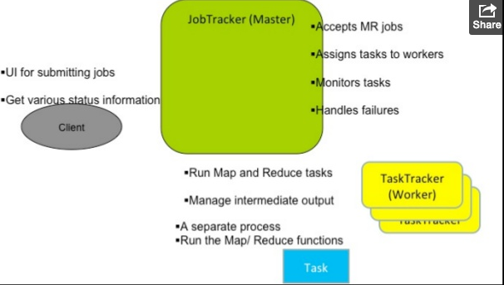
Hadoop Mapreduce的基本架构

Slide 51
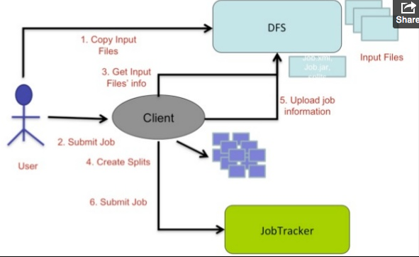
Hadoop MR程序执行过程1

Slide 52
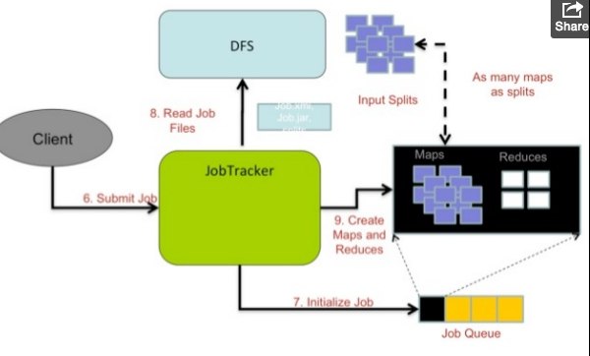
Hadoop程序执行过程2

Slide 53
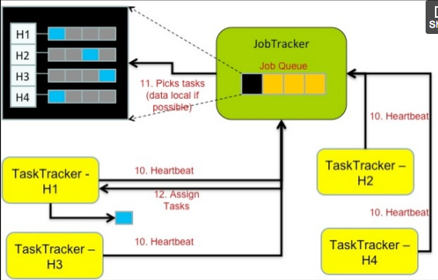
Hadoop 执行过程 3

Slide 54
Map reduce 总结

Slide 55
MapReduce Insights
Restricted key-value model
Same fine-grained operation (Map & Reduce) repeated on big data
Operations must be deterministic
Operations must be idempotent/no side effects
Only communication is through the shuffle
Operation (Map & Reduce) output saved (on disk)

Slide 56
What is MapReduce Used For?
At Google:
Index building for Google Search
Article clustering for Google News
Statistical machine translation
At Yahoo!:
Index building for Yahoo! Search
Spam detection for Yahoo! Mail
At Facebook:
Data mining
Ad optimization
Spam detection

Slide 57
MapReduce Pros
Distribution is completely transparent
Not a single line of distributed programming (ease, correctness)
Automatic fault-tolerance
Determinism enables running failed tasks somewhere else again
Saved intermediate data enables just re-running failed reducers
Automatic scaling
As operations as side-effect free, they can be distributed to any number of machines dynamically
Automatic load-balancing
Move tasks and speculatively execute duplicate copies of slow tasks (stragglers)
Notes:
Transparent: not a single line of code

Slide 58
MapReduce Cons
1. Extremely rigid data flow
M
R
Other flows constantly hacked in
M
M
R
M
Join, Union
Split
Chains
2. Common operations must be coded by hand
Join, filter, projection, aggregates, sorting, distinct
3. Semantics hidden inside map-reduce functions
Difficult to maintain, extend, and optimize

Slide 59
Pig Latin 语言简介

Slide 60
Example Data Analysis Task
Find the top 10 most visited pages in each category
Visits
Url Info
User | Url | Time
Amy | cnn.com | 8:00
Amy | bbc.com | 10:00
Amy | flickr.com | 10:05
Fred | cnn.com | 12:00
Url | Category | PageRank
cnn.com | News | 0.9
bbc.com | News | 0.8
flickr.com | Photos | 0.7
espn.com | Sports | 0.9

Slide 61
Data Flow
Load Visits
Group by url
Foreach url
generate count
Load Url Info
Join on url
Group by category
Foreach category
generate top10 urls

Slide 62
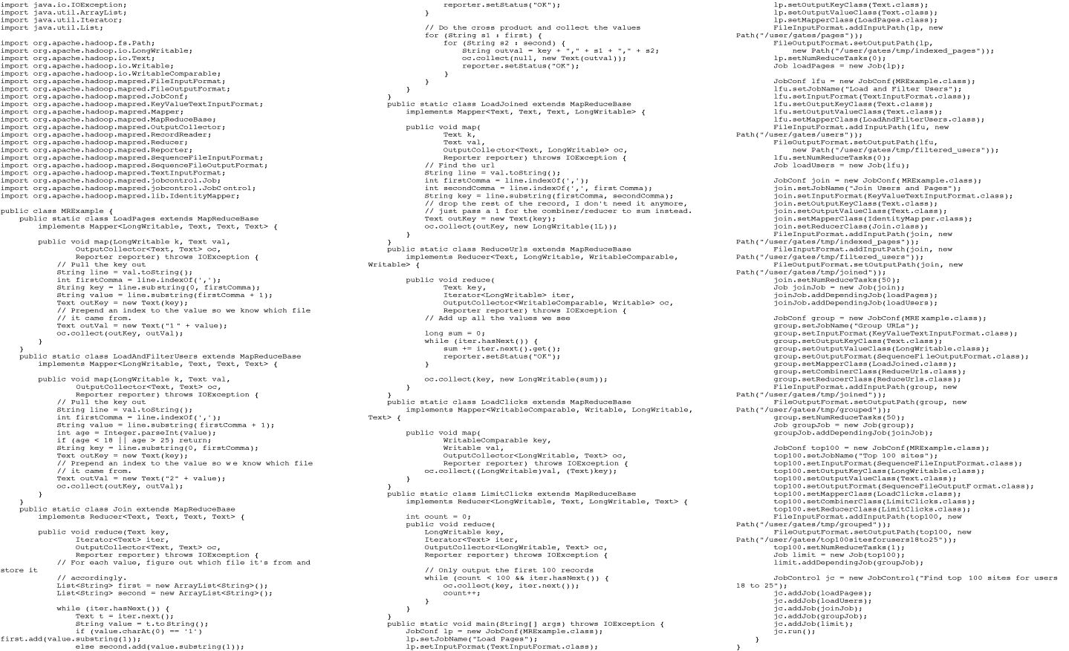
In MapReduce
Example from http://wiki.apache.org/pig-data/attachments/PigTalksPapers/attachments/ApacheConEurope09.ppt
Notes:
My point in putting in the java code isn’t too actually walk through it. It’s just to show that you have to hand code a fair amount of java. That way I can just point and say “look how much java you’d have to write to accomplish this”

Slide 63

Apache Pig
High-level language:
Expresses sequences of MapReduce jobs
Provides relational (SQL) operators (JOIN, GROUP BY, etc)
Easy to plug in Java functions
Started at Yahoo! Research
Runs about 50% of Yahoo!’s jobs
https://pig.apache.org/

Slide 64
In Pig Latin
visits = load ‘/data/visits’ as (user, url, time);
gVisits = group visits by url;
visitCounts = foreach gVisits generate url, count(visits);
urlInfo = load ‘/data/urlInfo’ as (url, category, pRank);
visitCounts = join visitCounts by url, urlInfo by url;
gCategories = group visitCounts by category;
topUrls = foreach gCategories generate top(visitCounts,10);
store topUrls into ‘/data/topUrls’;

Slide 65
Quick Start and Interoperability
visits = load ‘/data/visits’ as (user, url, time);
gVisits = group visits by url;
visitCounts = foreach gVisits generate url, count(urlVisits);
urlInfo = load ‘/data/urlInfo’ as (url, category, pRank);
visitCounts = join visitCounts by url, urlInfo by url;
gCategories = group visitCounts by category;
topUrls = foreach gCategories generate top(visitCounts,10);
store topUrls into ‘/data/topUrls’;
Operates directly over files

Slide 66
Quick Start and Interoperability
visits = load ‘/data/visits’ as (user, url, time);
gVisits = group visits by url;
visitCounts = foreach gVisits generate url, count(urlVisits);
urlInfo = load ‘/data/urlInfo’ as (url, category, pRank);
visitCounts = join visitCounts by url, urlInfo by url;
gCategories = group visitCounts by category;
topUrls = foreach gCategories generate top(visitCounts,10);
store topUrls into ‘/data/topUrls’;
Schemas optional;
Can be assigned dynamically

Slide 67
User-Code as a First-Class Citizen
visits = load ‘/data/visits’ as (user, url, time);
gVisits = group visits by url;
visitCounts = foreach gVisits generate url, count(urlVisits);
urlInfo = load ‘/data/urlInfo’ as (url, category, pRank);
visitCounts = join visitCounts by url, urlInfo by url;
gCategories = group visitCounts by category;
topUrls = foreach gCategories generate top(visitCounts,10);
store topUrls into ‘/data/topUrls’;
User-defined functions (UDFs) can be used in every construct
Load, Store
Group, Filter, Foreach

Slide 68
嵌套的数据结构

Slide 69
Nested Data Model
Pig Latin has a fully-nestable data model with:
Atomic values, tuples, bags (lists), and maps
More natural to programmers than flat tuples
Avoids expensive joins
finance
yahoo ,
email
news

Slide 70
Nested Data Model
Decouples grouping as an independent operation
User | Url | Time
Amy | cnn.com | 8:00
Amy | bbc.com | 10:00
Amy | bbc.com | 10:05
Fred | cnn.com | 12:00
group | Visits
cnn.com | Amy | cnn.com | 8:00
 | Fred | cnn.com | 12:00
bbc.com | Amy | bbc.com | 10:00
 | Amy | bbc.com | 10:05
group by url

Slide 71
CoGroup
results
revenue
query | url | rank
Lakers | nba.com | 1
Lakers | espn.com | 2
Kings | nhl.com | 1
Kings | nba.com | 2
query | adSlot | amount
Lakers | top | 50
Lakers | side | 20
Kings | top | 30
Kings | side | 10
group | results |  |  | revenue
Lakers | Lakers | nba.com | 1 | Lakers | top | 50
 | Lakers | espn.com | 2 | Lakers | side | 20
Kings | Kings | nhl.com | 1 | Kings | top | 30
 | Kings | nba.com | 2 | Kings | side | 10
Cross-product of the 2 bags would give natural join

Slide 72
Pig latin 的实现和优化

Slide 73

Implementation
SQL
user
automatic
rewrite +
optimize
Pig
or
or
Hadoop Map-Reduce
cluster
~50% of Hadoop jobs at
Yahoo! are Pig
1000s of jobs per day

Slide 74
Compilation into Map-Reduce
Map₁
Every group or join operation forms a map-reduce boundary
Load Visits
Group by url
Reduce₁
Map₂
Foreach url
generate count
Load Url Info
Join on url
Reduce₂
Map₃
Other operations pipelined into map and reduce phases
Group by category
Reduce₃
Foreach category
generate top10(urls)

Slide 75
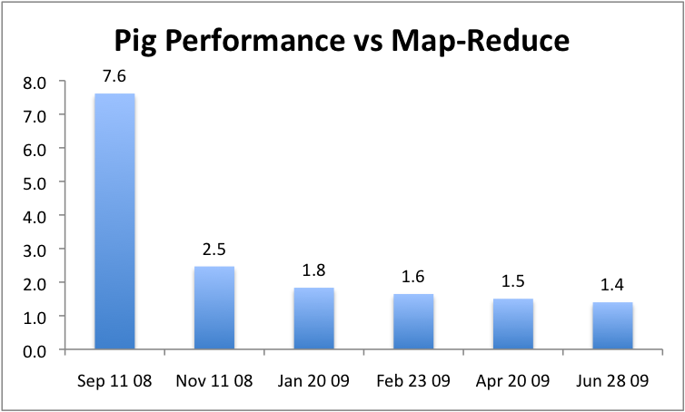
抽象的优势
可以逐渐优化，不影响用户使用

Slide 76
Optimizations: Using the Combiner
Input
records
k₁ | v₁
k₂ | v₂
k₁ | v₃
k₁ | v₁
k₁ | v₃
k₁ | v₅
Output
records
map
reduce
map
k₂ | v₄
k₁ | v₅
k₂ | v₂
k₂ | v₄
reduce
Can pre-process data on the map-side to reduce data shipped
Algebraic Aggregation Functions
Distinct processing

Slide 77
优化举例: Skew Join
Problem if too many values with same key
Skew join samples data to find frequent values
Further splits them among reducers
group | results |  |  | revenue
Lakers | Lakers | nba.com | 1 | Lakers | top | 50
 | Lakers | espn.com | 2 | Lakers | side | 20
Kings | Kings | nhl.com | 1 | Kings | top | 30
 | Kings | nba.com | 2 | Kings | side | 10

Slide 78
Optimizations: Fragment-Replicate Join
Symmetric-hash join repartitions both inputs
If size(data set 1) >> size(data set 2)
Just replicate data set 2 to all partitions of data set 1
Translates to map-only job
Open data set 2 as “side file”

Slide 79
Optimizations: Multiple Data Flows
Load Users
Map₁
Filter bots
Group by
state
Group by
demographic
Reduce₁
Apply udfs
Apply udfs
Store into ‘bystate’
Store into ‘bydemo’

Slide 80
Optimizations: Multiple Data Flows
Load Users
Map₁
Filter bots
Split
Group by
state
Group by
demographic
Demultiplex
Reduce₁
Apply udfs
Apply udfs
Store into ‘bystate’
Store into ‘bydemo’

Slide 81
其他类似框架
Sawzall
Data processing language on top of map-reduce
Rigid structure of filtering followed by aggregation
Hive
SQL-like language on top of Map-Reduce
DryadLINQ
SQL-like language on top of Dryad

Slide 82
总结与课程之后内容展望

Slide 83
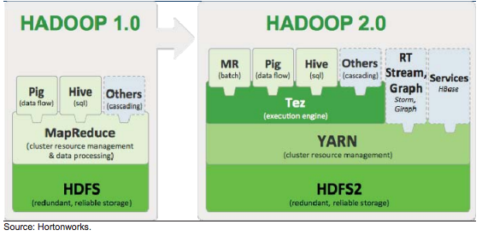
Hadoop与Pig

Slide 84
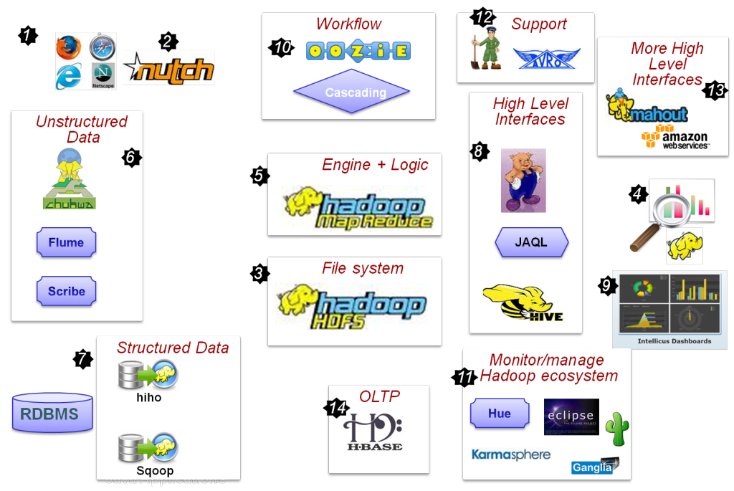
Hadoop 生态系统

Slide 85
另一面: “MapReduce: A major step backwards”
David J. DeWitt and Michael Stonebraker
A giant step backward in the programming paradigm
No Schema, No high level access language
A sub-optimal implementation
It uses brute force instead of indexing
Not novel at all
Techniques well known techniques nearly 25 years ago
Missing most of the features that are routinely included in current DBMS
Indexing, Updates, Transactions, Integrity Constraints, Logical Views

