Slide 2
Outline
Overview
New Challenges for Big Data Systems
General Architecture for Big Data Systems
Considerations in Big Data storage
Distributed file systems
Google File System
Other file systems
Key-value storage
Google’s Bigtable
Other key-value storage and their tradeoffs

Slide 3
Big data systems overview

Slide 4
Challenges in storage systems

Slide 5
Requirements in Storage Systems
Data
What kind of data?
How much data?
How the data are accessed?
Read / write / append
Sequential / random
Parallel accesses?
Infrastructure
Servers / networking
Reliability
More detailed requirements …

Slide 6
Challenges in Storage System Design
Scalability
Absolute scale + incremental adding storage
Fault Tolerance
Without losing data + Without losing availability
Performance: Throughput and Latency
Consistency
Features and workload
Versioned storage

Slide 7
Consistency
Database-style of transaction – “ACID”
Atomicity: Update: “all or nothing”
Consistency: State of tables must always be consistent
Isolation: Concurrent transactions produces the same result as if they occurred sequentially.
Durability: Once committed, the results of a transaction persist against various problems like power failure etc.

Slide 8
CAP Theorem
Consistency: All nodes have the same view of the data
Availability: Every request receives a response of success or failure.
Partition Tolerance: System continues even with loss of messages or part of the data nodes.
CAP theorem states that you cannot achieve all three at once.

Slide 9
Large variety of consistency models
Atomic consistency (linearizability)
reads/writes (gets/puts) to replicas appear as if there was a single underlying replica (single system image)
Eventual consistency
given enough time all updates will propagate through the system
One of the weakest forms of consistency; used by many systems in practice
Causal consistency, sequential consistency, strong consistency, …

Slide 10
Scalability
Support more nodes in the system
Master/directory must scale
Concurrent accesses (throughput)
Serve requests from all nodes
Unit of serving? block / file / value?
Replication and/or partition
Incremental changes
Add / remove nodes (including failures)
How do I know a node has failed?

Slide 11
Replication
Necessary for fault tolerance + throughput
Where to find all the replicas?
Master
Distributed Hash Tables (DHTs)
Write
Slow: need to wait for all replicas
Failed / slow node during replication?
Concurrent writes
Read
Consistency among replicas

Slide 12
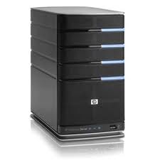
Replication without consistency
Master/Directory
put(K14, V14’)
K5
N2
put(K14, V14’’)
K14
N1,N3
K105
N50
put(K14, V14’’)
put(K14, V14’)
put(K14, V14’’)
put(K14, V14’)
K14
K14
V14
V14’
K5
V5
K14
K14
V14
V14’’
K105
V105
…
N₁
N₂
N₃
N₅₀
Figure Adapted from UC Berkeley CS 162 course slides

Slide 13
Questions in Storage System Design
Where to store the data?
How to access the data?
How to manage the metadata?
Notes:
Fast access: No bottleneck
reliable: do not lose data
cheap

Slide 14
Google File System (GFS)

Slide 15
Requirements
Data
Large Files (100MB – TBs) : Crawled webpages, indices
How much data? 1000+ nodes, 100s of TBs
How the data are accessed?
Sequential read (streaming), large chunks
Sequential append, large chunks
Parallel accesses?
Infrastructure
Servers / networking: relatively fast
Reliability: unreliable commodity servers

Slide 16
Other Requirements
Fault tolerance
Failure is normal
Extreme scale
Relaxed consistency
Allows inconsistent data on concurrent updates / failures
Metadata are guaranteed to consistent
Simple design
Deep integration with applications

Slide 17
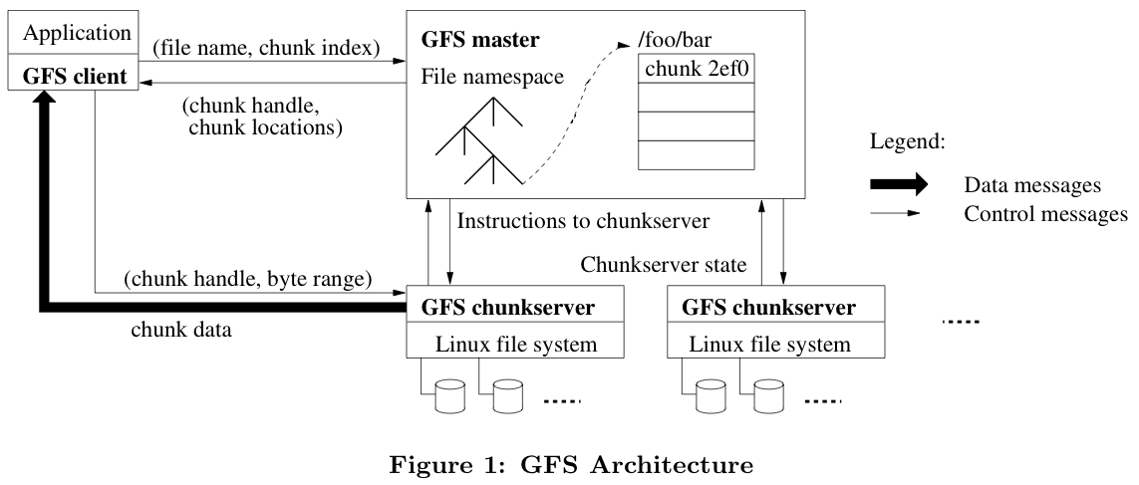
GFS Architecture

Slide 18
GFS Architecture
Where to store the data?
64MB chunks on Chunk Servers (1000s)
3 Replicas
How to access the data?
Client looks up directory on master
Access data directly from chunk servers
How to manage the metadata?
Single GFS master (!)
Namespace + Location of chunks
Use Chubby of locks etc.

Slide 19
GFS Master
Manages metadata
Namespace (directory hierarchy)
Permissions
Files -> chunks mapping
Locations of replicas (chunkservers)
Manages locking and concurrency
Directory locks
Leases to primary replicas
Resource Management
Replica Placement
Migrates chunks between chunkservers
Garbage collection

Slide 20
GFS Master Challenges
Single Node
Bottleneck?
Failures?
Lots of optimizations to make the single master handling as many chunk servers as possible

Slide 21
GFS Master Implementation
Holds all metadata in RAM
Ah?
Logs all client requests to disk
Replicate logs to backup servers

Slide 22
GFS Chunk Servers
64 MB file chunks on local disk
Version number and checksum
No caching of file data (beyond Linux buffer cache)
Read/write requests specify chunk handle and byte range
Chunks replicated on configurable number of chunkservers

Slide 23
GFS Client
Send metadata requests to master server
Send data requests directly to chunkservers
Caches metadata
Does no caching of data
Streaming reads and append writes
No consistency difficulties among clients
No POSIX, No VFS
Open, delete, read, write
Snapshot
Append

Slide 24
GFS Read
read(file name, chunk index)
Client
Master
chunk ID, chunk version number, locations of replicas
Chunk Server
Choose 1 Replica
Chunk Server
Chunk Server

Slide 25
GFS Write
A single replica decides the order of changes to a chunk: primary
Sends data and control in separate messages
Send data first (through “best” route)

Slide 26
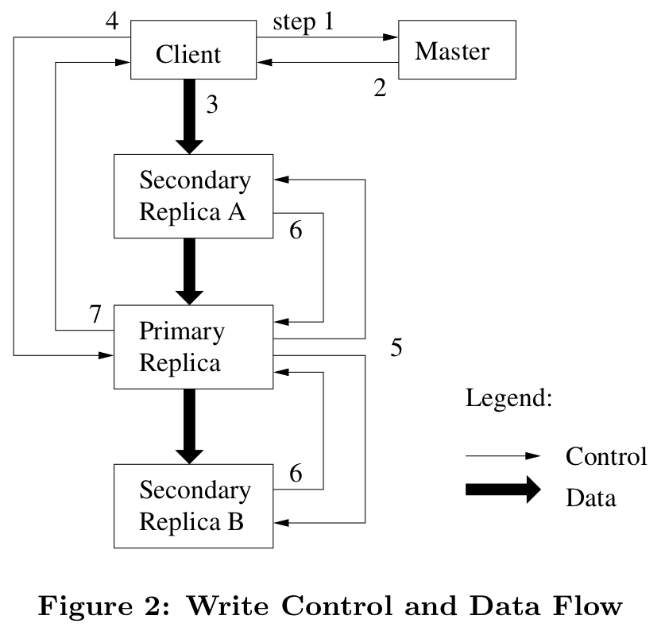
GFS Write
Notes:
All replicas acknowledge data write to client
Client sends write request to primary
Primary assigns serial number to write request, providing ordering
Primary forwards write request with same serial number to secondaries
Secondaries all reply to primary after completing write
Primary replies to client

Slide 27
Handling concurrent update in a chunk
Per-chunk primary determines the order of changes to the chunk
Primary is a lease from master
60 seconds lease, renewable with heartbeat
Can revoke lease
Chunks are versioned
Anyone can write, but only one wins
Consistency
All replica will be identical
order determined by primary
No file level guarantee
Chunk A from client A, Chunk B from client B …

Slide 28
Consistency Model Summary
Metadata: Atomic Changes
Single master
Locking to guarantee consistency
Each Chunk
All replicas are consistent
Each File
Consistent but undefined with concurrent write
With failures?
No guarantee

Slide 29
GFS Master Recovery
Replays log from disk
namespace (directory) information
File -> Chuck mapping
Asks chunkservers which chunks they hold
Chunk server locations

Slide 30
GFS Chunk Server Recovery
Failure discovery
Heartbeat
Re-schedule chunk placement
Background task

Slide 31
Discussion about GFS
Works
Doesn’t work
Notes:
Works:
- simple and cheap
Satisfies particular application
Doesn’t really work:
- Not general
- master does not scale

Slide 32
Second Generation GFS - Colossus
Better Metadata management
Master scaling
Smaller chunks
How? Use Big Table!
Better data storage than replication
Reed-solomon algorithms

Slide 33
Google Big Table

Slide 34
Requirements
Data
(semi-) Structured Data
Large
How the data are accessed?
Random / Sequential, Read / Write
Both batch and interactive
Infrastructure
GFS
Chubby (distributed locking)
Cluster Scheduling
Parallel Processing (MapReduce)

Slide 35
Other Requirements
Fault tolerance
High availability
Extreme scale, incrementally scalable
Relaxed consistency
Allows inconsistent data on concurrent updates / failures
Metadata are guaranteed to consistent
Simple design
Deep integration with applications

Slide 36
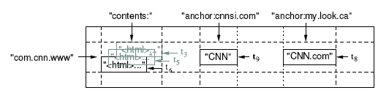
Big Table Data Model
<Row, Column, Timestamp> triple for key
Arbitrary “columns” per row
Column family:qualifier
Column-oriented physical store- rows are sparse!

Slide 37
Data Access
Lookup, insert, delete (C++ APIs)
Each read or write of data under a single row key is atomic
No multi-row transactions
Uninterpreted data values (raw byte array)
String keys, sorted

Slide 38
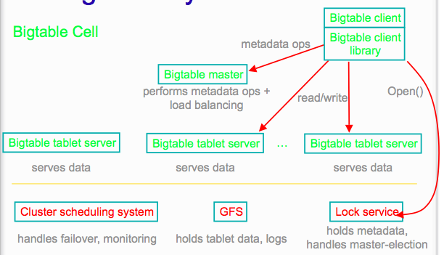
Big Table Architecture

Slide 39
Master
Tablets->servers mapping
Load balancing
Health check on Tablet servers
Garbage collection
Schema changes (new table / column family)
DOES NOT handle
Name resolution

Slide 40
Chubby (the real “master”)
Register master
Manages all metadata
Find the root tablet
Find/add/remove servers
ACL
Implementation
5 nodes + Paxos consensus protocol
“lease” locks
acquire lock = register
Disconnect = lose the lease

Slide 41
Data Partition: Tablet
“Contiguous” range of rows of the table
Row key -> locality
Unit of distribution & load balance
100MB ~ 200MB of data per tablet
Tablet
Start:aardvark
End:apple
64K block
64K block
64K block
SSTable
64K block
64K block
64K block
SSTable
Index
Index

Slide 42
Tablet Server
Tablet server is responsible for ~100 tablets
Why?
Fast recovery: 100 machines each pick up 1 tablet for failed machine
Fine-grained load balancing: Migrate tablets away from overloaded machine
Master makes load-balancing decisions

Slide 43
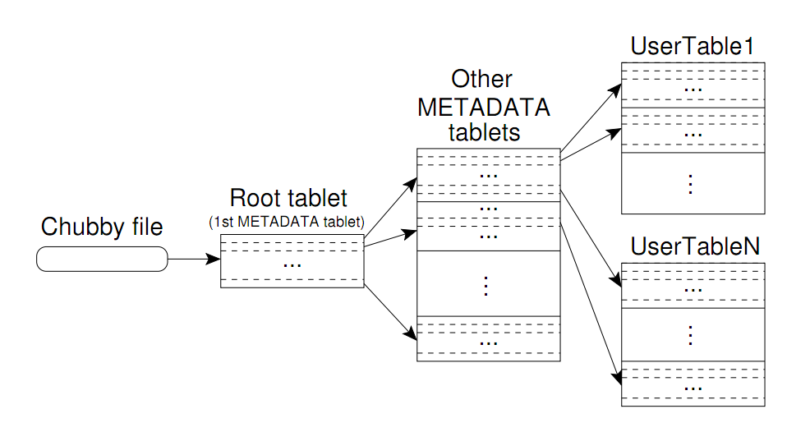
Locating a tablet
Where do we store tablet location data?
Multi-level lookup starting at Chubby
A big data table itself: METADATA
Caching and Prefetching

Slide 44
Tablet Server Implementation
Basic storage: SSTable
Disk structure, with in-memory index
Optionally load into memory
“IndexFile” in Hadoop
64K block
64K block
64K block
SSTable
Index

Slide 45
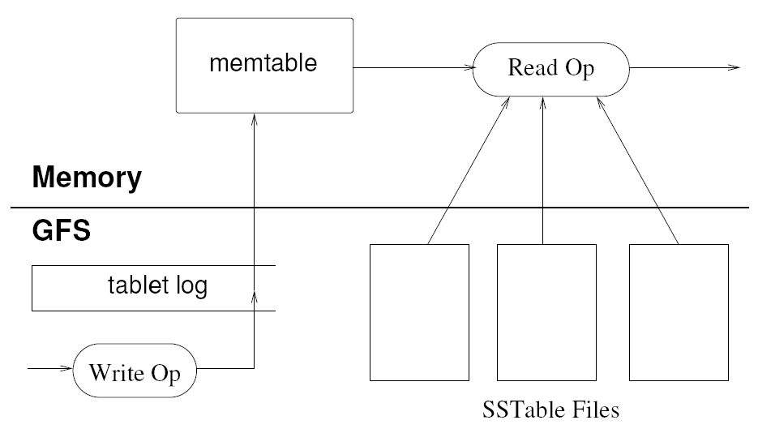
Tablet Server Implementation
Per tablet Server
Commit Log
Image Source: Chang et al., OSDI 2006

Slide 46
Tablet Server Implementation: Compactions
Minor compaction
Converts the memtable into an SSTable
Reduces memory usage and log traffic on restart
Merging compaction
Reads the contents of a few SSTables and the memtable, and writes out a new SSTable
Reduces number of SSTables
Major compaction
Merging compaction ALL -> only one SSTable
Why?
Notes:
Eliminate deletion records

Slide 47
Physical Storage (GFS)
GFS replicate the data (and the commit log)
Prefers to start tablet server on the same machine as the data for locality

Slide 48
Fault Tolerance
Master recovery
Through Chubby: one master
Chubby recovery
Re-elect master from the remaining 5 nodes
Tablet server recovery
Discover: using Chubby
Master reassign Tablets to many different servers

Slide 49
Fault Tolerance: Tablet Recovery
Per tablet server commit log (all tablet)
<table, row, seq #>
First sort the logs (MapReduce)
Then distribute to each Tablet Server

Slide 50
Fault Tolerance: GFS Slow?
Two threads to write logs
One slow -> use the other
Sequence number to sort / deduplicate

Slide 51
Reduce synchronization cost
Immutable Data Structures
SSTable
Memtable -> copy on write
Delete / update left to GC
Cons: impossible to do multiple-row-transactions

Slide 52
Other Optimizations
Locality groups: separate SSTables are created for each locality group
Lightweight compression: columns are easy to compress
Tablet servers use two levels of caching
Bloom filters

