Slide 1
6090: BIG DATA FINAL PROJECT
PREDICTION FOR OPTIONS WRITING
Dylan D'cruz
Jayashri
Chaitanya Bhure

Slide 2
PROBLEM:
Stock market being the most tricky business, the main issue goes around for the writer “How to Make PROFIT”. From the studies we can see that more than the buyer it is the writers who get more loss.
For balancing out one loss, he have to make many profits which is not technically possible for all the writers.
SOLUTION:
To resolve this issue, we are coming up with solution of predicting the options for the writer and also when the expiry date has to fall on.

Slide 3
OPTIONS AVAILABLE - Out of the money
CALL
COVERED CALL
UNCOVERED CALL
PUT
COVERED PUT
UNCOVERED PUT
Going through previous case studies, the most profitable part for an option writer is make a covered call and an uncovered put.
So that he makes the minimum premium amount as profit if there is any sudden bankruptcy with the respective company.

Slide 4
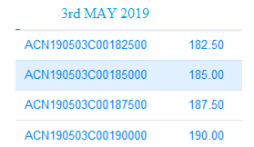
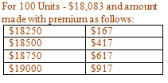
Why Covered call over Uncovered call
Considering an example,
The stock price for “Accenture plc (ACN)” on 26th April 2019
is $180.83, considering the call options with various strike
price on 3rd May 2019. The options shows that the writer has
made contract with the buyer with the following strike price
which includes the intrinsic value and premium together will
be $1.67, $4.17, $6.17, $9.17.
The writer has sold the contract for the above prices respectively
for minimum of 100 units. Therefore the amount made by the
writer will be as shown in the table:
The intrinsic and premium amount will be the minimum profit
made if the buyer does not get back with the contract.

Slide 5
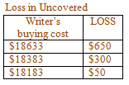
LET US ASSUME THE STOCK PRICE BE $188 on 3rd May 2019.
What happens with uncovered call:
Now the considering the writer has made an uncovered call option back on 26th April 2019: The buyers with the strike price as $182.50, $185, $187.50 will be back with the contract as they can make a profit with the increased stock price.
The writer would have to buy the stock for $188
and then sell the same stock to the buyer for the
same $188 when they come back to exercise the
contract. In this case there is a loss of $650, $300,
$50 respectively.
The loss incurred in above example is just a small
fraction of actual loss happening in the daily stock market for the writers.

Slide 6
What happens with covered call:
Now the considering with the same example and the writer had made a covered call on 26th April 2019: The buyers with the strike price as $182.50, $185, $187.50 will be back with the contract as they can make a profit with the increased stock price.
Being the covered call, the writer had already bought the stock for $180.83 and will sell the stock to the buyer for $188 when the buyer exercises the contract.
In this case though the writer does a wrong prediction, the writer will not be incurred with a loss but with a minimal profit. That is the writer makes the profit with the intrinsic value and the premium obtained initially.
But in both the covered call and uncovered call, buyers with the contract of strike price being $190 will not turn back. This results in making a minimal profit of $190 in both the cases.

Slide 7
LET US ASSUME THE STOCK PRICE BE $178 on 3rd May 2019.
With Uncovered call: The writer has made an uncovered call option on 26th April 2019: The buyers will not exercise as they can directly buy from the market with low stock price.
In this case the writer would make the minimum profit with the intrinsic and premium together, which will be $167, $417, $617, $917. Also there would be no loss incurred in this scenario.
With Covered call: The writer has made an covered call option on 26th April 2019: Similarly the buyers will not exercise as they can directly buy from the market with low stock price.
In this case, the writer will make an initial profit with the premium amount and also he can make uncovered put with the stock he has already bought.
The loss which can be occured is a rare case scenario.

Slide 8

Why Tensorflow 2.0
Default Eager Execution.
Easier debugging and less verbose.
More in-depth control with access to all lower level API’s.
Backwards compatible with tensorflow 1.0.

Slide 9
TRANSFORMER Neural Network
Replaced all variations of Recurrent Neural Networks, including GRU (Gated Recurrent Unit) and LSTM (Long Short Term Memory) for time-series data.
Self-Attention Mechanism.
Requires less computations to train, hence is optimized for modern machine learning hardware.

Slide 10
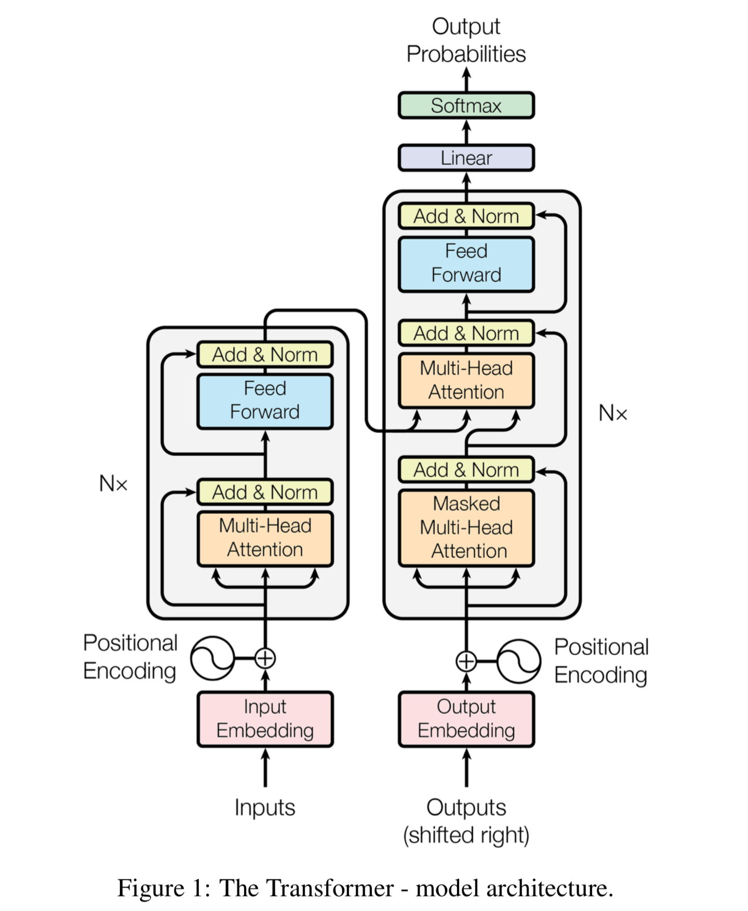
TRANSFORMER Neural Network Architecture

Slide 11
THE DATA:
We are considering historical data for this application.
After implementing the network with a few years of training data, the performance of the network was not up to the mark.
Increasing the training data, led us to having more than half a century of stock data for the companies in consideration. (Ford & Chevron)
Ford with 56 years of data and Chevron with 49 years of data.
With more data the model performs much better, as you will see in the coming slides.

Slide 12
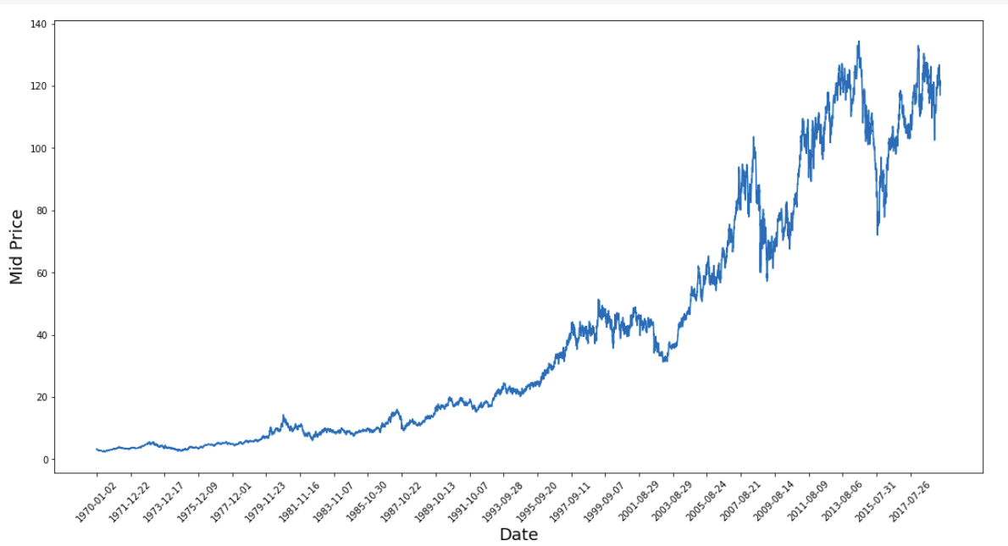
Implementation of Neural Network
Data Set is daily stock prices of companies taken from Yahoo Finance.
Companies considered include Chevron, Ford, etc.
Historical Data of a few decades has provided better accuracy.
Training Data is divided into segments of 25-30 days (value needed is different for each company).
For example, if 1000 days of training data are divided into segments of 30, the segments will be from days 1 to 30, 2 to 31 ……… 971 to 1000.

Slide 13
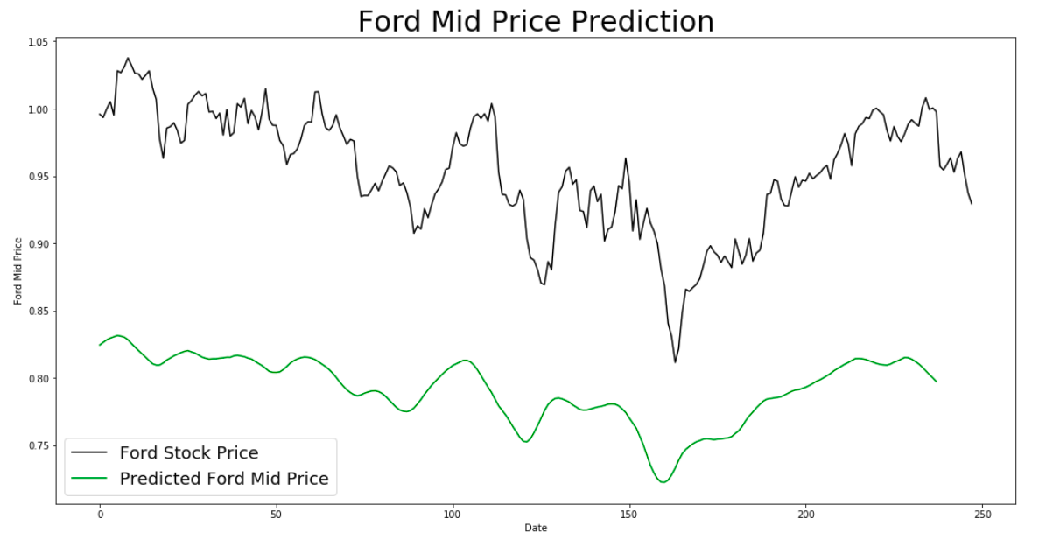
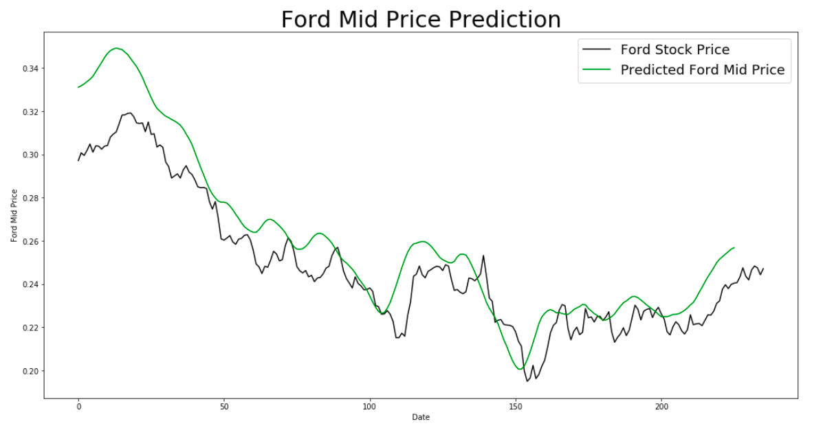
Prediction Accuracy Testing
The last 200-250 days are used as testing data to compare against the projections given by the training set.

Slide 14
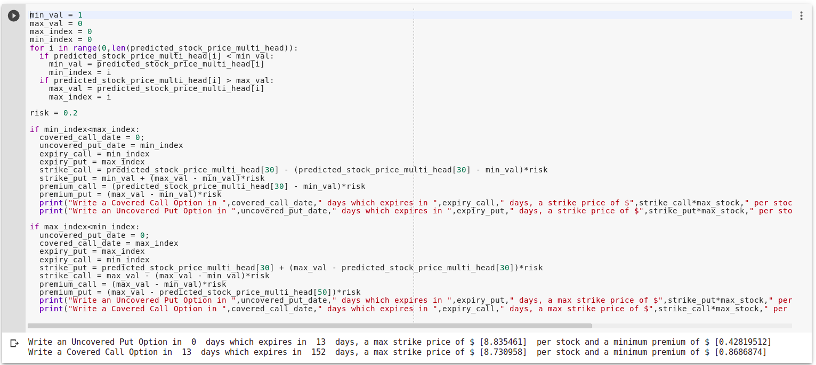
Writing Options
We recommend that the user write an Uncovered Put and a Covered Call Option.
The Max and Min Values are taken along with the days on which they occur.
The order of these days will determine when the Call and Put Options will be written.
Alongside this, we also provide recommended expiration dates, minimum premiums and maximum strike prices as outputs.
These are designed such that there is no loss procured no matter when the options are exercised.

Slide 15
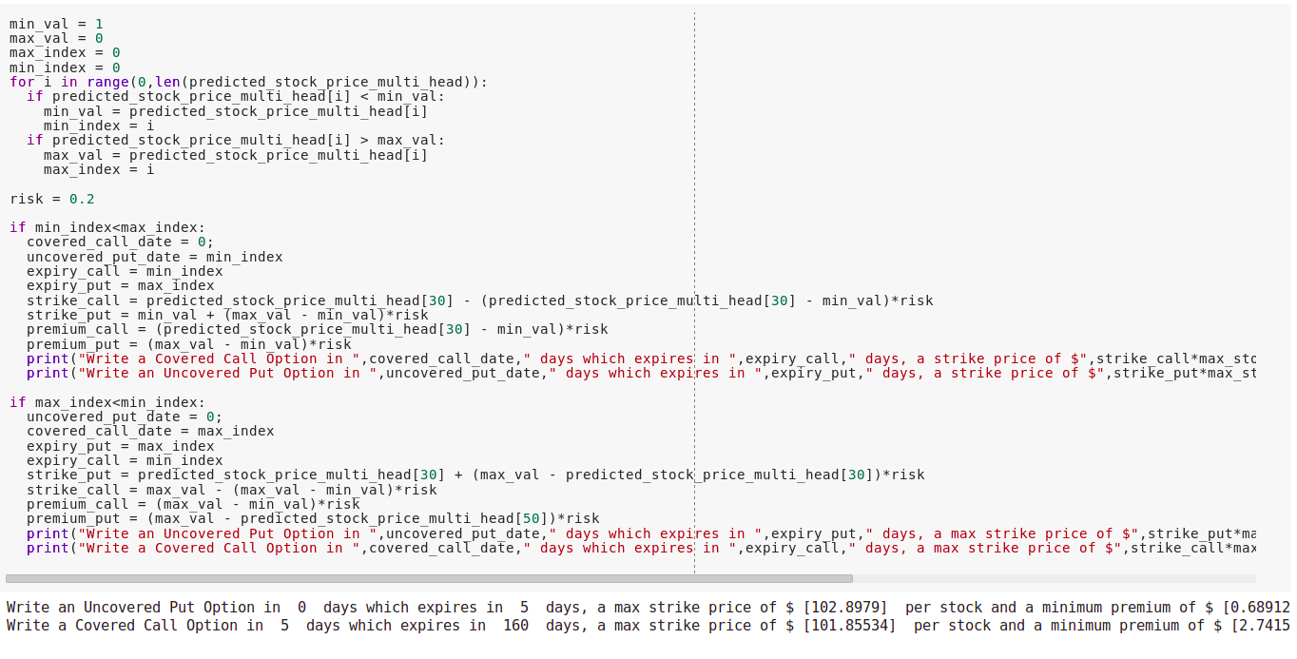
Writing Options
We recommend that the user write an Uncovered Put and a Covered Call Option.
The Max and Min Values are taken along with the days on which they occur.
The order of these days will determine when the Call and Put Options will be written.
Alongside this, we also provide recommended expiration dates, minimum premiums and maximum strike prices as outputs.
These are designed such that there is no loss procured no matter when the options are exercised.

Slide 16
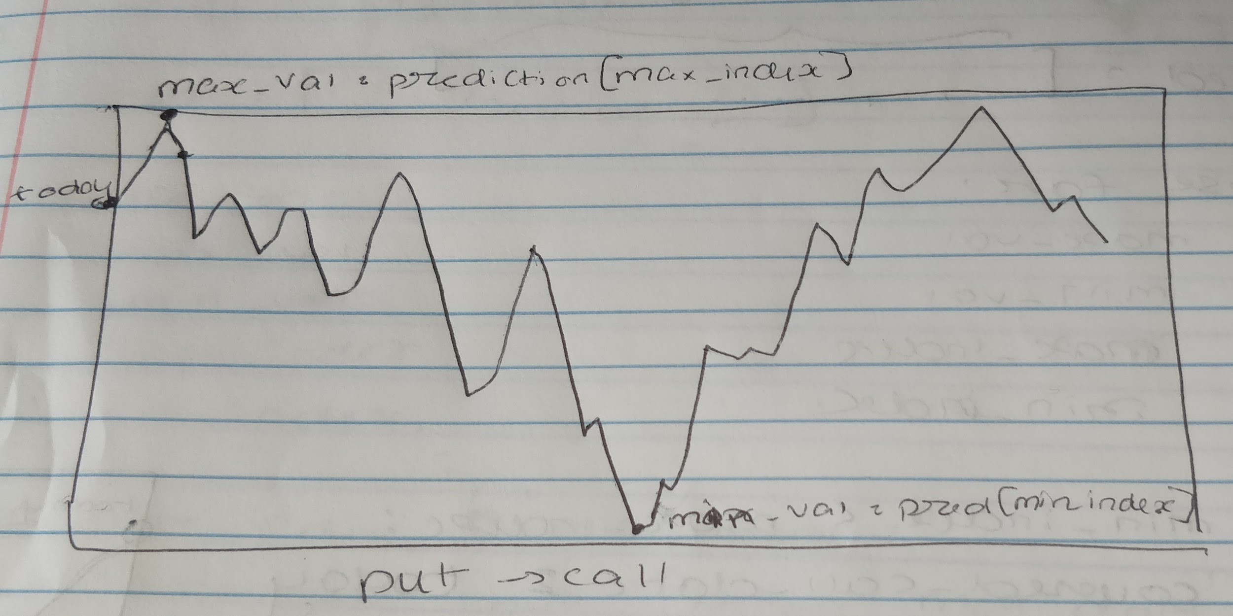
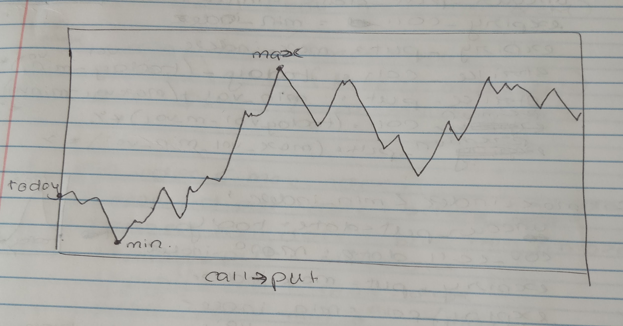
Writing Options
We recommend that the user write an Uncovered Put and a Covered Call Option or a covered call followed by a uncovered put.
The Max and Min Values are taken along with the days on which they occur.
The order of these days will determine when the Call and Put Options will be written.
Alongside this, we also provide recommended expiration dates, minimum premiums and maximum strike prices as outputs.
These are designed such that there is no loss procured no matter when the options are exercised.

Slide 17
CONCLUSION
Although, this is a high risk business historical data in large amounts, does help in predicting if not accurate values, but at least the trend, which is what is most important for our problem statement as option writers
Best case scenario with minimum loss is always a covered call followed by an uncovered put.
Bleeding-edge neural network models can adapt in a more generalized manner on past data reducing the chances of overfitting the model.

