Slide 1
Introduction to R
Alexis Robert, Sophie Meakin, Billy Quilty, Naomi Waterlow
Based on a script and session developed by
Abigail Page, Claire Dooley, Anushé Hassan, and Shammi Luhar.

Slide 2
Practical 2

Slide 3
Functions
A function is a set of commands, organised together, in order to perform a task.
R has many built-in functions. You have already used a few, such as “mean()”, “median()” etc.
Four different parts in a function:
The name of the function: How do you call this function?
The arguments: What inputs does this function need?
The body of the function: What set of commands is ran by the function?
The return value: What is the output of the function?

Slide 4
Functions (example)
Create a function that takes two numbers and compute the summed of their square values

Slide 5
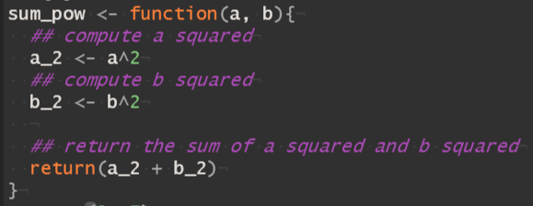
Functions (example)
Name
Arguments
Body
Return Value
A function is then called using parentheses, i.e. sum_pow(5, 9).

Slide 6
Packages
The functions used in the practical so far are included in base R.
Packages are units of shareable code, and can include functions, data, documentation, and tests.
Packages are stored on CRAN (https://cran.r-project.org/web/packages/), over 18,000 packages are currently available.
Packages should be installed using the function ‘install.packages()’ (only needed once)
Once installed, packages are loaded using the function ‘library()’ (needed every time a new session is opened).

Slide 7
Package for data visualisation: ggplot2
ggplot2 is one of the most popular packages for data visualization.
There are three main steps for making a ggplot:
Open the canvas with the “ggplot()” function and define which data set to use.
Tell R which variables (columns) you want to plot.
Tell R how you want to plot these data e.g. a histogram, a scatter plot, a boxplot.
Extra (optional) steps change the appearance of the plot.
Resources:
ggplot2 website
Epi R Handbook

Slide 8

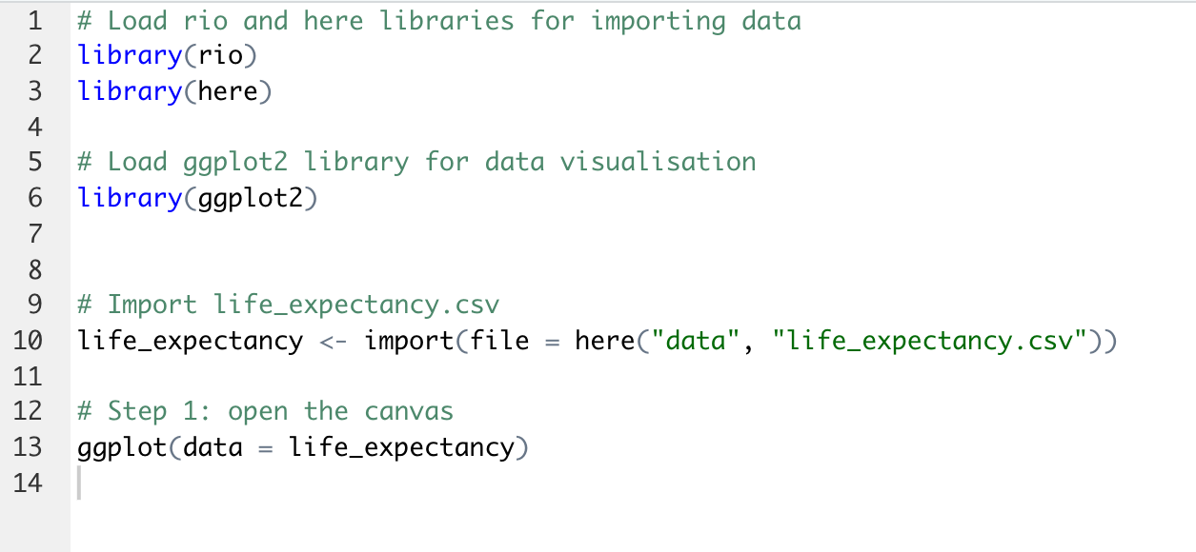
ggplot2, step 1
Step 1: Open the canvas with the “ggplot()” function and define which data set to use.
Output

Slide 9
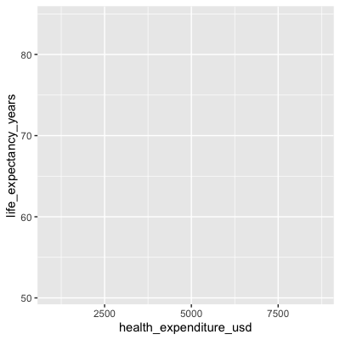
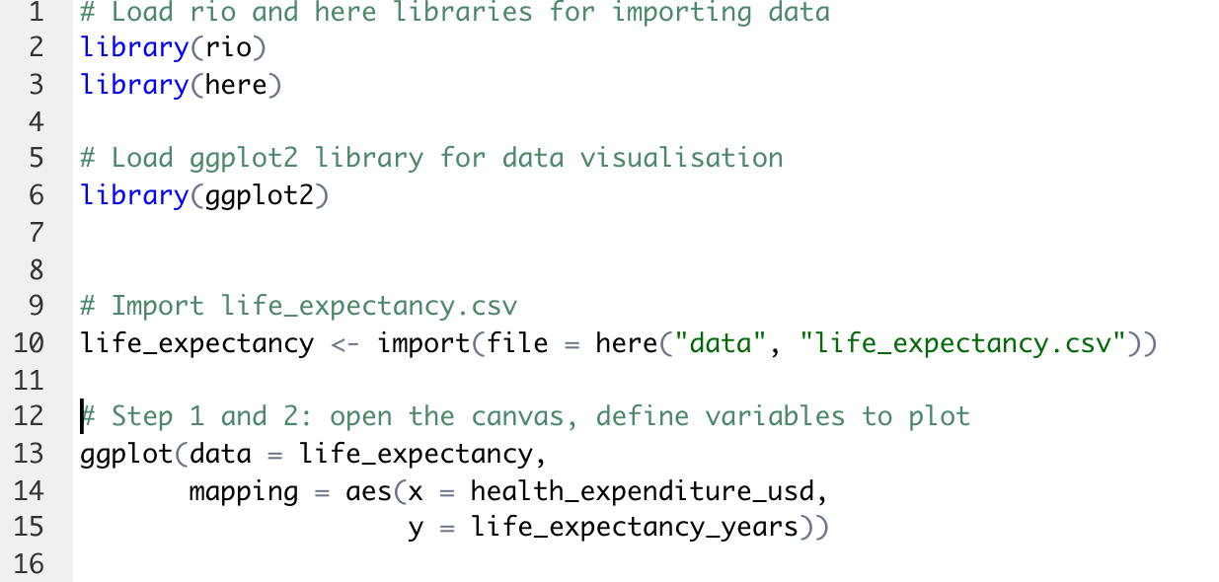
ggplot2, step 2
Step 2: Tell R which variables (columns) you want to plot.
To do this, we map variable names from our data to plot “aesthetics” (features), such as the x and y axes.
We map variables to aesthetics inside the `aes()` function, and assign this to the `mapping` argument of the `ggplot()` function.
Output

Slide 10
ggplot2, step 2
Output

Slide 11
ggplot2, step 3
Step 3: Tell R how you want to plot these data
We define the plot type with a “geom_” function, e.g. ”geom_point()” for adding points.
We literally add the points to the empty canvas by using a plus symbol (+) at the end of the ”ggplot()” function and before the ”geom_point()” function

Slide 12
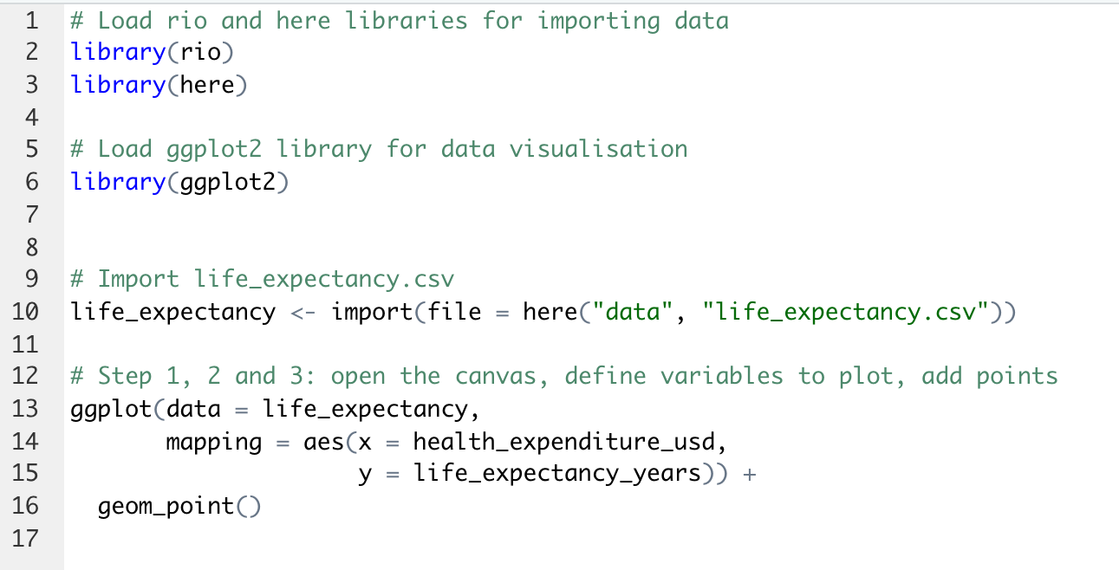
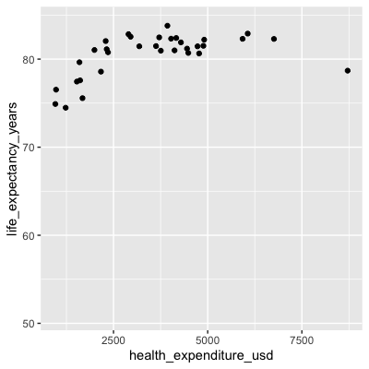
ggplot2, step 3
Output

Slide 13
ggplot2, extras
After making the basic plot, you can change the appearance of different parts to make it nicer, or easier to understand.
What are some examples of things you might want to change about this plot?
Limits (range) of axes
Axis labels
Plot title
Background colour
…
You can change each of these with a function

Slide 14
Practical
Practical
Walks through steps to make a basic ggplot
Introduces functions to change the appearance of the ggplot

Slide 15
Package for data cleaning: dplyr
dplyr is a package developed for handling and cleaning data
dplyr contains functions to manipulate data frames:
filter(): filter rows (depending on their value)
select(): select columns
rename(): rename columns
mutate(): add new columns, or change existing ones
group_by(): group rows together
summarise(): compute summary statistics

Slide 16
Trouble shooting
When debugging your code, a few tips / resources can come in handy:
Check every “, (, { or [ is closed, and that the letter case is correct.
Use ‘?’ to open the documentation of a function or dataset (e.g. ‘?mean’, ‘plot()’, ‘?iris’). The documentation usually provides information on:
How the function is meant to be used.
The arguments it can accept.
The value it returns.
Check the vignettes / examples associated with the packages you are using.
Google the error message and the name of the function causing the bug, someone else probably ran into the same problem before !

Slide 17
Further resources
Excellent summary of functions used for data analysis and visualization https://r4ds.had.co.nz/index.html
Making graphs in R: http://www.cookbook-r.com/Graphs/
For an introduction to packages and development: https://r-pkgs.org/intro.html
The cheatsheets of various R packages: https://www.rstudio.com/resources/cheatsheets/
For all questions answered by the R community: https://stackoverflow.com/

