Slide 1
Downloading R and RStudio

Slide 2
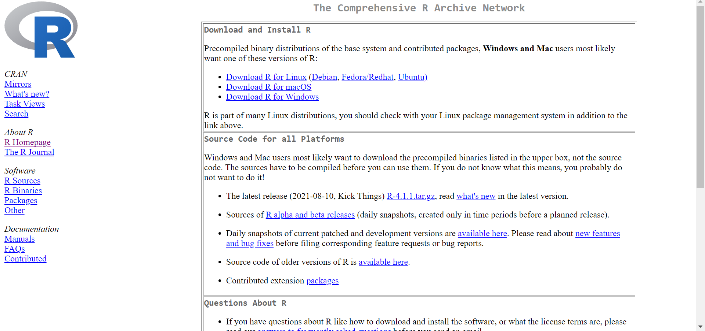
Download R
https://cran.ma.imperial.ac.uk/

Slide 3
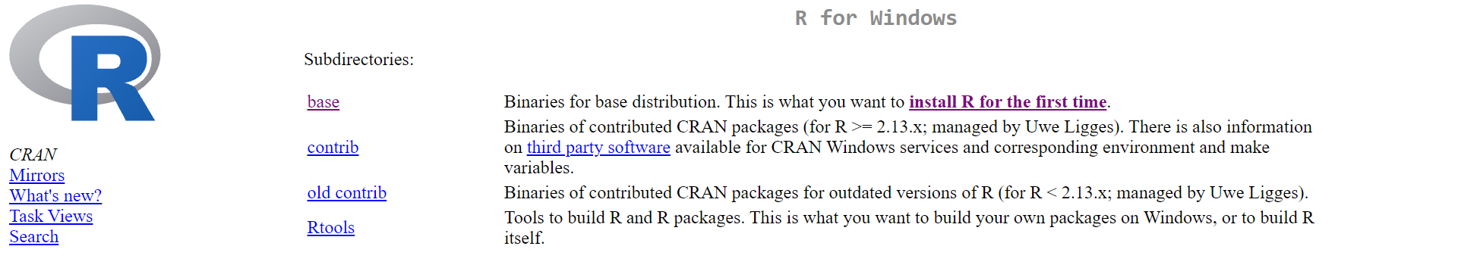
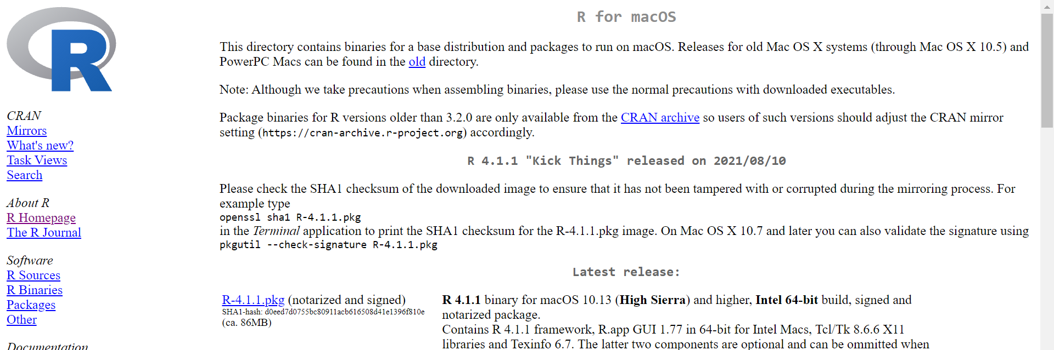
Download R
https://cran.ma.imperial.ac.uk/

Slide 4
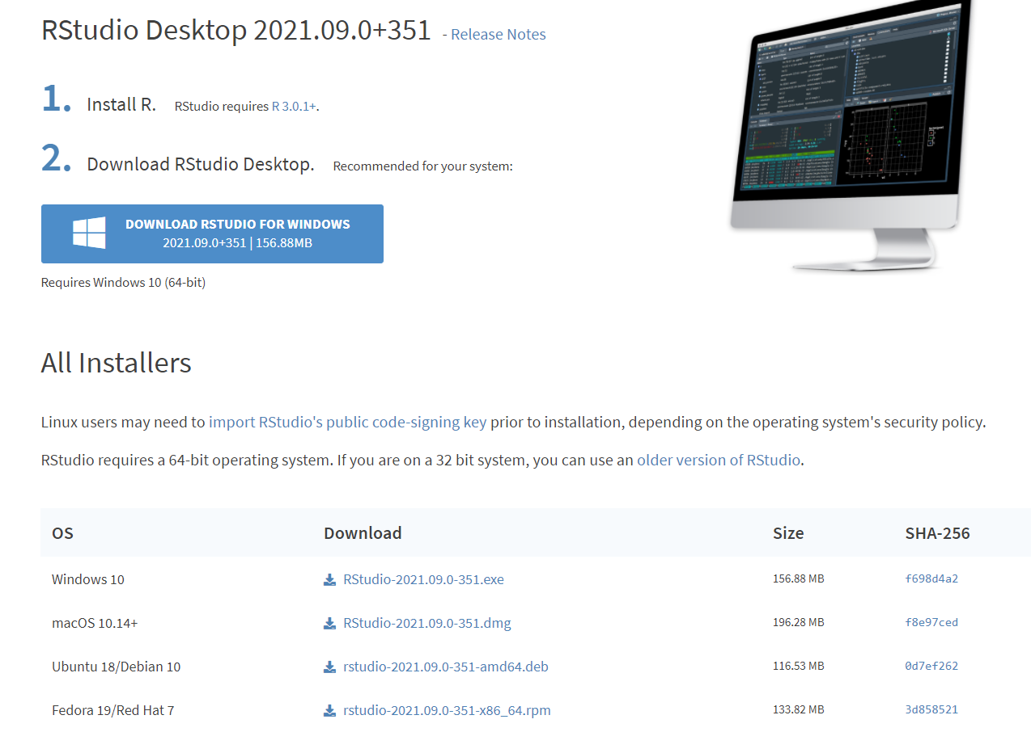
Download RStudio
https://www.rstudio.com/products/rstudio/download/#download

