Slide 1
Introduction to R
Alexis Robert, William Oswald
Based on a script and session developed by
Abigail Page, Claire Dooley, Anushé Hassan, and Shammi Luhar.

Slide 2
What is R?

Slide 3
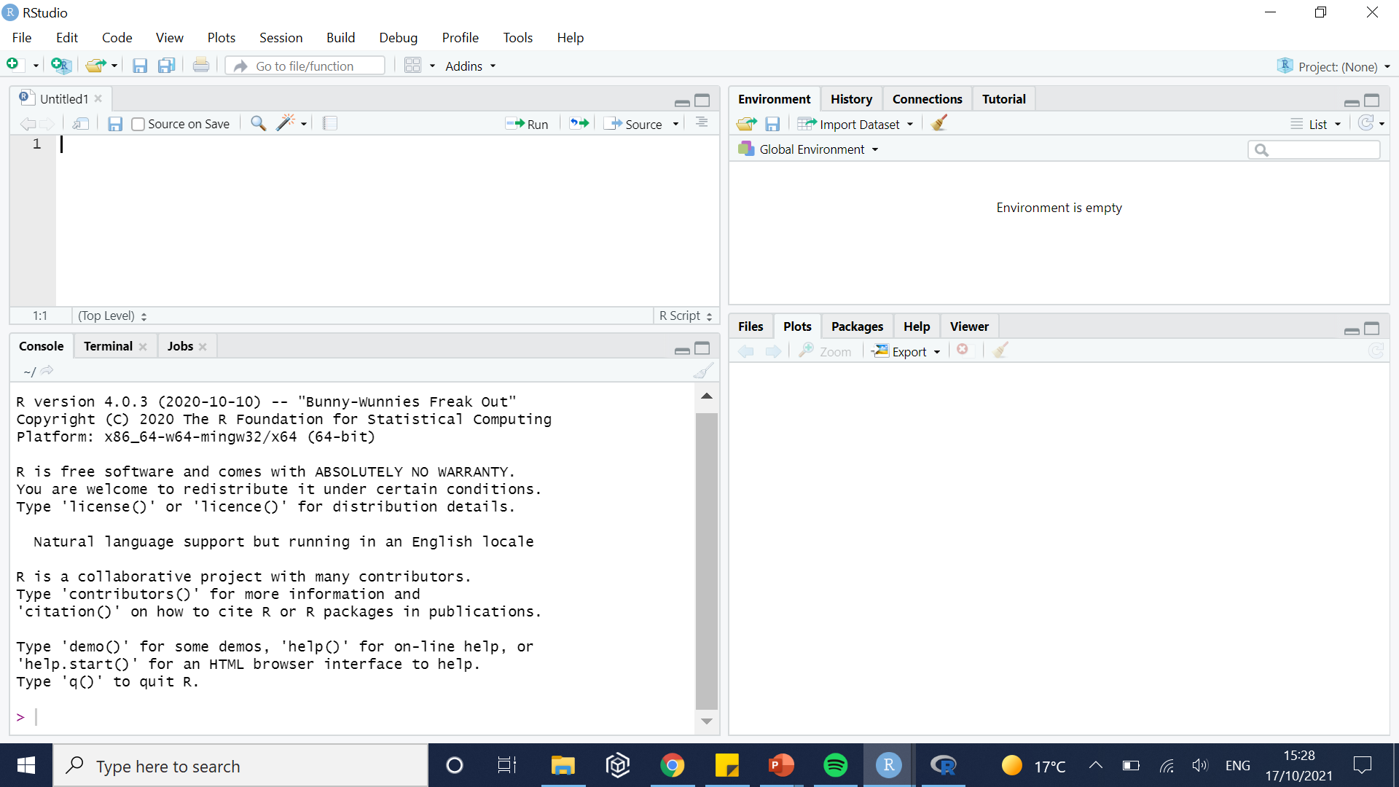
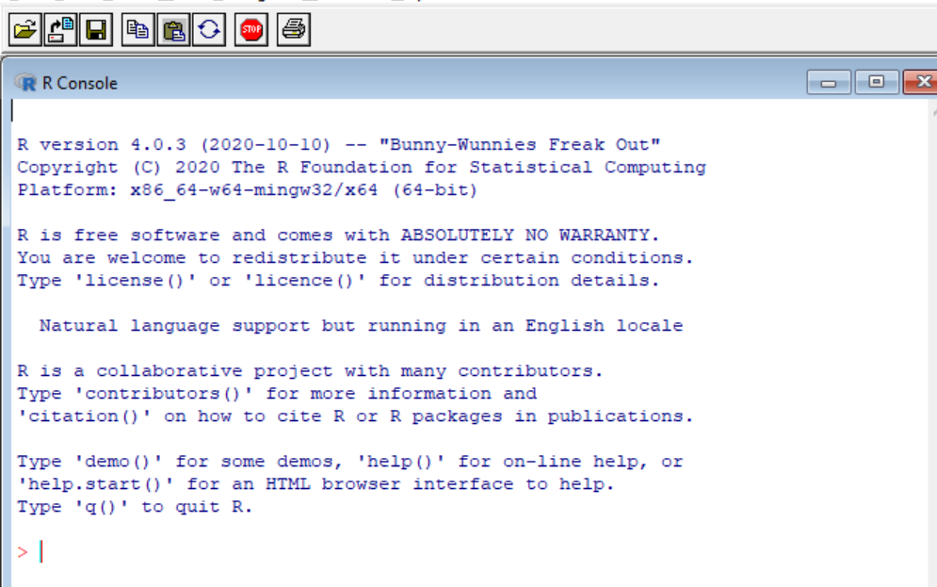
What is R, what is Rstudio?
R designates both the language and the software using this language
Similar to C, Fortran, Python…
R is (mostly) used for statistical computing (i.e. import, manipulate, analyse, and visualise data).
R has no graphical user interface.
RStudio is used as the graphical interface.

Slide 4
Why use R at all?
Free and open-source.
Quite versatile (packages developed for almost everything).
More intuitive than C / C++.
Highly popular:
Lots of learning resources.
Lots of forums / platforms providing help.

Slide 5
Useful resources
https://stackoverflow.com/questions/tagged/r (questions related to R answered by the community)
https://cran.r-project.org/doc/manuals/r-release/R-intro.pdf (Very thorough introduction to R, useful if you need more information on a specific aspect)
https://r4ds.had.co.nz/index.html (R for data science)
https://www.rstudio.com/resources/cheatsheets/ (Cheatsheets to use certain packages)

Slide 6
Getting familiar with RStudio

Slide 7
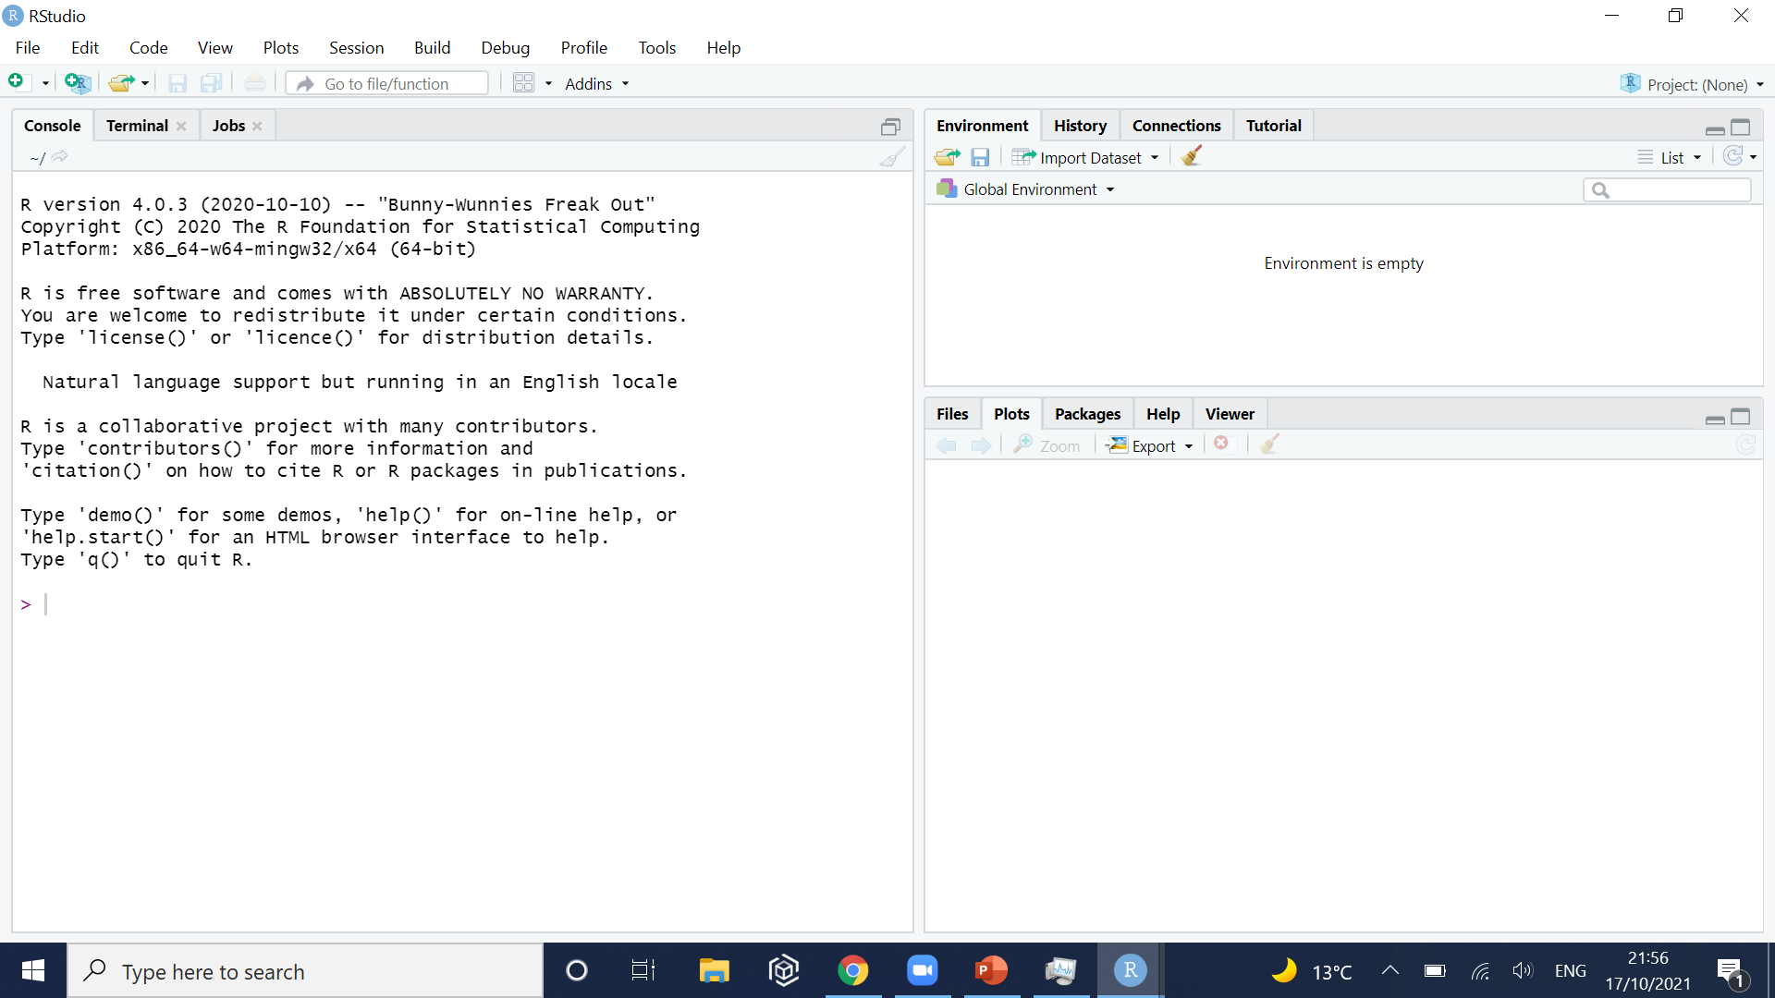
Opening RStudio and creating a new file
You can execute individual lines of code in this area, but it is more convenient to open a new script.

Slide 8
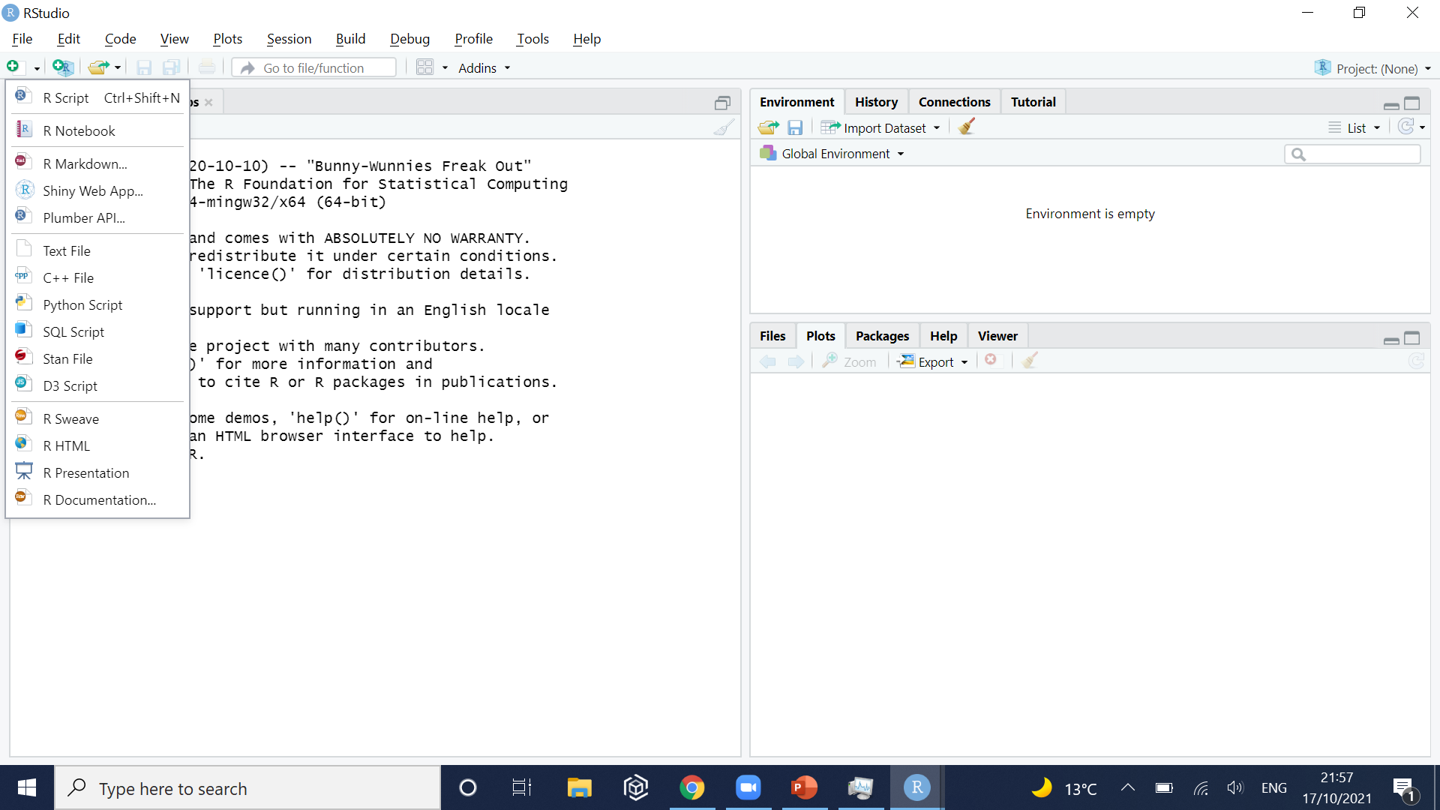
Opening RStudio and creating a new file

Slide 9
The new script is open!
Execute (i.e. run) the current line of your script
Area to write your script

Slide 10
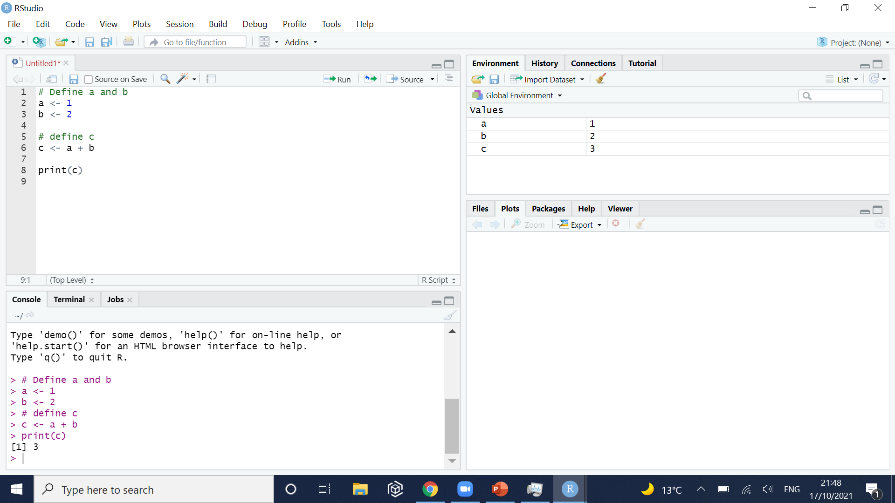
We can write and save the script
Objects currently loaded in your session
Commands that have been executed are shown here

Slide 11
Opening a file

Slide 12
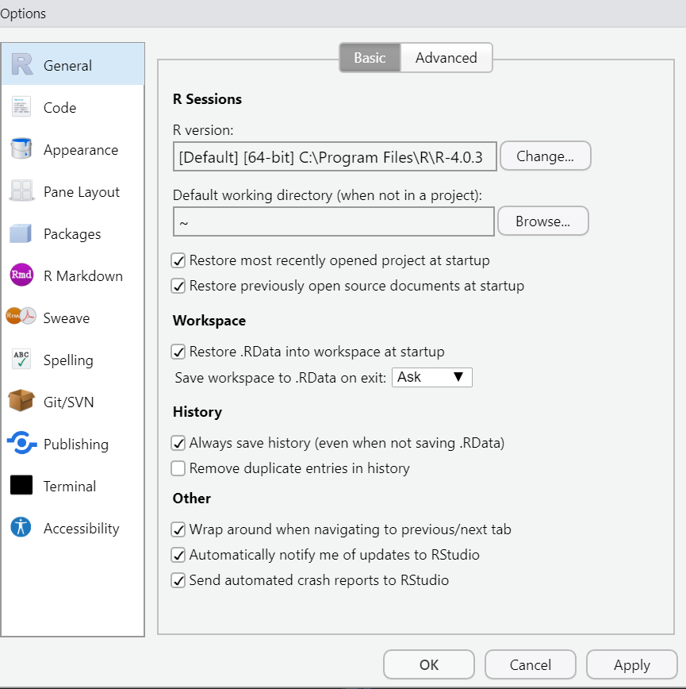
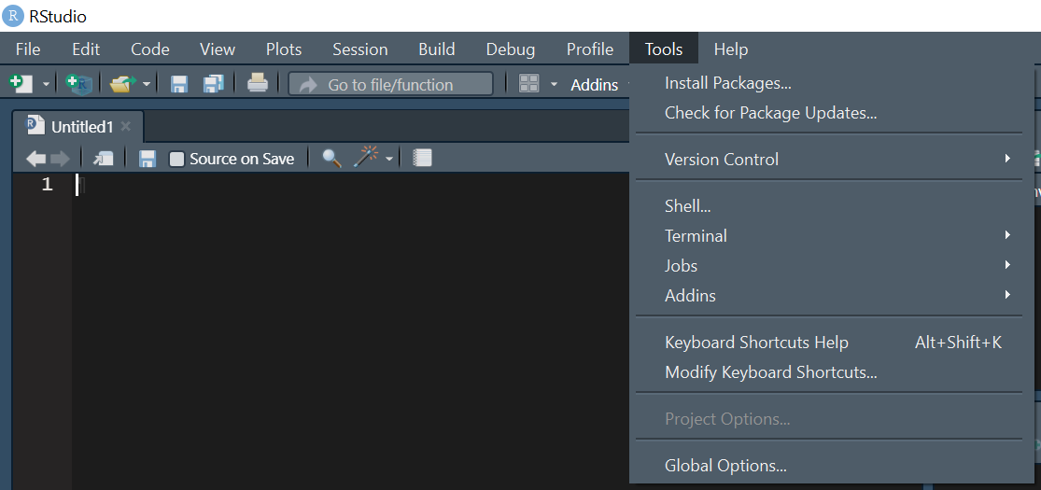
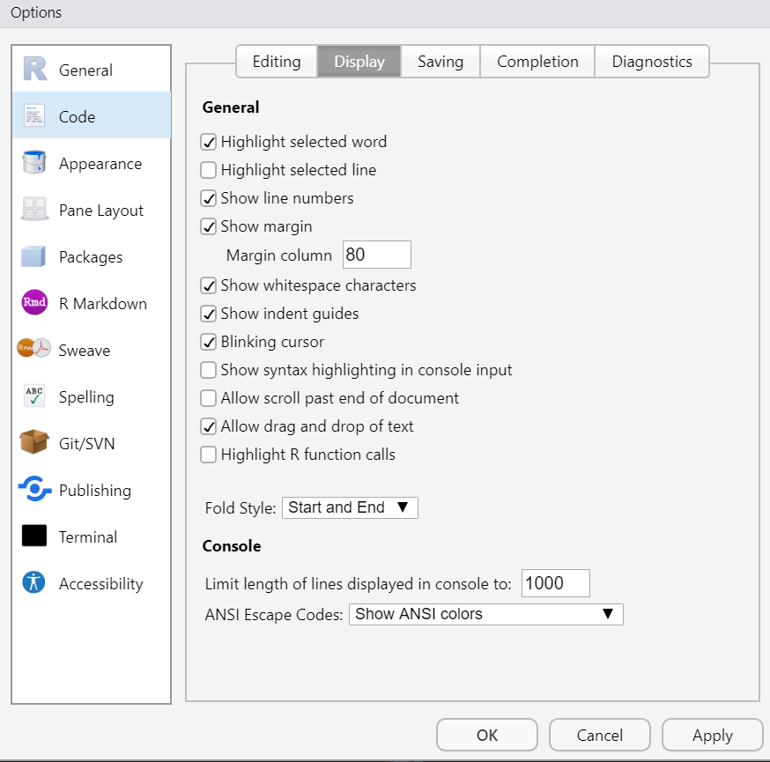
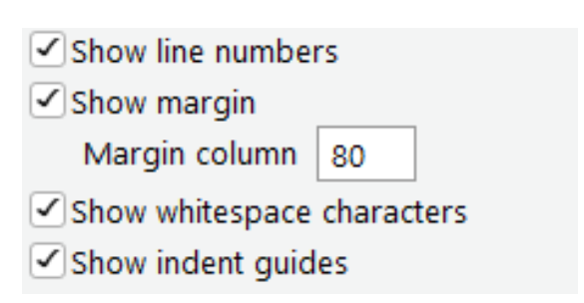
Change RStudio display options
Activate Dark Mode: Tools => Global options => Appearance => “Merbivore Soft”
Change code display: Tools => Global options => Code => Display

Slide 13
Practical

Slide 14
1/ Basic R expression
The most basic expressions are the same as would be anywhere else:
“+” to sum.
“-” to subtract.
“*” to multiply.
“^” to power.
“/” to divide.
Others have functions integrated in the base version of R
“sqrt()” for square root.
“exp()” for exponential.
“log()” for logarithm.

Slide 15
1/ Basic R expression

Slide 16
2/ Setting a new working directory
Create a new folder where you will put the scripts, data and outputs of these sessions.
Introduction_to_R
Script
Output
Data

Slide 17
2/ The working directory
The concept of working directory exists in many coding languages.
Tell the computer where you are working.
Default: getwd()
Documents
R
Introduction_to_R
Script
Output
Data
Downloads
Images
Music
getwd()
Intro to R
Script
Output
Data
setwd(“Documents/R”)

Slide 18
2/ Alternative working directory: R Project
Why use projects?
Data sharing:
Function here()

Slide 19
2/ Alternative working directory: R Project
How to create a new project

Slide 20
3/ Reading and Writing data
In R, files can be imported from text file (.txt) or csv Excel files (.csv) using different functions.
For .txt files, use the function “read.table()”.
For .csv files, use the function “read.csv()”.
Other Excel file formats can be read with specific functions / packages (“read.xlsx” for instance).
Importing data into R allows you to visualise and analyse them without modifying the data file (i.e. making sure you do not erase any data in the process).

Slide 21
3/ Reading and Writing data
Writing data refers to the process of exporting data from R to your computer.
The function ‘write.table(x, “mydata.csv”)’ allows you to save the R file “x” into an Excel text file called “mydata.csv” in your current working directory
This new file can then be opened using Excel.

Slide 22
4/ Data types and objects
There are five main data types that you will frequently come across in R:
Character: “a”, “hello”
Numeric: 2, 2.1, pi
Integer: 2L, 9:100.
Logical: True, False
Complex: 1+0i, 1+4i
The function “class()” can be used to tell you the type of a given object.

Slide 23
Practical: 30 minutes
Go through sections 1.0 to 1.4 (included) of the practical.
The main commands are given in the documents, try and manipulate the data and function to make sure you understand how they work.

Slide 24
5/ Datasets
Datasets (i.e. objects containing data) can take different shape:
Vectors: Contain only one variable per element.
Matrices: Can contain several variables per element of the data.
Data frame: Can contain several variables per element, of different formats.
Base functions are used to compute the mean, median, or summary of a given dataset.
“mean()”
“median()”
“summary()”
“quantile()”

Slide 25
6/ Variables
Many functions can help you summarise a dataset, whether it is a vector, matrix, or a dataframe.
‘length(x)’ (if x is a vector), or ‘dim(x)’ (if x is a matrix) indicates the number of elements if x.
‘head(x)’ prints the first 6 elements of the object x, useful to get more familiar with the dataset.
Columns in matrices can have names describing the variable it contains
‘names(x)’ shows the names of each column in x
For matrices, the operator ‘$’ is used to access a given column of a matrix
Running ‘X$height’ will show the column ‘height’ of the matrix X.

Slide 26
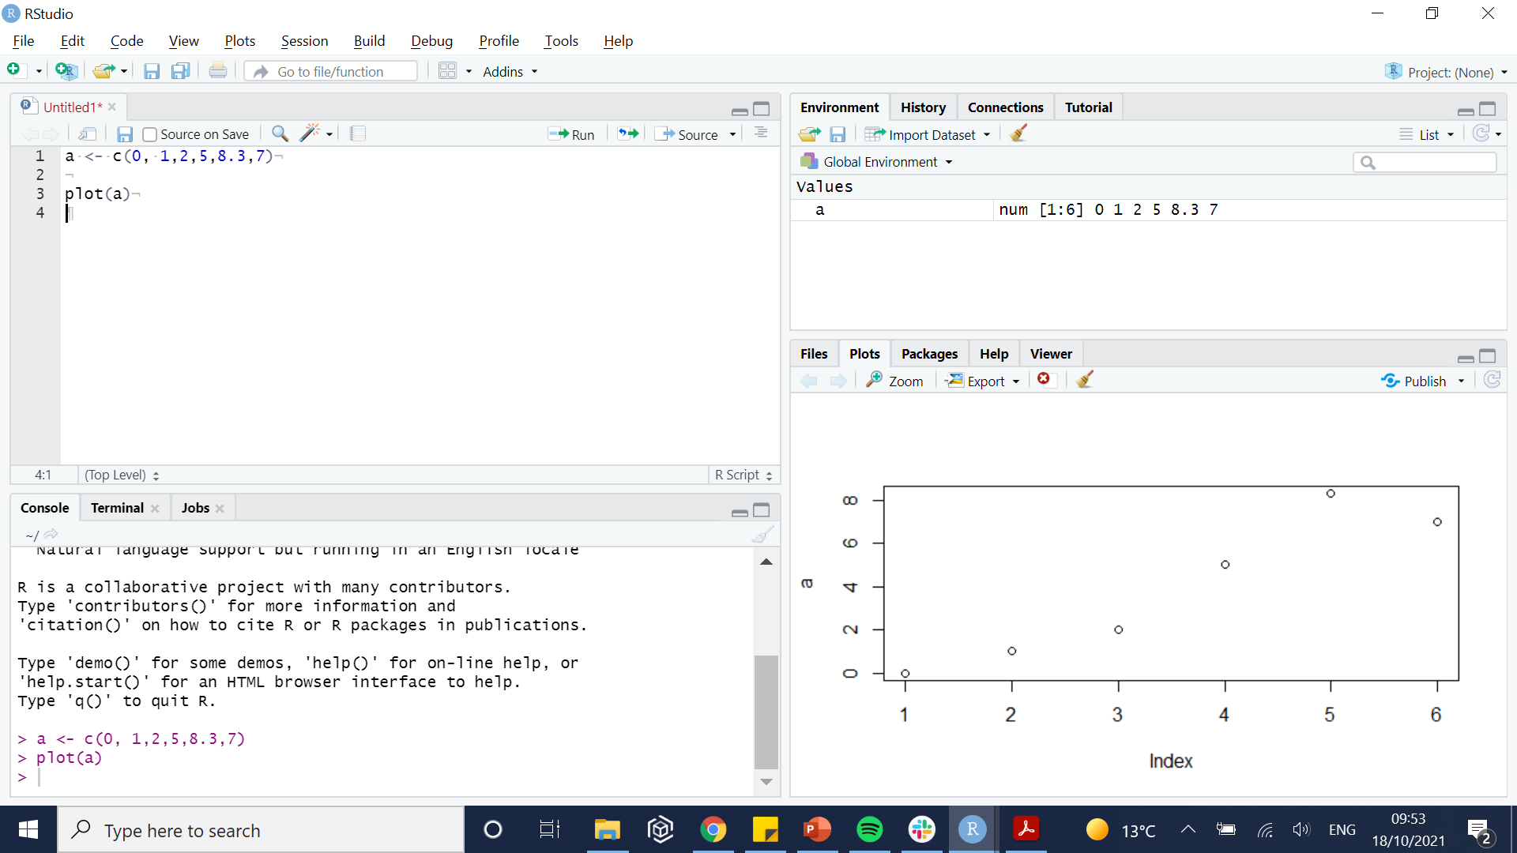
7/ Plots
Plots are paramount to visualize your data.
This session focuses on plots generated using the base R packages.
Different commands generate different type of plots (e.g.“hist()”, “plot()”, “boxplot()”)
Plotting area

Slide 27
Breakout room 3: 45 minutes
Go through sections 1.4 to 1.6 of the practical.

Slide 28
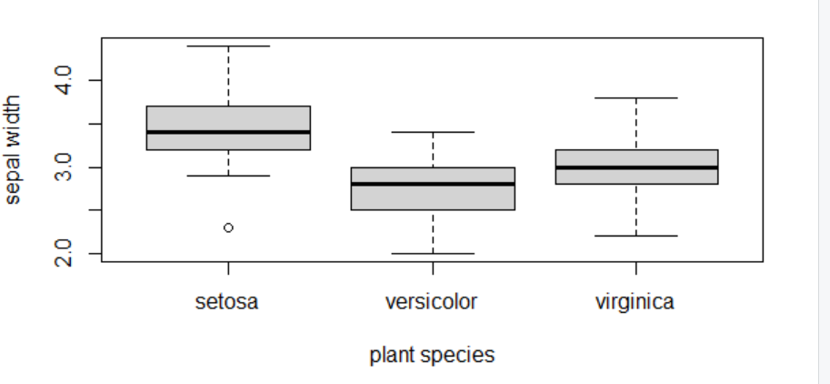
Solution section 1.1.6
 | Sepal Width | Petal Length | Petal Width
Mean | 3.05 | 3.76 | 1.20
Median | 3 | 4.35 | 1.3
Minimum | 2 | 1 | 0.1
Maximum | 4.4 | 6.9 | 2.5
Range | 2.0 - 4.4 | 1 - 6.9 | 0.1 - 2.5
Sum | 458.6 | 563.7 | 179.9

