Slide 1
Introduction to R
Alexis Robert, William Oswald
Based on a script and session developed by
Abigail Page, Claire Dooley, Anushé Hassan, and Shammi Luhar.

Slide 2
Reminder of Zoom etiquette
We’ll start with microphones muted
You are welcome to leave your camera on
Please type questions in the chat
In the breakout rooms, you can turn on your microphone and camera
Thank you for arriving on time

Slide 3
Structure of the practical
Reminder from last session
Introduction to the concepts covered in Practical 2
Breakout rooms
Wrap up, conclusions and further resources

Slide 4
Reminder from Session 1

Slide 5
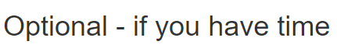
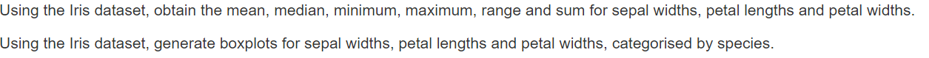
Walk-through optional Section 1.6

Slide 6
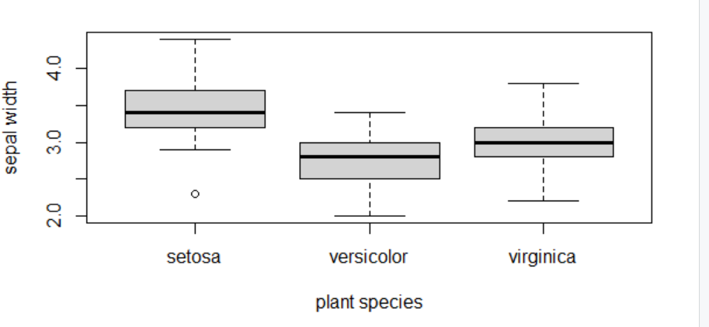
Solution section 1.6
 | Sepal Width | Petal Length | Petal Width
Mean | 3.05 | 3.76 | 1.20
Median | 3 | 4.35 | 1.3
Minimum | 2 | 1 | 0.1
Maximum | 4.4 | 6.9 | 2.5
Range | 2.0 - 4.4 | 1 - 6.9 | 0.1 - 2.5
Sum | 458.6 | 563.7 | 179.9

Slide 7
Practical 2

Slide 8
Vectors
Vectors contain a number of elements, usually of the same class.
A vector is constructed using the function ‘c()’
‘vec <- c(1,2,3)’ initialises a numeric vector, called vec, that contains three elements.
‘vec <- c(“a”,”b”,”c”)’ initialises a vector of characters, called vec, that contains three elements.
Values of a vector are accessed using brackets ‘[ ]’:
‘vec[3]’ designates the third element of the vector ‘vec’.
‘vec[-3]’ returns the vector ‘vec’ minus the third element.
‘vec[length(vec)]’ designates the last element of the vector ‘vec’.
1 | 2 | 3
“a” | “b” | “c”

Slide 9
Matrices
A matrix is a two-dimensional group of vectors, containing elements of the same class.
A matrix is constructed using the function ‘matrix()’, which needs 3 arguments:
‘data’: the values of the elements (by default set to NA).
‘nrow’: the number of rows (default to 1).
‘ncol’: the number of columns (default to 1).
‘mat <- matrix(c(1,2,3,4), nrow = 2, ncol = 2)’ initialises a matrix, called ‘mat’, with 2 rows and 2 columns:
‘mat[1,2]’ will return the element on the first row, and second column.
1 | 3
2 | 4

Slide 10
Dataframes
Dataframes are similar to matrix, except that they can contain multiple data types.
They are created using the command ‘data.frame()’
Their elements can be accessed in the same way as matrices.

Slide 11
Functions
A function is a set of commands, organised together, in order to perform a task.
R has many built-in functions (you have already used a few, such as “mean()”, “print()”, “setwd()”, etc..)
Four different parts in a function:
The name of the function: How do you call this function?
The arguments: What inputs does this function need?
The body of the function: What set of commands is ran by the function?
The return value: What is the output of the function?

Slide 12
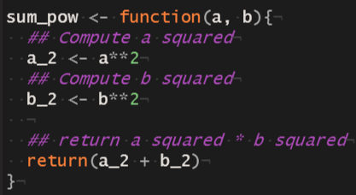
Functions (example)
Name
Arguments
Body
Return Value
A function is then called using parentheses, i.e. sum_pow(5, 9).

Slide 13
Packages
The functions used in the practical so far are included in base R.
Packages are units of shareable code, and can include functions, data, documentation, and tests.
Packages are stored on CRAN (https://cran.r-project.org/web/packages/), over 18,000 packages are currently available.
Packages should be installed using the function ‘install.packages()’ (only needed once)
Once installed, packages are loaded using the function ‘library()’ (needed every time a new session is opened).

Slide 14
Example of importing and using a package: ggplot2
ggplot2 is one of the most popular packages for data visualization.
It can be more flexible than base R plots.
The basic function is ‘ggplot()’, which returns an empty blank plot.
Layers of information are then added to the plot, using various functions.
More information on ggplot2 can be found on the cheatsheet and website (https://ggplot2.tidyverse.org/).

Slide 15
Breakout rooms

Slide 16
Trouble shooting
When debugging your code, a few tips / resources can come in handy:
Check every “, (, { or [ is closed, and that the letter case is correct.
Use ‘?’ to open the documentation of a function or dataset (e.g. ‘?mean’, ‘plot()’, ‘?iris’). The documentation usually provides information on:
How the function is meant to be used.
The arguments it can accept.
The value it returns.
Check the vignettes / examples associated with the packages you are using.
Google the error message and the name of the function causing the bug, someone else probably ran into the same problem before !

Slide 17
Further resources
Excellent summary of functions used for data analysis and visualization https://r4ds.had.co.nz/index.html
Making graphs in R: http://www.cookbook-r.com/Graphs/
For an introduction to packages and development: https://r-pkgs.org/intro.html
The cheatsheets of various R packages: https://www.rstudio.com/resources/cheatsheets/
For all questions answered by the R community: https://stackoverflow.com/

