Slide 1
Downloading R and RStudio

Slide 2
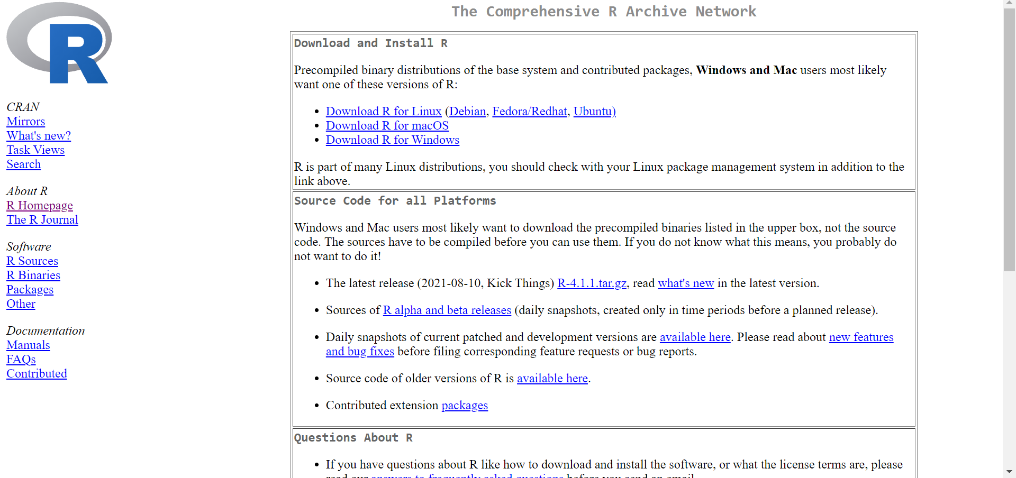
Download R
https://cran.ma.imperial.ac.uk/

Slide 3
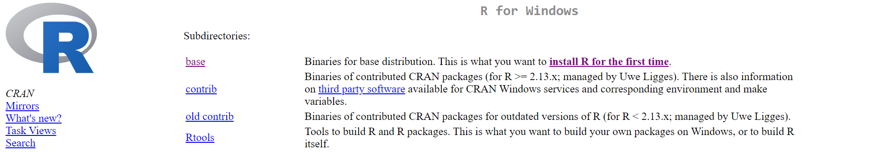
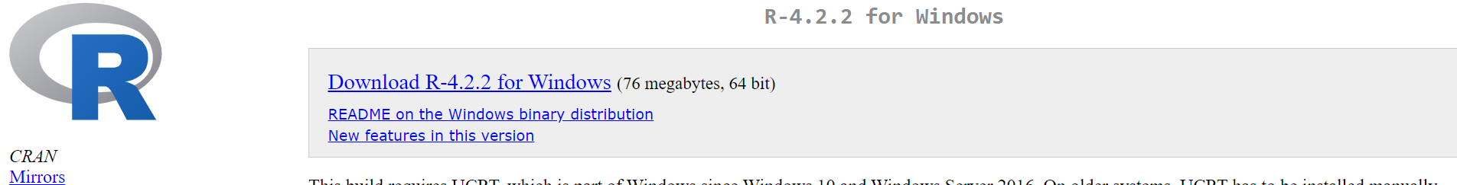
Download R: Windows
https://cran.ma.imperial.ac.uk/

Slide 4
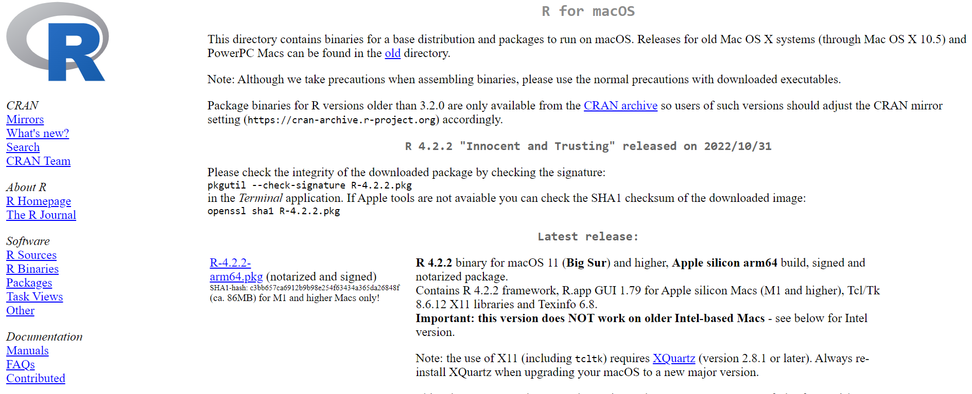
Download R:MacOS
https://cran.ma.imperial.ac.uk/

Slide 5
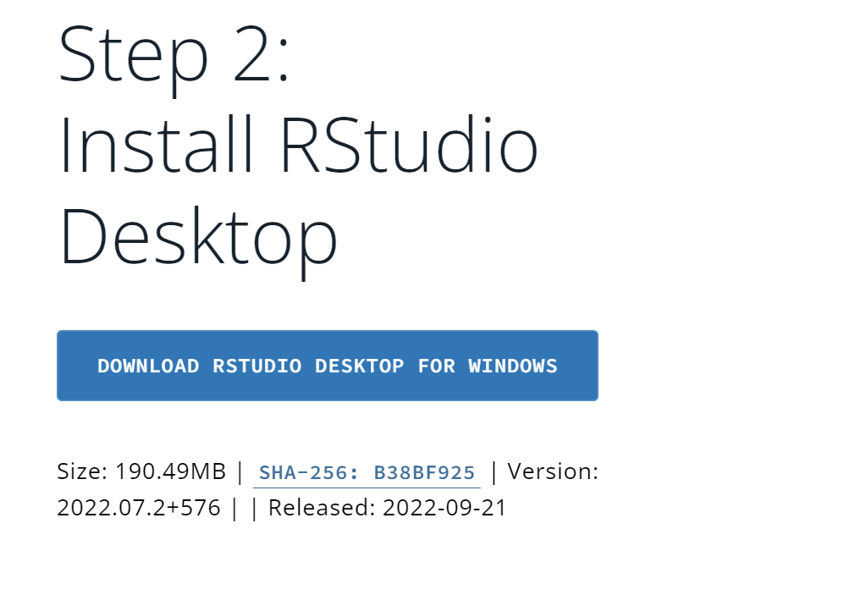
Download RStudio
https://posit.co/download/rstudio-desktop/#download

