Slide 1
Introduction to R
Alexis Robert, Sophie Meakin, Billy Quilty, Naomi Waterlow
Based on a script and session developed by
Abigail Page, Claire Dooley, Anushé Hassan, and Shammi Luhar.

Slide 2
Practical 2

Slide 3
Functions
A function is a set of commands, organised together, in order to perform a task.
R has many built-in functions (you have already used a few, such as “mean()”, “print()”, “setwd()”, etc..)
Four different parts in a function:
The name of the function: How do you call this function?
The arguments: What inputs does this function need?
The body of the function: What set of commands is ran by the function?
The return value: What is the output of the function?

Slide 4
Functions (example)
Create a function that takes two numbers and compute the summed of their square values

Slide 5
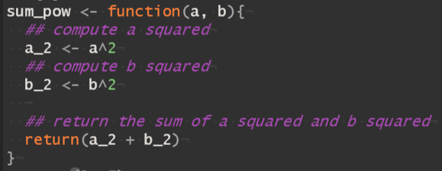
Functions (example)
Name
Arguments
Body
Return Value
A function is then called using parentheses, i.e. sum_pow(5, 9).

Slide 6
Packages
The functions used in the practical so far are included in base R.
Packages are units of shareable code, and can include functions, data, documentation, and tests.
Packages are stored on CRAN (https://cran.r-project.org/web/packages/), over 18,000 packages are currently available.
Packages should be installed using the function ‘install.packages()’ (only needed once)
Once installed, packages are loaded using the function ‘library()’ (needed every time a new session is opened).

Slide 7
Example of importing and using a package: ggplot2
ggplot2 is one of the most popular packages for data visualization.
It can be more flexible than base R plots.
The basic function is ‘ggplot()’, which returns an empty blank plot.
Layers of information are then added to the plot, using various functions.
More information on ggplot2 can be found on the cheatsheet and website (https://ggplot2.tidyverse.org/).

Slide 8
Package for data cleaning: dplyr
dplyr is a package developed for handling and cleaning data
dplyr contains a few commands to manipulate data:
filter(): select rows (depending on their value)
select(): select colums (depending on their value)
mutate(): add new variables
arrange(): change the order of the rows
summarise(): compute summary statistics
group_by(): group rows together

Slide 9
Trouble shooting
When debugging your code, a few tips / resources can come in handy:
Check every “, (, { or [ is closed, and that the letter case is correct.
Use ‘?’ to open the documentation of a function or dataset (e.g. ‘?mean’, ‘plot()’, ‘?iris’). The documentation usually provides information on:
How the function is meant to be used.
The arguments it can accept.
The value it returns.
Check the vignettes / examples associated with the packages you are using.
Google the error message and the name of the function causing the bug, someone else probably ran into the same problem before !

Slide 10
Further resources
Excellent summary of functions used for data analysis and visualization https://r4ds.had.co.nz/index.html
Making graphs in R: http://www.cookbook-r.com/Graphs/
For an introduction to packages and development: https://r-pkgs.org/intro.html
The cheatsheets of various R packages: https://www.rstudio.com/resources/cheatsheets/
For all questions answered by the R community: https://stackoverflow.com/

