Slide 1
Menu
Menus make selection easier and are widely used in window applications. JavaFX provides five classes that implement menus: MenuBar, Menu, MenuItem, CheckMenuItem, and RadioButtonMenuItem.
MenuBar is a top-level menu component used to hold the menus. A menu consists of menu items that the user can select (or toggle on or off). A menu item can be an instance of MenuItem, CheckMenuItem, or RadioButtonMenuItem. Menu items can be associated with nodes and keyboard accelerators.

Slide 2
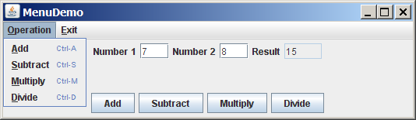
Creating Menus
MenuDemo
Run

Slide 3
Context Menu
A context menu, also known as a popup menu, is like a regular menu, but does not have a menu bar and can float anywhere on the screen. Creating a context menu is similar to creating a regular menu. First, you create an instance of ContextMenu, then you can add MenuItem, CheckMenuItem, and RadioMenuItem to the context menu.

Slide 4
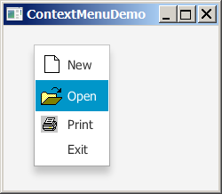
Creating Context Menus
ContextMenuDemo
Run

