Slide 1
Chapter 31 Advanced JavaFX

Slide 2
JavaFX CSS
A JavaFX style property is defined with a prefix –fx- to distinquish it from a property in CSS. All the available JavaFX properties are defined in http://docs.oracle.com/javafx/2/api/javafx/scene/doc-files/cssref.html. Listing 31.1 gives an example of a style sheet .

Slide 3
Style Class and Style ID
A style sheet uses the style class or style id to define styles. Mutiple style classes can be applied to a single node and a style id to a unique node. The syntax .styleclass defines a style class. The syntax #styleid defines a style id.
mystyle.css
StyleSheetDemo
Run

Slide 4
Coordinate Transformations
JavaFX supports coordinate transformations using translation, rotation, and scaling.

Slide 5
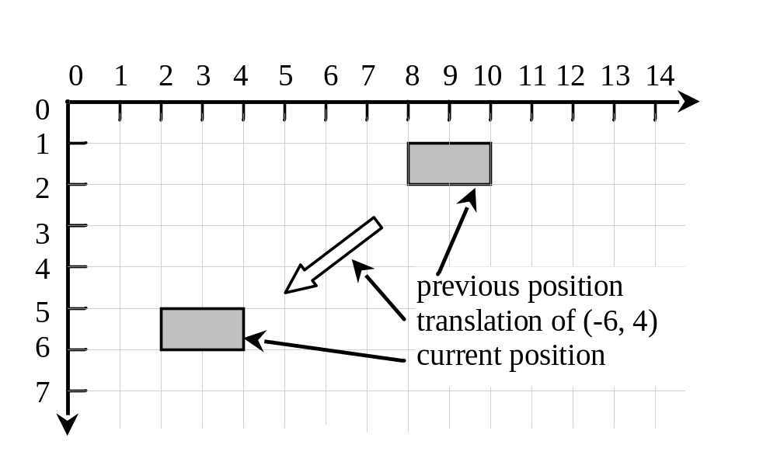
Translations
You can use the setTranslateX(double x), setTranslateY(double y), and setTranslateZ(double z)methods in the Node class to translate the coordinates for a node.
TranslationDemo
Run

Slide 6
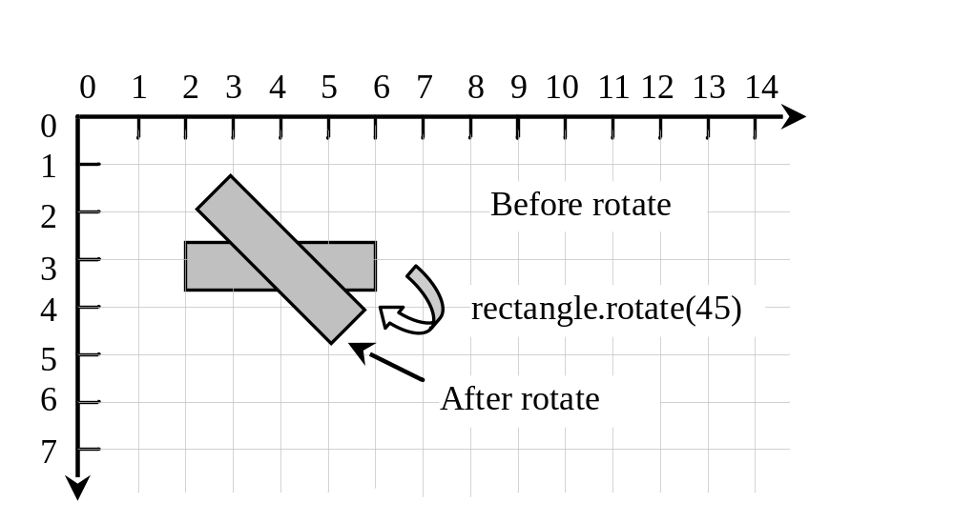
Rotations
You can use the rotate(double theta) method in the Node class to rotate a node by theta degrees from its pivot point clockwise, where theta is a double value in degrees. The pivot point is automatically computed based on the bounds of the node.
RotateDemo
Run

Slide 7
Scaling
You can use the setScaleX(double sx), setScaleY(double sy) , and setScaleY(double sy) methods in the Node class to specify a scaling factor. The node will appear larger or smaller depending on the scaling factor. Scaling alters the coordinate space of the node such that each unit of distance along the axis is multiplied by the scale factor. As with rotation transformations, scaling transformations are applied to enlarge or shrink the node around the pivot point.
For a node of the rectangle shape, the pivot point is the center of the rectangle.

Slide 8
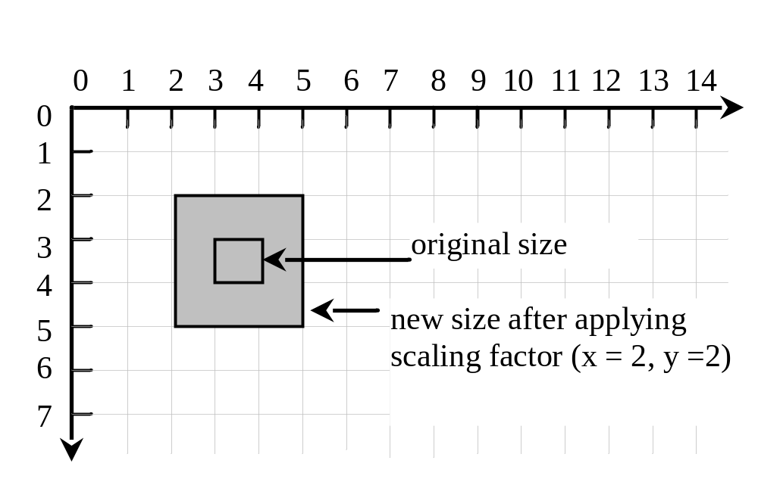
Scaling
ScaleDemo
Run

Slide 9
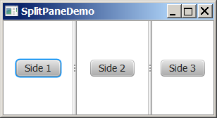
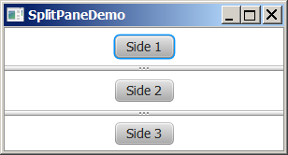
SplitPane
The SplitPane class can be used to display multiple panes and allow the user to adjust the size of the panes.

Slide 10
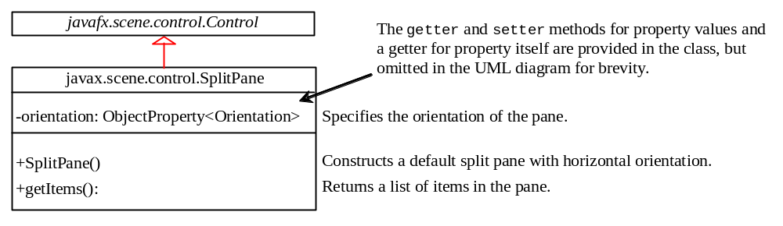
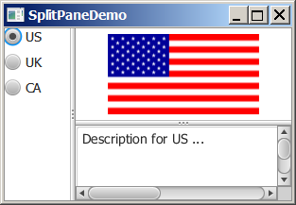
Using SplitPane
SplitPaneDemo
Run

Slide 11
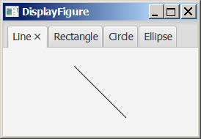
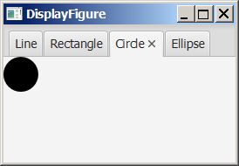
TabPane
The TabPane class can be used to display multiple panes with tabs.

Slide 12
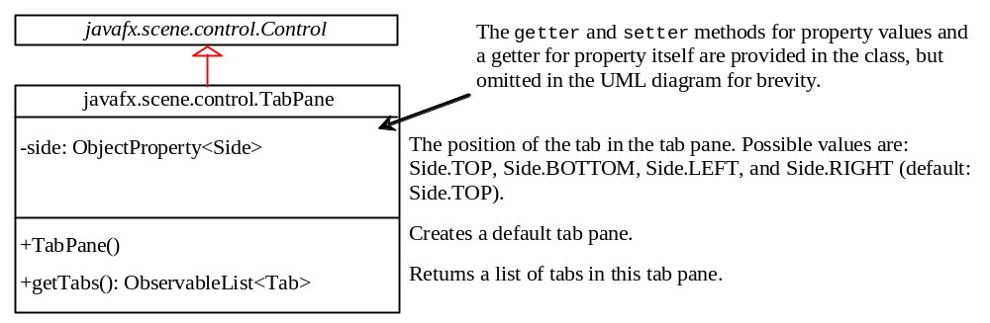
The TabPane Class

Slide 13
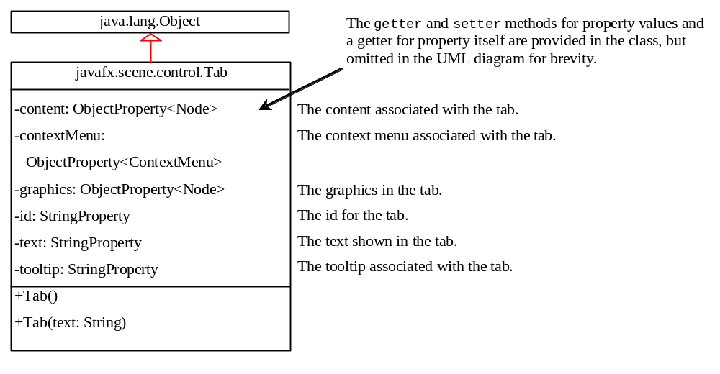
The Tab Class
TabPaneDemo
Run

