Slide 1
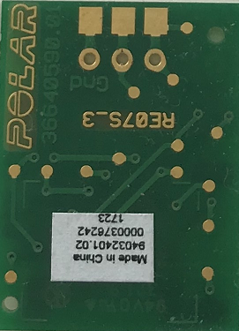

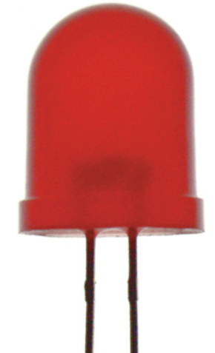
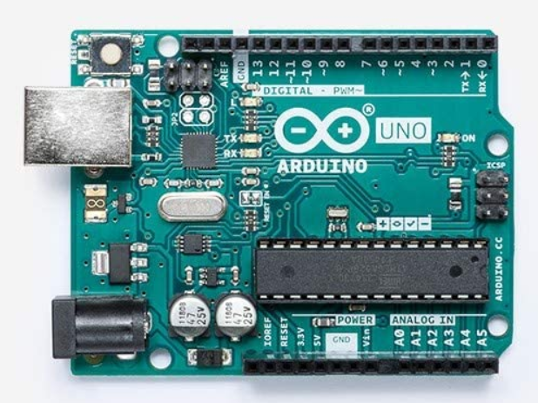
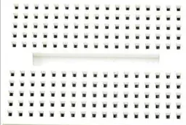


Step 1: Insert these pins in the slots and solder them.
Step 3: Connect all together and test the board functionality: LED should blink with every heartbeat.
Step 4: Connect the POLAR receiver to Arduino (UNO), pin D10.
“HR signal”
“+”
“-”
Step 2: Insert the circuit with soldered pins to the breadboard. Note that all vertical lines on the board are connected.
+
connected
battery
“-”
“+”
connected
https://thepihut.com/products/heart-rate-educational-starter-pack-with-polar-wireless-sensors | POLAR T34 with receiver

