Slide 1
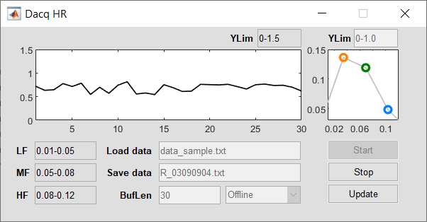
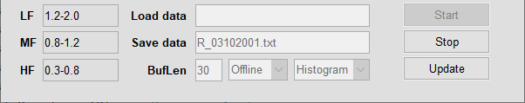
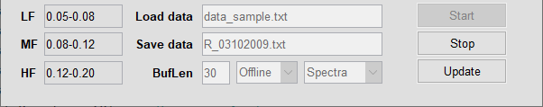
How to operate
Change parameters “LF” / ”MF” / ”HF” (bands), “Load Data” (if offline mode), “BufLen” (buffer length) if necessary;
Select mode “Offline” or “Online”;
Press “Start” to start acquisition;
Press “Update” to update parameters “LF” / ”MF” / ”HF” (bands) and “YLim” (scale of interbeat intervals (IBI)) if necessary;
Press “Stop” to finish data acquisition and save data;
HR spectra
HR data
IBI (s)
samples
f (Hz)
Options
“Load data” = file from which data will be loaded (in Offline regime); if “Load data” is empty random data will be generated.
“Save data” = file to which data will be saved; name of the file is generated automatically as R_MMDDmmss.txt
“BufLen” = length of data buffer (in samples);
“LF” / ”MF” / ”HF” = low / mid / high bands (in Hz), respectively;
“Offline/Online”: Offline = data are loaded from file or generated; Online = data acquired from Arduino;
“Start” = start acquisition; “Stop” = stop acquisition (script will be closed and data will be saved);
“Update” = update parameters when script is running; parameters that can be updated “YLim“, “LF”, “MF”, “HF”.

Slide 2
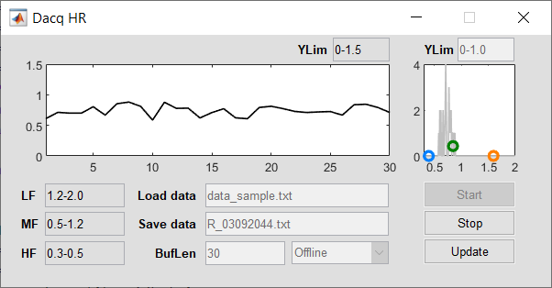
How to operate
Change parameters “LF” / ”MF” / ”HF” (bands), “Load Data” (if offline mode), “BufLen” (buffer length) if necessary;
Select mode “Offline” or “Online”;
Press “Start” to start acquisition;
Press “Update” to update parameters “LF” / ”MF” / ”HF” (bands) and “YLim” (scale of interbeat intervals (IBI)) if necessary;
Press “Stop” to finish data acquisition and save data;
HR histogram
HR data
IBI (s)
samples
f (s)
Options
“Load data” = file from which data will be loaded (in Offline regime); if “Load data” is empty random data will be generated.
“Save data” = file to which data will be saved; name of the file is generated automatically as R_MMDDmmss.txt
“BufLen” = length of data buffer (in samples);
“LF” / ”MF” / ”HF” = low / mid / high bands (in seconds not Hz), respectively;
“Offline/Online”: Offline = data are loaded from file or generated; Online = data acquired from Arduino;
“Start” = start acquisition; “Stop” = stop acquisition (script will be closed and data will be saved);
“Update” = update parameters when script is running; parameters that can be updated “YLim“, “LF”, “MF”, “HF”.

