Slide 1
Fast and Robust Fixed-Point Algorithms for Independent Component Analysis
In this paper, new objective (contrast) functions and algorithms for ICA are introduced.
Starting from an information-theoretic viewpoint, the ICA problem is formulated as minimization of mutual information
between the transformed variables s_{i}, and a new family of contrast functions for ICA is introduced (Section 2).
For practical maximization of the contrast functions, we introduce a novel family of fixed point algorithms (Section 4).

Slide 2
ICA concept
ICA = contrast function + optimization algorithm (book, “Man-machine Interaction 3”)
The contrast function is a quantitate measure of stochastic independence of sources, s_{i}.
For instance,
contrast function is G(u) = ¼u⁴ (see, next pages);
optimization algorithm is Newton method
Contrast function are called contrast because they contrast difference between functions (e.g., Gaussian and non-Gaussian variables)

Slide 3
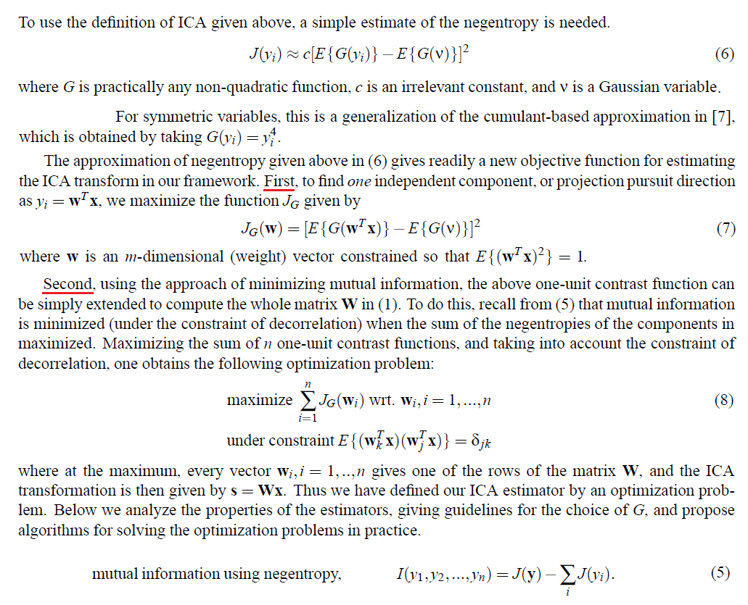
Contrast Functions through Approximations of Negentropy

Slide 4
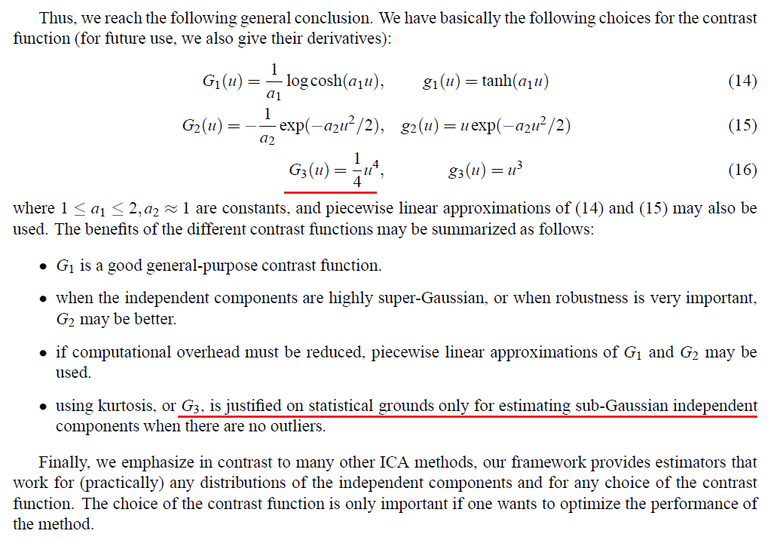
Practical choice of contrast function

Slide 5
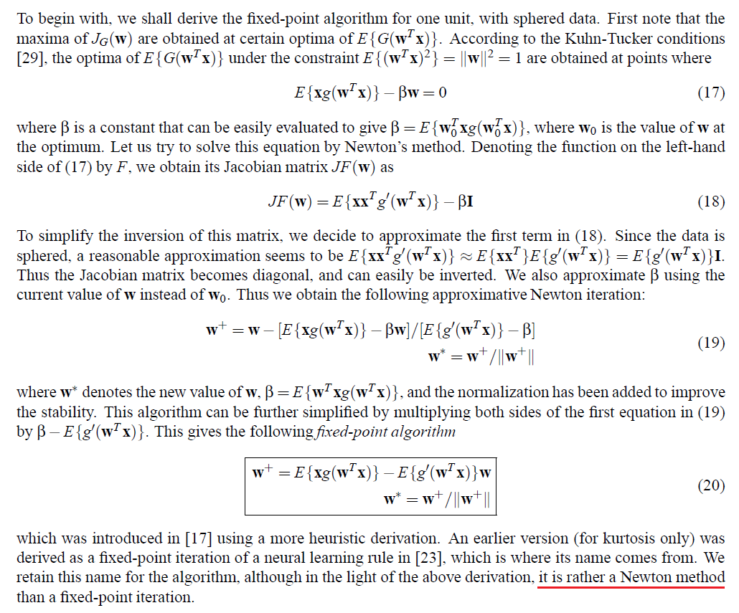
Fixed-point algorithms for ICA

