Slide 1
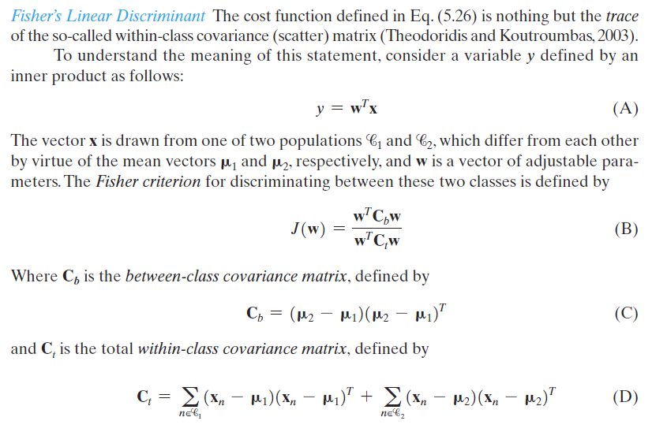
BOOK. Haykin S. 2009. Neural networks and Learning machines. 3rd edition

Slide 2
