Slide 1
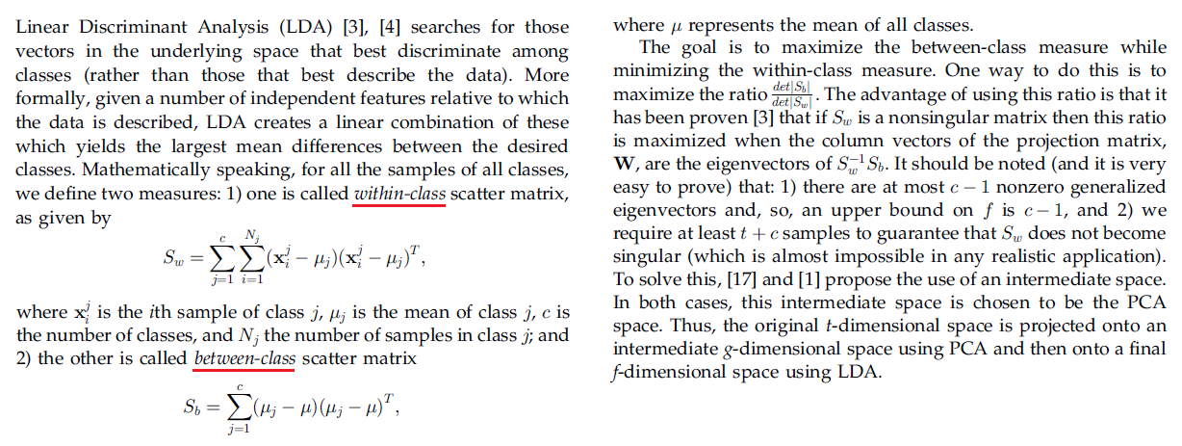
What is the difference between LDA and FDA?
LDA is a generalization of Fisher’s linear discriminant, a method used to separates two or more classes of objects.
Discriminant analysis has continuous independent variables and a categorical dependent variable (i.e. the class label), whereas ANOVA uses categorical independent variables and a continuous dependent variable
LDA method assumes that the independent variables are normally distributed. LDA explicitly attempts to model the difference between the classes of data.

Slide 2
What is the main properties of SVM?
An SVM classifies data by finding the best hyperplane that separates all data points of one class from those of the other class.
The best hyperplane for an SVM means the one with the largest margin between the two classes.
SVM works if data has exactly two classes.
http://se.mathworks.com/help/stats/support-vector-machines-for-binary-classification.html
Note 1: Support vector machines focus only on the points that are the most difficult to tell apart, whereas other classifiers pay attention to all of the points.
Note 2: Unlike other classifiers, the support vector machine is explicitly told to find the best separating line.

Slide 3
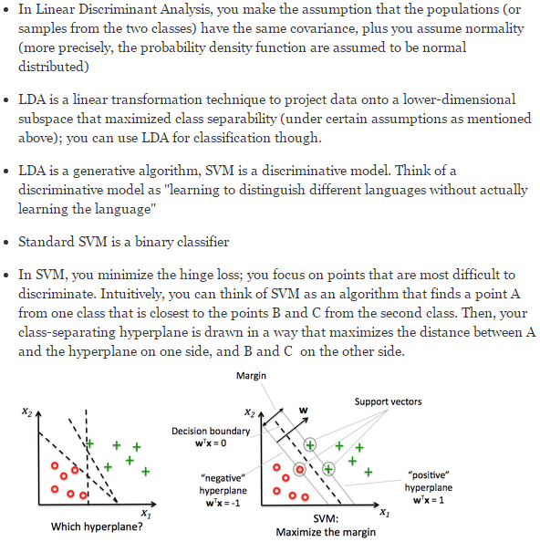
What is the difference between LDA and SVM? 1/2
See, paper “Comparing Linear Discriminant Analysis and Support Vector Machine”, Ibrahim Gokcen and Jing Peng, 2002
See, webpage, https://www.quora.com/What-is-the-difference-between-SVM-and-linear-discriminant-analysis (below)

Slide 4
What is the difference between LDA and SVM? 2/2
http://stats.stackexchange.com/questions/23391/how-does-a-support-vector-machine-svm-work

