Slide 1
Vert.x
Многоязычность(JavaScript, Ruby, Groovy, Java or Python)
Мощная модульная система
Простая реализация многопоточности
Простая интегрируемость в существующие Java приложения
Качественная документация

Slide 2
Verticle
Server.java
import org.vertx.java.core.Handler;
import org.vertx.java.core.http.HttpServerRequest;
import org.vertx.java.platform.Verticle;
public class Server extends Verticle {
public void start() {
vertx.createHttpServer().requestHandler(new Handler<HttpServerRequest>() {
public void handle(HttpServerRequest req) {
String file = req.path().equals("/") ? "index.html" : req.path();
req.response().sendFile("webroot/" + file);
}
}).listen(8080);
}
}

Slide 3
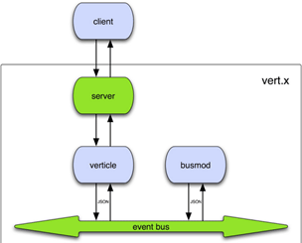
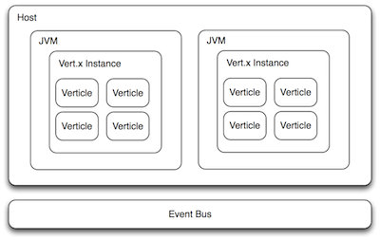
Vert.x architecture

Slide 4
Core API
TCP/SSL servers and clients
HTTP/HTTPS servers and clients
WebSockets servers and clients
The distributed event bus
Periodic and one-off timers
Buffers
Flow control
File-system access
Shared map and sets
Accessing configuration
SockJS

Slide 5
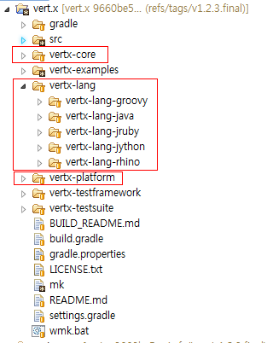
Vert.x Project Structure

Slide 6
Server.java
import org.vertx.java.core.Handler;
import org.vertx.java.core.http.HttpServerRequest;
import org.vertx.java.platform.Verticle;
public class Server extends Verticle {
public void start() {
vertx.createHttpServer().requestHandler(new Handler<HttpServerRequest>() {
public void handle(HttpServerRequest req) {
String file = req.path().equals("/") ? "index.html" : req.path();
req.response().sendFile("webroot/" + file);
}
}).listen(8080);
}
}
vertx run server.java

Slide 7
Messaging with Vert.x
publish/subscribe
point-to-point
EventBus eb = vertx.eventBus();
eb.publish(“test.address”,”msg”)
eb.send(“test.address”,”msg”)

Slide 8
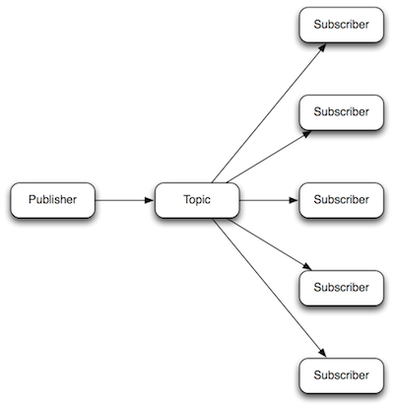

publish/subscribe messaging
point-to-point messaging

Slide 9
Publish/subscribe messaging example
Server.java
public class Server extends Verticle {
public void start() {
// Create our dependent verticles
container.deployVerticle("AuditVerticle.java");
// Create an HTTP Server that serves files
vertx.createHttpServer().requestHandler(new Handler<HttpServerRequest>() {
public void handle(HttpServerRequest req) {
Logger logger = container.logger();
logger.info("Here is an info message");
// Serve up our files
String file = req.path().equals("/") ? "index.html" : req.path();
req.response().sendFile("webroot/" + file);
// Let's tell the world (via the event bus) that we received a request
EventBus eb = vertx.eventBus();
eb.publish( "Server.announcements", "We received a request for resource: " + req.path() );
}
}).listen(8080);
}
}

Slide 10
AuditVerticle.java
public class AuditVerticle extends Verticle {
@Override
public void start() {
// Let's register ourselves as a listener to Server notifications
EventBus eb = vertx.eventBus();
Handler<Message> auditHandler = new Handler<Message>() {
@Override
public void handle(Message message) {
Logger logger = container.logger();
logger.info( "AuditVerticle here, someone requested resource: " + message.body() );
}
};
eb.registerHandler( "Server.announcements", auditHandler );
}
}
Output: (http://localhost:8080/1.txt)
AuditVerticle here, someone requested resource: We received a request for resource: /1.txt

Slide 11
Point-to-point messaging example
Server2.java
public class Server2 extends Verticle {
public void start() {
container.deployWorkerVerticle("MyWorkerVerticle.java");
vertx.createHttpServer().requestHandler(new Handler<HttpServerRequest>() {
@Override
public void handle(final HttpServerRequest req) {
// Set a shared variable
ConcurrentMap<String, String> map = vertx.sharedData().getMap("mymap");
map.put("mykey", "myvalue");
// Let's send a message to a worker verticle and wait for it to respond
EventBus eb = vertx.eventBus();
eb.send("request.worker", req.path(), new Handler<Message<String>>() {
@Override
public void handle(Message<String> message) {
Logger logger = container.logger();
logger.info( "Received a reply from our worker: " + message.body() );
req.response().headers().set("Content-Length", Integer.toString(message.body().length()));
req.response().write(message.body());
}
});
}
}).listen(8080);
}
}

Slide 12
MyWorkerVerticle.java
public class MyWorkerVerticle extends Verticle {
@Override
public void start() {
// Register a listener
EventBus eb = vertx.eventBus();
Handler<Message> workerHandler = new Handler<Message>() {
@Override
public void handle(Message message) {
Logger logger = container.logger();
logger.info( "MyWorkerVerticle just received a request for: " + message.body() );
// Examine our shared map
ConcurrentMap<String, String> map = vertx.sharedData().getMap("mymap");
logger.info( "Shared data: " + map.get( "mykey" ) );
message.reply( "<html><head><title>Worker Response</title></head><body>Hello, from the worker verticle</body></html>" );
}
};
eb.registerHandler( "request.worker", workerHandler );
}
}

Slide 13
Output:
MyWorkerVerticle just received a request for: /1.txt
Shared data: myvalue
Received a reply from our worker: <html><head><title>Worker Response</title></head><body>Hello, from the worker verticle</body></html>
Официальная документация:
http://vertx.io/

