Slide 1
A Torrent Client (Named Magneto)
Final Year Project – Phase 2 Presentation

Slide 2
Group Information
Group ID: S25BS006
Project Advisor: Dr. Ghulam Mustafa
Group Members:
Ali Anser (L1F20BSCS0603)
Minhaal Ali Hafeez (L1S21BSCS0065)
Faheem Raza (L1S23BSCS0257)

Slide 3
Group Information
Group ID: S25BS006
Project Advisor: Dr. Ghulam Mustafa
Group Members:
Ali Anser (L1F20BSCS0603)
Minhaal Ali Hafeez (L1S21BSCS0065)
Faheem Raza (L1S23BSCS0257)

Slide 4
Abstract
Magneto is a cross-platform torrent client with a built-in VPN, enabling secure and private file sharing without external configurations. Due to architectural limits in existing clients, Magneto was built from scratch to offer seamless integration of torrenting and privacy, targeting users who value both functionality and anonymity.

Slide 5
Methodology
Framework: Feature-Driven Development (FDD)
Reasons:
Great for complex projects (we expect our project to get substantially complex).
Scalable and modular.
Progress is easy to track feature-by-feature.
Strongly recommended by our advisor.

Slide 6
Key Features
Full BitTorrent Support
File Download Priority Support
Built-in VPN
Session Persistence
Cross-Platform Support
Additional Privacy Safeguards

Slide 7
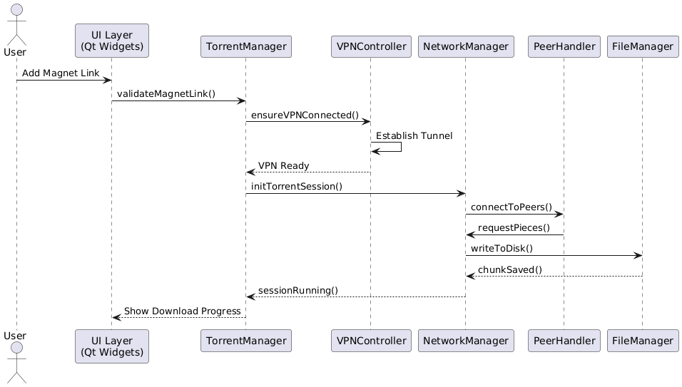
Sequence Diagram

Slide 8
Project Progress
Task | Status
Protocol & VPN Research, Design | Completed
Basic GUI | Completed
Torrent Parsing & Peer Communication | In progress
File Download & Torrent Management | Not started
VPN Module | Not started
Testing & Optimization | Not started
Documentation & Deployment | Not started

Slide 9
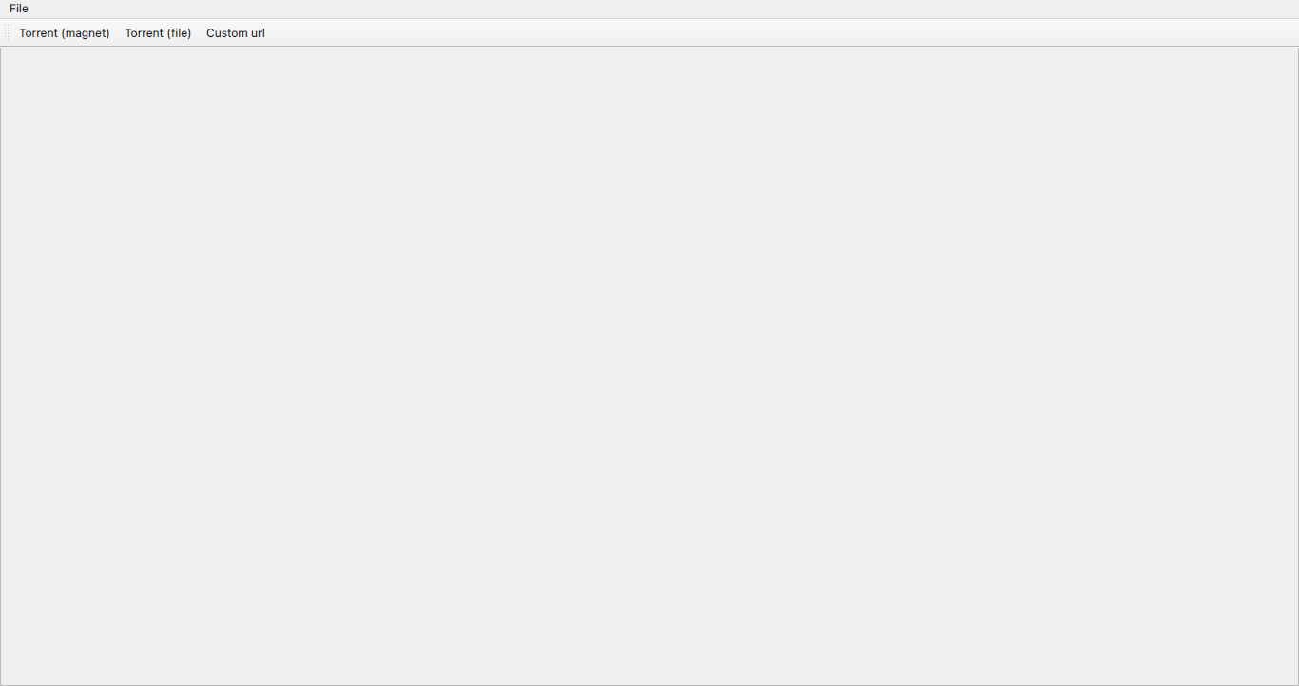
Screenshot # 1

Slide 10
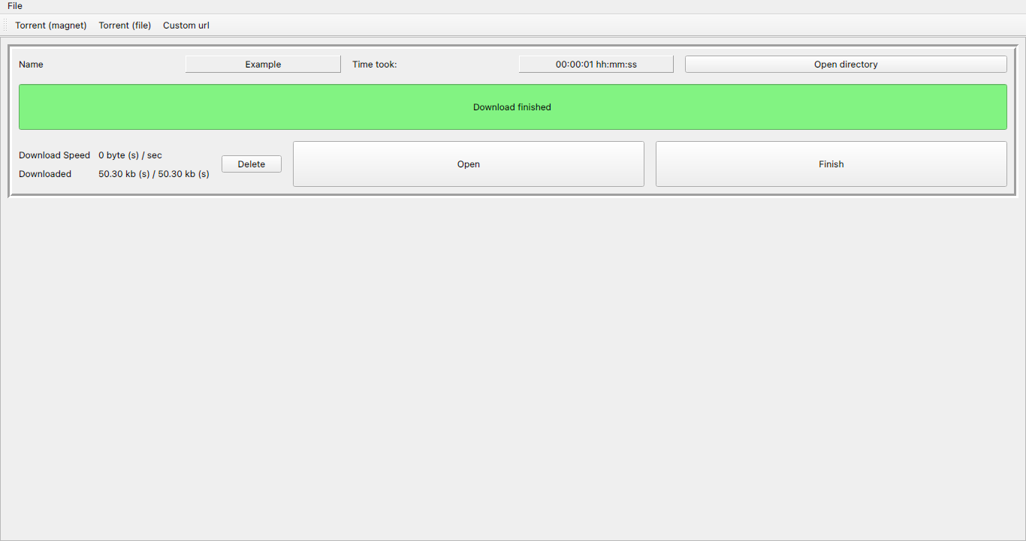
Screenshot # 2

Slide 11
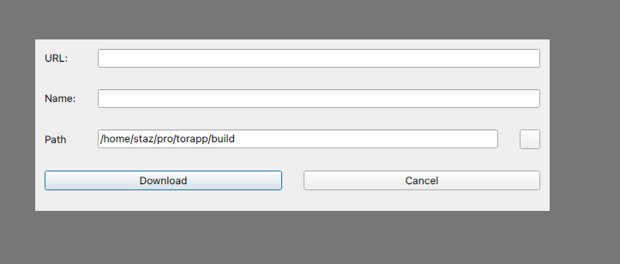
Screenshot # 3

Slide 12
Thank you

