Slide 1
Up Counter

Slide 2
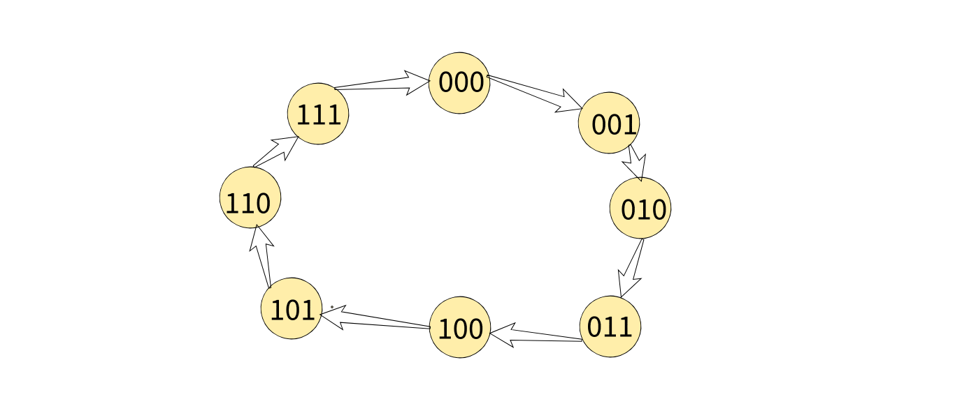
State Diagram

Slide 3
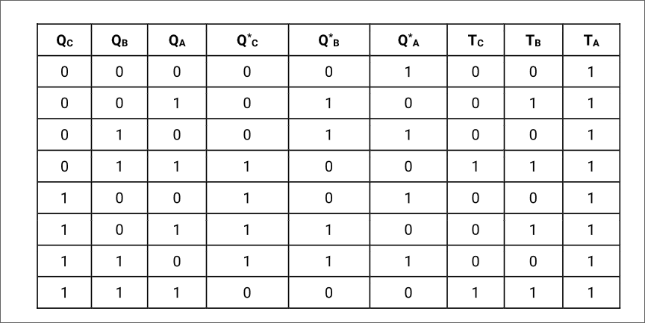
Excitation Table

Slide 4
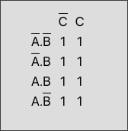
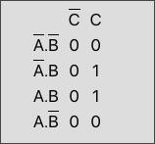
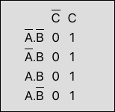
Kmaps
Tc
Tb
Ta
QbQa
Qa
1

Slide 5
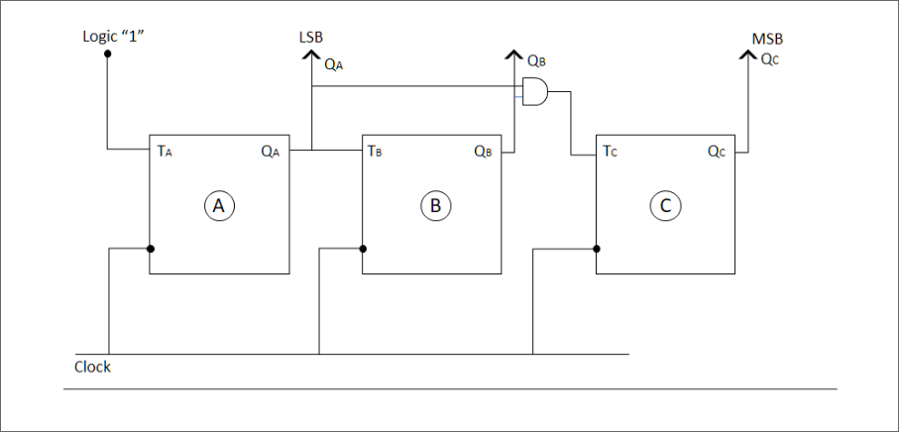
Circuit

Slide 6
Down Counter

Slide 7
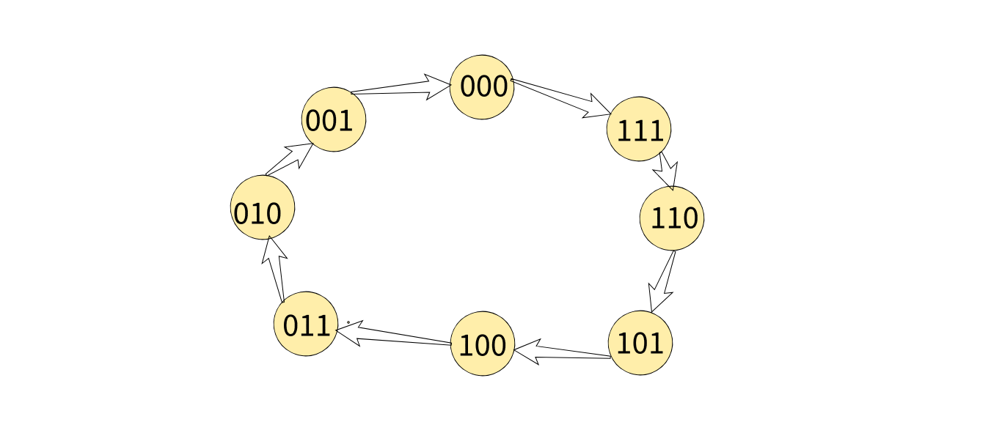
State Diagram

Slide 8
Excitation Table
Qc | Qb | Qa | Qc’ | Qb’ | Qa’ | Tc | Tb | Ta
0 | 0 | 0 | 1 | 1 | 1 | 1 | 1 | 1
0 | 0 | 1 | 0 | 0 | 0 | 0 | 0 | 1
0 | 1 | 0 | 0 | 0 | 1 | 0 | 1 | 1
0 | 1 | 1 | 0 | 1 | 0 | 0 | 0 | 1
1 | 0 | 0 | 0 | 1 | 1 | 1 | 1 | 1
1 | 0 | 1 | 1 | 0 | 0 | 0 | 0 | 1
1 | 1 | 0 | 1 | 0 | 1 | 0 | 1 | 1
1 | 1 | 1 | 1 | 1 | 0 | 0 | 0 | 1

Slide 9
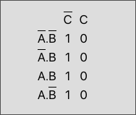
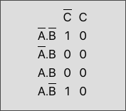
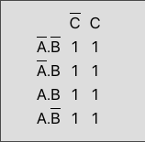
Kmaps
Tc
Tb
Ta
Qb’Qa’
Qa’
1

