Slide 1
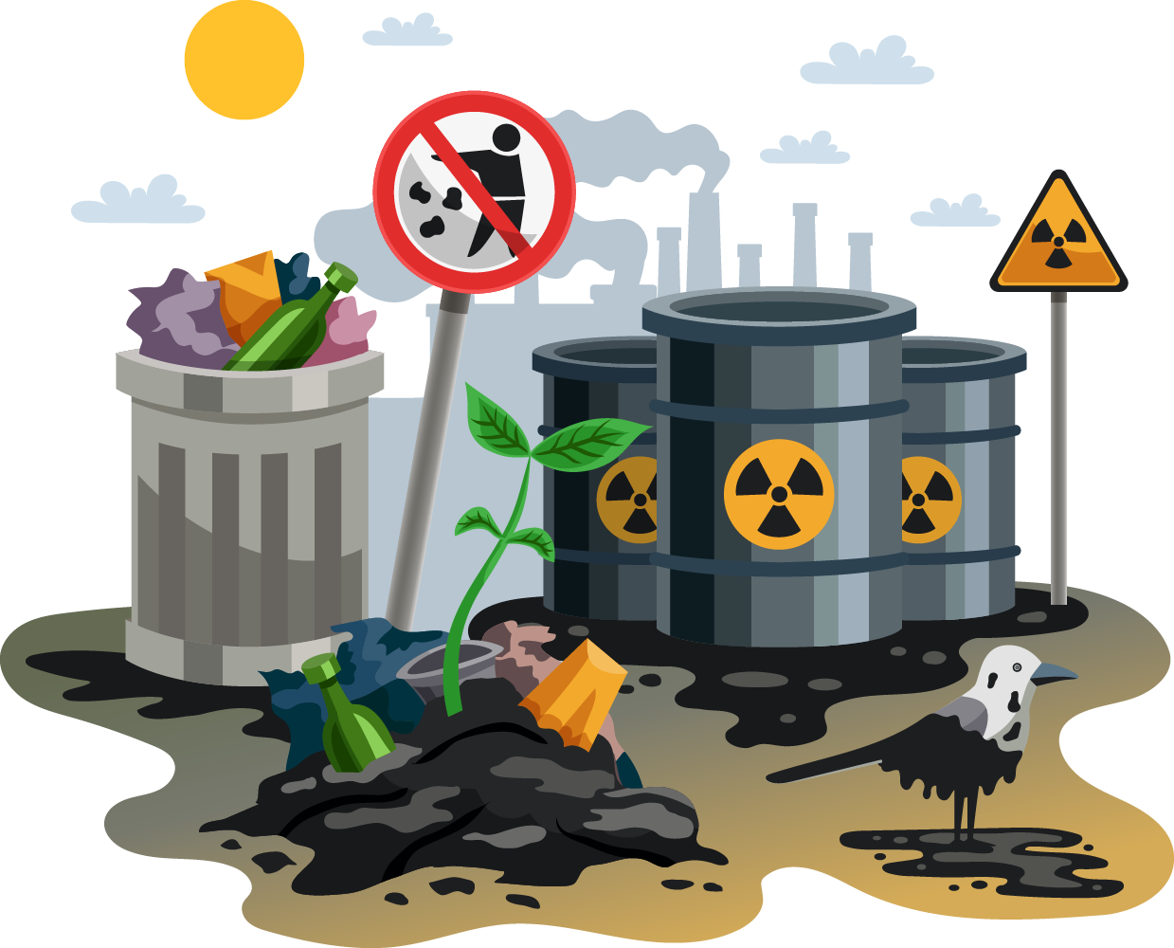
Təmiz hava Təmiz ətraf mühit
Hazırladı Əlyarzadə Nigar 120A5b

Slide 2
Təmiz hava
Ətraf mühitin təmizliyi havanın təmizliyi deməkdir.
Xəstəliklərdən uzaq, sağlam həyat sürməyin ən önəmli amillərindən biri də tənəffüs etdiyimiz havanın təmiz olmasıdır.
Son vaxtlarda dünyanın bir neçə ölkəsində havanın kəskin şəkildə çirklənməsi halları nəzərə çarpır ki, bu da, insan həyatı üçün böyük təhlükə deməkdir.Havanın çirklənməsi prosesi böyük şəhərlərdə daha sürətlə gedir. Şəhərlərdə sənaye və nəqliyyat vasitələrinin atmosferə buraxdığı tullantılar havanın kəskin şəkildə çirklənməsinə yol açır. Metallurgiya, kimya, neft, qaz və kömür emalı sahəsində sənaye məhsullarının istehsalı artdıqca tullantıların atmosferə atılması da genişlənir. Eyni zamanda vulkan püskürmələri, canlıların tənəffüsü, yanacaqların yandırılması, bakteriyaların fəaliyyəti, çürümə prosesləri nəticəsində karbon, dəm qazı, kükürd qazı və onun törəmələri, azot birləşmələri və oksidləri, ağır metalların oksidləri və s. atmosferə daxil olur. Bu maddələr sonradan fiziki- kimyəvi proseslərə məruz qalaraq ikinci qrup atmosfer çirkləndiricilərini, aerozolları, turşuları və s. əmələ gətirir. Araşdırmalar iri şəhərlərdə havanın yüksək dərəcədə çirkləndiyini göstərir ki, bu da ümumi ekoloji vəziyyətin gərgin olması deməkdir.

Slide 3
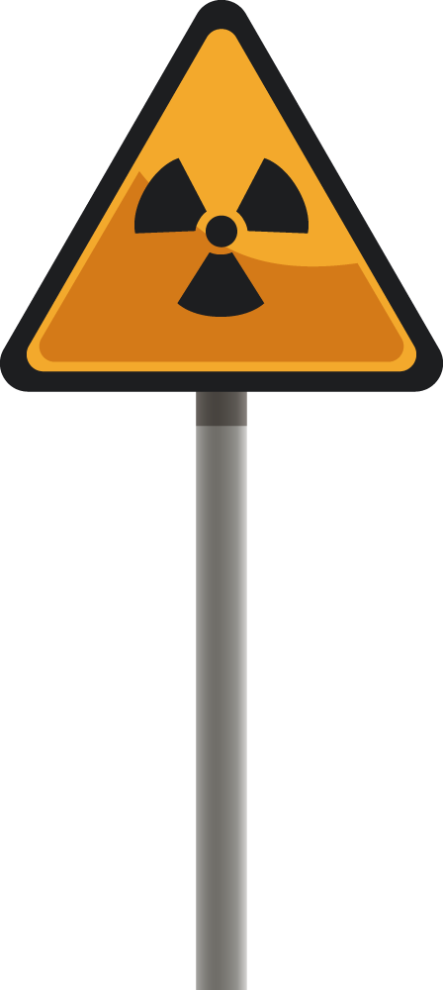

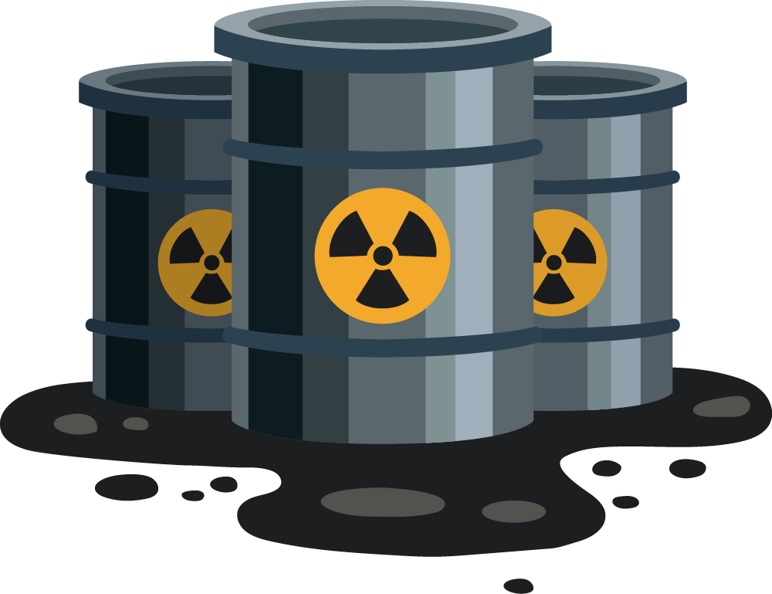

Slide 4
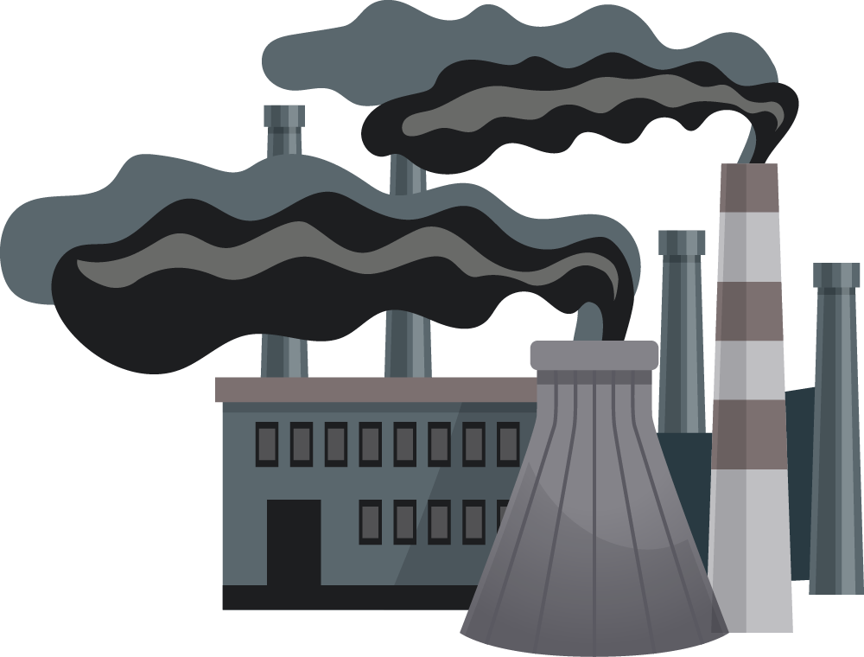
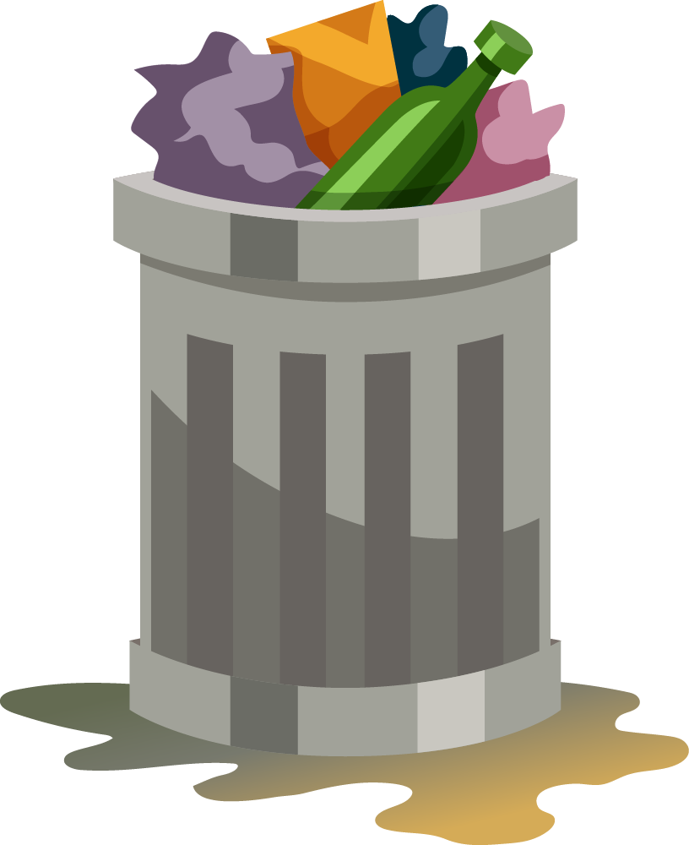
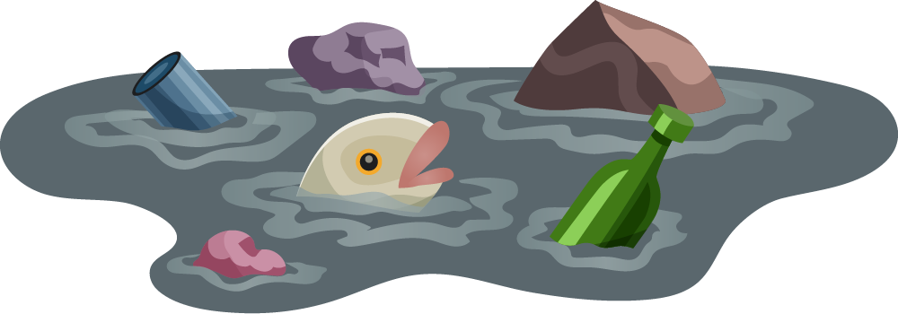

Slide 5
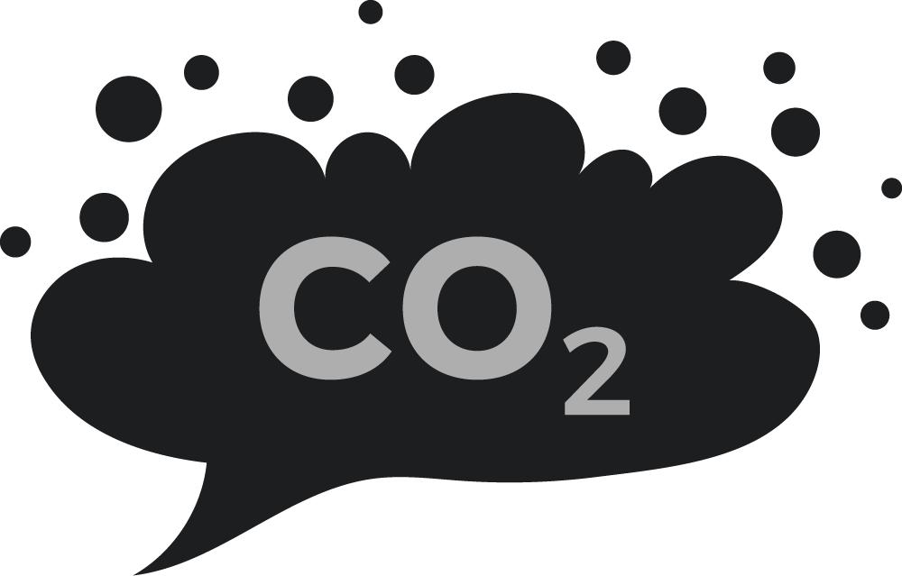
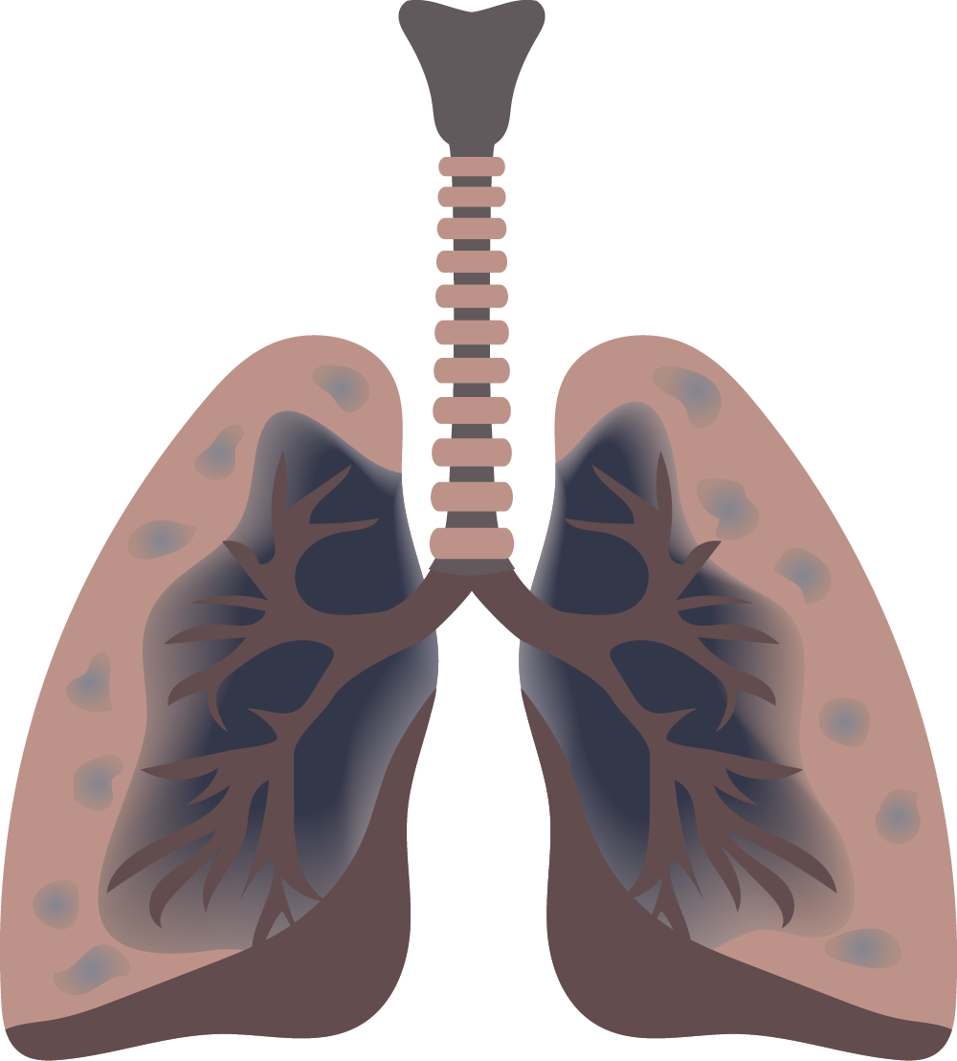

Slide 6

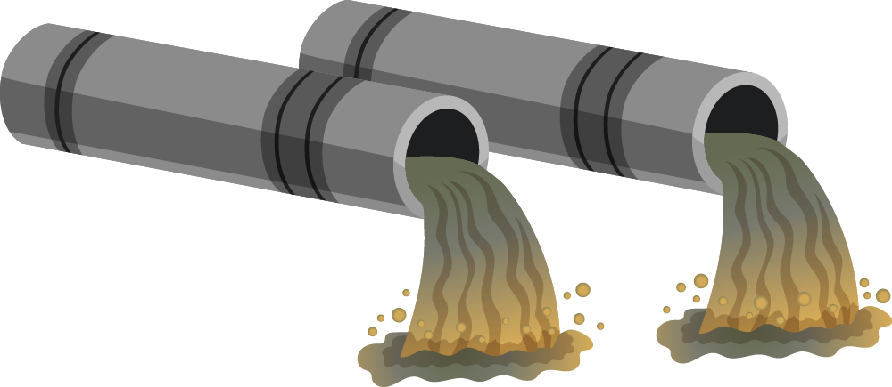
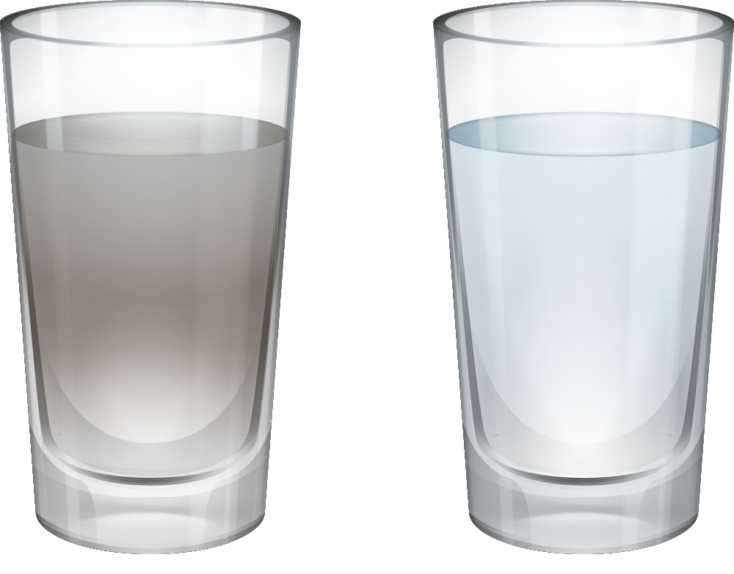

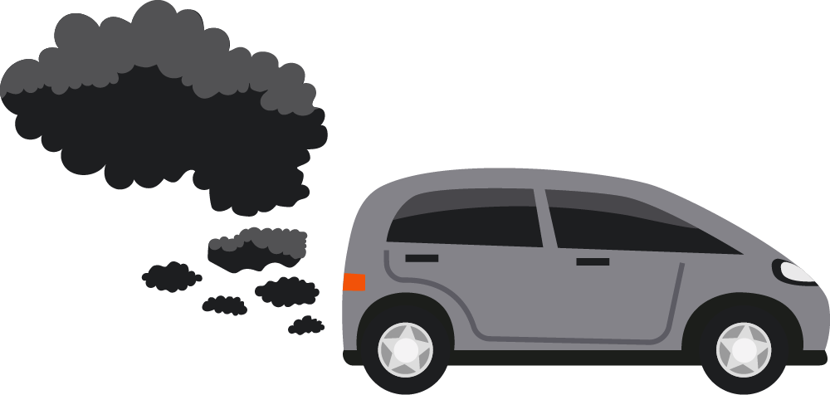
Alternative resources

Slide 7
01
02
03
About
Requirements
Goals
04
05
06
Sneak peek
The stages
Our team
You can describe the topic of the section here
You can describe the topic of the section here
You can describe the topic of the section here
You can describe the topic of the section here
You can describe the topic of the section here
You can describe the topic of the section here

Slide 8

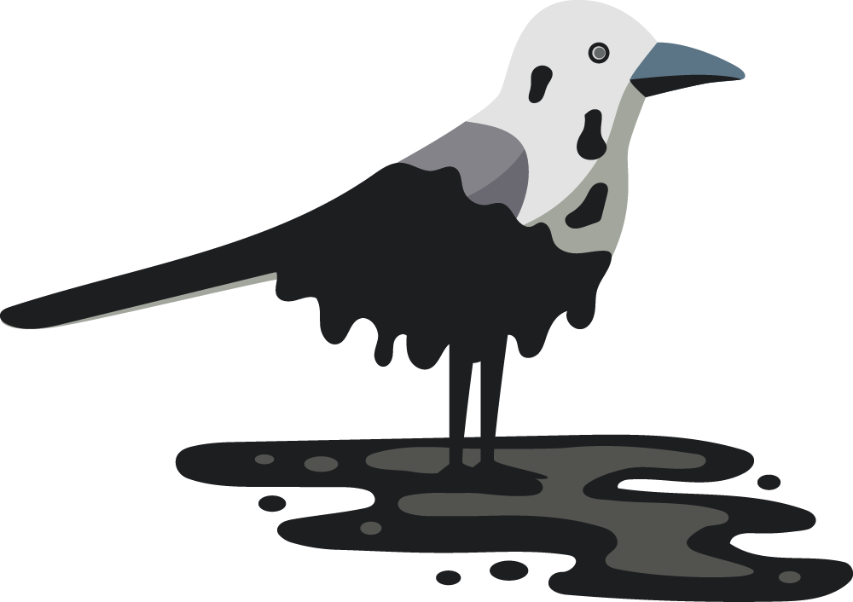
01
About
the project
You can enter a subtitle here if you need it

Slide 9
About the project
Do you know what helps you make your point clear?
Lists like this one:
They’re simple
You can organize your ideas clearly
You’ll never forget to buy milk!
And the most important thing: the audience won’t miss the point of your presentation

Slide 10
What we are working on
Mercury
Venus
Mars
It’s the closest planet to the Sun and the smallest of them all
Venus has a beautiful name and is the second planet from the Sun
Despite being red, Mars is a cold place. It’s full of iron oxide dust

Slide 11
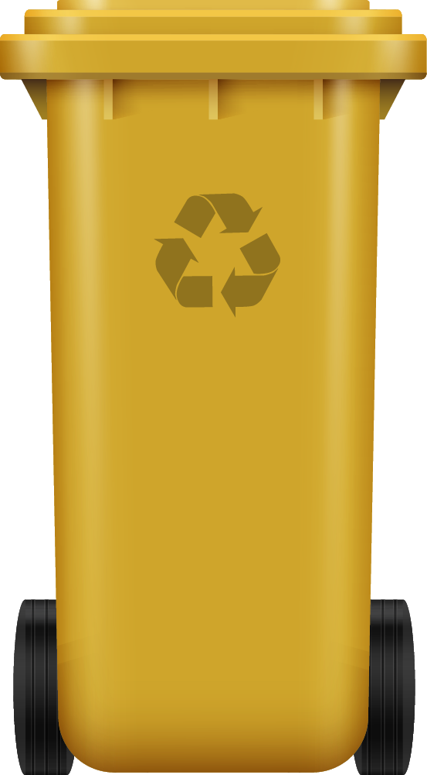
Our company
You can give a brief description of the topic you want to talk about here. For example, if you choose to talk about Mercury, you can say that it’s the smallest planet in the entire Solar System

Slide 12
Now
Jupiter is a gas giant and the biggest planet in the Solar System. It's the fourth-brightest object in the night sky. It was named after the Roman god of the skies and lightning

Slide 13
Future
Saturn is a gas giant and has several rings around it. It's composed mostly of hydrogen and helium. This planet was named after the Roman god of wealth and agriculture

Slide 14
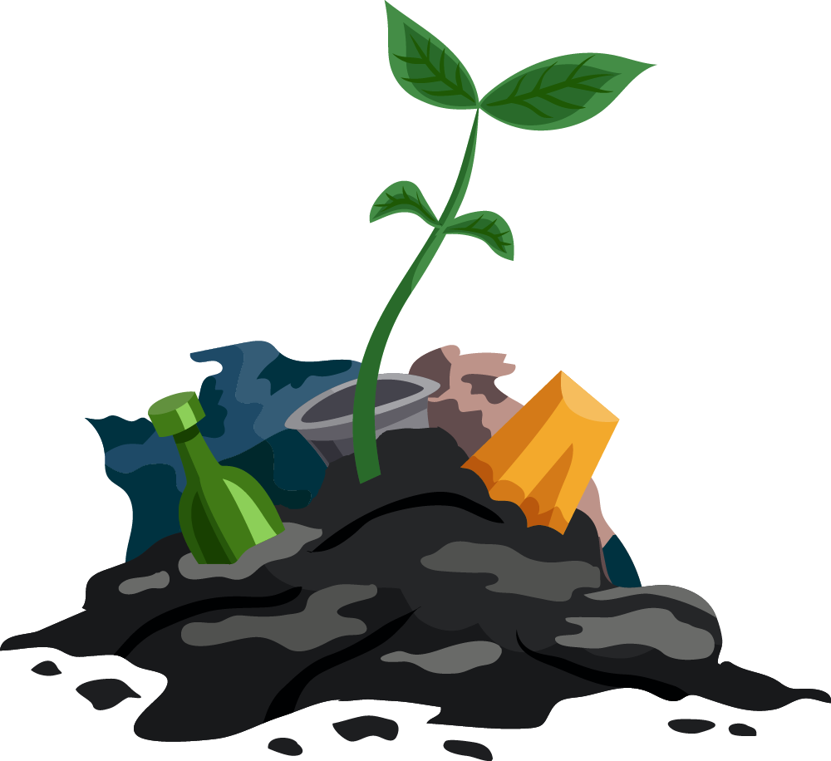
Major requirements
Pollution control
Recycling center
Mercury is the closest planet to the Sun and the smallest one in the Solar System—it’s only a bit larger than the Moon
Venus has a beautiful name and is actually the second planet from the Sun. It’s hot and has a poisonous atmosphere

Slide 15
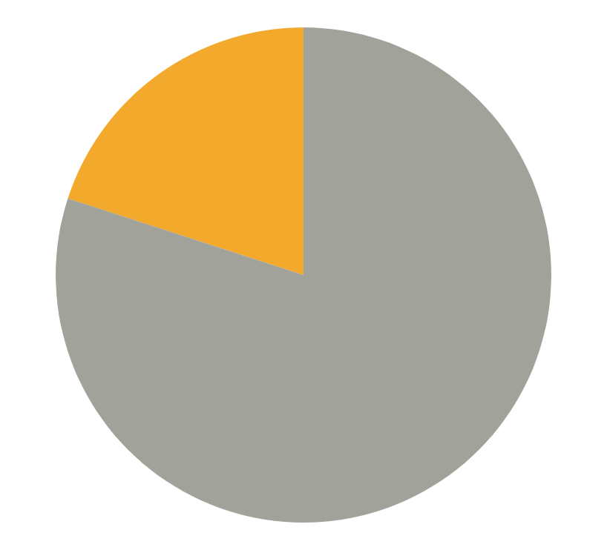
Budget
$20.000
Neptune
$80.000
Mercury
Total
$100.000
Neptune is the farthest planet from the Sun
Mercury is the closest planet to the Sun
Follow the link in the graph to modify its data and then paste the new one here. For more info, click here

Slide 16
Timeline
2015
2017
2020
2023
Mars
Mercury
Saturn
Venus
Despite being red, Mars is actually a cold place
Mercury is the closest planet to the Sun
Saturn is a gas giant and has several rings
Venus is the second planet from the Sun

Slide 17
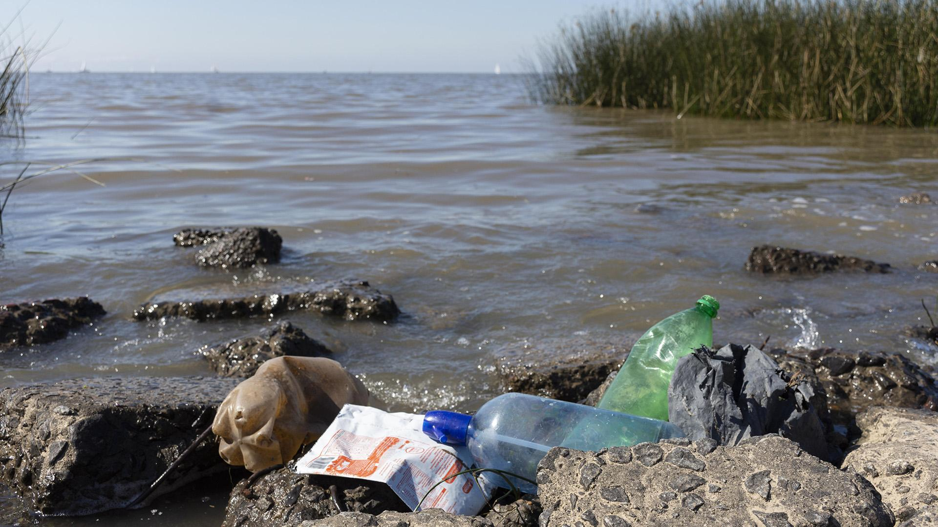
A picture is worth a thousand words

Slide 18
386,000 km
333,000,000
9h 55m 23s
Distance between Earth
and the Moon
The Sun’s mass compared to Earth’s
Exact duration of Jupiter’s rotation period

Slide 19

These are
our partners
Partner 1
Partner 3
Partner 2
Partner 4
Mercury is the closest planet to the Sun
Venus is the second planet from the Sun
Jupiter is the biggest planet of them all
Saturn is a gas giant and has rings

Slide 20
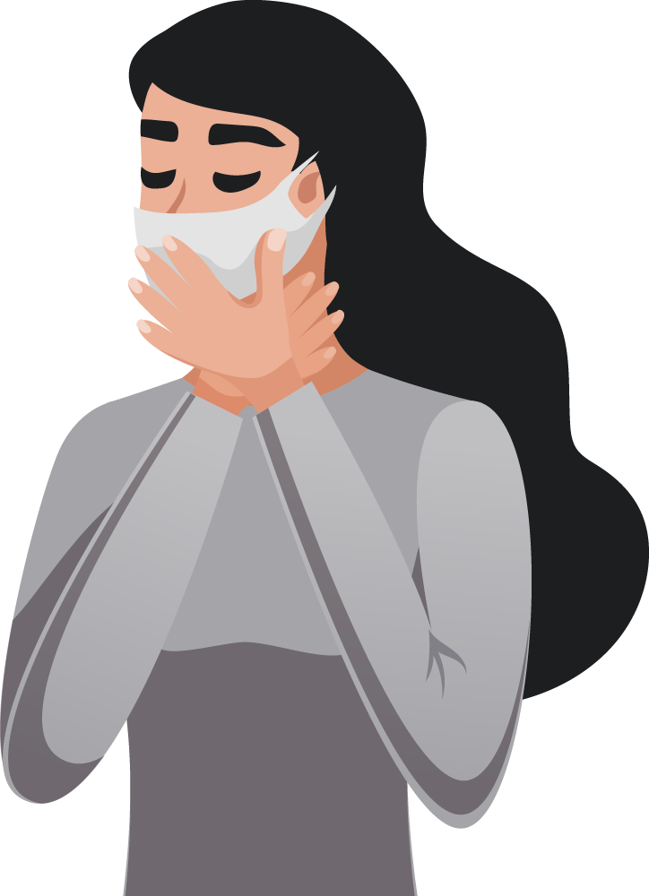
—Someone Famous
“This is a quote, words full of wisdom that someone important said and can make the reader get inspired”

Slide 21
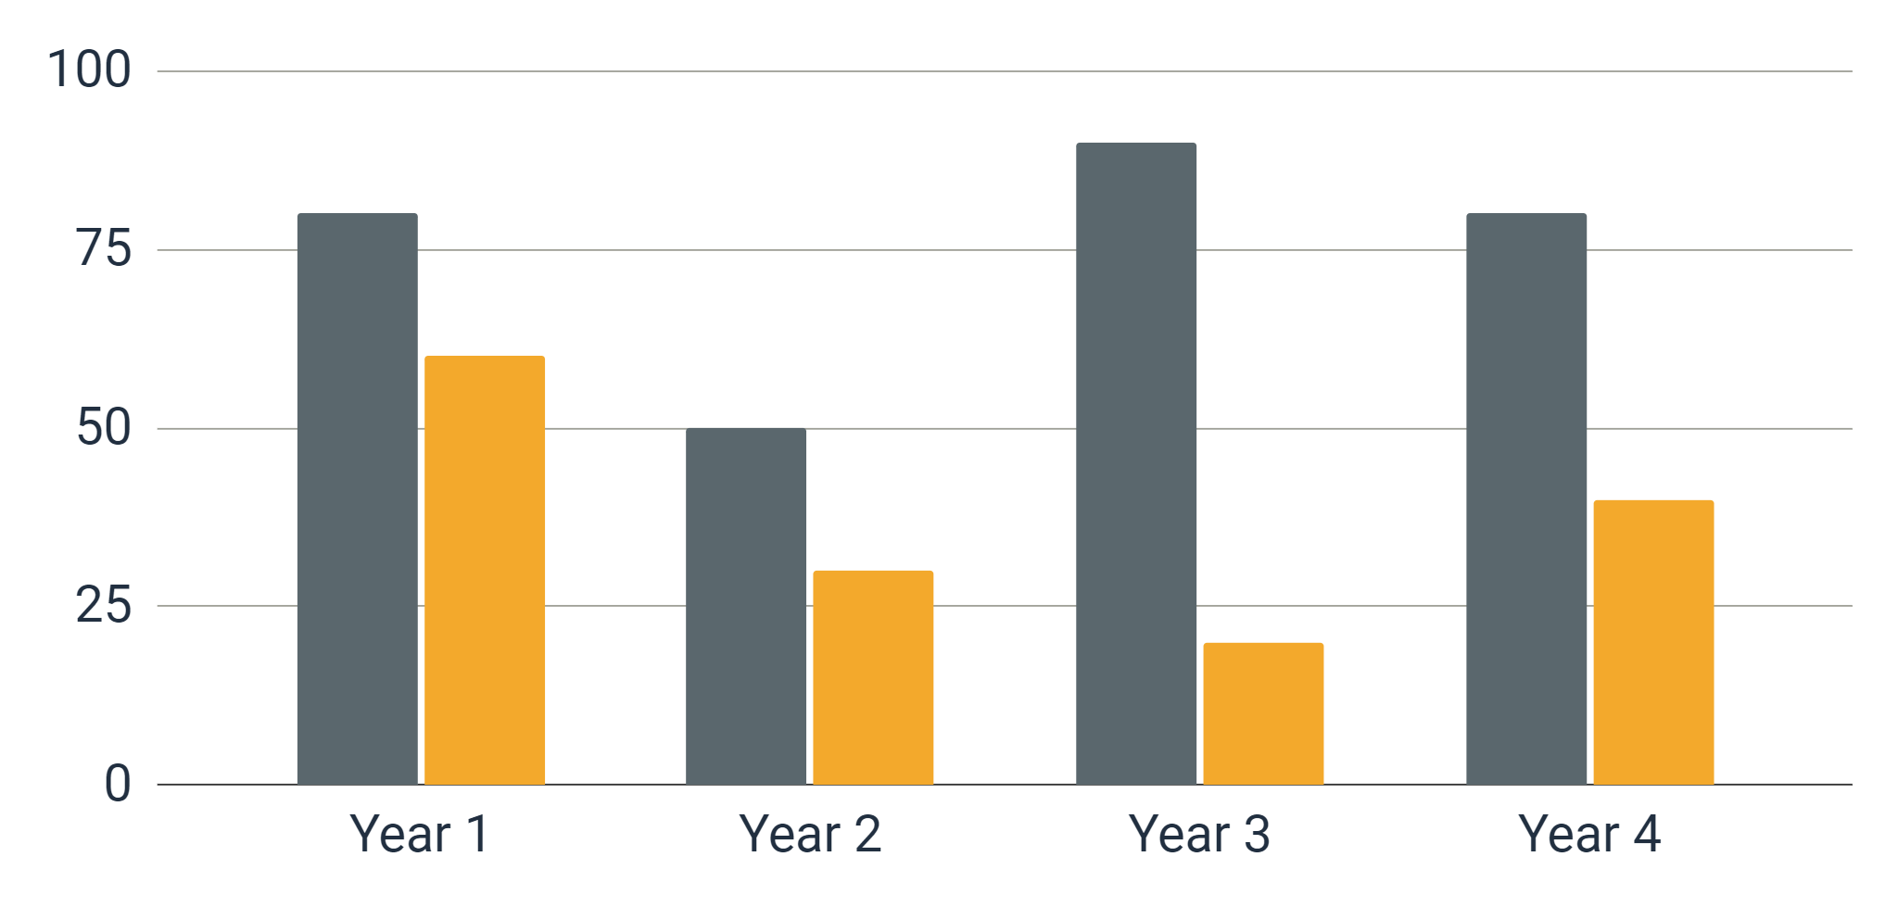
Predicted results
Mercury
Mercury is the closest planet to the Sun
Neptune
Neptune is the farthest planet from the Sun
Follow the link in the graph to modify its data and then paste the new one here. For more info, click here

Slide 22
Project stages
Planning
Budget
Preparation
Execution
Finalization
Maintenance
Mercury is the closest planet to the Sun
Venus is the second planet from the Sun
Despite being red, Mars is a cold place
Jupiter is the biggest planet of them all
Saturn is a gas giant and has rings
Neptune is the farthest planet from the Sun

Slide 23
Awesome words

Slide 24
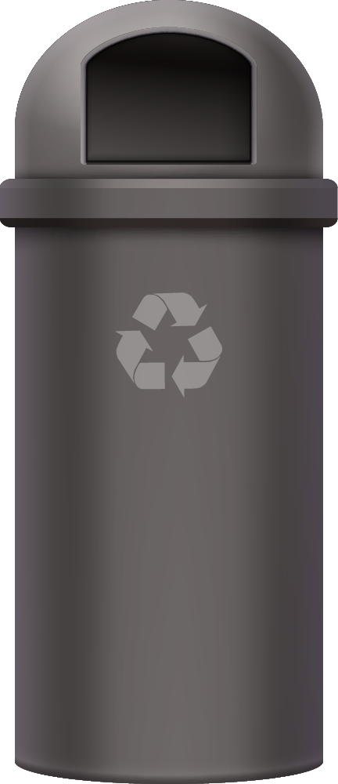
Recycling locations
Venus
Venus is the second planet from the Sun
Earth is the planet that has life
Pluto is now a dwarf planet

Slide 25
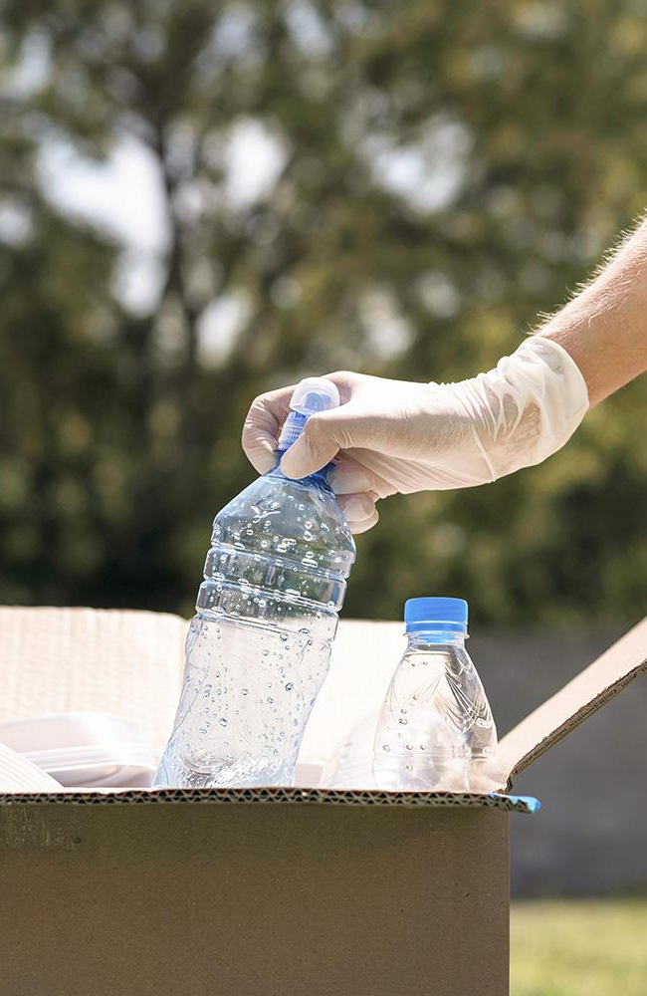
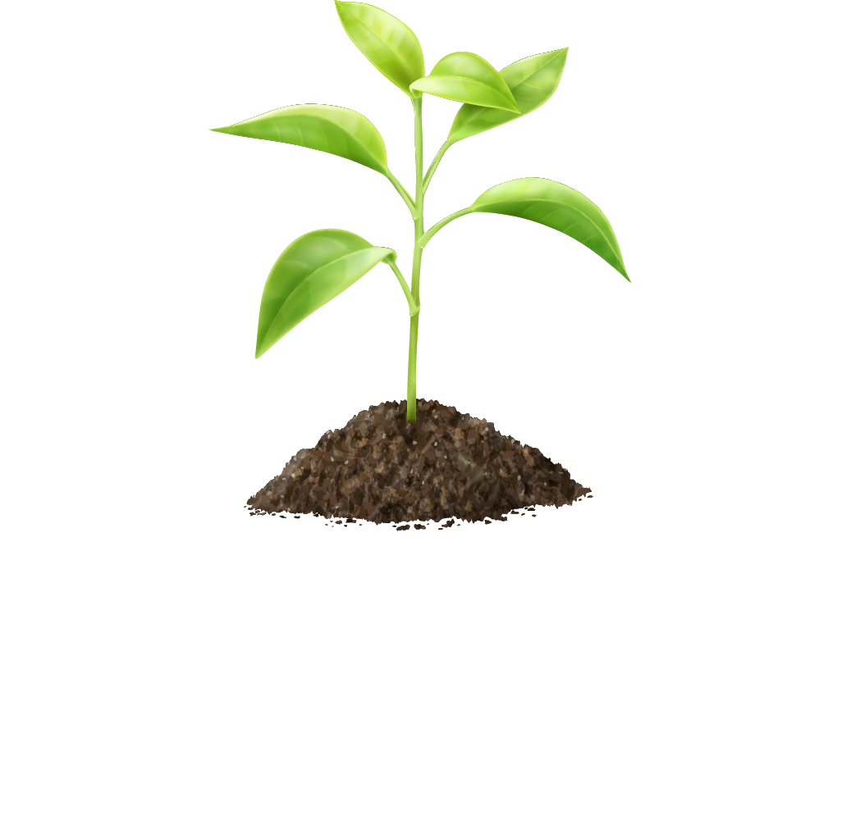
A picture always reinforces the concept
Images reveal large amounts of data, so remember: use an image instead of a long text. Your audience will appreciate it

Slide 26
Project plan
 | Phase 1 | Phase 2
Mercury | Mercury is the closest planet to the Sun | It’s also the smallest planet in the Solar System
Venus | Venus is the second planet from the Sun | It’s terribly hot, even hotter than Mercury
Earth | Earth is the third planet from the Sun | It’s the only one that harbors life in the Solar System

Slide 27


Meet the team
Creative Corey
Awesome Anna
You can explain more about this person here
You can explain more about this person here

Slide 28
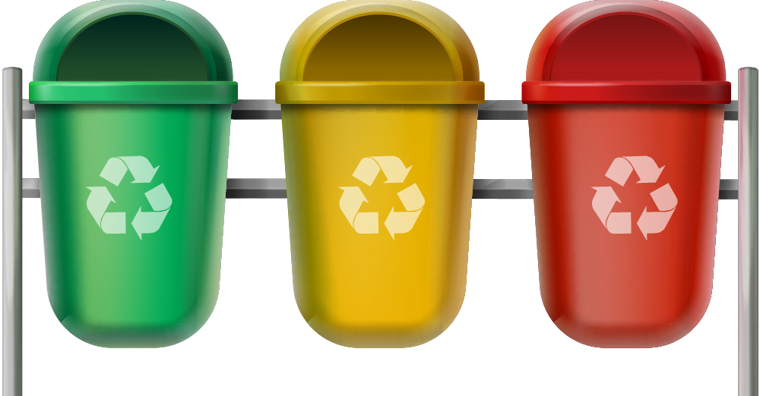
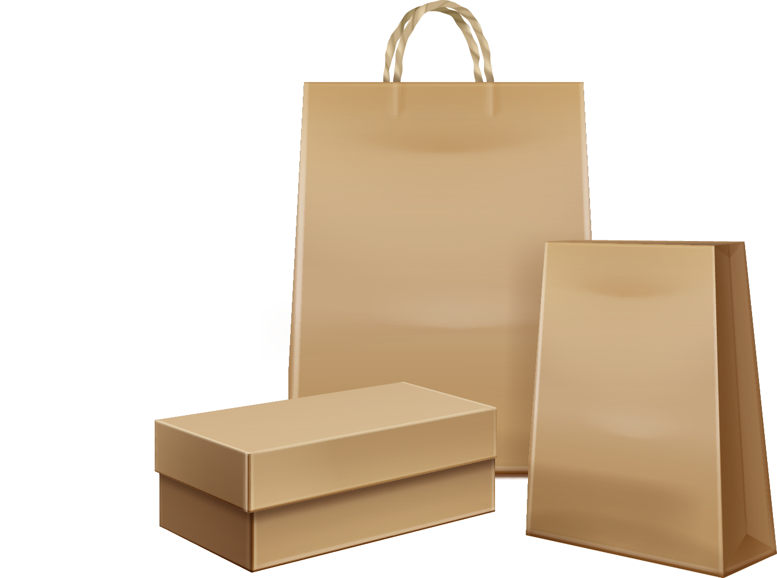
Sneak peek
You can replace the image on the screen with your own work. Just right-click on it and select “Replace image”

Slide 29
Thank you!
Do you have any questions?
youremail@freepik.com
+91 620 421 838
yourwebsite.com
Please keep this slide for attribution

Slide 30
Resources
Did you like the resources on this template? Get them for free at our other websites:
Photos:
Pollution concept of water with garbage
Close-up individual recycling plastic bottles
Young businesswoman posing with copy space
Smiley man posing while holding a laptop
Vectors:
Ecological disasters element collection
Environmental pollution illustration
Set of recycle bins for waste sorting, clean water drop, sprout and kraft paper bags isolated on white background

