Slide 1
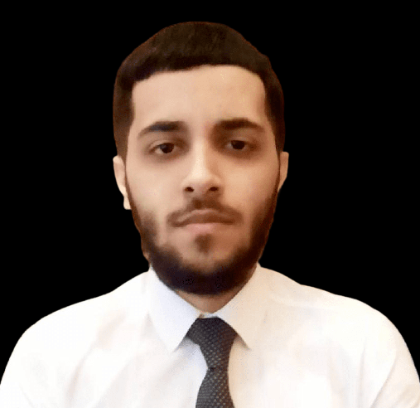
TUNAR
ALYARZADA
Hi, I am Front-End Developer who is so passionate and excited about learning new technologies and languages.
Programming skills
HTML
CSS
JavaScript
Bootstrap
React
Personal Info
Name: Tunar Alyarzada
Gender: Male
Date of Birth: 05.01.1998
Place of Birth: Baku, Azerbaijan
Marital status: Single
Language skills
English
Russian
Contact
Phone: +99455 664-30-64
Email: tunar.alyarzada.98@gmail.com
Education History
Bachelor degree:
Azerbaijan State Economic University (Business Administration and Management)
Master degree:
Baku Business University
(Master of Business Administration (MBA)

