Slide 1
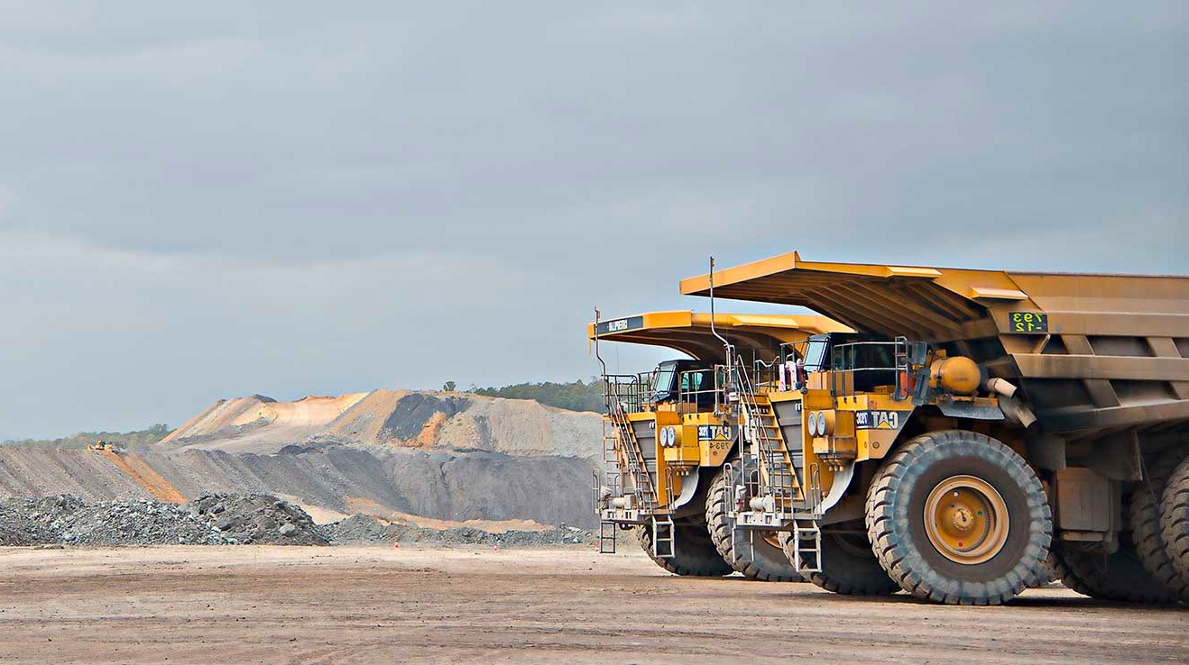

ISS playback: what we take back to industry
Draft for endorsement by Belinda Ward
Prepared by The Strategy Group | November 2026

Slide 2
ISS playback: for endorsement
This pack maps what we take back to ISS participants, for your endorsement
WHAT WE NEED YOU TO ENDORSE
HOW WE GOT HERE
1
The shortlist
Which initiatives we play back to ISS participants, and which we hold.
May to Jul 2026
ISS interviews with 30 senior MC and MEU stakeholders
Aug 2026
Cycle 1 report. ISS of 65, in the Guarded band
2
The message for each
Whether we share progress on it, or make a commitment with a date.
21 Oct 2026
GMT workshop mapped what is already in train
3
The value to each group
What is in it for the Minerals Council and employers, and for the MEU and workers. They differ.
3 Nov 2026
Prioritisation session with Belinda
4
How and when we go back
Who presents, in which forums, and how often we run the ISS from here.
Now
Commitments and priorities get agreed
Next
Board briefing, then the MC and MEU forums
Once endorsed, we turn this into a shorter presentation for the MC and MEU forums.
2

Slide 3
ISS playback: for endorsement
Of 61 initiatives, we play back the 7 industry will feel first
NOW within 6 months
NEXT 6 to 18 months
LATER 18 months plus
61
initiatives reviewed
Higher customer impact
● CMI Go to Green
● CS Health Standards, incl. Order 45
● Estimations
● Complaints and feedback uplift
● CS Health value review, incl. premiums
● Legal service standards
● CX measurement framework
● CMI Tech Optimisation (to clarify)
CMI Transformation
CS Health Transformation
MRRC Levy and service models
MRRC Orders 34 and 40
MSOH Reporting Portal
7
we play back
Lower or indirect impact
● Fit for Future PMO, Phase 2
● CMI CLCC
● Project Bedrock remediation
● Fit for Future PMO, Phase 3
● Channel engagement strategy
● Overarching comms strategy (new)
MRRC Industry engagement
MRRC Customer service uplift
3 progress updates (Now)
4 commitments (Next)
Fixes and enablers are told through 3 overarching messages. Later work is shown for context only.
● Progress update/ Commitment
● Overarching message
3

Slide 4
ISS playback: for endorsement
Now: progress we can share, because industry is already feeling it
Initiative
What it is
What we would say
Value to MC and employers
Value to MEU and workers
Theme and status
CMI Go to Green
CMI (Beth, Greg)
Ended Sep-26. Benefits still landing
Remediation that fixes the broken parts of CMI before transformation: liability decisions, contact and reimbursement timeframes.
“You told us the basics were not working. We have fixed the critical gaps, and here is what has changed.”
Faster, clearer liability decisions and fewer escalations to get a claim moving.
Members wait less for decisions and payments.
● Service consistency
● Trust
Confirm benefit measures with the CMI program before we claim progress.
CS Health Standards, incl. Order 45 variance
CS Health (Kirsty, Chris)
Ongoing. Full review targeted for 2029
Evidence-based standards that guide how doctors run health assessments under Order 45, so the outcome does not depend on who you see.
“Two standards are now published, with more on the way. They give every doctor the same clear guidance, and all standards will be reviewed by 2029.”
More consistent fitness decisions with less variation between doctors, so employers can have confidence in the outcome.
Fairer, more consistent decisions for workers, whichever doctor or clinic they see.
● Service consistency
● Trust
Confirmed with Chris, 9 Nov. Hold back draft content, dates for individual standards and impact figures.
Estimations: process improvement and automation
CMI (Beth)
Next 6 months, to confirm
Improving and automating how premium estimates are prepared.
“Premium estimates will be clearer and quicker, with the reasoning shown. [Get a clear understanding from Beth and Mon].”
Estimates employers can reconcile against their own results, a pain point raised in the ISS.
Indirect benefit only.
● Trust
● Value
Confirm scope and timing with Beth.
4

Slide 5
ISS playback: for endorsement
Next: commitments we can make, with a date attached
Initiative
What it is
What we would say
Value to MC and employers
Value to MEU and workers
Theme and status
Complaints and feedback uplift (Bowtie)
CEO portfolio (Peter)
Feb-27
Clear complaint and escalation pathways, including decision review for contentious claims.
“If you are unhappy with a decision, here is the pathway, and here is when you will hear back.”
A visible escalation route that does not rely on a senior contact.
A clear way for members to challenge a decision and be kept informed.
● Trust
● Service consistency
Belinda to share the draft escalation document.
CS Health value review, incl. premium transparency
CS Health, CMI
Outcomes in about 12 months
An audit of what industry values and what it costs, which shapes the future CS Health model. Premium notices to show what each portion pays for.
“We are taking a hard look at what you pay for and what you value, and we will shape the next model with you.”
Visibility of what the premium funds across CMI and CS Health, and a say in what is in and out.
Confidence that the health services protecting workers are designed with industry input.
● Value
● Trust
Keep early cost data out of the playback.
Legal service standards and target operating model
CMI (Beth, Monique)
Publication date TBC
Service standards for how legal and disputed matters are handled. Scope to confirm.
“We know that this is a high priority for industry. [Awaiting information from Beth Mon to fill this in]”
More predictable handling of disputed claims (to confirm).
Consistent, fair treatment for members in disputes (to confirm).
● Trust
● Service consistency
Confirm scope and publication date with Beth and Monique.
CX measurement framework, incl. sharing CS Health performance data
CEO portfolio, with TSG
Launch early 2027, then baseline
Measures at the moments that matter, starting with CS Health, then CMI. CMI design workshop on 13 Nov.
“We will measure how we perform where it matters to you, and share the results.”
Performance data on what employers experience, such as certificate timeframes and appointment access.
Measures that reflect what workers experience, reported back through the forums.
● Trust
● Service consistency
First baseline data from early 2027.
5

Slide 6
ISS playback: for endorsement
Three overarching messages carry the enablers and fixes
“We are owning and fixing what we broke”
“Change will be managed with you, not done to you”
“We are organising around you”
INITIATIVES BEHIND IT
Project Bedrock remediation: everyone owed is paid by the end of 2027
CMI Go to Green
WHAT INDUSTRY WILL FEEL
We said we would fix it, and we did. Trust is rebuilt by doing what we said.
THEME
● Trust & Transparency
INITIATIVES BEHIND IT
Fit for Future PMO, Phases 2 and 3
CMI CLCC (culture, leadership, change, capability)
WHAT INDUSTRY WILL FEEL
Advance notice of what is coming, impacts managed, and a pipeline industry is consulted on.
THEME
● Trust & Transparency
INITIATIVES BEHIND IT
Channel engagement strategy (B1.1)
Overarching comms strategy, internal and external (new, by Jun-27)
WHAT INDUSTRY WILL FEEL
One Coal Services, clearer channels, and consistent messages across the business units.
THEME
● Service Experience & Consistency
● Value & Stakeholder Confidence
Why Enablers and fixes matter to industry, but as one story. Listing them as commitments invites “so what?”
6

Slide 7
ISS playback: for endorsement
The value to the MC and the MEU is different, so the emphasis must be too
From the ISS The MEU sees Coal Services as a benefit to advocate for. The Minerals Council sees it as a cost to scrutinise. The same update needs a different emphasis for each.
Minerals Council and employers
MEU and workers
WHAT THEY WANT TO HEAR
Clarity on what they pay for, and why
Decisions that come with the reasoning
A pathway that does not rely on a senior contact
To be consulted before changes land, not after
LEAD WITH
Transparency around premiums and the CS Health value review
Complaints and escalation pathway
Clearer premium estimates
Consistent fitness determinations (CS Health Standards)
WHAT THEY WANT TO HEAR
Members not left waiting, and kept informed
Fair, consistent decisions whoever handles the case
A Coal Services that gets stronger, not smaller
Mistakes owned and fixed
LEAD WITH
CMI Go to Green: faster decisions and payments
CS Health Standards and Order 45 consistency
A clear way for members to challenge a decision
Project Bedrock remediation: owning what we broke
FRAME CAREFULLY
Call recording, which the MC has pushed back on | Cost conversations: show value, not just cost
FRAME CAREFULLY
The Bedrock go-forward approach, still in negotiation | Promises without dates
Implication One storyline, two emphases: value and transparency for the MC, fairness and follow-through for the MEU.
7

Slide 8
Industry Sentiment Scorecard
We heard you. Here are the 7 things we are doing about it
The Industry Sentiment Scorecard In 2026, 30 senior Minerals Council and MEU leaders told us how Coal Services is performing. Three themes stood out.
1 Trust & Transparency
2 Service Experience & Consistency
3 Value & Stakeholder Confidence
WHAT YOU TOLD US
Decisions are made without the reasoning, and getting something fixed relies on knowing someone senior.
WHAT YOU TOLD US
The outcome depends on who you deal with, and the basics take too long.
WHAT YOU TOLD US
It is hard to see what the premium pays for, and whether it is good value.
WHAT WE ARE DOING
WHAT WE ARE DOING
WHAT WE ARE DOING
Complaints and escalation
From early 2027
CMI Go to Green
Under way
Clearer premium estimates
Within 6 months
A clear way to challenge a decision, and to know when you will hear back.
Faster liability decisions, contact and reimbursement.
Estimates you can reconcile, with the reasoning shown.
CX measurement
From early 2027
CS Health Standards
Under way
CS Health value review
Over 12 months
We measure how we perform where it matters to you, and share the results.
Consistent fitness decisions, whichever doctor you see.
What your premium pays for, and a say in what is in and out.
Legal service standards
6 to 18 months
A consistent, predictable way disputed claims are handled.
8

Slide 9
ISS playback: for endorsement
We go back through the forums participants attend, then check in each year
1
2
3
4
5
Board briefing
ISS findings and next steps go to the Board first.
Belinda, Angela
Confirm forum dates
MC working group and MEU forums, north and south.
Mon
Meet key contacts
Talk through the outcomes with Lisa Player and Chad Hansen.
Belinda
Update the forums
A short agenda item at each forum.
Belinda, with Angela
Follow up in writing
What we heard, what we are doing, and when we will be back.
TSG to draft
CADENCE: AN ANNUAL ISS, WITH LIGHTER CHECK-INS IN BETWEEN
Aug 2026
Nov to Dec 2026
Q1 2027
Mid 2027
Aug 2027
Cycle 1 baseline
Board presentation
Commitments update
Light pulse check
ISS Cycle 2 Reporting
CX measurement results reported through the MC and MEU forums between cycles
Why annual Much of the work lands 12 months or more from now. A full re-measure at 6 months risks showing no movement.
9

