Slide 1
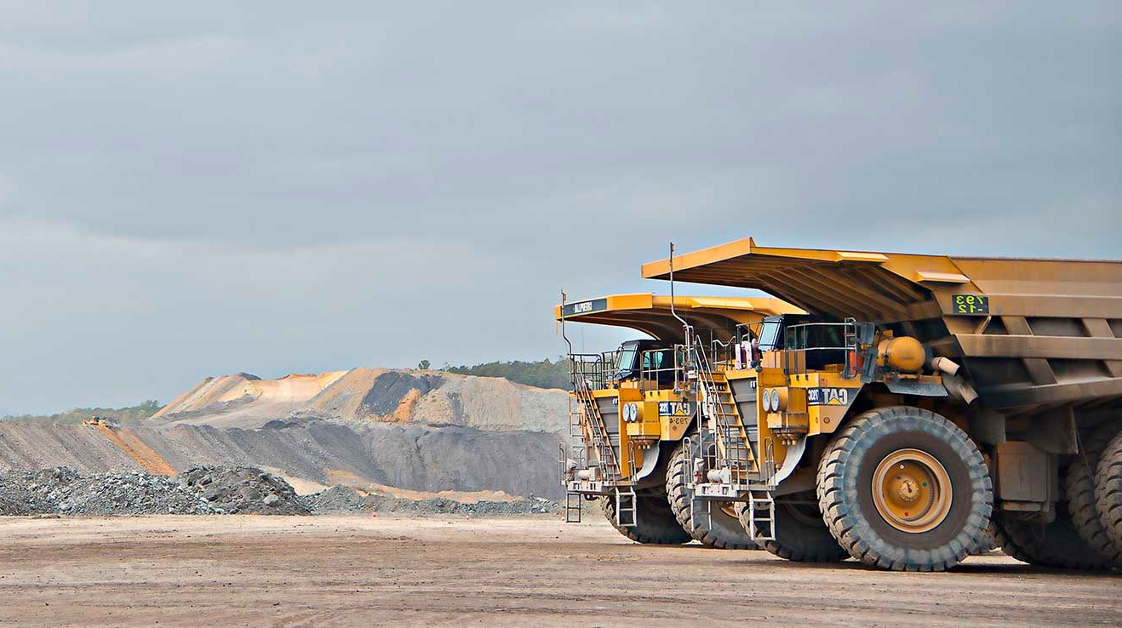

Industry Sentiment Scorecard: from insight to action
GMT Working Session
Connecting and sequencing the work already in train
22 October 2026 | 75 minutes
Notes:
Welcome (part of 0:00–0:10). Thank the GMT for their time. Frame quickly: this is a working session, not a presentation. Everyone will contribute to every theme.

Slide 2
ISS GMT Working Session
Today is about connecting the work already underway, not starting from scratch
PURPOSE
KEY OUTCOME
Most of the work to address the ISS findings is already underway across the business. It just hasn’t been organised or communicated to industry.
A clear story to take back to industry
Some fixes take time to land. Naming that early protects trust.
Here’s what you said
1
A shared view
What is already in train against each ISS theme, across every BU
Here’s what we’re already doing
Clear gaps
Problems with nothing addressing them, each with a proposed owner
Here’s what’s missing
2
New initiatives only come in where there’s a real gap.
3
Agreed timing
What lands now, next and later, and where expectations need managing
3
Notes:
0:00–0:10 (Marcus). Key message: this is about visibility and prioritisation, not ideation. The gap is sequencing, comms and expectation management. Example to use: some fixes, like the legal review, could take around 12 months, so stakeholders need to hear that now.

Slide 3
ISS GMT Working Session
Seventy-five minutes, built around four theme stations
TIME
ACTIVITY
WHAT HAPPENS
LEAD
0:00–0:10
Set the scene
ISS headline results, what is working, what needs to improve, and why this session matters
Marcus
0:10–0:15
How today works
Stations, rotations and the impact-time matrix
Alycia
0:15–0:45
Theme stations
Mixed groups work two of the four ISS themes, building on each other’s work
Alycia
0:45–1:05
Play back and prioritise
Each station shares back, and priorities go onto the impact-time matrix
All
1:05–1:15
Agree the plan
Confirm plan components, owners for gaps, and next steps
Marcus
More than half the session is hands-on.
3
Notes:
Walk through briefly. Emphasise that more than half the session is hands-on.

Slide 4
ISS GMT Working Session
Industry sentiment sits at 65, with clear room to build confidence
67
64
65
WHAT THIS MEANS FOR TODAY
Strengths give stakeholders a reason to stay engaged
The gaps are fixable, and many fixes are already underway
Stakeholders need to see progress, and know when to expect it
+
=
Relationship Score
Business Unit Score
Industry Sentiment Score
How industry sees Coal Services as an organisation
How industry rates the units it deals with most
Guarded band. Cycle 2 target is Conditional (70+)
Based on 30 senior stakeholder interviews across the Minerals Council and the MEU.
SIX WEIGHTED DIMENSIONS
30%
20%
15%
15%
10%
10%
Trust
Responsiveness
Value & Strategic Alignment
Effort to Engage
Communication
Consistency
3
Notes:
0:00–0:10 (Marcus). Keep this to two or three minutes. Open on strengths, then name the gaps as opportunities. Do not re-present the report. The GMT has seen the overview. ISS is 65 (Guarded), from a Relationship Score of 67 and a Business Unit Score of 64.

Slide 5
ISS GMT Working Session
Stakeholders value the people, the purpose and consultation done well
A purpose worth backing
Capable, committed people
“
Both shareholder groups see a coal-specific scheme as better suited to industry than the commercial alternative.
Account managers and senior staff are described as competent, knowledgeable and acting in good faith.
We don’t want to get rid of them... We want them to be stronger and providing a greater service to the industry.
Consultation that works
Change is being noticed
The Standing Dust Committee, MRS Working Group and Order 45 consultation are named as open engagement that produced better outcomes.
Respondents credit recent leadership with more open engagement, and see real momentum in CS Health.
MINING AND ENERGY UNION RESPONDENT
3
Notes:
0:00–0:10 (Marcus). Open on strengths before naming gaps. Key point: industry is not asking for a different organisation. Both groups want Coal Services to succeed. Confidence sits with the people and the purpose, and the opportunity is to make the systems match it.

Slide 6
ISS GMT Working Session
The bright spots show what good looks like, and it can be repeated
86
MSOH score
Highest-rated business unit
WHAT THE BRIGHT SPOTS HAVE IN COMMON
1
A named contact. Where an account manager or established contact exists, responsiveness is rated highly and matters are settled first time.
83
MRS score
Seen as a levy worth paying
2
Planned communication. Regular updates, forums and webinars are described as timely, clear and relevant.
3
Genuine consultation. Scores lift where stakeholders are consulted, not just informed of a decision already made.
70
Communication
Strongest of the six dimensions
4
A predictable process. A known, repeatable process lets stakeholders set expectations, even when they cannot change the outcome.
3
Notes:
0:00–0:10 (Marcus). Bridge into the stations: the patterns behind the bright spots are a useful lens for today. When groups look at what is in train, ask whether it builds these four things.

Slide 7
ISS GMT Working Session
Trust and value score lowest, and Trust carries the most weight
1
Trust moves the score most
At 60, Trust is the weakest dimension and makes up 30% of the ISS. Lifting it does more for the overall score than any other dimension.
2
Value is not in dispute, priorities are
Industry rates the purpose highly, but questions whether Coal Services’ priorities and pace match what both shareholders need.
3
The gap sits in systems, not people
Confidence sits with the individuals stakeholders deal with, not yet with the processes behind them.
Overall dimension scores, lowest first
3
Notes:
0:00–0:10 (Marcus). Move from strengths to gaps, framed as opportunities. Point out that Trust carries 30% of the weighting, so it is where improvement shows up fastest in the score.

Slide 8
ISS GMT Working Session
Good delivery happens by exception, not by design
Commitments are not followed through
Outcomes arrive without the reasoning
“
Promises, plans and forward commitments do not produce a visible outcome, which holds confidence back.
Notices, determinations and premium decisions come with a result but no explanation, so stakeholders chase.
There are times where I don’t hear back, and I have to escalate it to our account manager, because then I’ll get a response.
Service depends on who you get
Escalation has become the system
The same request produces different results depending on the person. Standards exist but are not holding at the point of delivery.
Matters move quickly once they reach a senior contact, so industry builds workarounds to get there.
MINERALS COUNCIL RESPONDENT
3
Notes:
0:00–0:10 (Marcus). These four patterns show up across every BU, not just one. They are the lens for the stations: does what is in train fix the pattern, or just the symptom?

Slide 9
ISS GMT Working Session
The ISS is the thread that links existing work, not another program on top
Control Tower initiatives
1
A clear why
ISS findings show which stakeholder problem each initiative is solving
BU plans: CMI, CSH, MRS, MSOH
IT and digital
ISS
shared themes and measures
2
One set of themes
Progress is visible across BUs, not just within them
Stakeholder engagement
Risk and legal
3
No surprises
A single view of progress for the executive, GMs and Board
Closed-loop feedback
3
Notes:
0:00–0:10 (Marcus). The mothership framing. Make it explicit that this is not additional work. Closed-loop feedback and the stakeholder engagement strategy should sit visibly inside BU work.

Slide 10
ISS GMT Working Session
Four stations, each anchored in what stakeholders told us
1
2
3
4
STATION 1
STATION 2
STATION 3
STATION 4
Show the reasoning behind every decision
Timeliness
Consistency
Engage industry before decisions are made, not after
How might we make the reasoning behind our decisions visible to the people they affect?
How might we make sure every worker and site gets a timely response, without needing a senior contact to step in?
How might we make service quality consistent regardless of who handles it?
How might we make engaging first the default across Coal Services?
STRENGTH TO PROTECT
MRS Working Group’s prepared papers and openness about plans
STRENGTH TO PROTECT
Account managers who call ahead and follow through
STRENGTH TO PROTECT
MSOH’s statutory dust reporting arriving without prompting
STRENGTH TO PROTECT
Order 45 consultation, the Standing Dust Committee, and recent improvement in CMI dispute handling
3
Notes:
0:10–0:15 (Alycia). Introduce the four stations, one per ISS theme. Each station carries the theme’s How Might We statement. Initiative cards from Belinda’s Control Tower mapping are already laid out at each station.

Slide 11
ISS GMT Working Session
Two rounds per group, with the second building on the first
1
ROUND 1 | 12 MIN | FIRST STATION
2
ROUND 2 | 12 MIN | NEXT STATION
Map and find the gaps
Time and prioritise
Check each initiative card sits against the right problem, and add anything missing
Mark the problems nothing is currently addressing
Review the first group’s work, then estimate when stakeholders will notice: now, next or later
Choose the top two, and flag anything that needs expectation management
Four mixed-BU groups, one per station to start
Build on what is there, don’t start over
The round 2 group plays back each station
3
Notes:
0:10–0:15 (Alycia). Explain the two rounds. Mixed-BU groups are deliberate: every BU's work is visible at every station, so no one area dominates. 0:15–0:45: round 1 runs 12 minutes, allow about 3 minutes to move and read the previous group's work, then round 2 runs 12 minutes. Each theme is worked by two groups.

Slide 12
Station canvas | Print at A3
Station 1: Show the reasoning behind every decision
How might we make the reasoning behind our decisions visible to the people they affect?
Already in train
Initiative, owner, BU
Gaps
Problems nothing is addressing yet
Time to impact
Now (0–3 months), next (3–12), later (12+)
Top two priorities
And any timing messages stakeholders need
3
Notes:
Station 1 canvas. Print at A3 and place with the pre-mapped initiative cards for this theme. Photograph before playback.

Slide 13
Station canvas | Print at A3
Station 2: Timeliness
How might we make sure every worker and site gets a timely response, without needing a senior contact to step in?
Already in train
Initiative, owner, BU
Gaps
Problems nothing is addressing yet
Time to impact
Now (0–3 months), next (3–12), later (12+)
Top two priorities
And any timing messages stakeholders need
3
Notes:
Station 2 canvas. Print at A3 and place with the pre-mapped initiative cards for this theme. Photograph before playback.

Slide 14
Station canvas | Print at A3
Station 3: Consistency
How might we make service quality consistent regardless of who handles it?
Already in train
Initiative, owner, BU
Gaps
Problems nothing is addressing yet
Time to impact
Now (0–3 months), next (3–12), later (12+)
Top two priorities
And any timing messages stakeholders need
3
Notes:
Station 3 canvas. Print at A3 and place with the pre-mapped initiative cards for this theme. Photograph before playback.

Slide 15
Station canvas | Print at A3
Station 4: Engage industry before decisions are made, not after
How might we make engaging first the default across Coal Services?
Already in train
Initiative, owner, BU
Gaps
Problems nothing is addressing yet
Time to impact
Now (0–3 months), next (3–12), later (12+)
Top two priorities
And any timing messages stakeholders need
3
Notes:
Station 4 canvas. Print at A3 and place with the pre-mapped initiative cards for this theme. Photograph before playback.

Slide 16
ISS GMT Working Session
The impact-time matrix shows what lands when
IMPACT ON STAKEHOLDERS
Higher
Quick wins
Deliver and promote
Core program
Resource and track
Long-lag fixes
Communicate timing early
HOW TO USE IT
Place each station’s top two where stakeholders will feel the impact.
Anything top right needs a timing message, so silence is not read as inaction.
e.g. legal review, about 12 months
Tidy-ups
Just do it
Review
Confirm it is worth it
Park or rethink
Revisit at next review
Lower
Now (0–3 months)
Next (3–12 months)
Later (12+ months)
TIME TO IMPACT
3
Notes:
0:45–1:05. Draw this on the whiteboard or print at A1. As each station plays back, place its top two priorities on the grid. Spend the last few minutes on the top-right cell: what will stakeholders hear, and when?

Slide 17
ISS GMT Working Session
Three minutes per station, three questions
01
02
03
What is already in train that others may not know about?
Where are the biggest gaps, and who should own them?
What do stakeholders need to hear about timing?
The round 2 group at each station presents. Priorities go straight onto the impact-time matrix.
3
Notes:
0:45–1:05. Keep each playback to three minutes. Alycia captures. Marcus probes on gaps and timing.

Slide 18
ISS GMT Working Session
Today’s output becomes the draft plan for the executive and Board
Engagement and comms strategy
CX measurement framework
PLUS
Tracked alongside other work
One approach to how Coal Services engages and keeps stakeholders informed
Consistent measures rolled out across all BUs
ISS initiatives will sit within the rolling portfolio dashboard and risk register, so progress is visible next to related work without extra meetings.
Service standards and stakeholder strategy
Initiative roadmap
Core standards so the experience feels consistent
Initiatives mapped to problems, with owners and timelines
3
Notes:
1:05–1:15 (Marcus). Confirm the four plan components with the room. Ask: is anything missing? Then confirm owners for the gaps identified.

Slide 19
ISS GMT Working Session
From today’s session to Board endorsement
Today
Within 48 hours
Following weeks
Monthly
Date TBC
GMT working session
Outputs and draft plan outline shared
Gaps assigned and plan refined with BU owners
ISS initiatives reported in the portfolio dashboard
Board paper: ISS findings and recommended KPI target
All
TSG
GMs and BU PMs
Belinda
Executive
Ask of the GMT: nominate an owner for each gap, and keep your initiative status current for the dashboard.
3
Notes:
1:05–1:15 (Marcus). Close on the ask. Confirm the Board timing if Belinda has it by then.

Slide 20
Thank you
Marcus Naoum and Alycia Wolf
The Strategy Group

Slide 21
Facilitator notes | Not for presentation
Room set-up and materials
Before the session
In the room
Initiative cards printed from Belinda’s Control Tower mapping, one per initiative, colour-coded by BU
Four station canvases printed at A3
Impact-time matrix printed at A1 or drawn on a whiteboard
Mixed-BU group allocations set in advance
Sticky notes in two colours, markers and a visible timer
Stations set up in four corners, cards already laid out
Alycia calls the switch at 12 minutes, with 3 minutes to move
Marcus floats between stations and probes on gaps and timing
Belinda answers ‘is this already happening?’ questions
Photograph every canvas before playback
3

