Slide 1
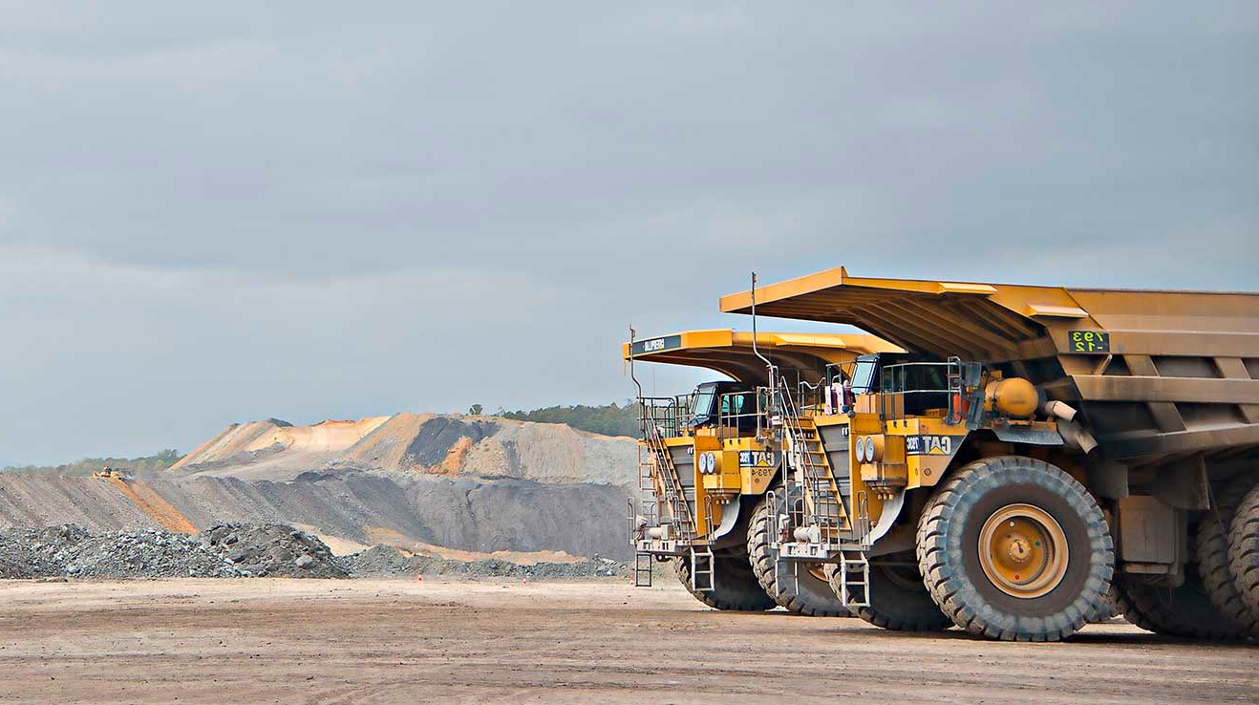

Industry Sentiment Scorecard:
Workshop Outputs
What the GMT told us, and what happens next
GMT working session, 21 October 2026
Notes:
Welcome. Frame quickly: this is a working session. We are here to respond to the ISS findings, not to redesign strategy.

Slide 2
ISS GMT Working Session
Four things we took away from the session
1
Service Experience & Consistency is the theme that moves the score
The GMT recognised it as the overarching theme. Inconsistency is what industry feels in every interaction, and fixing it underpins Trust and Value.
2
CMI and CS Health changes will drive the shift
Most fixes added on the day sit in CMI (phone answering, telephony, capability, operating model) and CS Health (Health Standards, processing timeframes, Order 45 variance). These are the units industry deals with most.
3
Industry is tired of commitments and wants to see progress
Staff in the room have heard this directly. The canvases asked for promises mapped to outcomes, updates on what’s been done and what’s to come.
4
Far more is underway than industry can see
The GMT added 26 initiatives to the 16 pre-mapped. The gap is visibility, not activity, which is why mapping the timelines is the first step.
3

Slide 3
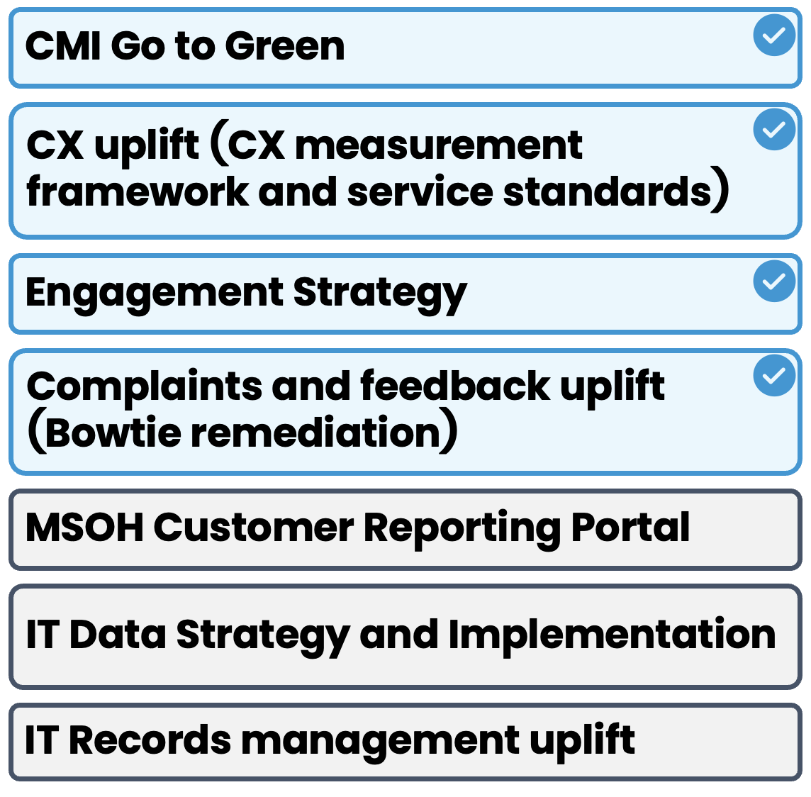
ISS GMT Working Session
Theme 1: Trust & Transparency
How might we show industry we do what we say to increase trust and transparency?
Already in train
What else do we need to do?
How will we share progress?
ENTERPRISE-WIDE, ON EVERY THEME
CMI Go to Green, CX uplift (measurement framework and service standards), Engagement Strategy, Complaints and feedback uplift (Bowtie)
PRE-MAPPED AND VALIDATED
MSOH Customer Reporting Portal
IT Data Strategy and Implementation
IT Records management uplift
ADDED BY THE GMT
Call recording and transcribing
Telephony upgrade (part of CMI Go to Green)
Call abandonment rate
Data and reporting taskforce
Privacy policy review
Stakeholder engagement plan for all stakeholders
Transparency around premiums
Legal service standards and target operating model (?)
Operating rhythm for consistency
Payments taskforce: backlog reduction and automation
Estimations: process improvement and automation
NEW IDEAS
Customer-centricity workstream within the transformation
Define what good looks like for CMI customers (design principles)
OPEN QUESTIONS
What does our change management process involve?
Where do the health surveillance levels sit?
WHAT WE SHARE
The pain points, what we’ve done and what’s to come
Our processes, up front
Limits of liability for health appointments and certificates
Our service standards
A chance for stakeholders to talk it through
WHO NEEDS TO HEAR IT
Not captured on the canvas
HOW WE REACH THEM
A key liaison for MEU and MC, as the main point of contact during transformation
Clearer access to information, e.g. the website
So what Trust comes from being clear up front: our processes, our limits and our service standards, with a named contact through the transformation.
(?) = handwriting unclear on the canvas, to confirm.

Slide 4
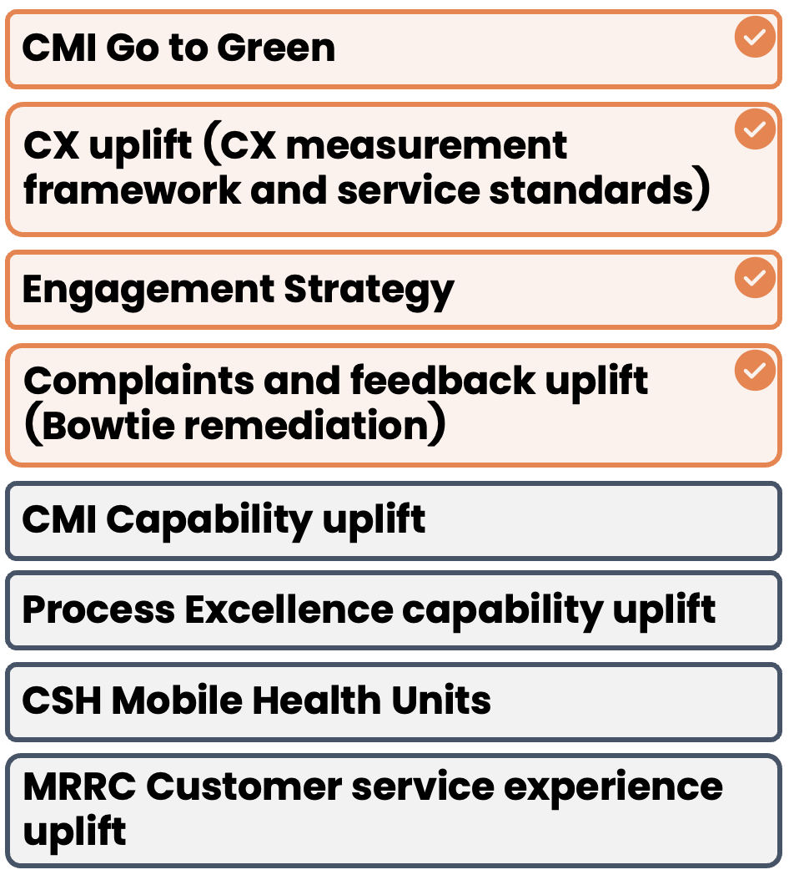
ISS GMT Working Session
Theme 2: Service Experience & Consistency
How might we make a good experience the standard, not the exception?
Already in train
What else do we need to do?
How will we share progress?
ENTERPRISE-WIDE, ON EVERY THEME
CMI Go to Green, CX uplift (measurement framework and service standards), Engagement Strategy, Complaints and feedback uplift (Bowtie)
PRE-MAPPED AND VALIDATED
CMI Capability uplift
Process Excellence capability uplift
CSH Mobile Health Units
MRRC Customer service experience uplift
ADDED BY THE GMT
CMI capability: individual career (?) basics and standards
CMI phone answering: fixing the basics
CMI target operating model, incl. regional manager spans (?)
Operational group: consistency of processes
Customer understanding in onboarding, induction and recruitment
CS Health: Health Standards and standardised decisions
CS Health: processing timeframe KPIs
CS Health: Order 45, reducing variance between doctors
A consistent MRS experience
AI assistance to improve language
Action: Beth / Brooke to provide detail on A2C (?), CMI capability and process
NEW IDEAS
Coal Services app: access to services and a comms channel
Account managers across all BUs
Single point of contact for employers
Holistic view of key businesses, with all data in one place
WHAT WE SHARE
CSH Health Standards and Order 45 consultation
The plan and lessons learned with CMI
Updates on what’s been done
Bowtie complaints
Reports with outstanding (?) data, given complaint volumes
Honesty and transparency
WHO NEEDS TO HEAR IT
MC working group, maintaining the level of interaction
MEU working group
HOW WE REACH THEM
1:1 meetings with Angela, for trust building
Monthly escalations with MC
Large exec group meeting
So what Most fixes are operational basics in CMI and CS Health. Industry wants one point of contact, not a chain of escalations.
21
(?) = handwriting unclear on the canvas, to confirm.
Notes:
Station 2 canvas. Print at A3 and place with the Station 2 handout. Photograph at the end of the rotation.

Slide 5
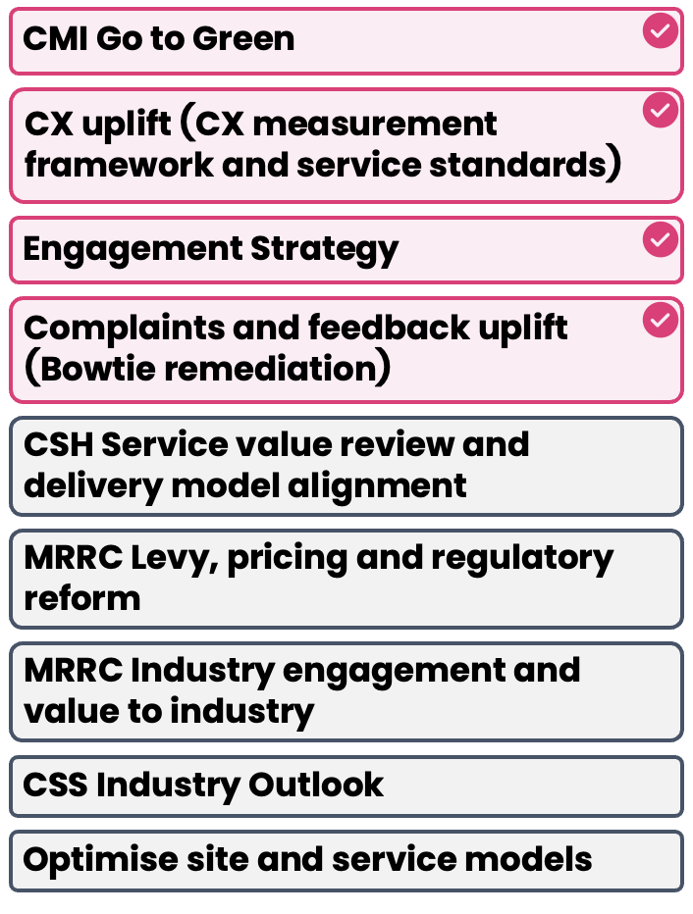
ISS GMT Working Session
Theme 3: Value & Stakeholder Confidence
How might we give industry confidence we’re working in their interest?
Already in train
What else do we need to do?
How will we share progress?
ENTERPRISE-WIDE, ON EVERY THEME
CMI Go to Green, CX uplift (measurement framework and service standards), Engagement Strategy, Complaints and feedback uplift (Bowtie)
PRE-MAPPED AND VALIDATED
CSH Service value review and delivery model alignment (incl. service value model)
MR Levy clarity, ‘bang for buck’ (renamed on the day from Levy, pricing and regulatory reform)
MRRC Industry engagement and value to industry
CSS Industry Outlook
Optimise site and service models
ADDED BY THE GMT
MRRC Order reviews 34, 40 and 42
MR cost to serve
Stakeholder map
Internal and external comms review
Impact of sharing CSH performance data
CMI Go to Green: the group asked for a drill down
NEW IDEAS
Coal Services premium clarity
CRM and visibility
Gated website content (policyholder space)
Internal stakeholder forums
Language to customers
WHAT WE SHARE
Promises mapped to outcomes and deliveries, and priorities
WHO NEEDS TO HEAR IT
Cascaded and directed by Coal Services
HOW WE REACH THEM
Monthly newsletter to workers
A stakeholder map to direct information sharing
Transparency of money ($$$)
So what Value comes down to money clarity: premiums, the levy and where the money goes. Who hears what still needs mapping.
23
(?) = handwriting unclear on the canvas, to confirm.
Notes:
Station 3 canvas. Print at A3 and place with the Station 3 handout. Photograph at the end of the rotation.

Slide 6
ISS GMT Working Session
53 initiatives in one place, and what we share back on each
Initiative | Owner | Theme | Flag | Share
Pre-mapped and validated
1 CMI Go to Green | CMI | 1 2 3 | ✓ | Progress
2 CX uplift (CX measurement framework, service standards) | CEO | 1 2 3 | ✓ | Awareness
3 Engagement Strategy | CEO | 1 2 3
4 Complaints and feedback uplift (Bowtie remediation) | CEO | 1 2 3 | ✓
5 MSOH Customer Reporting Portal | MRRC | 1
6 IT Data Strategy and Implementation | CIO | 1
7 IT Records management uplift | CIO | 1
8 CMI Capability uplift | CMI | 2
9 Process Excellence capability uplift | CEO | 2
10 CSH Mobile Health Units | Capital | 2
11 MRRC Customer service experience uplift | MRRC | 2
12 CSH Service value review and delivery model (incl. service value model) | CSH | 3
13 MR Levy clarity, bang for buck (renamed on the day) | MRRC | 3 | ✓
14 MRRC Industry engagement and value to industry | MRRC | 3
15 CSS Industry Outlook | CSS | 3
16 Optimise site and service models | COO | 3
Added on the day as already in train
17 Call recording and transcribing |  | 1
18 Telephony upgrade (part of CMI Go to Green) | CMI | 1
Initiative | Owner | Theme | Flag | Share
Added on the day as already in train (cont.)
19 Call abandonment rate |  | 1
20 Data and reporting taskforce |  | 1
21 Privacy policy review |  | 1
22 Stakeholder engagement plan for all stakeholders |  | 1
23 Transparency around premiums |  | 1
24 Legal service standards and target operating model (?) | Legal | 1
25 Operating rhythm (consistency) |  | 1
26 Payments taskforce: backlog reduction, automation |  | 1
27 Estimations: process improvement, automation |  | 1
28 CMI capability: career (?) basics and standards | CMI | 2
29 CMI phone answering: fixing the basics | CMI | 2
30 Operational group: consistency of processes |  | 2
31 Customer understanding in onboarding, induction, recruitment |  | 2
32 Health Standards: standardised decisions | CSH | 2 | ✓ | Awareness
33 Processing timeframes KPIs | CSH | 2
34 Order 45: mitigating variance between doctors | CSH | 2 | ✓
35 CMI TOM, incl. regional manager spans (?) | CMI | 2
36 Consistent MRS experience | MRS | 2
37 AI assistance to improve language |  | 2
Initiative | Owner | Theme | Flag | Share
Added on the day as already in train (cont.)
38 Order reviews 34, 40 and 42 | MRRC | 3
39 Cost to serve | MRS | 3
40 Stakeholder map |  | 3
41 Internal and external comms review |  | 3
42 Impact of sharing performance data | CSH | 3 |  | Result
New ideas (what else do we need to do?)
43 Customer-centricity workstream in transformation |  | 1
44 Define what good looks like for customers (design principles) | CMI | 1
45 Coal Services app: access to services, comms channel |  | 2
46 Account managers across BUs, business wide |  | 2
47 Single point of contact for employers |  | 2
48 Holistic view of key businesses (all data in one place) |  | 2
49 Coal Services premium clarity |  | 3
50 CRM and visibility |  | 3
51 Gated website content (policyholder space) |  | 3
52 Internal stakeholder forums |  | 3
53 Language to customers |  | 3
Theme: 1 Trust & Transparency 2 Service Experience & Consistency 3 Value & Stakeholder Confidence. Flag ✓ = raised in ‘How will we share progress?’. Share back = progress, awareness or result, where the stickies make it clear. Blank = to decide.
Still open from the canvases: What does our change management process involve? Where do the health surveillance levels sit? Beth / Brooke to provide detail for A2C (?), CMI capability and process.
3
Notes:
Most of the work to address the ISS findings is already underway across the business. It just hasn’t been organised or communicated to industry. We are not here to redesign strategy.

Slide 7
ISS GMT Working Session
How we share progress: who hears from us, how, and what we tell them
Who Needs To Hear From Us?
Through What Mechanisms?
What Should We Regularly Communicate?
MC working group, maintaining the level of interaction
MEU working group
MEU and MC, through a key liaison during transformation
Workers
Employers
Policyholders
Internal stakeholders
How it is decided
Cascaded and directed by Coal Services
A stakeholder map directs who gets what
Raised on the canvases
1:1 meetings with Angela, for trust building
Monthly escalations with MC
Large exec group meeting
A key liaison for MEU and MC as the main point of contact
Monthly newsletter to workers
Clearer access to info, e.g. website
Raised as new ideas
Coal Services app as a comms channel
Gated website content (policyholder space)
Internal stakeholder forums
Account managers across BUs
Single point of contact for employers
Content
The pain points, what we’ve done and what’s to come
Updates on what’s been done
Promises mapped to outcomes and deliveries, and priorities
Service standards, incl. CSH Health Standards
Our processes, up front
Limits of liability for health appointments and certificates
Order 45 consultation
The plan and lessons learned with CMI
Bowtie complaints
Transparency of $$$
Reports with outstanding (?) data
How we say it
Honesty and transparency
Give them the opportunity to talk it through
NEXT: shape these into a simple quarterly stakeholder engagement framework
12
Notes:
What other mechanisms ways channels should we be communicating out
HEALTH AND SAFETY TRUST

Slide 8
ISS GMT Working Session
Recommended next steps: five steps to our first progress update to industry
Step
When
What happens
Who
Output
Lock the list
w/c 26 Oct
Confirm the 53 initiatives, owners and duplicates. Resolve the items marked (?).
Belinda and TSG
A validated initiative register
1
Map the timelines
By 13 Nov
For each initiative: start, end, key milestones and what has already been delivered. CMI and CS Health first.
TSG and Belinda, with BU owners
One roadmap of now, next and later
2
Prioritise what goes back
By 20 Nov
Shortlist what industry will feel, can see progress on soon, and ties to Service Experience & Consistency. Tag each as progress, awareness or result.
Belinda and TSG, Angela to sign off
A shortlist of 6 to 8 items to take back
3
Build the comms approach
By 4 Dec
Map stakeholders, name the owner of each relationship (incl. the MC and MEU liaison), set the cadence and channels.
TSG and Belinda
A quarterly engagement framework and first update drafted
4
Go back to industry
Mid Dec (TBC)
Share ‘what you said, what we’ve done, what’s next’ through the MC and MEU working groups, then quarterly.
Angela and Belinda
First progress update delivered
5
Principle Lead with progress, not commitments. Only take back what has been delivered or has a date attached.
Dates are proposed, to confirm with Belinda.
3

Slide 9
ISS GMT Working Session
What we need from Belinda this week
Belinda
TSG
1
Book a two-hour mapping session with TSG
w/c 26 Oct, to lock the list and start the roadmap
1
Send the validated register and a roadmap template
Before the mapping session
2
Nominate one contact per BU who can confirm dates
CMI and CS Health first, as they carry the most change
2
Draft the prioritisation criteria and a first shortlist
For Belinda to review by 20 Nov
3
Confirm the +3pp per year decision
The target sets how ambitious the first update can be
3
Draft the stakeholder map and quarterly framework
Building on the channels raised on the day
4
Decide who owns the MC and MEU relationships
The GMT asked for a named liaison through the transformation
4
Draft the first industry update for Angela
Ready to go to the MC and MEU working groups
5
Agree what we are comfortable sharing externally
For example service standards, performance data and premium detail
Outcome A first progress update in front of industry before the end of the year, built on work that is already moving.
3

Slide 10
Thank you

