Slide 1
A more direct route to Sydney Central
GoFar Alternative Alignment for AP1 and AP3
Alignment Wrap-Up | Without Prejudice

Slide 2
Comparing route lengths from the Central Coast
01

Slide 3
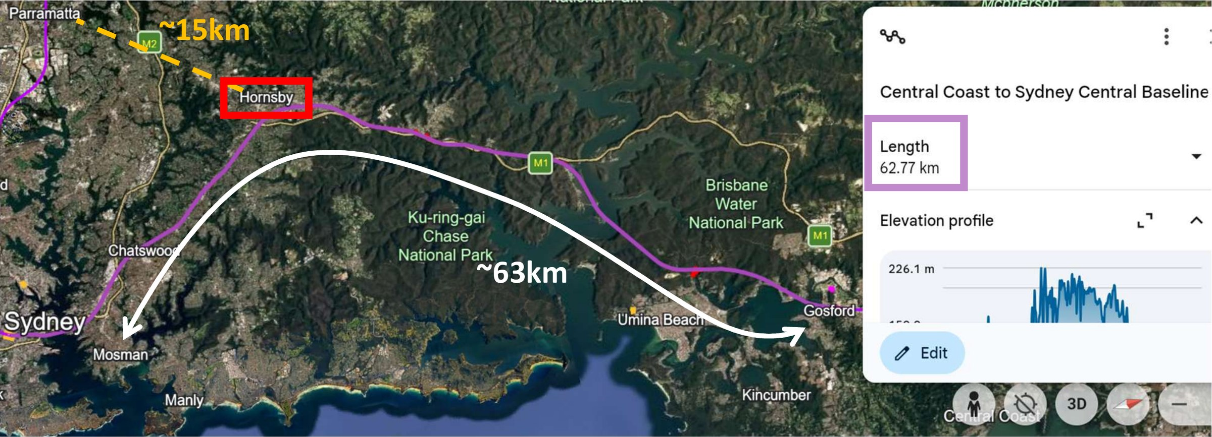
ALIGNMENT WRAP-UP | WITHOUT PREJUDICE
The Baseline Alignment runs about 63km from the Central Coast to Sydney Central
62.8km
Baseline Alignment, Central Coast to Sydney Central
From the Central Coast, the Baseline Alignment heads west to Hornsby before turning south towards Sydney Central. At Hornsby, the route is still about 23km from Sydney Central.
Map key
Baseline Alignment
Hornsby to Parramatta, about 15km

Slide 4
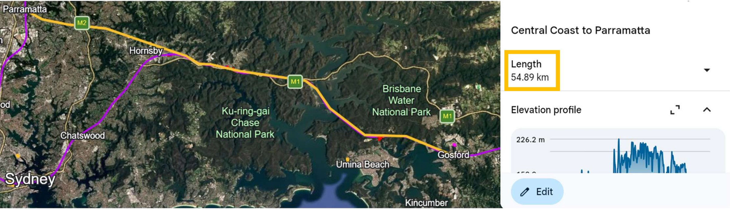
ALIGNMENT WRAP-UP | WITHOUT PREJUDICE
For comparison, the route from the Central Coast to Parramatta is about 55km
62.8km
Baseline Alignment, to Sydney Central
54.9km
Central Coast to Parramatta
The Baseline Alignment and the route to Parramatta follow the same corridor as far as Hornsby. From there, Parramatta is about 15km away and Sydney Central is about 23km away.
Map key
Central Coast to Parramatta
Baseline Alignment

Slide 5
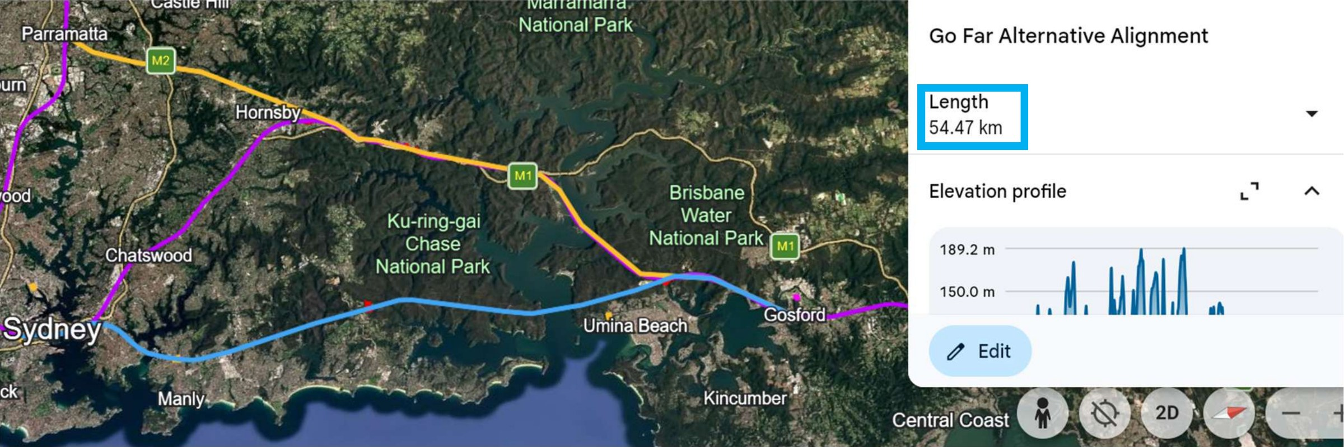
ALIGNMENT WRAP-UP | WITHOUT PREJUDICE
The Alternative Alignment gives HSRA a straighter route to Sydney Central
62.8km
Baseline Alignment
54.5km
GoFar Alternative Alignment
The Alternative Alignment runs directly from the Central Coast to Sydney Central, making the route about 8km shorter than the Baseline Alignment and slightly shorter than the route to Parramatta.
Map key
GoFar Alternative Alignment
Baseline Alignment
Central Coast to Parramatta, about 55km

Slide 6
Thank You.

