Slide 1
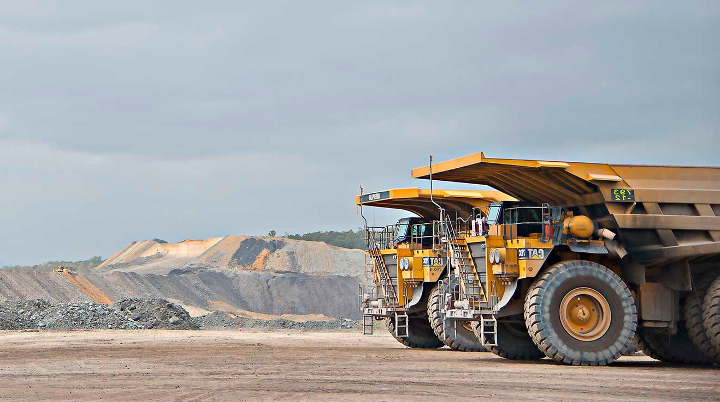

Coal Services:
Industry Sentiment Scorecard
Board Presentation
Prepared by The Strategy Group
October 2026

Slide 2





Industry Sentiment Scorecard
Who we are
Marcus Naoum
Director
Alycia Wolf
Senior Strategist
2

Slide 3
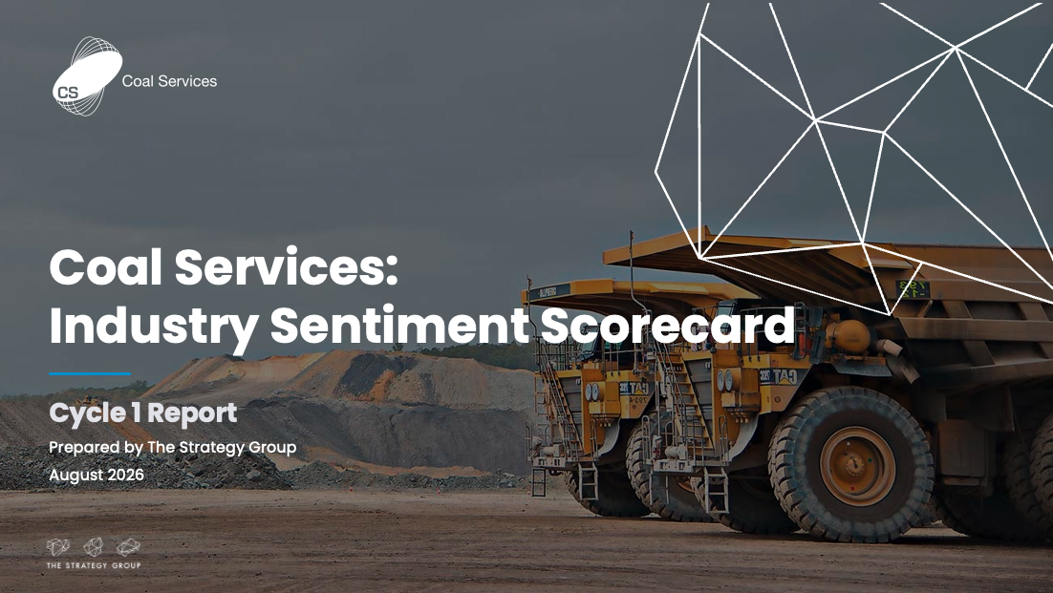
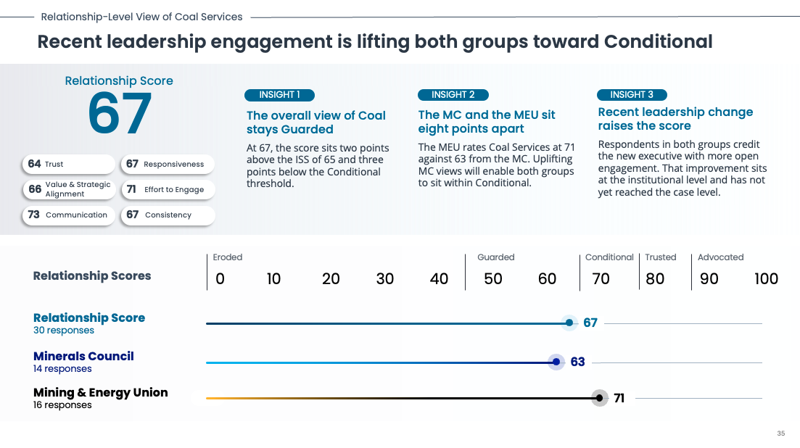
Industry Sentiment Scorecard
Understanding how the NSW Coal Industry sees Coal Services, to act on what matters most
Strengthening partnerships with industry by seeking understanding of their needs and expectations.
Measuring shareholder priorities and sentiment over time through the Industry Sentiment Scorecard (ISS).
Baselining this first cycle through independent interviews with senior leaders from the NSW Minerals Council and the Mining & Energy Union.
[The ISS – Cycle 1 report]
3

Slide 4
Industry Sentiment Scorecard
Coal Services starts its baseline year at 65 in the Guarded band
65
Coal Services
FY’26 ISS
Eroded
Guarded
Conditional
Trusted
Advocated
0-44
45-69
70-79
80-89
90-100
Trust has broken down
More cautious than confident
Broadly positive, on terms
Confidence is settled
Actively championed
4
© The Strategy Group 2026. All rights reserved.

Slide 5
Industry Sentiment Scorecard
CMI scores lowest, yet is where most stakeholders engage
How industry scored each business unit they had high interaction with*
Individual Business Unit
Scores
Eroded
Guarded
Conditional
Trusted
Advocated
0
10
20
30
40
50
60
70
80
90
100
Business Unit Score
57 responses
64
Coal Mines Insurance
25 responses
54
Coal Services Health
22 responses
66
Mines Rescue Service
7 responses
83
Mine Site Occupational Hygiene
3 responses
86
* Respondents rated up to 2 business units each
5

Slide 6
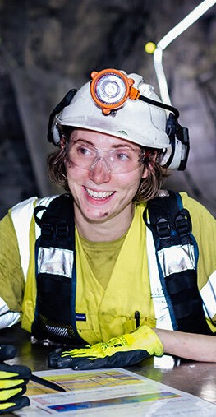
Same systems produce different tensions and needs for MC and MEU
Five Key Insights
Five key insights behind Coal Services’ Industry Sentiment Score
1
Both the ownership and the business model set conflicting priorities within Coal Services
2
3
Low trust is driving how the industry behaves, a call to action for Coal Services to bolster relationships
4
Shifting CMI from resist-first to engage-first is the single biggest opportunity to improve the score
5
Good delivery happens by exception, not by design
6
Notes:
1 – Both the Minerals Council and MEU raised questions around Coal Services’ ownership and business model structure
2 – Diverse needs and expectations emerged from both stakeholder groups across shared experiences
3 – Trust was the lowest scoring dimension across the whole assessment, although notably Value & Strategic Alignment was a close second
4 – CMI is where positive perceptions are lowest, but it presents the greatest opportunity for shifting stakeholder perspectives
5 – Current service processes are often strong by incident or individual, rather than through a process designed to ensure consistency.

Slide 7
Section 2:
The ISS Workshop
What to expect on 22 October
GMT offsite, Hunter Valley

Slide 8
ISS Workshop
The workshop starts with what’s already underway, then finds the gaps
PURPOSE
KEY OUTCOME
Most of the work to address the ISS findings is likely already underway. It just hasn’t been organised or communicated to industry.
A clear story to take back to industry
On the day, we will work through three questions
Here’s what you said
1
What are we already doing about each issue?
Here’s what we’re already doing
Here’s what’s missing
2
Where are the gaps?
New initiatives only come in where there’s a real gap. This is an input session, so TSG will synthesise the outputs and share them back afterwards.
3
How do we organise and communicate this back to industry?
3

Slide 9
ISS Workshop
Three things to do before 22 October
1
2
3
Read the ISS report
Understand the four themes
Tell us what’s underway
Read the Cycle 1 report and note what industry said about Coal Services and your business unit.
Read each theme, its How Might We statement and the sub-insights underneath. These are what we will work through on the day.
Complete the initiatives template we will email you. List the CX initiatives already underway in your area, including work in areas like Risk, Legal and IT that links to ISS issues.
Please send your initiative updates to TSG before 22 October so the map is ready for the day.
3

Slide 10
ISS Workshop
Four themes we will work through on the day
1
Show the reasoning behind every decision
2
Timeliness
How might we make the reasoning behind our decisions visible to the people they affect?
How might we make sure every worker and site gets a timely response, without needing a senior contact to step in?
3
Consistency
4
Engage industry before decisions are made, not after
How might we make service quality consistent regardless of who handles it?
How might we make engaging first the default across Coal Services?
The insight on ownership and the business model is an executive and Board question, so it sits outside the workshop.
3

Slide 11
Section 3:
Q&A
Questions from the GMT
Other questions and clarifications

Slide 12
Q&A
Questions from GMT members
1
Why were MSOH and MRS called out separately, but not other units such as MSTS and MSL?
Report p.10
2
Why was the response rate low for some business units, and what does it mean for confidence in the results?
Report p.10
3
Is “making it hard to get back to work” about CS Health or CMI? What is the nuance?
Report p.16
4
Why did an MEU respondent say Coal Services should value the MEU more than the Minerals Council?
Report p.21
5
What is the context behind “they still treat everything like an underground”? What does it mean for service delivery beyond Mines Rescue?
Report p.22
6
Is “MSOH outputs land with representatives rather than the workforce” a problem? What is the value to the individual worker?
Report p.36
7
What is the “that” in “they’ve admitted to us that they’ve incorporated that because they’re getting paid by the company to do it”?
Report p.39
3

Slide 13
Q&A
Other questions and clarifications: the research
Who did you speak to, and were any stakeholders excluded?
Can people work out who said what?
1
5
Are these site-level people or senior decision makers?
Is 30 respondents enough?
2
6
How were respondents selected? Were they cherry-picked?
Did respondents find the process worthwhile?
3
7
Which companies were involved?
4
3

Slide 14
Q&A
Other questions and clarifications: the score
Where did the methodology come from, and what is the anchor point?
When respondents say “Coal Services”, do they mean corporate or the business units?
1
4
Should we have set a target score before we started?
What does “Value and Strategic Alignment” actually measure?
2
5
Does 65 match what we would expect?
Why did the MEU score higher than the Minerals Council?
3
6
3

Slide 15
Q&A
Other questions and clarifications: the findings
Did the Prism and premium issues drive the low trust score?
Were there any surprises?
1
4
Is “overreach” about scope or about capacity?
Why is CS Health scored this way when we’ve invested so heavily in Order 45?
2
5
Do Minerals Council respondents know what good looks like elsewhere?
Isn’t this just perception rather than reality?
3
6
3

Slide 16
Q&A
Other questions and clarifications: what happens next
What do we actually do with this?
When do we go back to industry?
1
4
Who sees this report?
What if we don’t move the needle by Cycle 2?
2
5
What’s a realistic target for Cycle 2?
How does this relate to CSAT and the CX measurement model?
3
6
3

