Slide 1
PROPOSAL
Earning Webuild's place on Gold Coast Light Rail Stage 4
EOI strategy, positioning and storyboarding support
Prepared for Webuild
Presented by The Strategy Group | October 2026

Slide 2
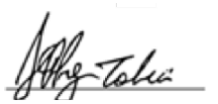
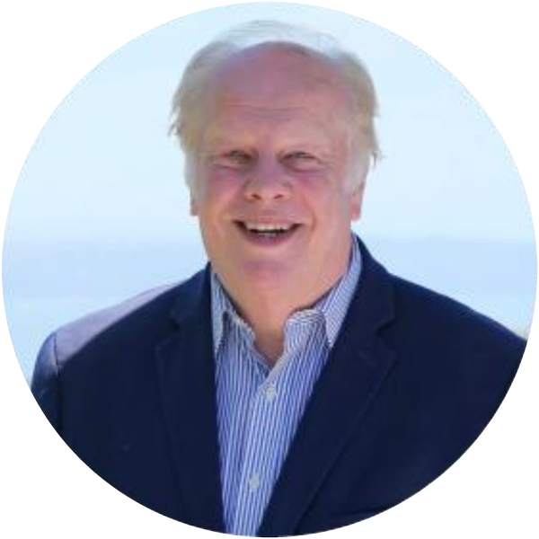
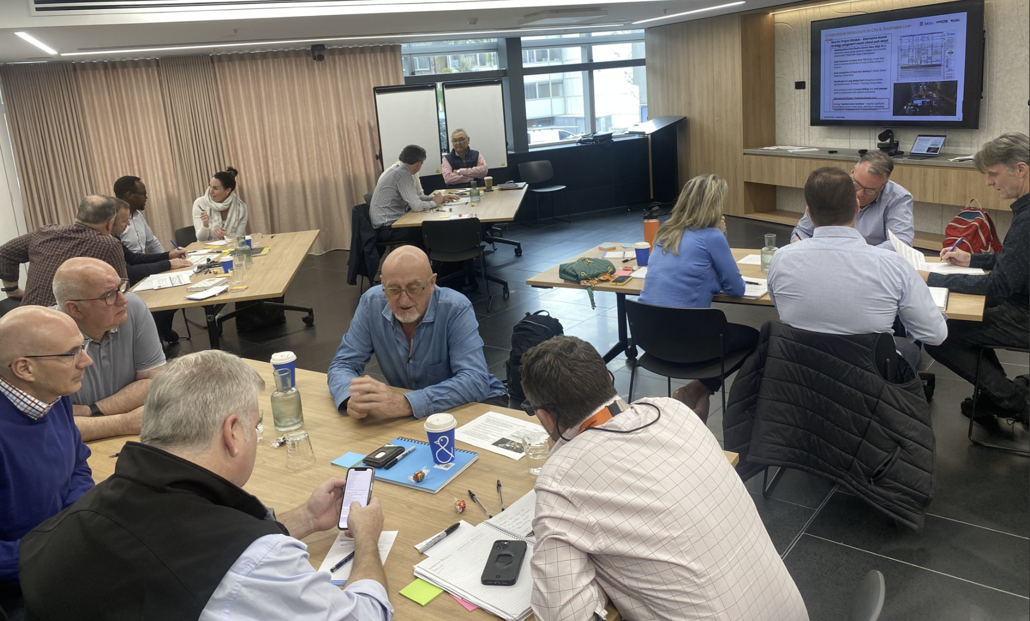
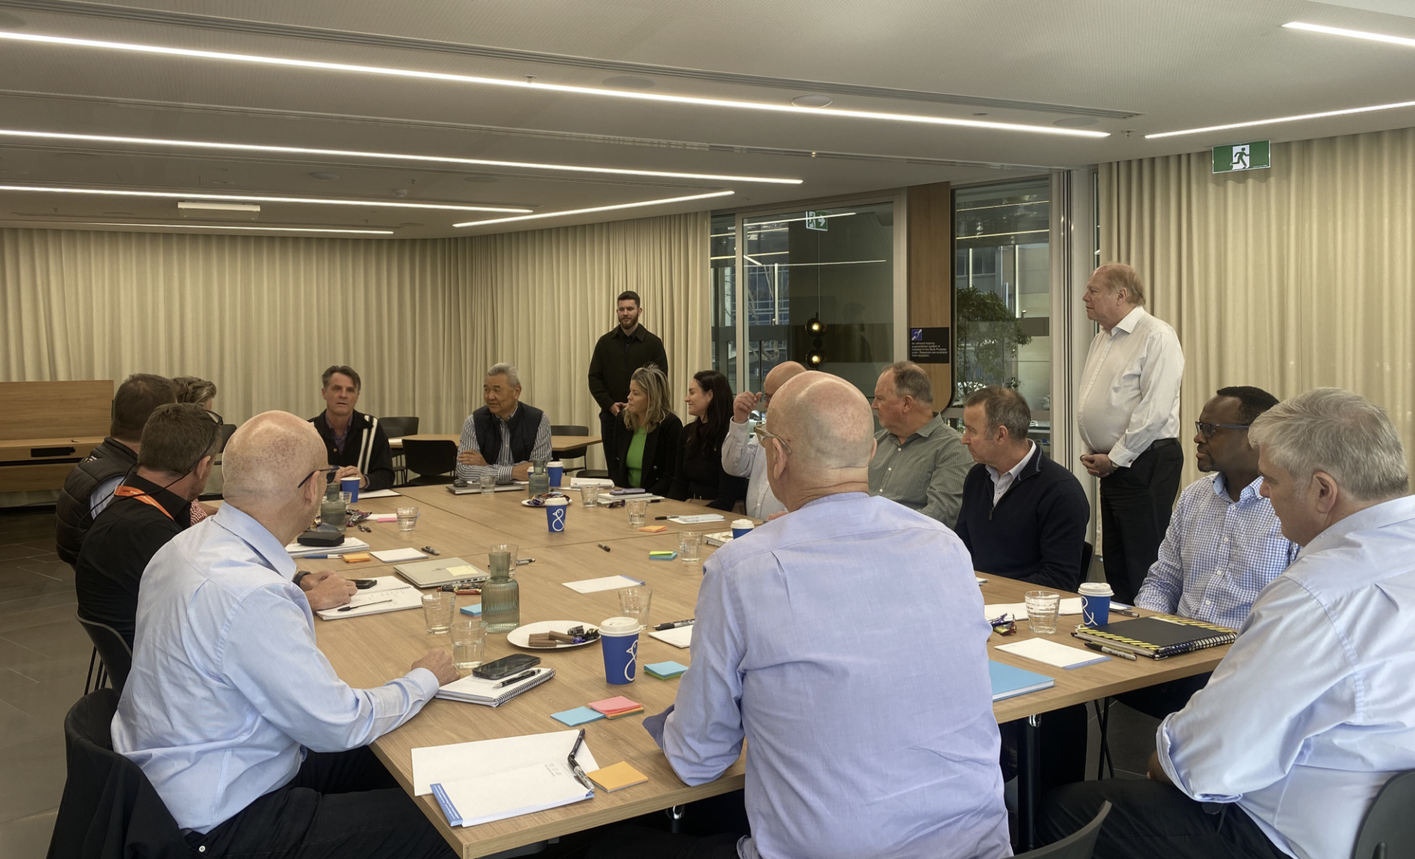
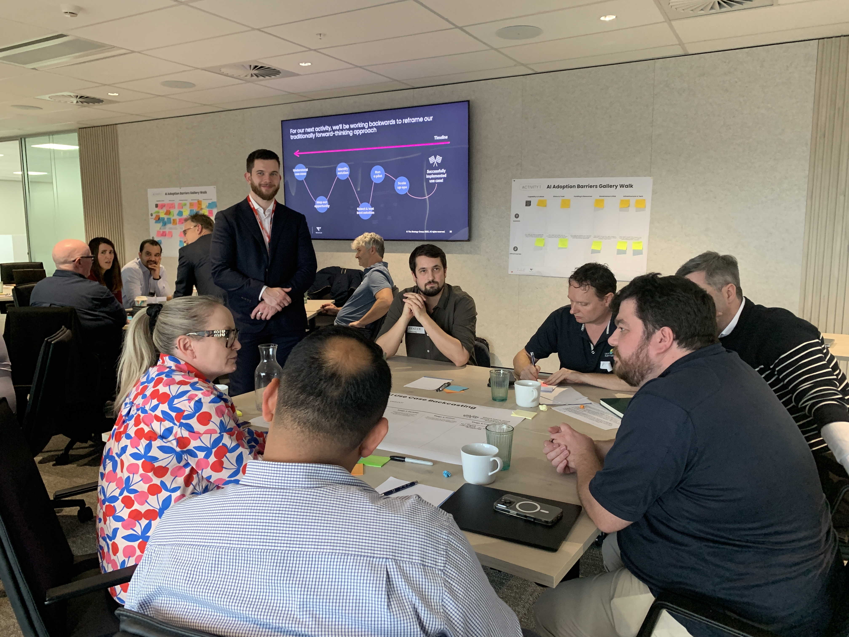
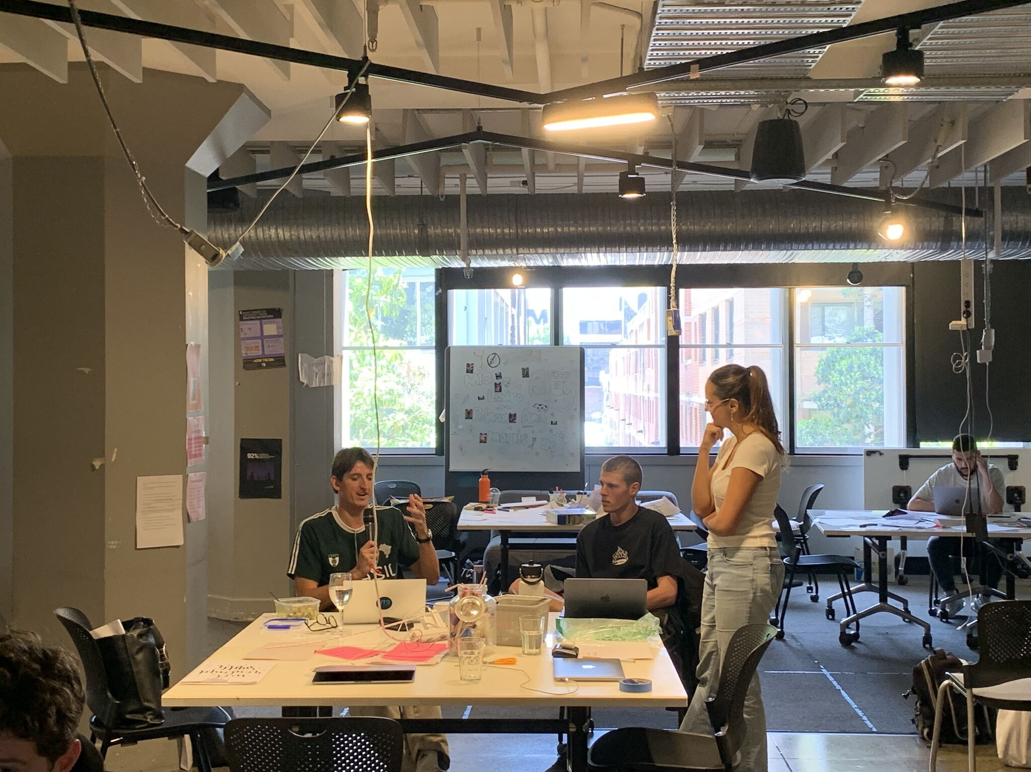

Dear Joe,
Thank you for the opportunity to present this proposal, and for the open conversation about where Webuild wants to go next. Gold Coast Light Rail Stage 4 is a modest project by Webuild's standards, but it carries real weight: it is the door into Australia's light rail market and a chance to remind the market who Webuild really is.
We understand the challenge plainly. Webuild has not yet delivered light rail, it will compete against contractors who have, and recent headlines on other projects mean evaluators may arrive with questions already in mind. None of that changes what Webuild brings: more than 20 years of rail delivery, a global network of rail and metro expertise, and people who know how to deliver complex infrastructure for demanding clients. The task is to make that capability visible, relevant and credible through the client's eyes.
That is where we can help. We are not your bid writers. Our role is to help your leadership and proposed team agree on what the client truly needs, rediscover the Webuild story and storyboard every EOI response so it tells one consistent, evidence-backed story. Your team then takes that direction to your writers, and we check in at two key points to make sure the story holds.
We have partnered with leading construction and engineering organisations across Australia for more than 20 years, including Webuild on Sydney Water. We recently used this same storyboarding approach to help a consortium earn its place in the ECI phase of Australia's High Speed Rail project.
We would be delighted to partner with you on this bid and to help Webuild take its first step into light rail with confidence.
Warm regards,
Jeffrey Tobias
Founder and Managing Partner, The Strategy Group

Slide 3
Contents
01 |  | Our Understanding of Your Needs
02 |  | Why The Strategy Group
03 |  | Our Approach
04 |  | Our Experience and Team
05 |  | Investment

Slide 4
Contents
01 |  | Our Understanding of Your Needs
02 |  | Why The Strategy Group
03 |  | Our Approach
04 |  | Our Experience and Team
05 |  | Investment

Slide 5
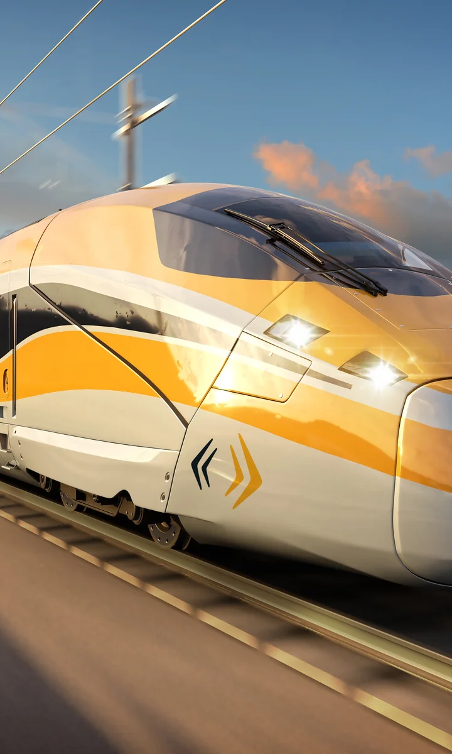
Webuild is seeking to enter Australia's light rail market, starting with Gold Coast Light Rail Stage 4
Background
The Queensland Government is seeking Expressions of Interest from contractors to partner on Gold Coast Light Rail Stage 4 through an Early Contractor Involvement (ECI) model. The EOI is expected shortly, with a response period of around six weeks.
Webuild brings decades of rail and major infrastructure delivery, but has not yet delivered light rail. It will compete against contractors with light rail track records, at a time when coverage of other projects has put its reputation under scrutiny. The EOI must do more than answer questions: it must give the client confidence that Webuild understands their world and will be a partner that is easy to work with.
Our Strategic Approach
Key Benefits
Build a clear picture of what the client needs, values and will not compromise on
Help Webuild rediscover its story and define evidence-backed win themes
Storyboard each EOI response, linking every person and project to the client's outcomes
Equip Webuild to brief its bid writers with clear, prescriptive direction
Review drafts at Weeks 4 and 5 through an independent client lens
Transferable experience reframed as a credible strength, not a gap
One consistent, client-centred story across every response
A proposed team the client can picture working alongside
Skills your team keeps for future bids, not a one-off rewrite
1

Slide 6
Three challenges Webuild must address head-on in its EOI
Each one is real, and each one can be turned into a reason to choose Webuild.
01
02
03
NO LIGHT RAIL TRACK RECORD
A REPUTATION UNDER SCRUTINY
A FIELD OF EXPERIENCED COMPETITORS
Competitors will point to completed light rail projects. Webuild cannot, so the EOI must show why its experience transfers and what it has learned that applies directly to Stage 4.
High-profile challenges on other major projects are well known in the market. Evaluators may read the EOI looking for reassurance on delivery, cost and transparency.
Contractors with light rail experience, including those who delivered earlier stages, will be in the field. After reported cost pressures on Stage 3, the client will want a partner it can trust.
Our response
Present Webuild's rail portfolio like a strong CV for a career move: transferable skills, global knowledge sharing and named people.
Our response
Help Webuild lead with who it is: its values, how it works with clients and what it has learned, backed by evidence rather than claims.
Our response
Differentiate on partnership: a client-centred team that puts cost certainty and genuine collaboration at the heart of every response.

Slide 7
Light rail is new, but delivering rail for demanding clients is not
Like a strong CV for a career move, the EOI must show how existing capability transfers. These hypotheses will be tested and evidenced in Workshop 1.
WHAT WEBUILD BRINGS
WHAT IT COULD MEAN FOR STAGE 4
More than 20 years of rail delivery
Proven track, systems and integration capability, applied to a light rail network
Access to the Webuild Group's global rail and metro expertise
International light rail and metro knowledge shared directly into the ECI
Delivery in live, complex environments
Construction planned around an operating network, residents, businesses and visitors
Major project governance, safety and risk management
Confidence on safety, programme and cost, when budget certainty matters most
Experience working collaboratively with major clients
A partner ready to co-develop the best solution with the client during ECI

Slide 8
What we expect the client will look for in an ECI partner
Early hypotheses, to be confirmed against the EOI documents and the client's own language once released.
01
02
03
04
Cost certainty
Minimal disruption
A genuine partner
A team they can trust
After cost pressures on Stage 3, the client will want evidence of disciplined estimating, transparent reporting and early risk identification.
Stage 4 extends an operating network through busy coastal communities. Protecting residents, businesses and visitors during construction will matter.
ECI rewards contractors who listen, share ideas openly and solve problems with the client, not those who simply respond to scope.
The client will want to meet the real team: named people who are available, locally present and committed from ECI through delivery.
Workshop 1 tests these against the EOI so Webuild's win themes are built on fact, not assumption.

Slide 9
Contents
01 |  | Our Understanding of Your Needs
02 |  | Why The Strategy Group
03 |  | Our Approach
04 |  | Our Experience and Team
05 |  | Investment

Slide 10
A proven approach to helping contractors stand out through the client's eyes
AN OUTSIDE-IN, CLIENT-CENTRIC PERSPECTIVE
A STORYBOARDING METHOD YOUR TEAM OWNS
WE KNOW WEBUILD, AND WE KNOW RAIL
Contractors are experts in delivery. What is harder to do from within is see the bid through the client's eyes. We bring that outside-in lens, grounded in human-centred design, so every response speaks to what the client needs to feel confident.
We do not write the bid. We teach your team how to build each response around the client, then give you prescriptive storyboards to brief your writers. The skills stay with Webuild long after this EOI is submitted.
We have worked with Webuild on Sydney Water and alongside contractors on Sydney Metro and Australia's High Speed Rail project. We understand rail procurement, ECI models and what evaluators look for.

Slide 11
Clear roles: we shape the strategy, Webuild owns the EOI
A clear division of work avoids duplication and keeps the story in Webuild's hands.
The Strategy Group
Webuild leadership and proposed team
Your bid writing team
Research the client and its priorities
Facilitate the discovery and storyboarding workshops
Develop win themes and question-by-question storyboards
Review drafts through an independent client lens
Share the Webuild story, values and evidence
Confirm the real proposed team and availability
Own the win themes and storyboard decisions
Brief the bid writers using the storyboard outputs
Write and produce the EOI responses
Apply the storyboard direction to every answer
Manage compliance, formatting and submission
Incorporate feedback from the Week 4 and Week 5 reviews
Workshops are designed for Webuild's leadership and proposed delivery team, so your people can speak openly and own the outcome.

Slide 12








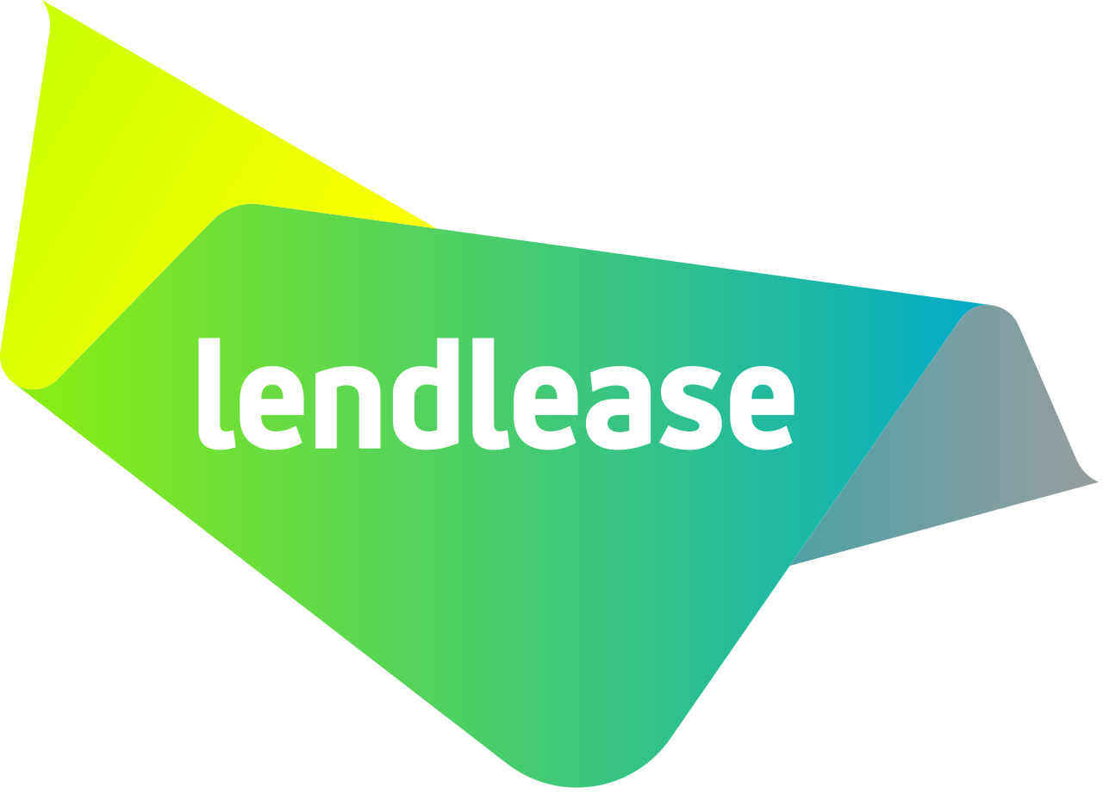






We have successfully partnered with leading construction companies in Australia
We partner with Australia’s leading engineering, construction and infrastructure organisations to strengthen client focus, lift tender performance and deliver better project outcomes, combining strategy, customer experience and innovation expertise built over more than 20 years.

Slide 13
Contents
01 |  | Our Understanding of Your Needs
02 |  | Why The Strategy Group
03 |  | Our Approach
04 |  | Our Experience and Team
05 |  | Investment

Slide 14
Our approach: three focused stages across the six-week EOI period
Weeks 1-2
Weeks 1-2
Weeks 4-5
STREAMS
1. DISCOVER & POSITION
2. STORYBOARD
3. REVIEW & REFINE
CLIENT RESEARCH
Review the EOI documents, project information and public commentary
Map the client's objectives, challenges and non-negotiables
WORKSHOP 1: DISCOVERY (FULL DAY)
Understand the client and test our hypotheses
Rediscover the Webuild story: values, strengths and what keeps clients coming back
Develop and stress-test evidence-backed win themes
TEAM AND CV ALIGNMENT
Confirm the team Webuild will actually resource (target 75-80% on the project)
Rapid exercise: each team member draws out the experience most relevant to Stage 4
WORKSHOP 2: STORYBOARDING (HALF DAY)
Storyboard each EOI question: the ask, the need, Webuild's answer and the proof
Link every person and project back to the win themes
WRITER BRIEFING PACK
Prescriptive, self-explanatory storyboards to brief your bid writers
WEEK 4: ALIGNMENT CHECK
1 to 2 hour review of early drafts
Are we telling the story, or just answering the question?
Realign direction early where needed
END OF WEEK 5: CLIENT LENS REVIEW
Independent review of the draft final, read as the client would
Prioritised recommendations and debrief ahead of Week 6 submission
KEY ACTIVITIES
THE QUESTION
What does the client need, and who is Webuild at its best?
How does every response prove it, with people and evidence?
Will the client believe it, and choose Webuild?
Client priorities map
Agreed Webuild positioning
Evidence-backed win themes
Question-by-question EOI storyboard
Team and project evidence matrix
Writer briefing pack
Draft alignment feedback
Client lens review and prioritised recommendations
OUTCOMES

Slide 15
Workshop 1: Rediscovering who Webuild is, through the client's eyes
Full-day facilitated workshop with Webuild leadership and the proposed team | Weeks 1-2
01
UNDERSTAND THE CLIENT
02
DISCOVER WEBUILD'S STORY
03
DEVELOP THE WIN THEMES
What does the client need from its ECI partner?
Who is Webuild, at its best?
Why should the client choose Webuild?
Unpack the EOI, its evaluation criteria and the client's language
Map objectives, challenges and non-negotiables
Identify what Webuild must prove to earn confidence
Explore values, culture and what keeps clients coming back
Surface the projects, people and lessons that transfer to light rail
Address the reputation question openly, with evidence
Bring client needs and Webuild strengths together
Test each theme: is it relevant, distinctive and provable?
Agree three to four themes to carry through every response
Outputs: client priorities map | Webuild positioning statement | agreed win themes with supporting evidence

Slide 16
Workshop 2: Storyboarding every response before a word is written
Half-day working session with the proposed team, straight after Workshop 1 | Weeks 1-2
For each EOI question, we work through five prompts together
1 The ask
2 The need
3 Our answer
4 The proof
5 The thread
What is the client asking, and why?
What problem or outcome sits behind the question?
How do Webuild's approach, people and experience solve it?
Which projects, lessons and facts make it credible?
How does it link back to our win themes?
For example: "Provide three examples of relevant light rail experience"
Rather than listing heavy rail projects, the storyboard shows the challenge each project shared with Stage 4, what the team learned, who from that project is on the proposed team and how Webuild's global light rail expertise will be shared into the ECI. The answer acknowledges the gap and turns it into evidence.
What Webuild receives
A storyboard for every EOI question
Clear, prescriptive direction to brief your writers
A shared language your team can use beyond this bid

Slide 17
Every person, every project, every question: one story woven through the EOI
1
2
3
4
5
Person
Project
Lesson
Client outcome
Win theme
A named member of the proposed team
Where they have delivered before
What they learned that applies here
How it solves the client's challenge
The message it reinforces
A real team, not a showcase
Clients notice when proposed teams change after selection. We will help Webuild propose the team it will actually resource, aiming for 75-80% of named people to be on the project, with a clear plan if changes occur.
CVs tailored to Stage 4, by the people who own them
Rather than reusing the same CVs bid after bid, each team member draws out the experience most relevant to light rail, cost certainty and collaboration. Your writers then refine, not reinvent.
The goal
"They haven't built light rail yet, but this team clearly understands our problems and can solve them."

Slide 18
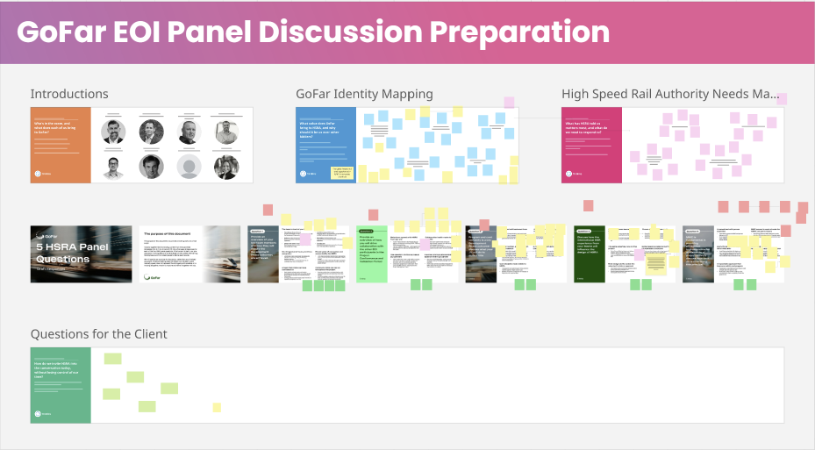
We have used this approach to help a consortium earn its place in the High Speed Rail ECI phase
THE BRIEF
As part of its EOI for Australia's High Speed Rail project, the GoFar consortium faced a panel discussion built around five key questions from the client.
WHAT WE DID
Ran an in-person session with the core team, working live in Miro
Opened with introductions focused on the value each person brings
Mapped GoFar's identity: one team, personally invested, with values aligned to the client
Mapped the client's needs and priorities, in the client's own language
Storyboarded each of the five questions: themes, key points and evidence, refined with the team
The GoFar EOI panel storyboard, built in person with the core team on Miro
The result
GoFar was shortlisted into the ECI phase. Workshop 2 for Webuild follows the same proven structure.

Slide 19
Two checkpoints to make sure the story holds through to submission
We step back in at the moments that matter most, so drafts stay on course without slowing your writers down.
WEEK 4
1 to 2 hours
END OF WEEK 5
Independent review
Alignment check
A quick review of early draft responses against the agreed win themes and storyboards.
Questions we ask
Are we telling the story, or just answering the question?
Does every response link to the client's needs?
Are people, projects and evidence connected?
Output: Clear, practical feedback to realign drafts early
Client lens review
A review of the draft final, read the way the client's evaluation panel would.
Questions we ask
Does this solve the client's problem?
Would we trust this team with our project?
Is Webuild easy to picture working alongside?
Output: Prioritised recommendations and a debrief, with time to act before Week 6
To make the most of the client lens review, we will need the draft final by the end of Week 5.

Slide 20
Indicative six-week timeline, aligned to the EOI response period
Project Stages | Key Activities | Week 1 w/c 2 Nov | Week 2 w/c 9 Nov | Week 3 w/c 16 Nov | Week 4 w/c 23 Nov | Week 5 w/c 30 Nov | Week 6 w/c 7 Dec
1. DISCOVER & POSITION | Client research and EOI review
 | Workshop 1: discovery and win themes
2. STORYBOARD | Team and CV alignment
 | Workshop 2: storyboarding
 | Storyboards and writer briefing pack
WEBUILD | Drafting with bid writers
3. REVIEW & REFINE | Week 4 alignment check
 | Week 5 client lens review
 | Final revisions and submission
LEGEND
Dates assume the EOI is released this week. We will confirm timing once the documents are received.
: Key activity
: Key meeting (workshop, review session)
: Webuild drafting
: Deliverable
6

Slide 21
Contents
01 |  | Our Understanding of Your Needs
02 |  | Why The Strategy Group
03 |  | Our Approach
04 |  | Our Experience and Team
05 |  | Investment

Slide 22
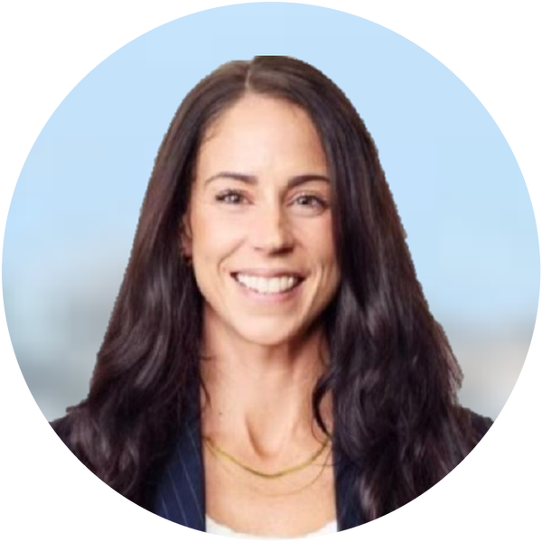
Your team: senior, hands-on and focused on Webuild's success
AW
ENGAGEMENT SPONSOR
ENGAGEMENT LEAD
STORYBOARDING LEAD
Jeffrey Tobias
Founder and Managing Partner
Heather King
Manager, Major Projects & Construction
Alycia Wolf
The Strategy Group
Provides strategic oversight and quality assurance, drawing on 30 years of shifting organisations from inside-out to outside-in thinking and TSG's work on Australia's most significant infrastructure bids.
Leads day-to-day delivery and co-facilitates both workshops, bringing construction pursuit experience and a strong understanding of how project teams are experienced by their clients.
Leads the storyboarding method and co-facilitates the workshops, having storyboarded GoFar's EOI panel responses for the High Speed Rail project.

Slide 23

04 Our Experience and Team
Background
Jeffrey has spent his career working alongside senior executives on their most strategic challenges. At Cisco, he led the global Innovation Thought Leadership team, advising the CEOs of Cisco's top 20 customers on how to shift the mindset of their organisations. At AGSM, he works with the most senior executives in the country on transformation and the largest topics of the day.
The thread that runs through all of this work is mindset shift. Jeffrey has spent 30 years moving large organisations from inside-out to outside-in thinking, and from technical-first to customer-first. That is the shift that will help Webuild stand out on Gold Coast Light Rail Stage 4.
In recent years Jeffrey has personally led TSG's engagements on some of Australia's most significant infrastructure bids: the Sydney Metro Eastern Tunnel Package (JCG JV, $1.6B contract won), Sydney Metro LineWide 2 (CPB-UGL JV) and the Hunter Transmission Project (CPB-UGL JV).
Adjunct Professor of Innovation and Entrepreneurship and AGSM Fellow, UNSW Australian Graduate School of Business.
Relevant Experience
Eastern Tunnel Package, Sydney Metro: Sponsor and lead coach for the JCG JV (John Holland, CPB, Ghella). $1.6B contract won. Tom Murray (Delivery Director, Sydney Metro): "I have no doubt that The Strategy Group engagement led to the provision of an incredibly well structured, customer-centric proposal."
LineWide 2, Sydney Metro: Sponsor and lead coach for the CPB-UGL JV across 80+ interactives and multiple major client engagements.
Hunter Transmission Project: Sponsor and lead coach for the CPB-UGL JV bidding to EnergyCo.
Cisco IBSG: Global Lead for Innovation Thought Leadership, advising executives of Fortune Global 500 companies on transformation and customer-centric design.
Jeffrey Tobias
Founder and Managing Partner
Engagement Sponsor
What Jeffrey brings to this engagement
30 years shifting mindsets at Cisco, AGSM and TSG; the same shift Webuild needs to show the client
Personal track record on three of Australia's most significant infrastructure JV bids: ETP, LineWide 2 and HTP
Strategic counterpart to senior leadership on major contractor bids
Built TSG into a boutique consultancy advising some of Australia's largest entities on their most strategic problems
Adjunct Professor at AGSM, working with senior executives on transformation and strategic change
Qualifications
Bachelor of Science (First-class Honours in Computer Science; University Medal), University of NSW
Ph.D., Computer Science, University of New South Wales

Slide 24
04 Our Experience and Team
Background
Heather is a Manager specialising in major projects and construction, bringing experience across construction, strategic bids, client engagement, business development and stakeholder management. Most recently at FDC Construction NSW, Heather worked across complex pursuits alongside project directors, pre-construction managers, estimators, consultants and design teams, contributing to over a billion dollars of tendered work and the award of multiple significant projects in under 12 months.
Heather brings a distinct client perspective to major projects. Prior to construction, she spent six years delivering Qantas Business and First Class service to high value customers, developing a strong understanding of client expectations, relationship management and service experience.
This combination enables Heather to understand both how project teams operate and how they are experienced by the client, helping teams articulate their value and present themselves with greater clarity and impact.
Relevant Experience
Worked across construction pursuits in commercial, industrial, education, health and government sectors
Coordinated complex submissions with project directors, estimators, pre-construction managers, consultants and designers
Managed the full tender lifecycle across D&C, construct only and other procurement models, from opportunity to debrief
Developed strategic project narratives, tailored proposal content and positioning to communicate team capability and client value
Built and maintained client relationships across the construction sector, supporting repeat business
Founder of a wearable technology venture, leading commercial strategy, R&D partnerships and investor engagement
Heather King
Manager, Major Projects & Construction
Engagement Lead
What Heather brings to this engagement
Client and stakeholder engagement
Strategic bids and pursuit strategy
Business development and relationship management
Client experience and service strategy
Qualifications
Diploma in Construction (Construction Management), Open Polytechnic
Diploma in Interior Design, The Interior Design Institute

Slide 25
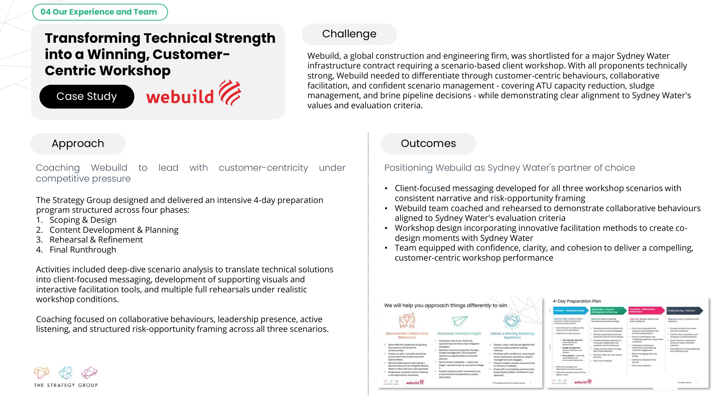

Slide 26
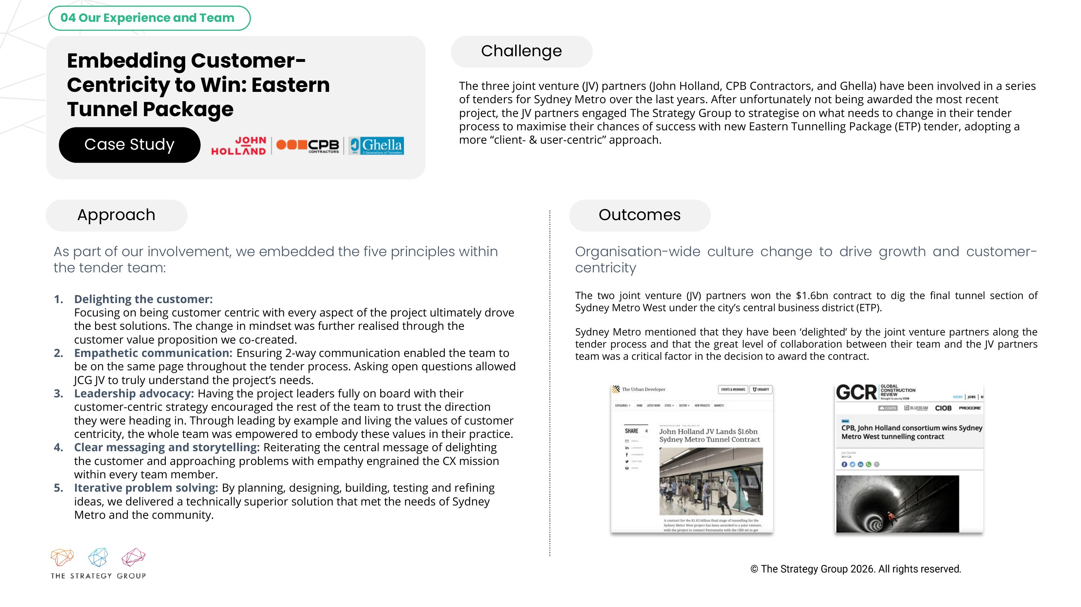

Slide 27
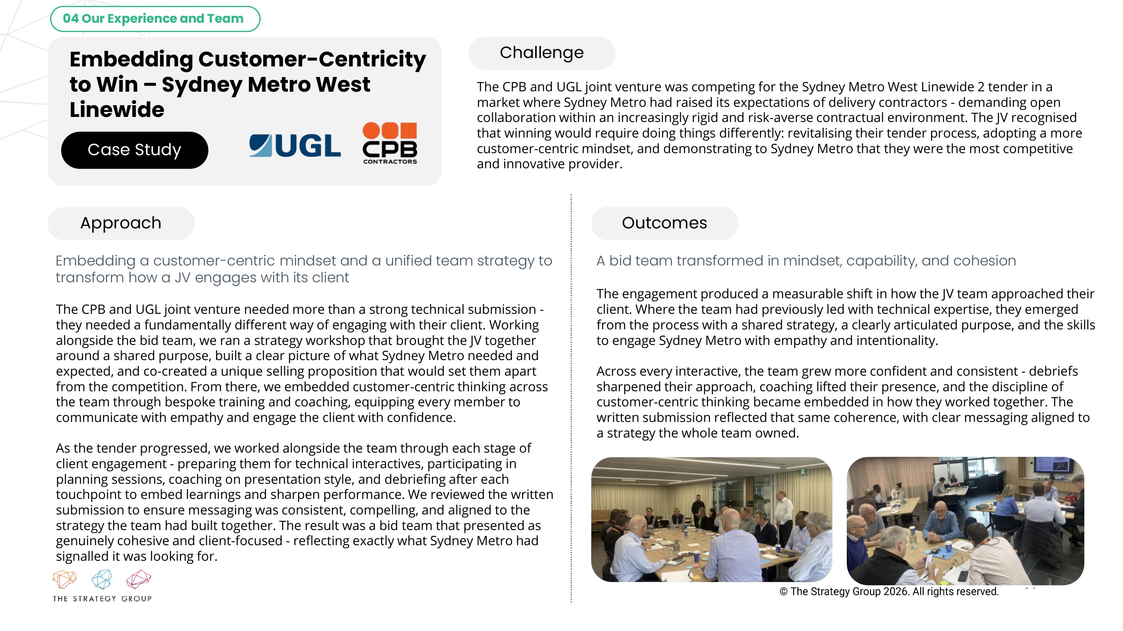

Slide 28
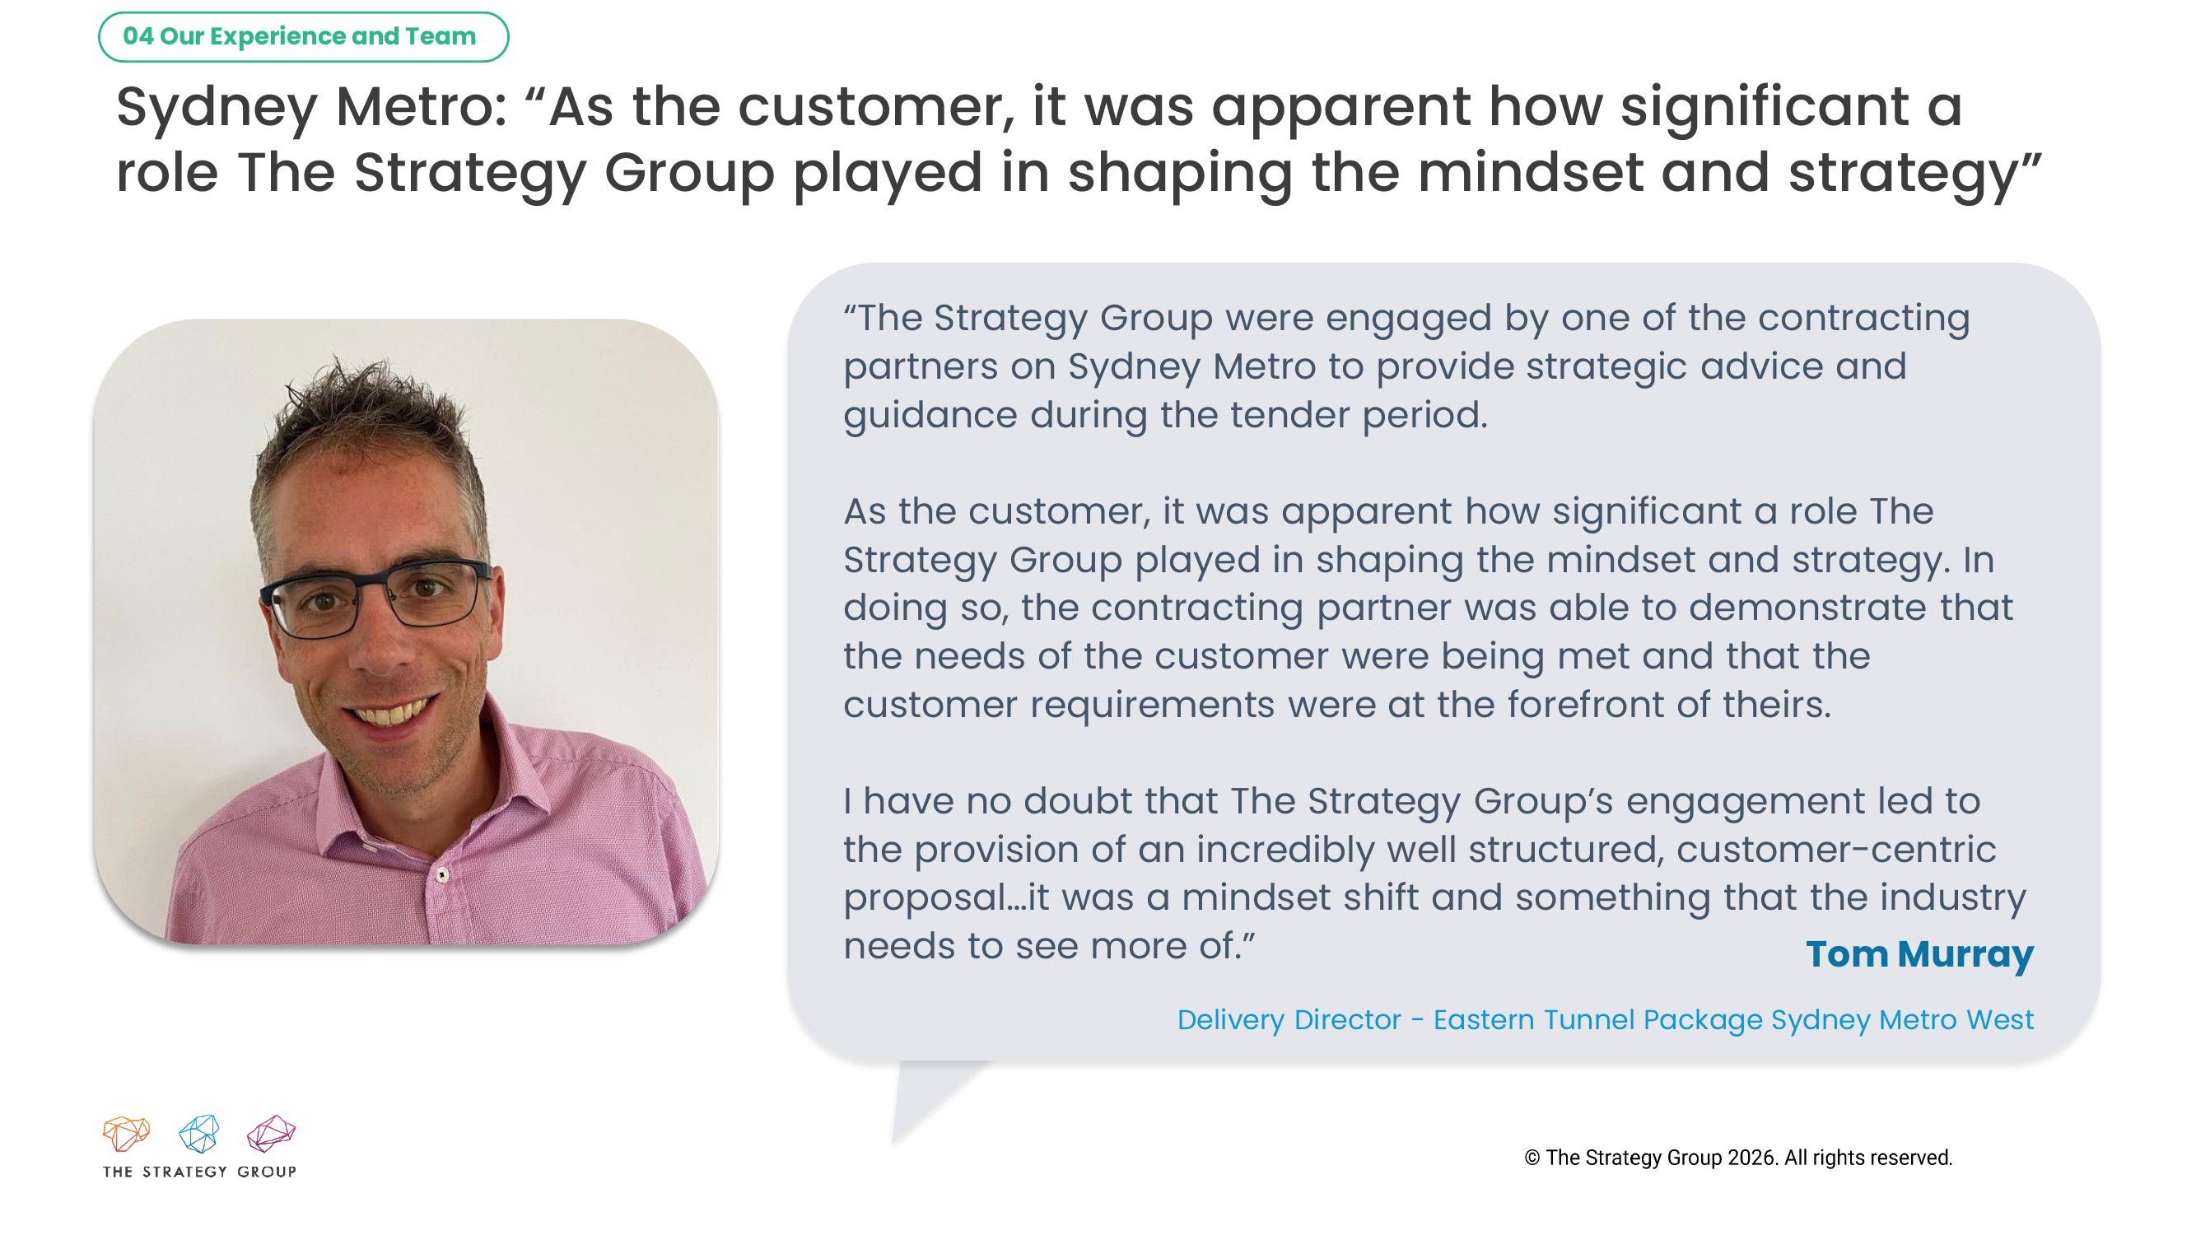

Slide 29
Contents
01 |  | Our Understanding of Your Needs
02 |  | Why The Strategy Group
03 |  | Our Approach
04 |  | Our Experience and Team
05 |  | Investment

Slide 30
Investment
We have kept this engagement focused and efficient, recognising that EOI costs are funded by Webuild. The fixed fee below covers all three stages of our support across the six-week EOI period.
Project Steps | Key Outputs | Investment (excl. GST)
EOI Strategy and Storyboarding Support
1. Discover & Position | Client research, full-day Workshop 1, client priorities map, Webuild positioning and win themes | $11,000
2. Storyboard | Team and CV alignment, half-day Workshop 2, question-by-question storyboards and writer briefing pack | $8,000
3a. Week 4 Alignment Check | Review of early drafts against the storyboards, with realignment feedback | $2,000
3b. Week 5 Client Lens Review | Independent client lens review of the draft final, prioritised recommendations and debrief | $4,000
Total |  | $25,000
All fees exclude GST. Bid management, writing, compliance and production remain with Webuild and its bid writing team. Scope will be confirmed once the EOI documents are released.

Slide 31
Assumptions and next steps
KEY ASSUMPTIONS
The EOI response period is around six weeks; timing will be confirmed once the documents are released
Workshops are held in person, with Webuild leadership and the proposed delivery team attending
Workshop 1 (full day) and Workshop 2 (half day) run on consecutive days in Week 1 or 2
Bid writing, compliance and production remain with Webuild and its bid writing team
Webuild provides the draft final for review by the end of Week 5
Any change to scope, once the EOI questions are known, will be agreed with you before work proceeds
NEXT STEPS
1
Confirm this proposal and the engagement scope
2
Share the EOI documents as soon as they are released
3
Lock in workshop dates and participants
4
Provide current CVs and project sheets for the proposed team

Slide 32
Thank you
We look forward to working with you
Jeffrey Tobias
Founder and Managing Partner
jeffrey@thestrategygroup.com.au
Heather King
Manager, Major Projects & Construction
heather@thestrategygroup.com.au
Alycia Wolf
Storyboarding Lead
alycia@thestrategygroup.com.au

