Slide 1
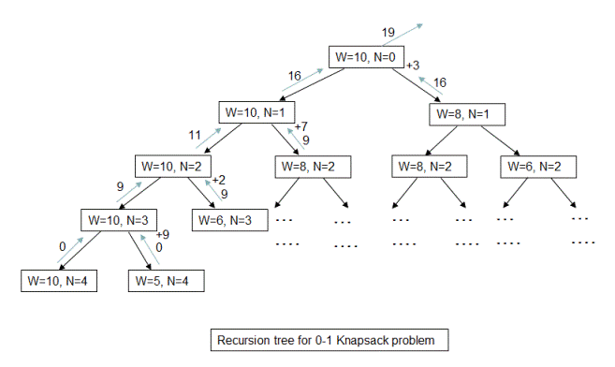

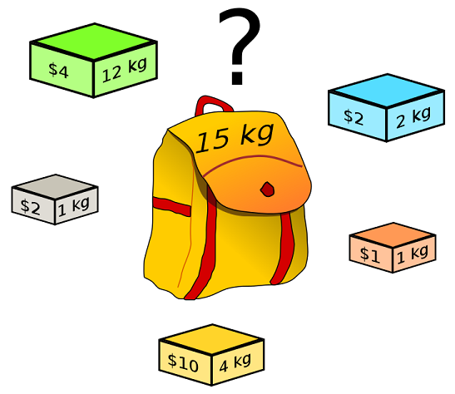
Max Knapsack Presentation
Jonny Lynch, Ethan Crawford, Michael Leek, and Aly Clark

Slide 2
Max Knapsack
My problem consists of whether we take the item or we do not take the item:
Given W, V, L is there a max value V where an item in list L has a weight that is less than the max weight W?
Optimization Version:
Many NP-Complete problems have their "optimization" version. For example, what is the largest independent set in a graph G?

Slide 3
Problem Input
Example Input:
First Line: A nonnegative integer weight w
Second Line: A nonnegative integer n
n Lines: Each line n contains a String (name) followed by a String (dollar value) followed by another String (item’s weight)
Example Code input:
11
3
ring 100 5
gold 50 10
silver 50 5

Slide 4
Reduction (justify its inclusion in NP-Complete)
Show the reduction that justifies the problem is in NP-Complete
Given weights W and values V, can a subset of items X in {1, 2, …, n} be picked that satisfy the following constraints:
The sum of each item’s value is greater than or equal to V
The sum of each item’s weight is less than or equal to W
Solving the above inequalities is the same as solving the Subset-Sum problem, which is already proven to be NP-Complete. Therefore, the max knapsack problem can be reduced to the Subset-Sum problem in polynomial time.
The complexity of this problem depends on the size of the input values of each item’s weight and value. With this being said, the time to complete the algorithm depends on the size of the input. If the inputs are binary, it’s complexity becomes exponential therefore making this problem NP-Complete.

Slide 5
Sketch of Exact Solution (pseudo-code)
Knapsack (items, weight):
Knapsackinator (weights_remain, i_index):
check if weights_remain is empty or i_index is greater than or equal to the length of the items
return a list containing zero and an empty list
with_item <- Knapsackinator (weights_remain - items's weight, i_index + 1)
without_item <- Knapsackinator (weights_remain, i_index + 1)
add item's value to with_item array
check if with_item's value is greater than without_item
return with_item
else:
return without_item
return Knapsackinator(weight, 0)

Slide 6
Worst Case Example (if possible)
Worst case is when you have to take every item.

Slide 7
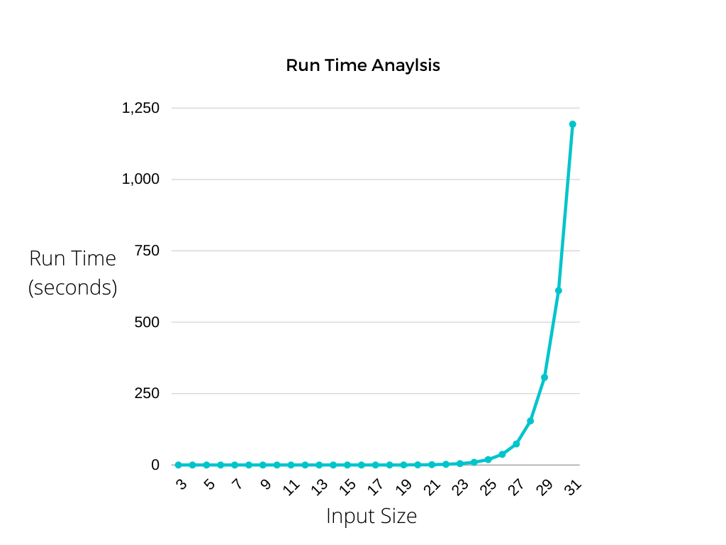
Test Cases
How did you generate them? (hopefully with a python program)
Test case Sizes?
Performance of test cases of different sizes?
Plot of the run time of your program as you increase the input size. You MUST run your program on inputs that cause your program to run more than 20 minutes.

Slide 8
Approximation Portion
Aly Clark and Mike Leek

Slide 9
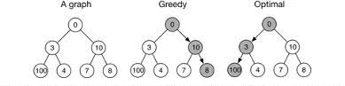
Approximation
We chose a greedy algorithm because it drastically speeds up decisions. We sort and choose the most valuable items first.
high- everything fits in the knapsack and needs to be tested and taken
Plot comparing difference in run time and solution quality using your test cases.

Slide 10
Pseudocode
max_knapsack (items):
sort items from most valuable per weight unit
while there is still more weight allowed and more items:
if item weight <= weight left over:
add to knapsack
subtract weight item weight from remaining
return item list

