Slide 1
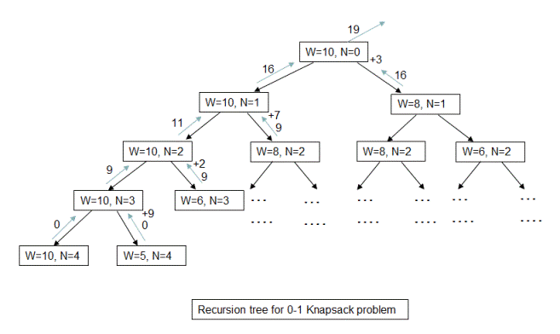

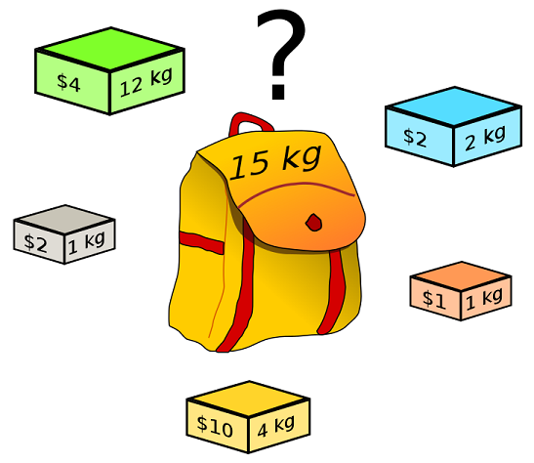
Max Knapsack Presentation
Jonny Lynch, Ethan Crawford, Michael Leek, and Aly Clark

Slide 2
Max Knapsack
My problem consists of whether we take the item or we do not take the item:
Given W, V, L is there a max value V where an item in list L has a weight w that is less than the max weight W?
Optimization Version:
Dynamic Programming
Top Down
Optimal in both time and space
Stores results of all the subproblems

Slide 3
Applications that use Max Knapsack
Determine the best programs to run on a limited resource cloud system
Optimize water distribution across a fixed pipe network
Optimize the company’s supply chain

Slide 4
Problem Input
Example Input:
First Line: A nonnegative integer weight W
Second Line: A nonnegative integer N
N Lines: Each line n contains a String (name) followed by a String (dollar value) followed by another String (item’s weight)
Example Code input:
31
3
HTXRX 25.4 1.8
GIPRI 4.1 2.1
EOFMM 0.7 0.5

Slide 5
Reduction
Given weights W and values V, can a subset of items X in {1, 2, …, n} be picked that satisfy the following constraints:
The sum of each item’s value v is greater than or equal to V
The sum of each item’s weight w is less than or equal to W
Solving the above inequalities is the same as solving the Subset-Sum problem, which is already proven to be NP-Complete. Therefore, the max knapsack problem can be reduced to the Subset-Sum problem in polynomial time.
The complexity of this problem depends on the size of the input values of each item’s weight and value. With this being said, the time to complete the algorithm depends on the size of the input. If the inputs are binary, it’s complexity becomes exponential therefore making this problem NP-Complete.

Slide 6
Reduction (justify its inclusion in NP-Complete)
Illustrated Example:
Max Knapsack wants to maximize the value whereas Subset-Sum wants to maximize the weight
Subset Sum:
sum (j, W) = max { sum (j - 1, W) if j ∈ S*
{ w_{j} + sum (j - 1, W - w_{j}) if j ∈ S*
Max Knapsack:
sum (j, W) = max { sum (j - 1, W) if j ∈ S*
{ v_{j} + sum (j - 1, W - w_{j}) if j ∈ S*
Max Knapsack
Input
(Y)
Subset-Sum
(X)
Max Knapsack
Output
(Y)
Polynomial Time
Polynomial Time

Slide 7
Sketch of Exact Solution (pseudo-code)
Knapsack (items, weight):
Knapsackinator (weights_remain, i_index):
check if weights_remain is empty or i_index is greater than or equal to the length of the items
return a list containing zero and an empty list
with_item <- Knapsackinator (weights_remain - items's weight, i_index + 1)
without_item <- Knapsackinator (weights_remain, i_index + 1)
add item's value to with_item array
check if with_item's value is greater than without_item
return with_item
else:
return without_item
return Knapsackinator(weight, 0)

Slide 8
Worst Case Example (if possible)
Worst case is when you have to take every item: O(2^{n})
Example:
40
3
GOLD 5 10
SILVER 5 10 BRONZE 5 10

Slide 9
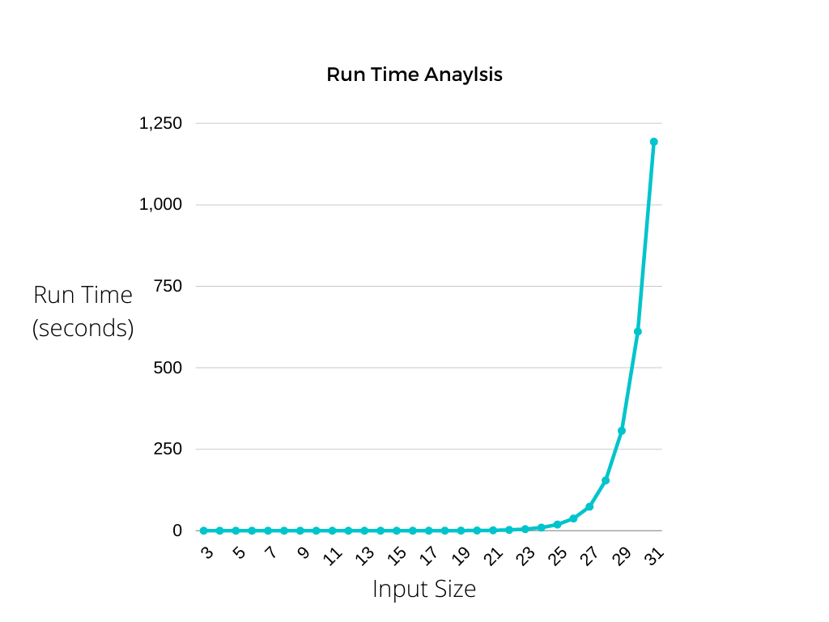
Test Cases
Generated with a python program
29 test with inputs ranging from 3 - 31
Input of 3 items run time: 0.000010s
Input of 31 items run time: 1193.307045s (~20 minutes)

Slide 10
Approximation Portion
Aly Clark and Mike Leek

Slide 11
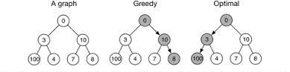
Approximation
We chose a greedy algorithm because it drastically speeds up decisions
Sort and choose the most valuable items to put into our knapsack first
This might not make the optimal choice when the first item in our sorted list is not in the final knapsack
Notes:
Speeds up decisions by grabbing most valuable items per weight unit first
Choose fractional because fractional can take parts of items and thus is guaranteed to never be less than the other two

Slide 12
Pseudocode
max_knapsack (items):
sort items from most valuable per weight unit
while there is still more weight allowed and more items:
if item weight <= weight left over:
add to knapsack
subtract weight item weight from remaining
return item list
Runtime: O(nlog(n)) where n is the number of items

Slide 13
Bash Script For Testing
#!/bin/sh
N=43
for t in `seq 1 1`
do
echo ""
echo "============================"
echo "Test with $N inputs 200 weight results:"
echo "============================"
echo ""
echo "Exact Knapsack:"
python3 max_knapsack.py < current_test_for_weight_200_tests.txt
echo ""
echo "Approximate Knapsack:"
python3 knapsack_approximator.py < current_test_for_weight_200_tests.txt
echo ""
echo "Fractional Knapsack:"
python3 cs412_lab7_b.py < current_test_for_weight_200_tests.txt
done > final_results_200_weight_all_knapsacks.txt

Slide 14
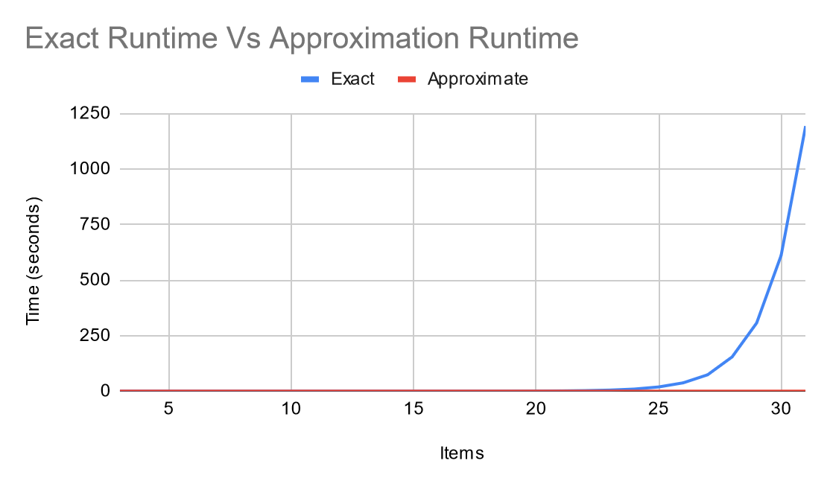
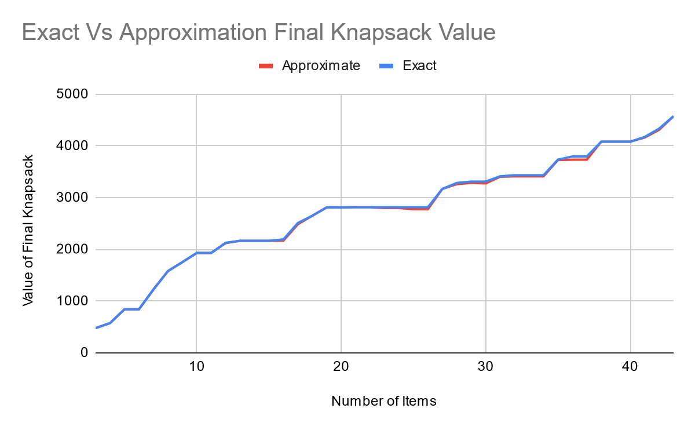
Results For Exact vs Approximation

Slide 15
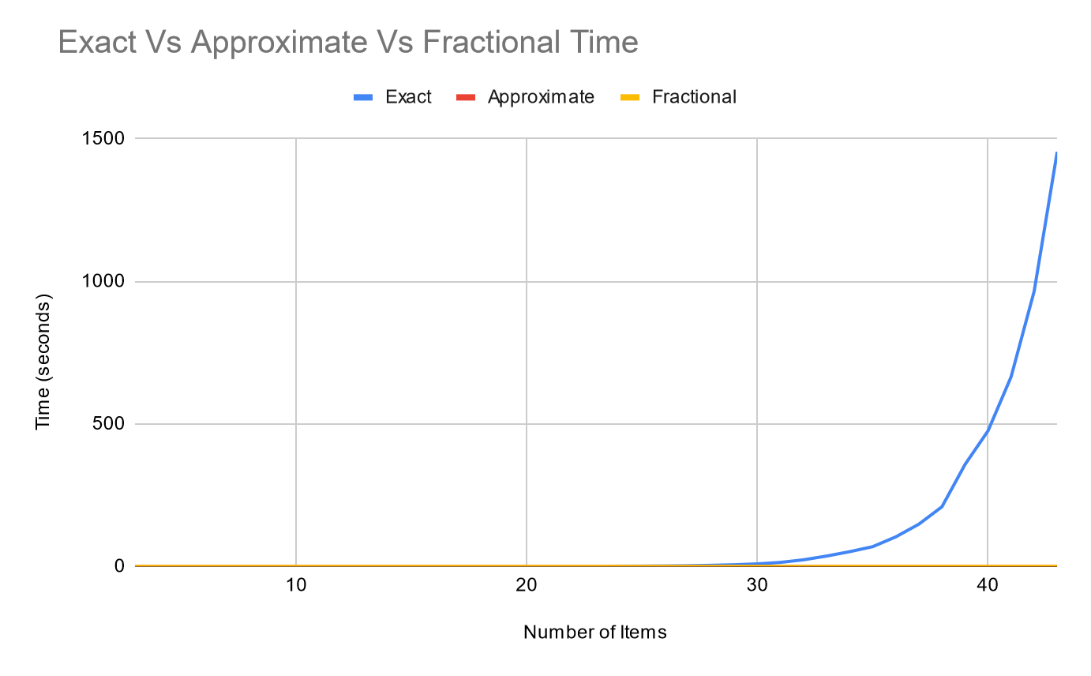
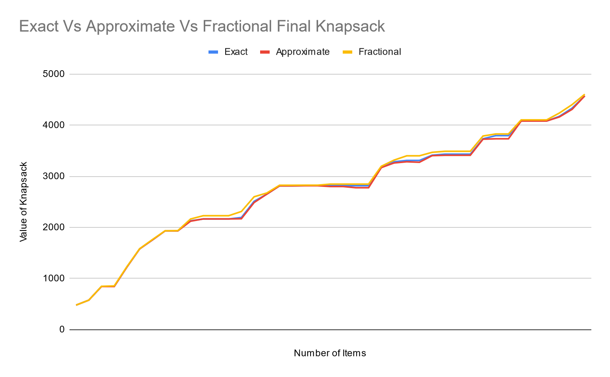
Upper Bound Comparison
For our upper bound, we chose fractional knapsack because it’ll always be at least as large as both the exact code and our approximation

Slide 16
Results For Exact vs Approximation
Timing Results for Exact Vs Approximate Vs Fractional
Final Knapsack Value for Exact Vs Approximate Vs Fractional
26 | 1.565075 | 0.000013 | 0.000027
27 | 2.334511 | 0.000014 | 0.000027
28 | 3.77564 | 0.00004 | 0.000027
29 | 5.749604 | 0.000015 | 0.000028
30 | 8.820384 | 0.000014 | 0.00003
31 | 14.020346 | 0.000015 | 0.000028
32 | 23.122838 | 0.000015 | 0.000032
33 | 36.32115 | 0.000015 | 0.000031
34 | 51.603293 | 0.000016 | 0.000031
35 | 69.206458 | 0.000016 | 0.000031
36 | 103.593328 | 0.000016 | 0.000033
37 | 148.12317 | 0.000017 | 0.000029
38 | 208.987934 | 0.000016 | 0.00003
39 | 357.23057 | 0.000023 | 0.000031
40 | 475.593058 | 0.000018 | 0.000033
41 | 665.108136 | 0.000019 | 0.000032
42 | 965.156957 | 0.000023 | 0.000034
43 | 1454.780017 | 0.000019 | 0.000032
26 | 2815.8 | 2776.6 | 2847.5
27 | 3170.3 | 3170.3 | 3196.4
28 | 3284.9 | 3261.3 | 3317
29 | 3311 | 3284.7 | 3401.5
30 | 3311 | 3275.2 | 3401.5
31 | 3413.9 | 3404.4 | 3469.8
32 | 3433.9 | 3411.9 | 3490.1
33 | 3433.9 | 3411.9 | 3490.1
34 | 3433.9 | 3411.9 | 3490.1
35 | 3734.8 | 3726.9 | 3789.3
36 | 3796.4 | 3734.5 | 3828.9
37 | 3796.4 | 3734.5 | 3828.9
38 | 4082.4 | 4082.4 | 4104.5
39 | 4082.4 | 4082.4 | 4104.5
40 | 4082.4 | 4082.4 | 4104.5
41 | 4173.9 | 4161.8 | 4238.5
42 | 4333.9 | 4310.3 | 4402.9
43 | 4574.6 | 4574.6 | 4606.8

