Slide 1
Insights into Opioid Epidemic in Indiana
Data Visualization – Fall 2018
Helen Yezerets
Notes:
Hi, my name is Helen Yezerets and my project was focused on the Opioid Epidemic in Indiana

Slide 2
Outline
Motivation and Objectives
Background – relevant existing data, studies, and visualizations
Initial hypothesis
Refined hypothesis
Methodology
Results
Insights
Future work
Notes:
There is one caveat in the outline of this project - I have explored and eventually abandoned the initial hypothesis, which however helped me with arriving at a refined and much more fruitful hypothesis.

Slide 3
Motivation
1
Opioid epidemic is one of the major plights of the U.S. society
Every day, more than 115 people in the United States die after overdosing on opioids.^{[1]}
The Midwest region is particularly affected, with the overdoses increasing by 70% from July 2016 through September 2017.^{[2]}
Drug-related overdoses killed more Americans in 2016 (64,070) than the entire Vietnam War (58,200). Among these, ¾ of all drug overdose deaths are now caused by opioids^{[3]}
[1] CDC/NCHS, National Vital Statistics System, Mortality. CDC Wonder, Atlanta, GA: US Department of Health and Human Services, CDC; 2017. https://wonder.cdc.gov.
[2] Vivolo-Kantor, AM, Seth, P, Gladden, RM, et al. Vital Signs: Trends in Emergency Department Visits for Suspected Opioid Overdoses--United States, July 2016-September 2017. Centers for Disease Control and Prevention
[3] https://www.cbsnews.com/news/opioids-drug-overdose-killed-more-americans-last-year-than-the-vietnam-war/
Notes:
The scope of the opioid epidemic is nothing short of colossal, so I just would like to put things in perspective by saying that one-year overdosing death count in the U.S. exceeds the total death toll from Vietnam War.

Slide 4
Project Objectives
1
Primary: Explore various aspects of the opioid epidemic, to better understand its nature and mitigation opportunities
Secondary: demonstrate fluency with the appropriate use of various visualization data, depending on the scope and complexity, including Excel, Tableau, and Python
Notes:
So, the primary purpose of this project was to better understand the causes of the epidemic in a hope to more effectively mitigate them. I have arranged my examples as a progression of the increasing data complexity and visualization – from Excel to Tableau and Python

Slide 5
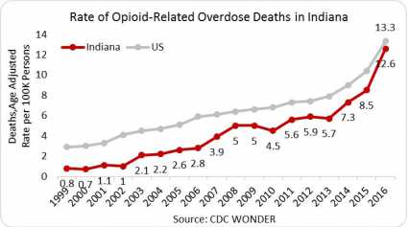
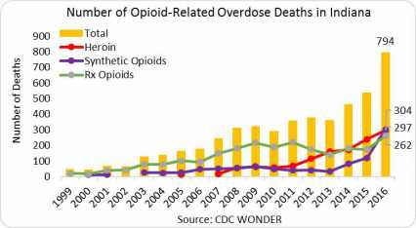
Background - Previous data
2
Extensive statistics is maintained by the National Institute of Drug Abuse (NIDA)^{[1]}
Opioid deaths in Indiana used to trail the national values, however in the recent years, Indiana rates have been increasingly sharply, approaching national averages
Particularly concerning trend with regards to synthetic opioids
[1] National Institute on Drug Abuse. Opioids. NIDA. https://www.drugabuse.gov//drugs-abuse/opioids. Accessed November 27, 2018.
Notes:
Given its impact on the society, the issue of opioid abuse has been actually quite well researched. Indiana is among the states strongly affected by this epidemic, and some of the trends are particularly worrisome. For example, overdose deaths jumped 2.5 times from 2013 to 2016. Also, deaths related to synthetic opioids increased in the same period more than 7 times

Slide 6
Initial Hypothesis
Our initial hypothesis was that the opioids epidemic, like many other social plights, is related to socio-economic factors
Using Excel for initial data exploration, in the form pairwise correlations
3
Y_{i} = ƒ (x_{j})?
Dimensions of the epidemic
Deaths from overdose^{[1]}
Non-lethal hospital admissions^{[2]}
Emergency room visits^{[3]}
Number of opioid prescriptions disbursed^{[4]}
Socio-economic indicators
Median Income^{[5]}
Per capita
Per household
Per family
Tobacco use^{[6]}
[1-4] Indiana State Department of Health, Division of Trauma and Injury Prevention, INSPECT, https://gis.in.gov/apps/isdh/meta/stats_layers.htm
[5] https://en.wikipedia.org/wiki/List_of_Indiana_locations_by_per_capita_income
[6] http://www.countyhealthrankings.org/app/indiana/2015/measure/factors/9/data
Notes:
So, my initial exploration focused on whether there is a clear relation between various dimensions of the epidemic and some common socio-economic indicators – direct ones such as income, and indirect- such as tobacco use which is increasingly marginalized in the society

Slide 7
Better understanding the potential predictors
Various measures of income differ depending on the prevailing size of the families and households in different counties, but as expected, all three are strongly correlated
Thus, I arbitrarily chosen one indicator (per capita income) for subsequent analyses
3
Socio-economic indicators
Median Income
Per capita
Per household
Per family
Tobacco use
Notes:
First, I needed to better understand our potential predictors. As you can see, I can use just one of these, for example Median Per Capita Income, as the rest of them are well correlated and therefore not orthogonal

Slide 8
Better understanding the potential predictors
Tobacco use is negatively correlated with income, as expected, however the correlation is weak – can treat these two variables as nearly independent
3
Socio-economic indicators
Median Income
Per capita income
Per household
Per family
Tobacco use
Notes:
Now let’s examine the relationship between our socio-economic predictors, such as per capita income and tobacco. As expected in today’s society, tobacco use is more common in the less affluent communities. However, that correlation is quite weak, so it makes sense to examine the relationship of the Epidemic to both of these predictors – income and tobacco.

Slide 9
Epidemic Dimensions vs. Income (only two dimensions shown to avoid redundancy)
Dimensions of the epidemic
Deaths from overdose
Non-lethal hospital admissions
Emergency room visits
Number of opioid prescriptions disbursed
Socio-economic indicators
Median Income
Per capita income
Per household
Per family
Tobacco use
3
Notes:
To illustrate my next step, I picked two specific dimensions of the epidemic – those most impactful at the human level, such as deaths, and those most monetarily expensive to the society, such as hospital admissions.
Very surprisingly, none of the dimensions of the epidemic (and I am only showing two here to avoid redundancy) correlated with income.

Slide 10
Epidemic Dimensions Vs. Tobacco Use (only two dimensions shown to avoid redundancy)
Dimensions of the epidemic
Deaths from overdose
Non-lethal hospital admissions
Emergency room visits
Number of opioid prescriptions disbursed
Socio-economic indicators
Median Income
Per capita income
Per household
Per family
Tobacco use
3
Notes:
The correlation to tobacco was also very weak, but all four dimensions came up with a positive slope.

Slide 11
Insights for the initial hypothesis
Opioid epidemic can’t be explained based on such key socio-economic predictors as income or tobacco
Consistently positive, if very weak correlation against tobacco, gave me an idea for a new avenue for investigation, based on correlating among various types of substance abuse
3
Notes:
So, I had to reject the initial hypothesis – opioid crisis appears to be not related to the poverty levels or smoking. However, the exploration of smoking gave me idea to look at some different angle, from the substance perspective.

Slide 12
Revised Hypothesis
Better understanding of the opioid epidemic in Indiana may be gleaned from other aspects of substance abuse, such as relations among various types of substances
Dataset Description
The Treatment Episode Data System (TEDS)^{[1]} datasets by county and by state
Hospital admissions related to State-paid substance abuse treatment, including
Demographic data (age, gender, race, ethnicity)
Location data (county)
Substances: cocaine, heroin, marijuana, methamphetamine, opioids, alcohol
4
[1] TEDS data were collected from SAMHSA’s Drug & Alcohol Services Information System (SAMHSA, 2018). http://wwwdasis.samhsa.gov/dasis2/teds.htm. Accessed November 27, 2018.
This analysis builds upon my previous work for State Epidemiological Outcomes Workgroup (SEOW) from Richard M. Fairbanks School of Public Health, using Tableau
Notes:
The revised hypothesis is based on exploring the relations among different types of substances. I based it on a large public dataset, for various substance-related hospital admissions.

Slide 13
Methodology - Data analysis approach
Data Exploration in Python
Jupyter Notebook will be attached to the final paper
Data correlation heatmaps
Identify and isolate artificial correlations due to non-orthogonal variables
Strongest non-artificial correlations
Temporal trajectories analysis using small multiples
Demographics
Geographic factors
5
Notes:
Firstly, I just oriented myself in this dataset using data exploration in Python, as reflected in my Jupyter notebook. Then I tried to understand the relations among the critical variables, including those that are correlated artificially because of how the dataset is defined. Once I isolated those, I can focus on the ones that appear to be truly pointing at some useful correlations
Finally, I have employed a variety of small multiples visualizations, to explore temporal analysis by demographic and geographic factors

Slide 14
Data Exploration in Python
335866 record
50 columns
2008-2017
6
Notes:
Head analysis using Python showed that this is a rich dataset, covering over 300,000 records covering the most recent decade.

Slide 15
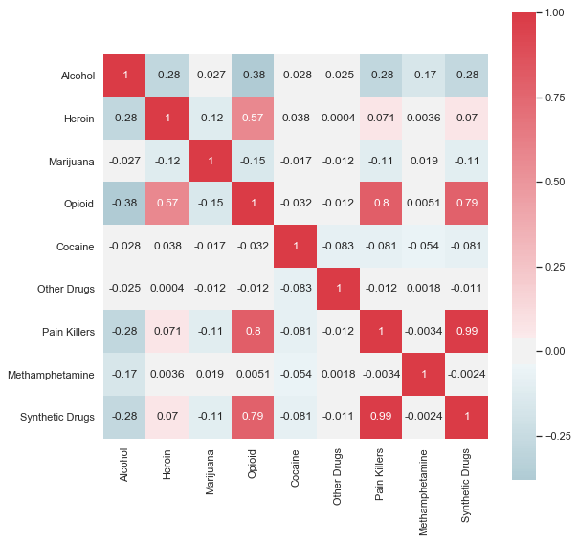
Substance Data Correlation Heatmap
Explored correlation among different types of abused substances in the most aggregated form, as averaged by years, counties, and demographics
6
Notes:
My next step was to employ a correlation heatmap, to better understand how all the major types of abused substances are related

Slide 16
Substance Data Correlation Heatmap
Some correlations are artificial, because of the nature of the dataset, since these variables are not orthogonal, for example:
Heroin is part of Opioids
Opioids are part of painkillers
Synthetic Drugs and Opioids partially overlap
Pain Killers and Synthetic Drugs partially overlap
6
Notes:
Unfortunately, upon closer examination, it turned out that the strongest correlations were artificial, because of how the data were collected. For example, heroin is part of opioids, so naturally the two were correlated.

Slide 17
Substance Data Correlation Heatmap
Excluding the non-orthogonal factors, the strongest remaining correlation was a negative one between Alcohol and Opioids:
Suggesting that Opioids are potentially displacing Alcohol among the abused substances
More nuanced analysis was performed using ratios of specific drug abuse cases to the total drug abuse ones
6
Notes:
Once I isolated those artificial ones, the strongest correlation proved to be between alcohol and opioids. To explore that and other relationships further, I drilled down from the aggregate data, and looked into their temporal trajectories.

Slide 18
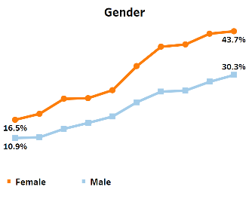
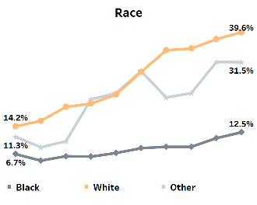
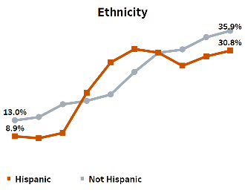
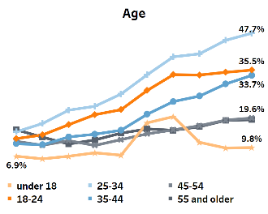
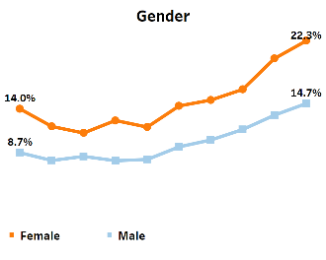
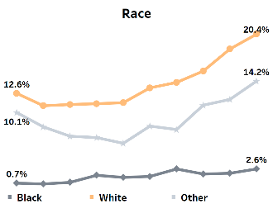
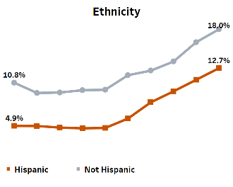
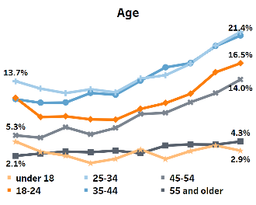
Results: Example - Increased abuse in 2008 -2017
Opioids
6
Meth
Notes:
I found that Opioids and Meth were among the fastest growing abused substances. One can see some significant differences among the different groups, for example for these two categories women tend to be more susceptible than men; and the youngest and the oldest age group appears to be least affected, so Opioids and Meth appear to be especially the middle age population plight.
Importantly, the general trend of strong growth was present in all of these groups over the last decade.

Slide 19
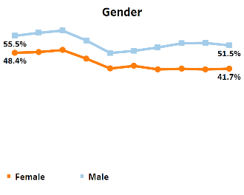
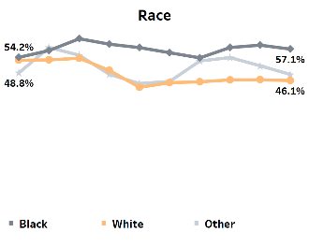
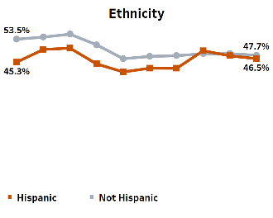
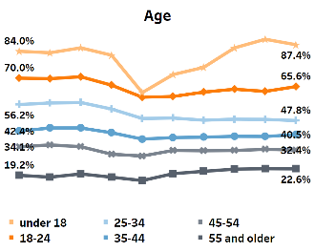
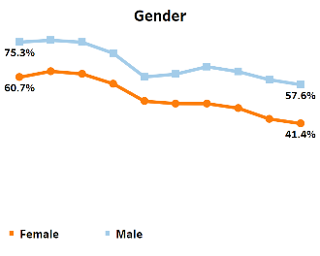
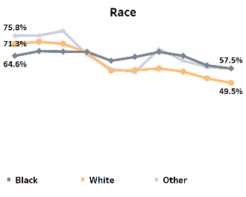
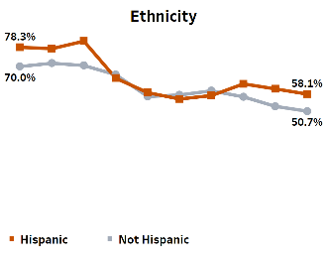
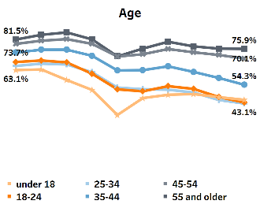
Results: Example - Stable or declining abuse in 2008 -2017
Marijuana
6
Alcohol
Notes:
In contrast, the use of Marijuana held at a relatively stable rate, while the proportion of alcohol declined among substance abuse related hospitalizations. It may be interesting to point out here, that for these two examples, men were more affected than women, contrary to the Opioids and Meth charts on the previous slide. Also, in contrast to the previous slide, the youngest were the champions in Marijuana admissions, while the oldest – in the Alcohol-related ones.
Once again, despite these important differences among various groups, the temporal trends were fairly consistent for all of them.

Slide 20
Interim insights - Demographics
All the demographic factors appear to show the same general temporal trends
Except Hispanics and the youngest age group represented the most volatile category, likely reflecting variations in the respective overall population(s) in Indiana.
6
Notes:
So, to summarize the demographic part of our data analysis, there appear to be some very telling differences in substance abuse patterns among different groups, which are worth revisiting and digging in deeper in the future. However, the general trends were consistent among all of these demographics, which enabled us to now look for geographic location trends without complicating them by demographic details.

Slide 21
Example: Geographic trends by year
6
2008 | 2009 | 2010 | 2011 | 2012 | 2013 | 2014 | 2015 | 2016 | 2017
Notes:
As I looked at the data organized by the drugs, counties, and years, it became clear that geographic variation of both the absolute values and of the trends was complex. In other words, some counties are in a much worth shape than others. There were also some regional patterns, for example 10 years ago meth epidemic was primarily a rural problem, concentrated in the southwestern part of Indiana, but now it is unfortunately spread more evenly.
For opioids, if we look at the earlier part of the decade, the epidemic was fairly evenly distributed across the state. This indirectly supports our initial finding that the opioid epidemic is not majorly related to socio-economic status, because both poor and rich counties were affected. Towards the end of the decade, the Opioid epidemic appears to be particularly focused near Chicago, Louisville, and Ohio border. This suggests a promising direction for future exploration.

Slide 22
Example: Geographic trends by year
6
2008 | 2009 | 2010 | 2011 | 2012 | 2013 | 2014 | 2015 | 2016 | 2017
Notes:
The distribution for Marijuana and Alcohol appear quite different, geographically and temporally.
For Marijuana, I have previously noted that the trajectory was fairly flat across all the demographic groups. Here, one can see that it is also quite evenly distributed geographically. In other words, Marijuana appears to be just an established part of life for certain groups of population, mostly the youngest, everywhere.
In contrast, the relative role of alcohol is vanning, as other drugs, especially opioid-related ones, take the lead.

Slide 23
Interim insights – Geographic Distribution
Multiple methods of visualizing geographic distribution showed large variations among counties
Understanding what factors result in “good” and “bad” counties would open a promising avenue for future visualization work, towards crisis mitigation
This method of visualization was used to complement the previous slides, especially to look for counties with temporal anomalies
6
Notes:
To summarize the geographic-related findings, based on the above heatmaps and on the county-based trends on this slide, it appears that there are very substantial differences in the status and trends for different counties, except for perhaps Marijuana. So, if one was able to further drill down into what makes “good” and “bad” counties, one may be able to better understand health-related, society-related, and law-enforcement related avenues for improving the situation.

Slide 24
Major Overall Insights
Socio-economic factors appear to play minor role in the opioid epidemic, as confirmed by the weak correlation of its various dimensions to:
Direct socio-economic indicators such as income,
Indirect indicators such as tobacco use, and
Fairly limited geographic variations, especially earlier in the decade.
Opioid abuse is growing at an alarming pace among all the demographics.
Non-Hispanic women appear to be particularly affected, as well as the middle-aged population overall.
Opioid abuse is rapidly displacing some of the other substances, which implies that the first response and treatment organizations need to be preparing by proper staffing, training, and medications
Marijuana use appears to be poorly correlated to the opioids in its temporal trends or geographic distribution, suggesting that Marijuana doesn’t serve as a “gateway drug” as sometimes suggested in press
7
Notes:
Overall, I have shown that Opioids use afflicts people across the range of incomes, and its growth is reflected for all of the groups and location studied. White, non-Hispanic, middle-aged women are particularly at risk, especially in certain border areas of Indiana.
Alcohol, historically the most abused substance, appears to be increasingly displaced by the opioids, which means the society needs to re-orient to support this type of problems.
In contrast, Marijuana use appears to be unrelated to this epidemic.

Slide 25
Future Work Recommendations
Deeper analysis of the discovered trends
Demographic variations, for example why white women are most affected?
Geographic variations, for example why in the recent years the opioids became concentrated in the some border areas? Is this related to legal supply availability (prescription rates), illegal supply availability (drug dealer related arrests), etc.?
Including additional complementary datasets
First responders statistics
Law enforcement, for example substance-related arrests
Mental health studies, such as Substance Use Disorder (SUD)
Availability of help and resources, for example the number of Narcan™ (Naloxone) carrying responders per county
Prescription rates by county
8
Notes:
Uncovering the historic trends allows me to pose new questions regarding the causes of the opioids epidemic. Thus, my future work suggestions are based on the above findings, especially those related to strong variations or anomalies. For example, if we could drill down into the factors that make some geographic location more susceptible to opioids, relative to other abused substances, may yield some additional actionable insights.
Some of this additional information could be extracted from the deeper analysis of the discussed datasets, but it would be particularly useful to expand the data scope, such as to better characterize both the dimensions of the epidemic, and its potential causes.
Thank you for your attention.

