Slide 1

ATM Simulation System Using Python Flask
By Bilawal Faiz — SU92-BSAIM-F25-133
By Ali Hassan— SU92-BSAIM-F25-079
By Abu_bakar— SU92-BSAIM-F25-129
By Ali Hassan— SU92-BSAIM-F25-338
Bachelor of Science in Artificial Intelligence — Department of Software Engineering, The Superior University Lahore — 2026

Slide 2

Introduction
ATMs provide convenient access to banking services — withdrawals, balance inquiries, deposits, and account management. This project develops a web-based ATM Simulation System using Python Flask to replicate core banking operations with a simple, interactive interface demonstrating frontend-backend integration and security basics.

Slide 3

Problem Statement
Manual transaction management is inefficient and slow. The ATM Simulation System provides a digital platform to simulate essential ATM operations securely via a web interface, improving efficiency and user experience for educational purposes.

Slide 4
Project Objectives
Secure PIN Login
Balance Inquiry
Deposit & Withdrawal
Implement PIN-based authentication.
View current account balance.
Deposit and withdraw funds with validation.
PIN Management
Simulation
Allow secure PIN changes.
Replicate real ATM behavior and teach Flask web development.

Slide 5
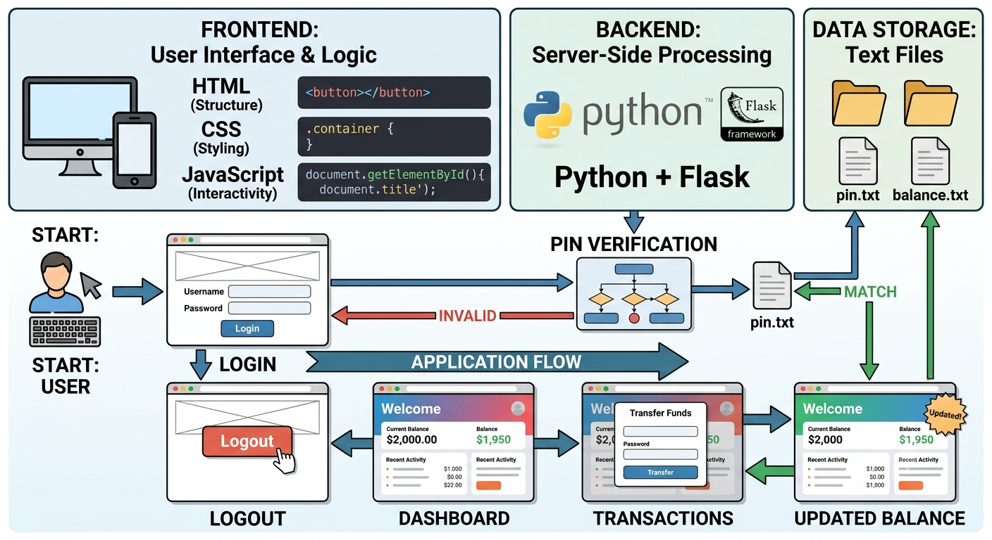
Scope
Core ATM functionalities for educational use: login with PIN, check balance, deposit, withdraw, change PIN, and secure logout. Designed as a learning platform that can be extended with advanced banking features.
System Architecture (overview)
Frontend: HTML, CSS, JavaScript — Backend: Python + Flask — Data: pin.txt & balance.txt — Flow: User → Login → PIN Verification → Dashboard → Transactions → Updated Balance → Logout

Slide 7

Functional & Non-Functional Requirements
Functional
Non-Functional
PIN authentication
Balance inquiry
Deposit (updates balance)
Withdrawal (balance validation)
Change PIN
Logout
Security: PIN-based auth
Reliability: accurate transactions
Usability: user-friendly UI
Performance: fast responses
Maintainability: easy to update

Slide 8
Tools & Technologies
Technology
Purpose
Python
Backend development
Flask
Web framework
HTML / CSS / JavaScript
Frontend structure & UI
VS Code
Development environment
pin.txt / balance.txt
Simple data storage for demo

Slide 9
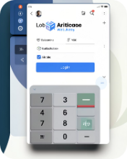

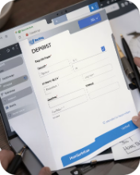
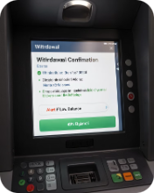

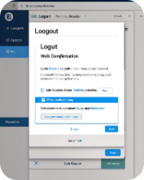
System Design — Main Modules
Login Module
Balance Module
Deposit Module
Withdrawal Module
Authenticates users via PIN verification.
Displays current account balance.
Adds deposited amount and updates balance.
Validates funds before processing withdrawals.
PIN Management
Logout Module
Allow secure PIN changes saved for future logins.
Ends the user session securely.

Slide 10
Testing & Results
Test Case
Result
Correct PIN
Login Successful — Passed
Wrong PIN
Access Denied — Passed
Deposit Amount
Balance Increased — Passed
Withdraw Amount
Balance Decreased — Passed
Excess Withdrawal
Low Balance Alert — Passed
Change PIN
New PIN Saved — Passed
All core functionalities performed successfully during testing.

Slide 11



Future Enhancements & Conclusion
Conclusion
Future Enhancements
Database integration (MySQL/SQLite)
Multiple user accounts & transaction history
Account registration & admin dashboard
SMS/Email notifications & card number authentication
Enhanced security features
The ATM Simulation System replicates core ATM functionalities using Python Flask, demonstrating secure PIN authentication, transaction handling, and frontend-backend integration. The project is a practical learning tool for web development and banking application basics.
References include official Python, Flask, HTML5, CSS, and JavaScript documentation and web development learning resources.

Slide 12
Thank You 🌟
Thanks for listening!
Any Questions?

