Slide 1
Bank Marketing Campaign
An analysis of data collected from a marketing campaign conducted to encourage clients to subscribe to a term deposit.
Analysis Completed: 5/18/21
Completed by: Alyson Lamberti

Slide 2
Purpose
To evaluate the data with the intent on improving or validating the banks current model that predicts which clients will be receptive to similar marketing campaigns.
Evaluate the variables available
Find patterns within the data
Clean the data for continued modeling
Evaluate current model
Produce New model

Slide 3
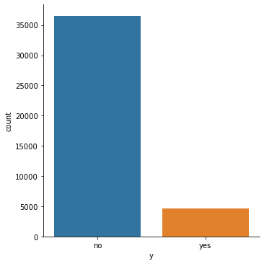
20 variables, 1 target
20 Variables
age job marital education default housing loan contact month day_of_week duration campaign pdays previous poutcome emp.var.rate cons.price.idx cons.conf.idx euribor3m nr.employed
1 Target (y)
‘Yes’= The client subscribed a term deposit
Only 11% of the total records are labeled as ‘Yes’ making this an imbalanced dataset.

Slide 4
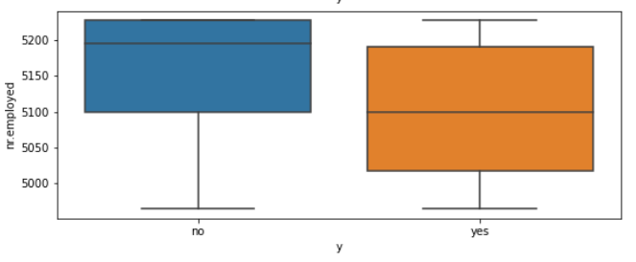
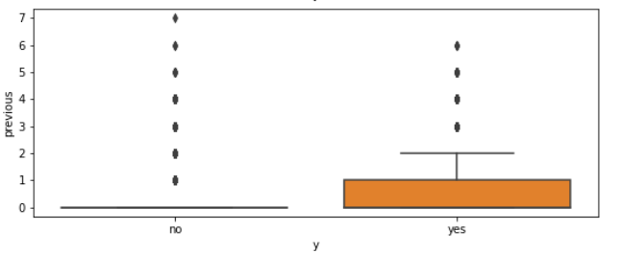
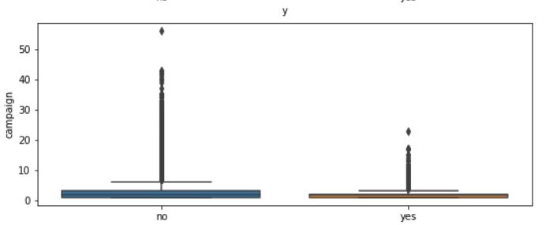
Variables vs target
Numeric data is easy to visualize with box plots
To evaluate if the variable has influence on the target a comparison of the box portion of the plot is done. The box portion holds the core of the data points. Boxes that are offset from each other mean that the ‘yes’ and ‘no’ classifications within the target groups contain different sets of data points within that variable. Therefore, that variable may have influence on predicting the target.
Variables found: nr.employed , previous, campaign

Slide 5
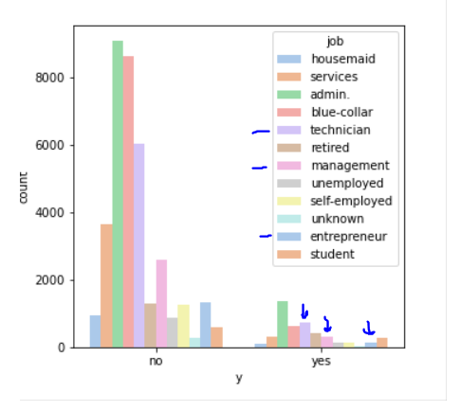
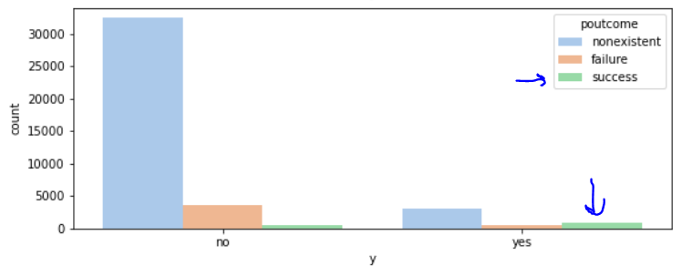
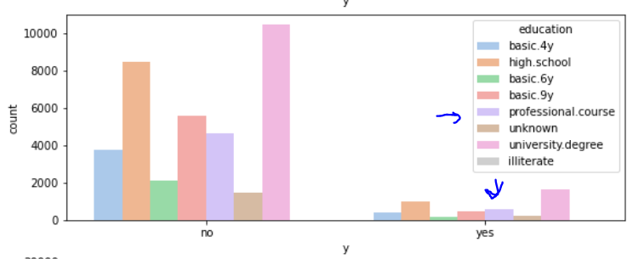
Variables vs target
Categorical data can be visualized by bar graphs
To evaluate if the variable has influence on the target a comparison of variable class representation within the target variable ‘yes’ and ‘no’ classes is completed. If any class is more or less prominent in the target variable results it can indicate a possible influence. Since this is an imbalanced dataset it is difficult to conclude.
Variables found: job, poutcome,education

Slide 6
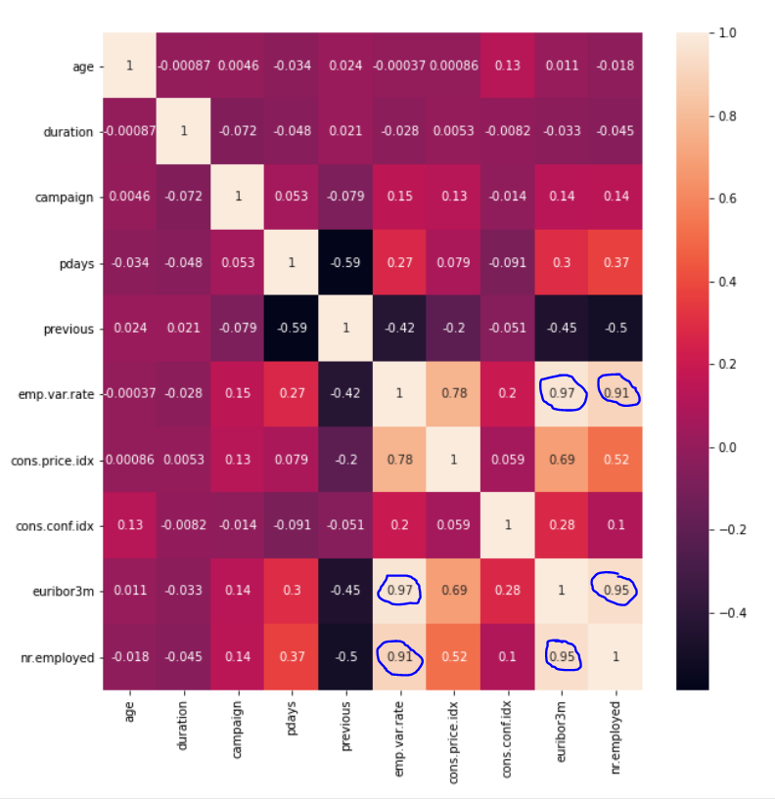
Collinearity
When one independent variable is directly correlated with another independent variable it causes problems receiving accurate results from a model.
A high correlation is a value close to 1.
Variables Found:
Euribor3m vs emp.var.rate
Euribor3m vs nr.employed
Nr.employed vs emp.var.rate

Slide 7
Cleaning the data
Issue | Method | Variables Effected
Transform Target Value | Change into Binary 0=no , 1=yes | Target (y)
Missing values | Search for Nan and missing value placeholders Replace values with the mode or mean | Numeric Variables: no missing values and both 0 and 999 placeholder’s hold meaning Categorical Variables: ‘unknown’ had no meaning. Replaced with mode. (job, marital, education, default, housing, loan)
Inconsistent data | Look for any data combinations that do not make logical sense (input errors) | Pdays is 999 when previous >0 and poutcome = ‘failure’ Replace 999 with the average for those rows
Not useful/Correlated Variables | Remove | emp.var.rate, Euribor3m, duration

Slide 8
Cleaning the data
Issue | Method | Variables Effected
Outliers | Categorical: Bin Numerical: Evaluate skewness, log transform if needed, cap at the .01 and .99 percentiles Bin variables into categorical variables | Categorical: In education variable, the illiterate class was binned with basic.4y Numerical: Log Transformed: campaign Capped: age, campaign, cons.conf.idx, Made categorical: previous, pdays
Dummy Variables | Hot Encode categorical variables for use in a model | job,marital,education,default,housing, loan, contact, month, day of week, poutcome, pdays, previous
Train and Test | Default Train: 75%, Test: 25%
Standardize | Standardize numeric variables a since they have different ranges | Age, campaign, pdays,previous,cons.price.ind, cons.conf.idx,nr.employed

Slide 9
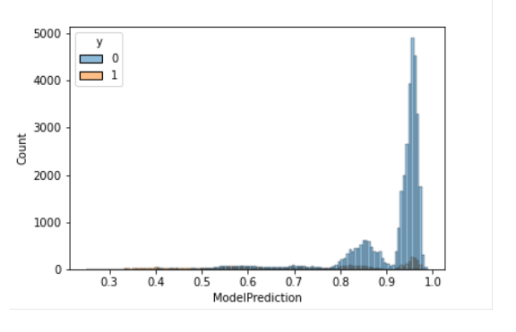
Current model performance
In a simple analysis it is shown that both the ‘yes’ and ‘no’ classes within the target variable both share the same distribution of values. With the assumption that the model gave high probabilities to predict the ‘yes’ value, we can see the ‘no’ values share the same high probabilities.

Slide 10
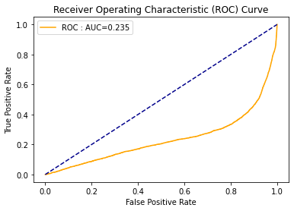
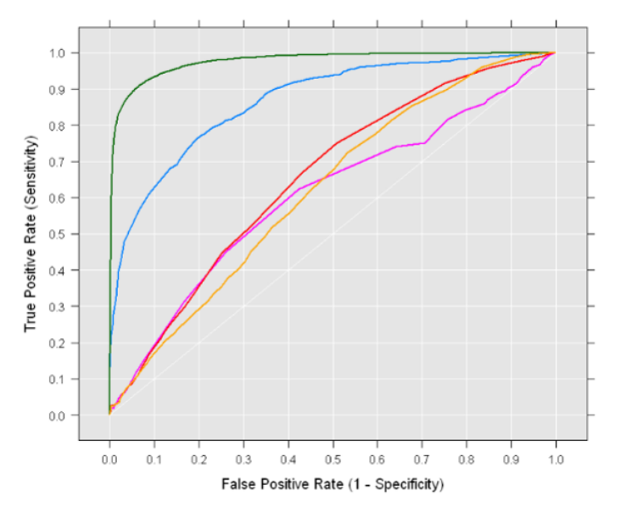
Current model performance
As a deeper evaluation the ROC curve and Precision-Recall curve are evaluated
The ROC curve is a common metric that evaluates the True Positive Rate (the proportion of observations that were correctly predicted to be positive out of all positive observations) against the False Positive Rate (the proportion of observations that are incorrectly predicted to be positive out of all negative observations).
An Ideal ROC curve is graphed to the far left corner of the graph with an AUC (Area Under the Curve) very large value close to 1.
This models’ predictions show graph under the diagonal line (a model with no prediction value) with a very small AUC of 0.235. This means that the model is providing virtually no value as it is predicting almost all values as ‘yes’ when they are truly a ‘no’
Ideal ROC Curve
What is a ROC Curve and How to Interpret It | Displayr

Slide 11
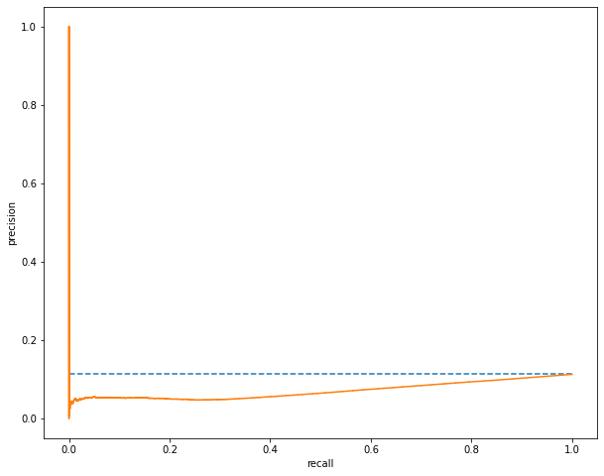
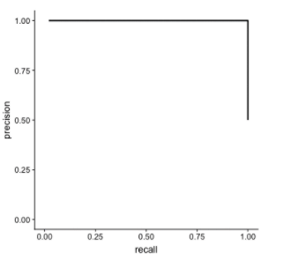
Current model performance
As a deeper evaluation the ROC curve and Precision-Recall curve are evaluated
Precision-Recall curves are better evaluators of imbalance data sets because it focuses on how well the model is predicting the minority class (the positive ‘yes’)
Precision is what percentage of the positive predictions were correct
Recall is what percentage of the actual positives were identified
An ideal curve is to the far right corner of the graph.
This models predictions graph under the horizontal line (A no-skill model with a precision that is the ratio of positive examples in the dataset). This means that the model is very poor and only correctly predicting a ‘yes’ because it is predicting almost everything a ‘yes’
Ideal Precision-Recall
ROC, AUC, precision, and recall visually explained – paulvanderlaken.com

Slide 12
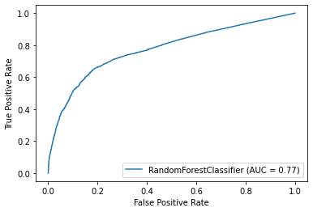
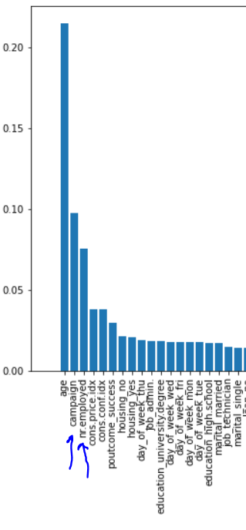
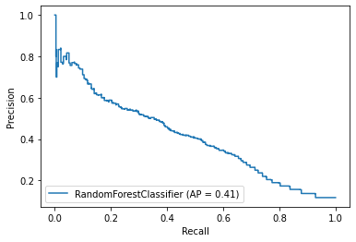
new model performance
ROC Curve
A basic Random Forest Classifier was fit with the cleaned dataset
As seen in both the ROC curve and the Precision-Recall curve, this new model with a cleaned data set is outperforming the current model.
This type of classifier also produces a list of variable importance. It is shown that two of the variables found in the earlier data exploration are on the top of the list.
Precision-Recall curve
NEXT STEPS:
Fine tune the Random Forest Classifier parameters
Fit additional model types that do well with imbalanced data sets and compare results

