Slide 1
Retail Business Inventory and Sales Management System

Slide 2
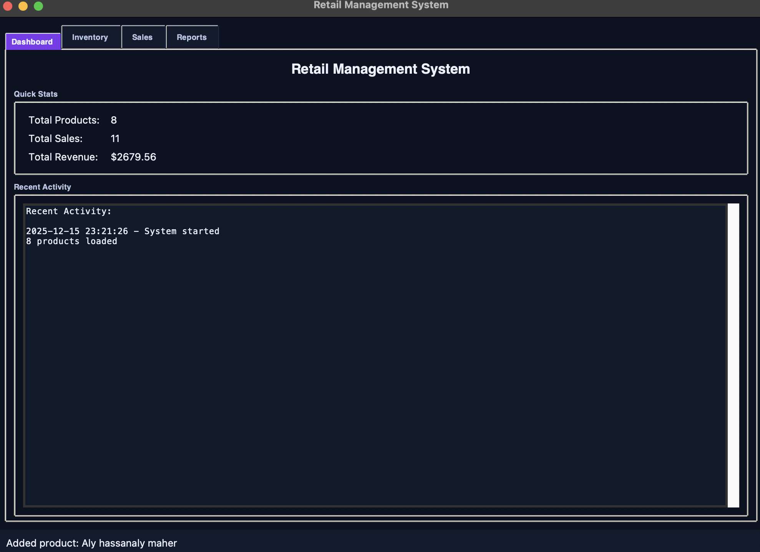
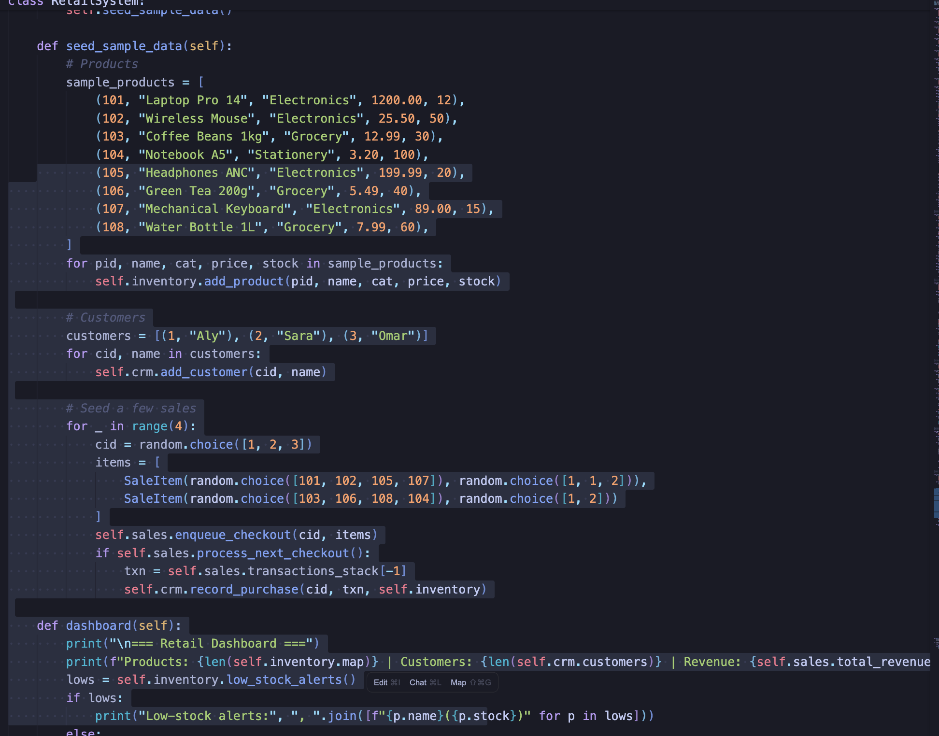
Code responsible:
  class RetailSystem -> seed_sample_data() (adds the 8 products)
  class InventoryManager -> add_product() (stores each product into self.map)
So “8 products loaded” happens because
seed_sample_data() added 8 products into inventory.map.

Slide 3
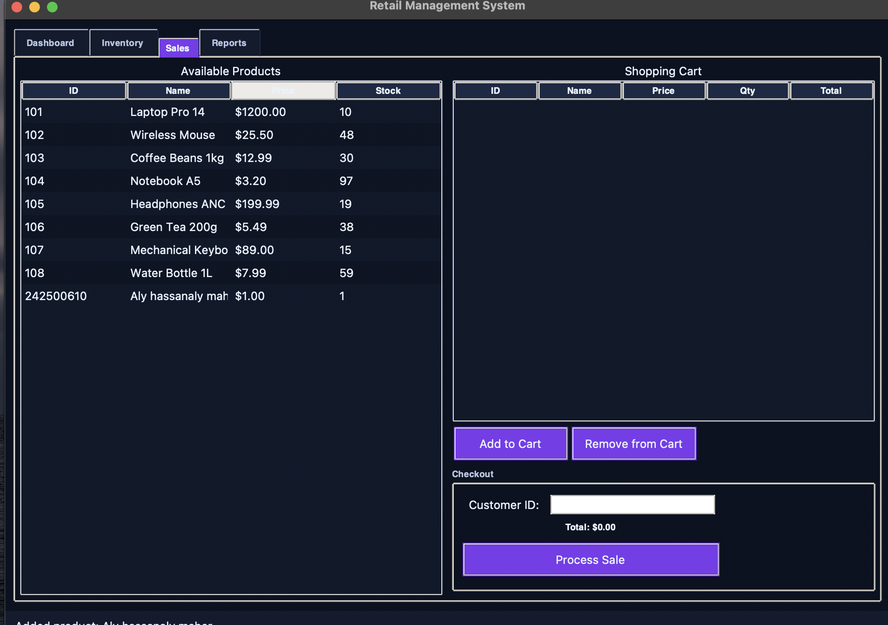
Total Sales
Source: Product.total_sold
Where it changes:
InventoryManager.deduct_stock()
Code responsible:
  class InventoryManager -> deduct_stock()
  It does:
    product.stock -= quantity
    product.total_sold += quantity
So the total sales number is basically the sum of total_sold across all products (because every sale increments total_sold).

Slide 4
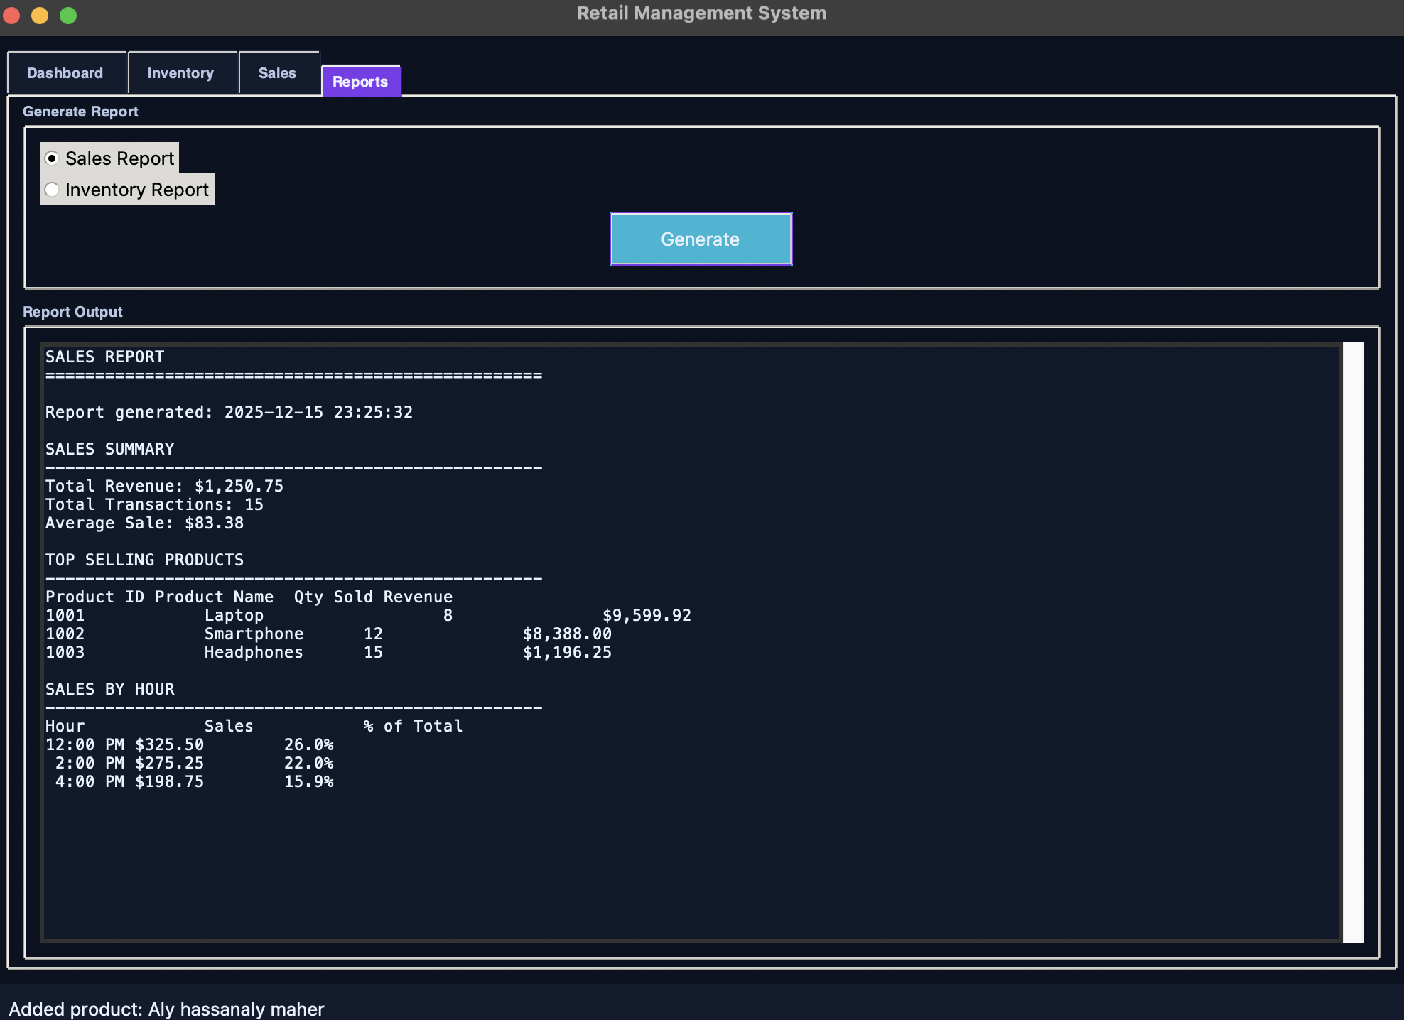
Component | Data Structure | Purpose
Inventory | AVL Tree + Hash Table | Organize and lookup products
Stock History | Linked List | Track stock changes
Checkout | Queue | Simulate customer line
Transactions | Stack | Log sales for refunds/audits
CRM | Hash Map + Stack | Customer profiles and history
Recommendations | Sorting + Searching | Suggest products

Slide 5
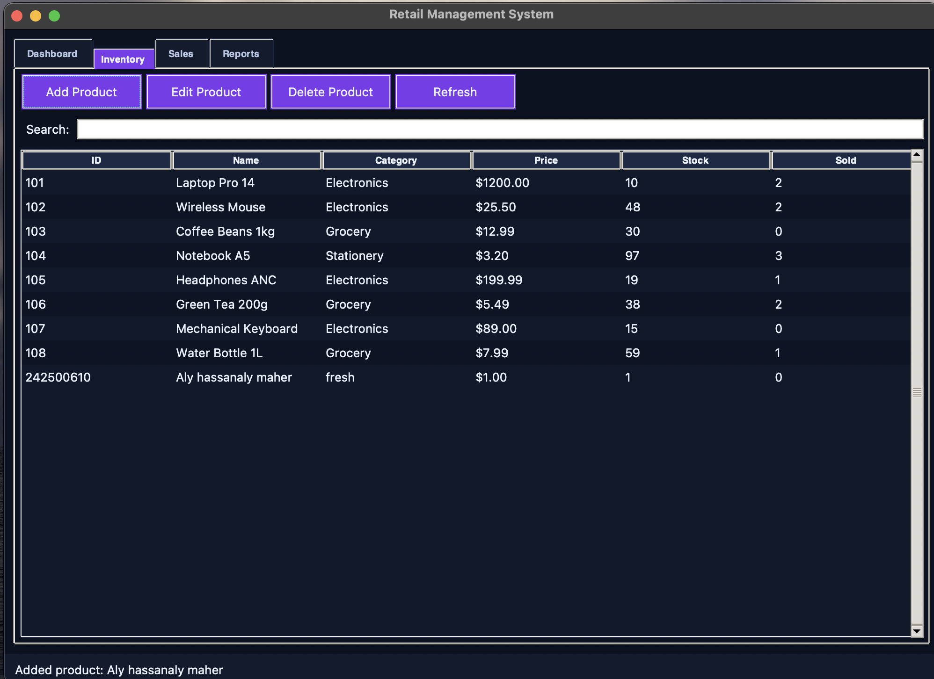
inventory management
Key Functionalities
Add/remove/restock products
Process sales and refunds
Track customer purchases and preferences
Generate sales reports and inventory alerts
Recommend products based on popularity or customer history
Predictive restocking suggestions
Restock Product
Functionality: Increase the stock quantity of a product and log the change.
Code Used: product.stock += quantity
self.stock_changes.add_change(product_id, quantity, "Restock")
self.tree.root = self.tree.insert(self.tree.root, product_id, product)
self.map[product_id] = product
Functionality: Create a new Product object and insert it into:
AVL Tree → for ordered listing by product_id
Hash Table (dict) → for fast lookup by product_id

Slide 6
Thank you
Aly Hassan Aly Maher (242500610)
Ahmed sameh (242500136)
Youssef ahmed gharib (242500659)
Youssef eslam (242500420)
Yehia hazem badr (242500613)

