Slide 1

Inventory Management System GUI
By: Ahmed Sameh, Yehia Badr, Aly Hassan

Slide 2
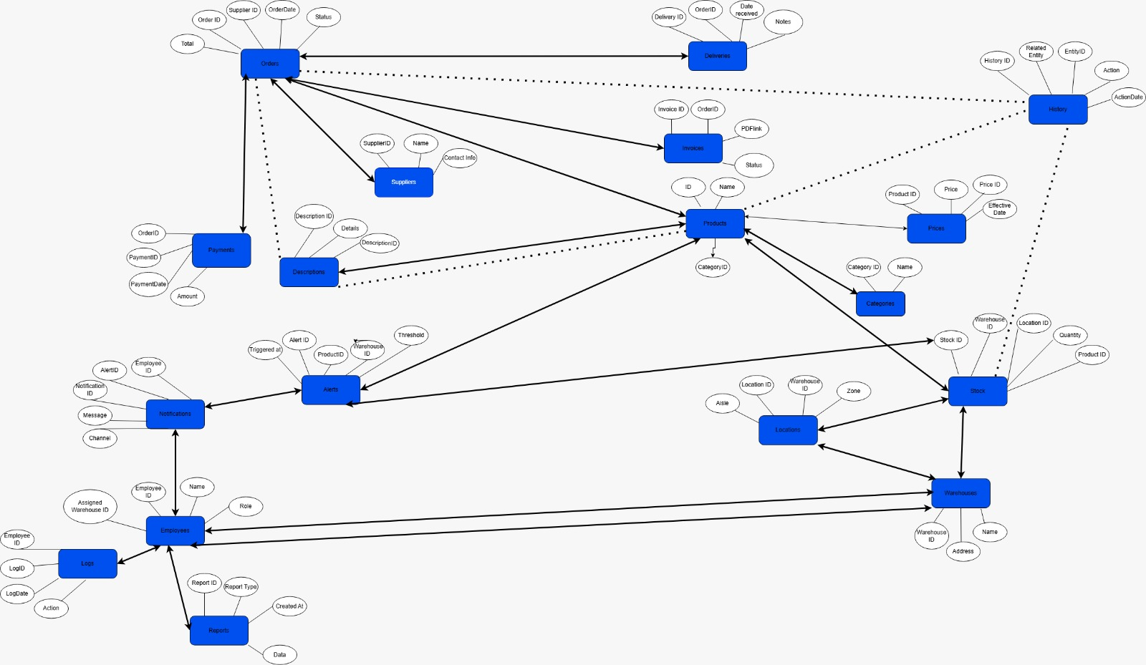
EERDD
Created the diagram
Clear vision and goal

Slide 3
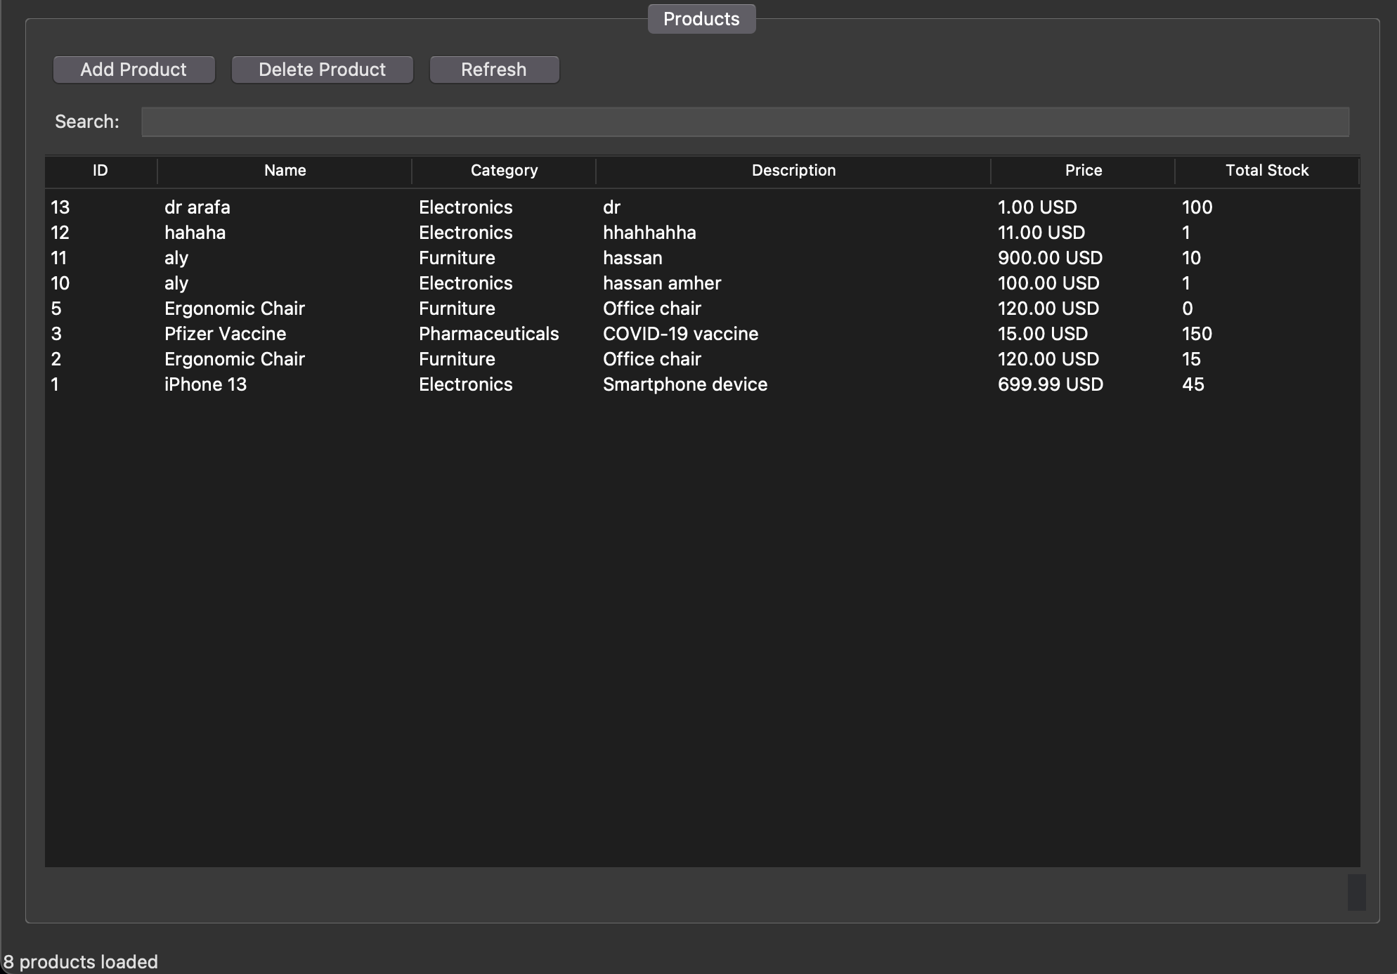

Home Page
Consists of our products
Add product button
Delete product button
Refresh button
Search Bar
And all products in inventory

Slide 4
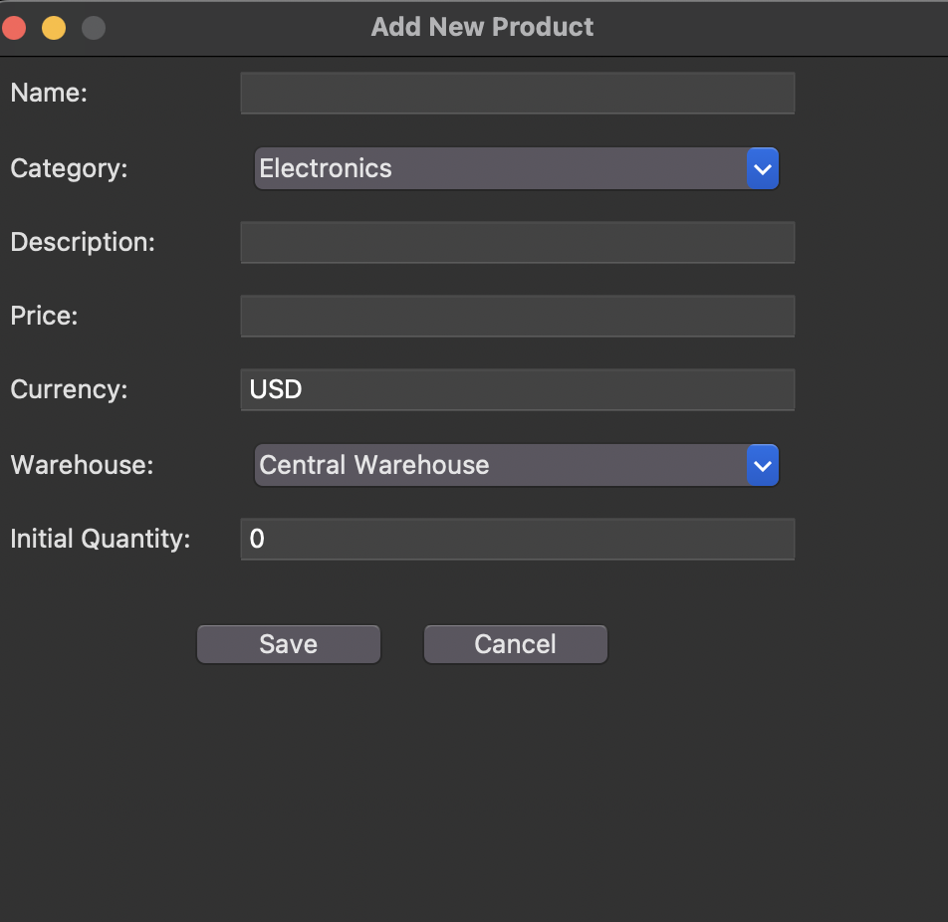
How to add products
Consists of the Name of product
The category in which the product falls in
A brief description
Price
Currency
The warehouse it will be stored in
The quantity available

Slide 5
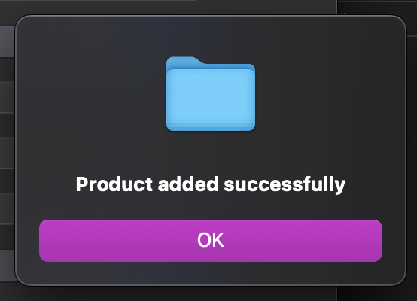
How to know when a product is successfully added

Slide 6

Thank you

