Slide 1



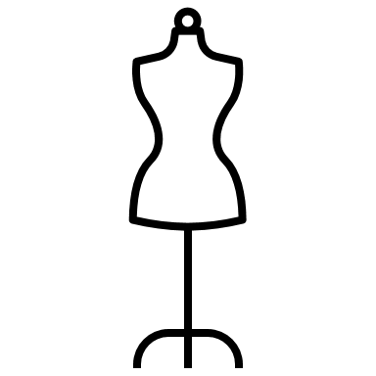
Fashion Trends Analysis
Project 3
Group 1 – Crystal Burkhardt, Alice Krauze, Jonathan Koo, Charles Martin, Khyati Thakore

Slide 2
Background/Purpose
Data analytics is used in the fashion industry to allow companies to make better decisions, make predictions about consumers and competitors, effectively market products, etc. by determining what trends are selling, what type of customers are buying them, how much inventory to order, and what sales might look like in the future
We looked at an e-commerce site ssense.com and placed ourselves as a potential competitor in the fashion world
SSENSE has garnered critical acclaim as both an e-commerce engine and a producer of cultural content
The site generates an average of 100 million monthly page views
Approximately 80% of its audience is between the ages of 18 to 40
High double digit annual growth and profitability since its inception

Slide 3
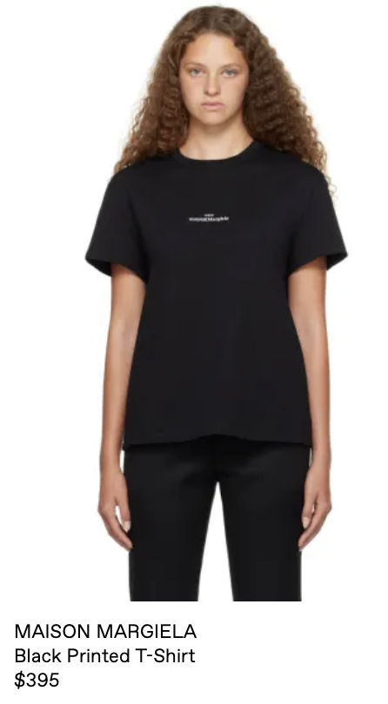
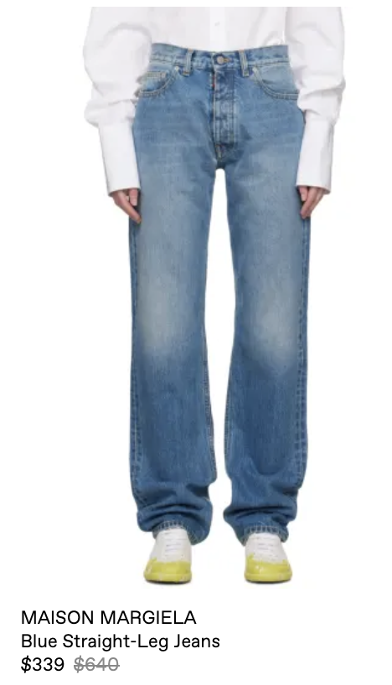
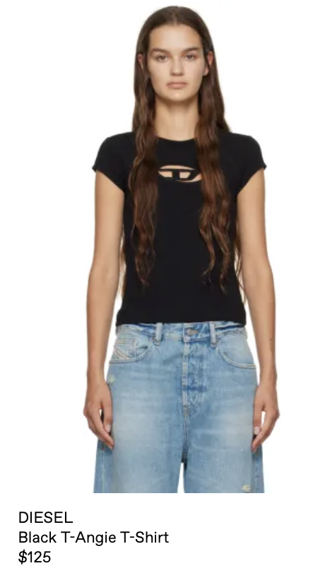
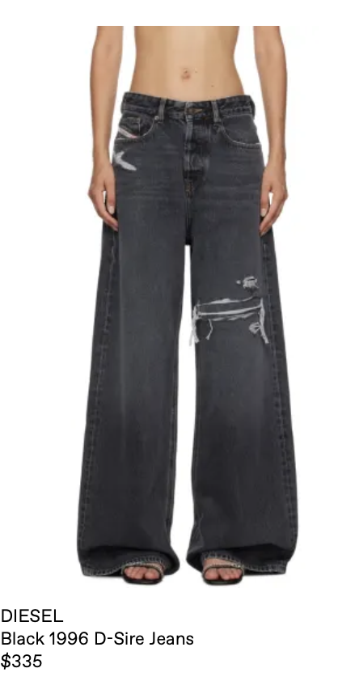
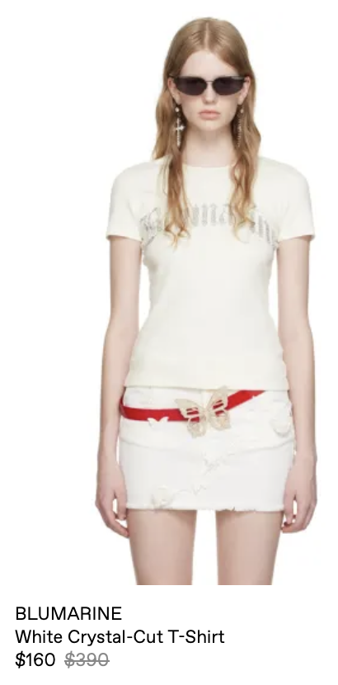
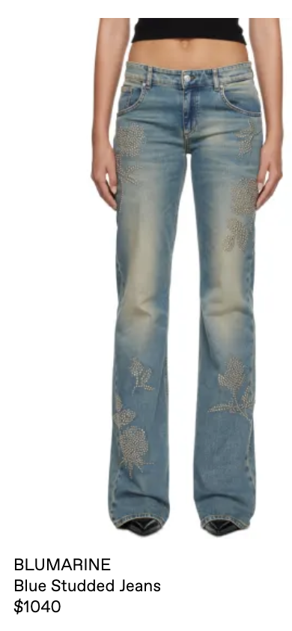
Data Scraping for Maison Margiela, Diesel, Blumarine
3 similar brands in the fashion world
Diesel & Maison Margiela owned by OTB group
Searches by region
Searches throughout the year
Prices of Jeans and Shirts of Each Brand

Slide 4
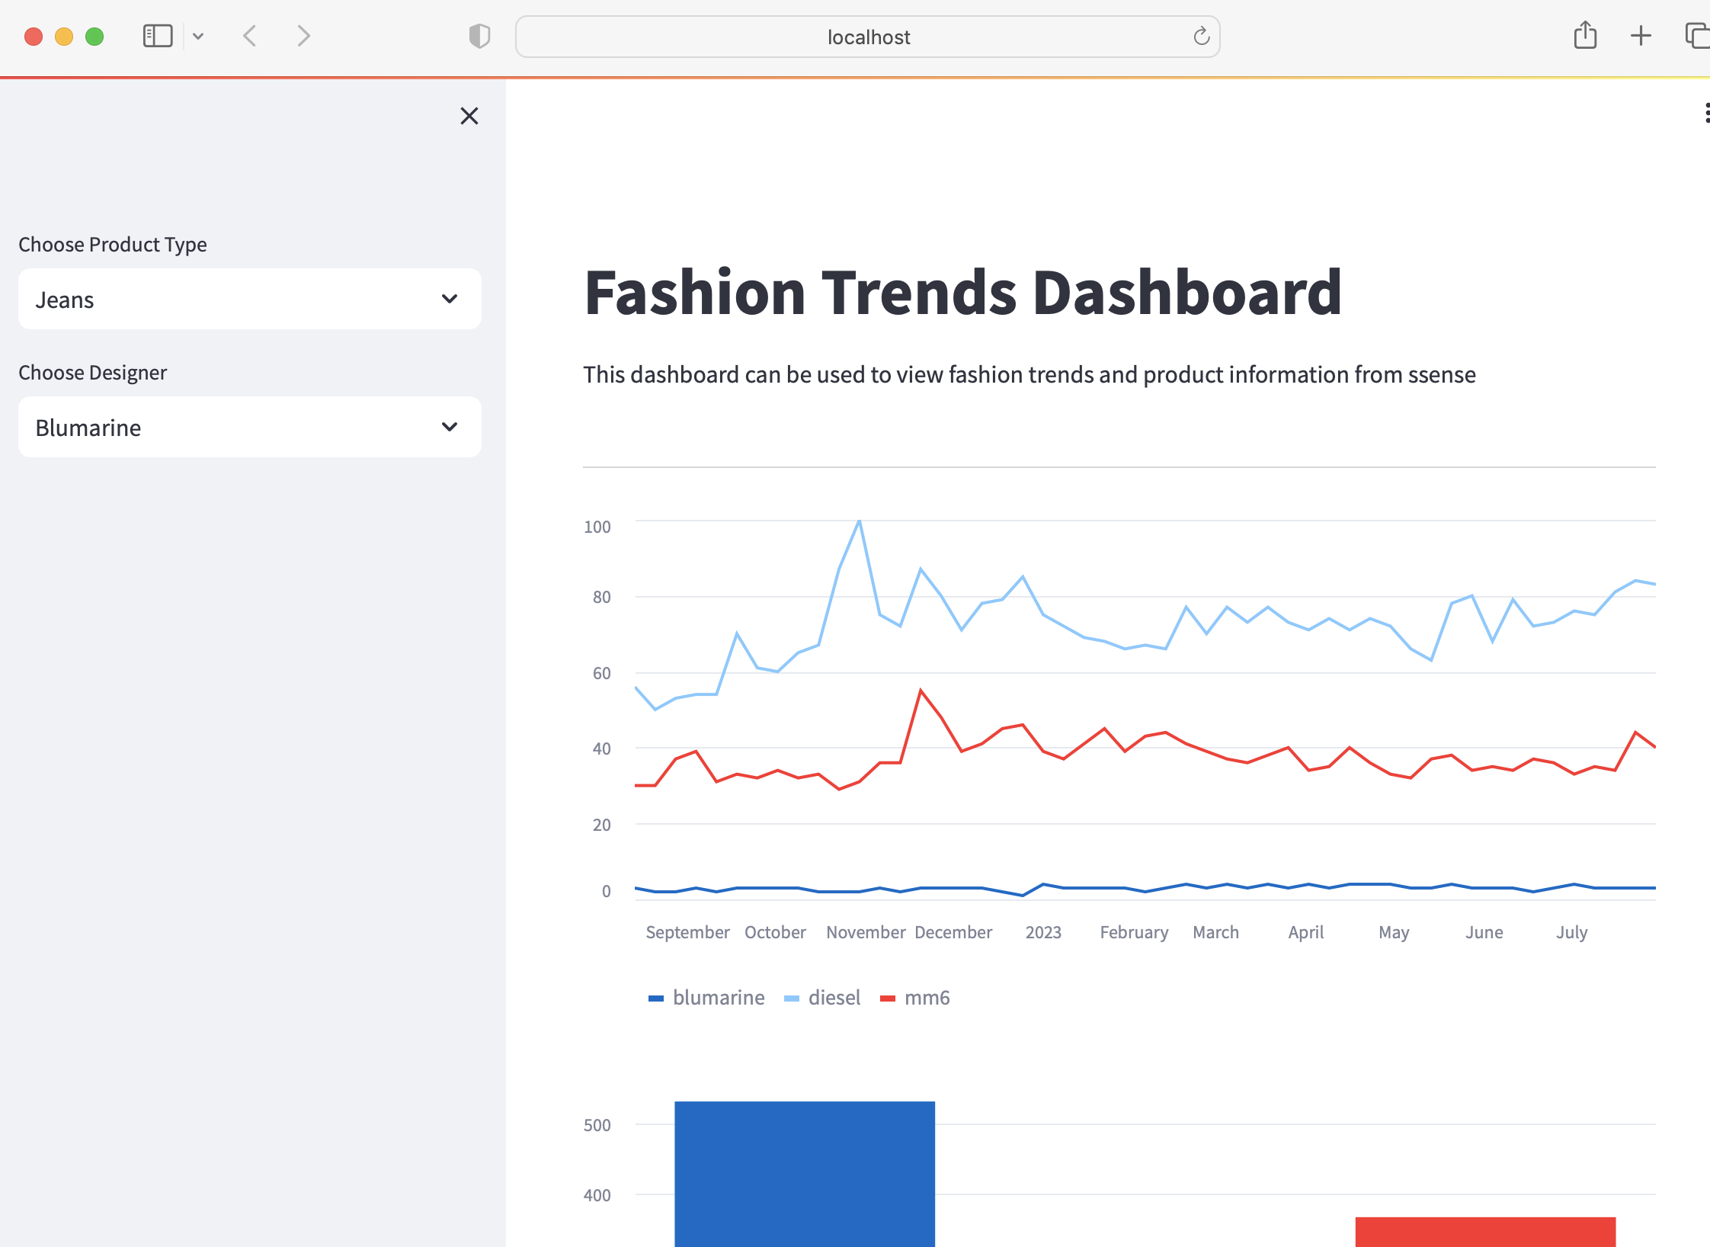
Dashboard/App
Utilized Streamlit (java script library)

Slide 5
Analysis
Diesel and MM6 are owned by a larger group able to mass produce for consumerism = cheaper options
Include a larger amount of diesel in stock since it is more likely to be searched
Smallest stock of Blumarine, consider having these as sale items
Medium stock of MM6
MM6 & Diesel include wider legged pants => more likely to be sold vs Blumarine has a more narrow collection of pants
Possible future fashion trend we can look into buying more of this style clothing

Slide 6
Data Limitations
We narrowed our search to 3 designers and 2 product types, with the intention that the tool would be dynamic and scalable to allow for more products and designers
Not having access to: sales data (how much is sold/ in stock), how many times a refence on the page has been clicked on, demographic of buyers
Information on how much ssense was purchasing items for vs. selling point

Slide 7
Future Analysis
Types of buyers
What trends are more likely to sell
Comparing a larger scale of brands and apparel items
Analyze the different types of jeans:
Skinny, wide leg, bootcut, flare

Slide 8
Questions/Comments?

