Slide 1
SW Project
Clothes Store

Slide 2
Clothes Store System
Introduction:
This presentation shows our implementation of the full cycle often software development including system requirements, system analysis, system design, system implementation, system testing while applying diagrams and using the Object-Oriented Programming and Design which is a powerful programming style.
User Requirements:
Our product is a clothes store. The system is a simple clothes shop management system that stores the product id, quantity of items, their prices, it also stores username, mobile, history of sale process and allows each user to have his own privileges and his own access to certain data.
It starts with a login screen in which each type of user can login using his own username and password. After logging in successfully each type of user can use his own privileges to use the product as designed.
For example: cashier will login, it can view two options (new purchase / logout), An administrator is the one with the most privilege.

Slide 3
Feasibility study:
Financial Feasibility:
The system will flow the freeware software standards. No cost will be charged from the potential customers. Bug fixes and maintaining tasks will have its cost, beside the associated cost.
Technical Feasibility:
Project is a desktop application, main technologies and the tools that are associated with project are:
- JAVA programming language
- NetBeans
- MySQL
- Swing tool in java used for GUI
Diagram drawing tools:
- Microsoft vision

Slide 4
Resource and Time Feasibility:
Resources that are required for the project includes:
- Programming device (Laptop).
- Programming tools (freely available).
- Programming individuals.
Time limitations of the product development and the ease of implementing using these technologies are synchronized.
System Requirements:
Functional Requirements.
Non-Functional Requirements.

Slide 5
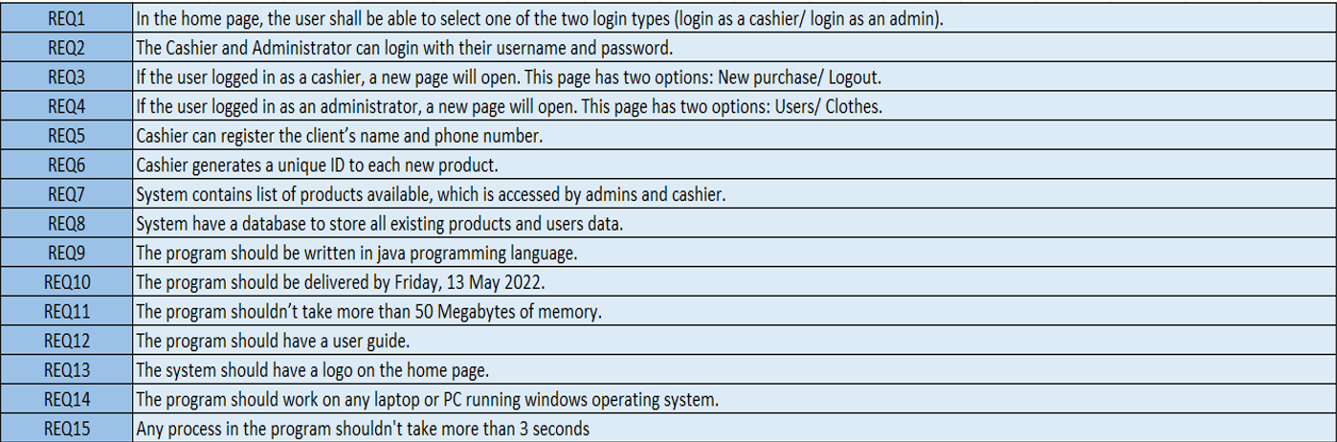
Requirements Validation:
Requirements:

Slide 6
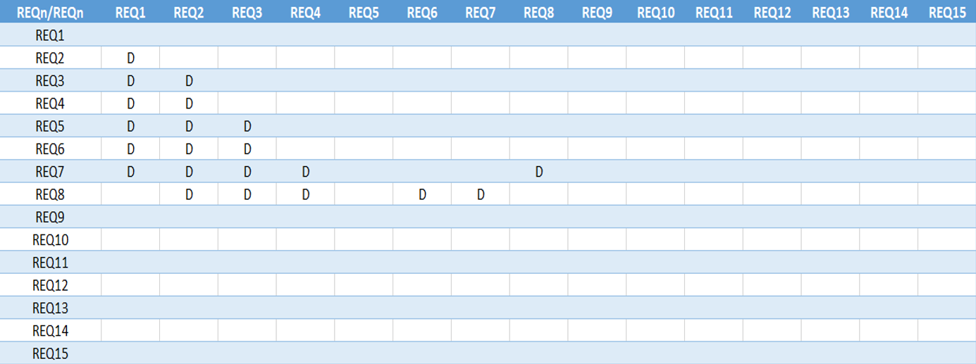
Requirements traceability Matrix:

Slide 7
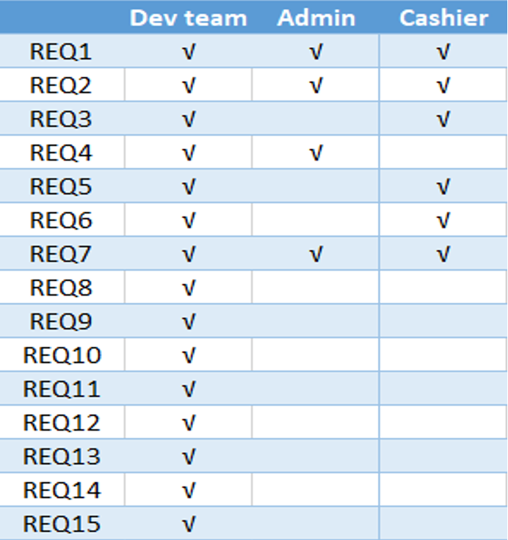
Source traceability Matrix:

Slide 8
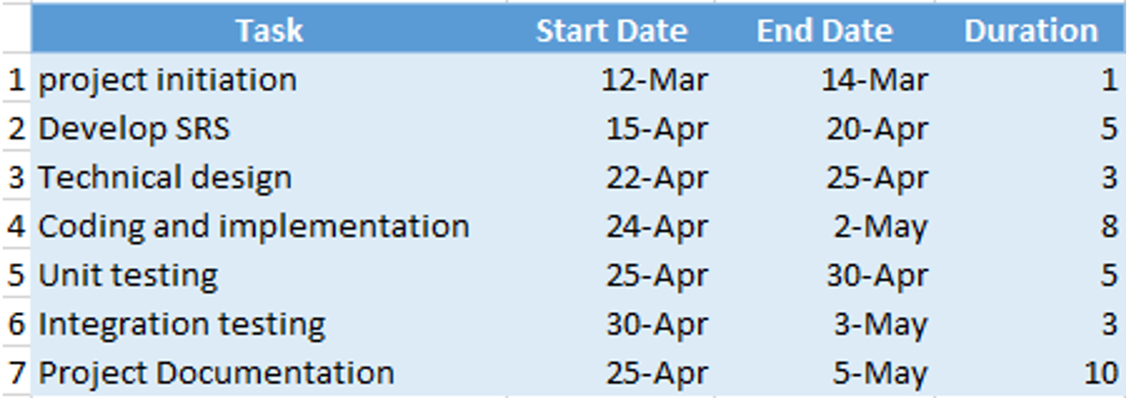
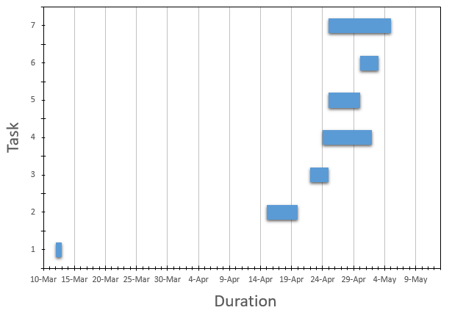
Gantt chart:

Slide 9
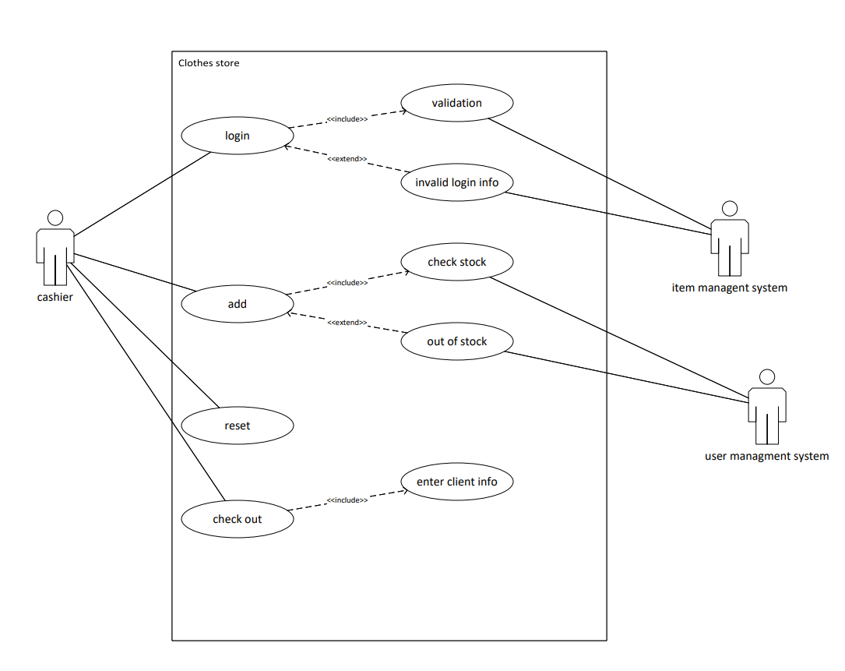
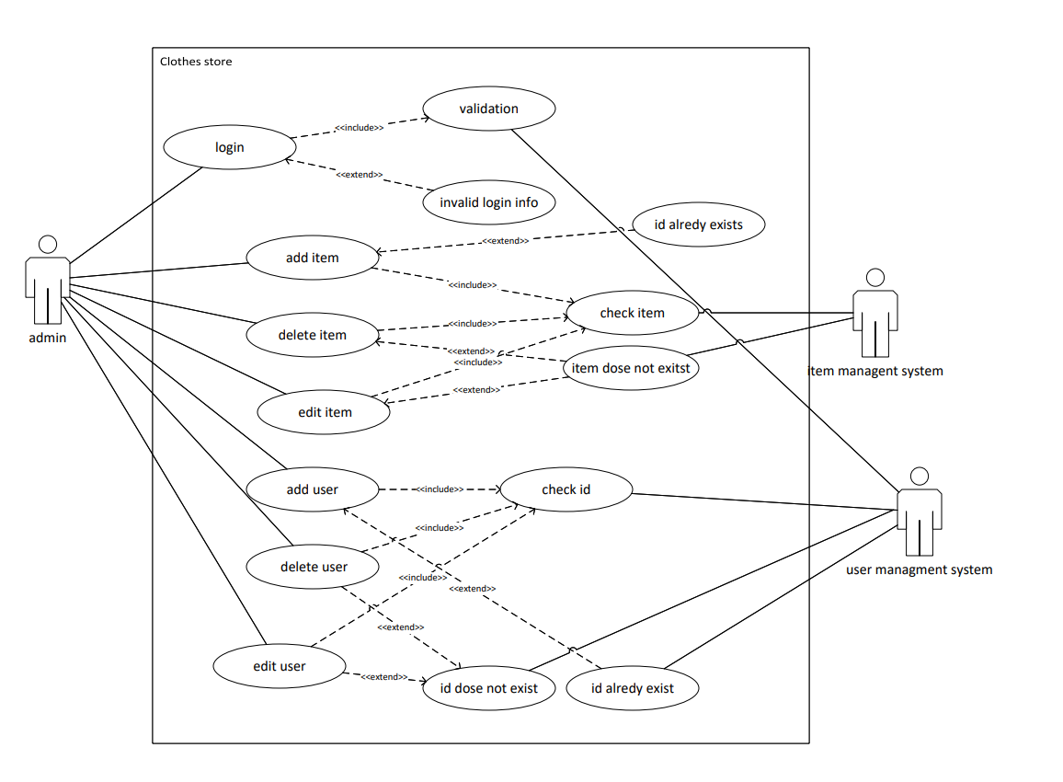
Diagrams
Use-Case Diagram:
Cashier use case diagram Admin use case diagram

Slide 10
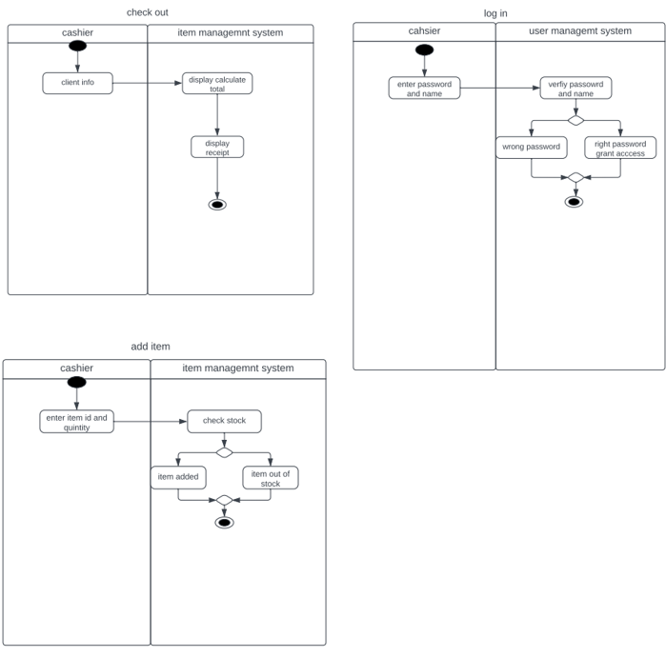
Swimlane Diagram:
Cashier use cases:

Slide 11
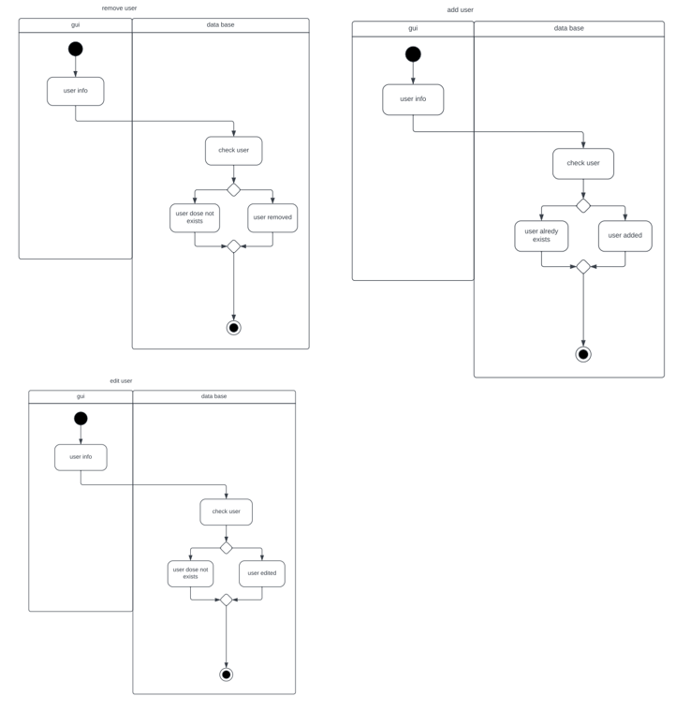
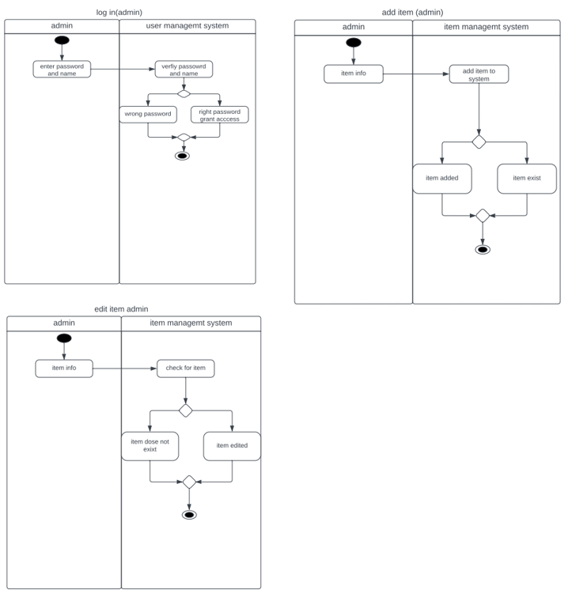
Admin use cases:

Slide 12
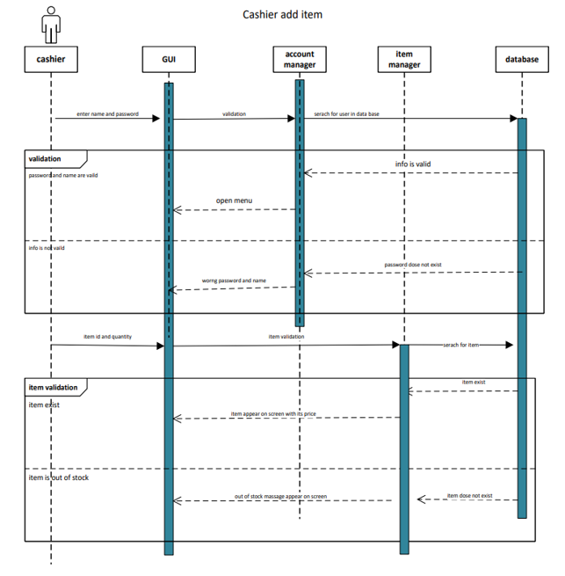
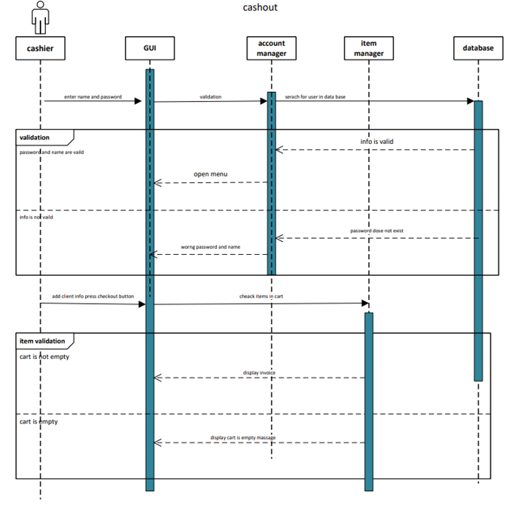
Interaction Diagrams:

Slide 13
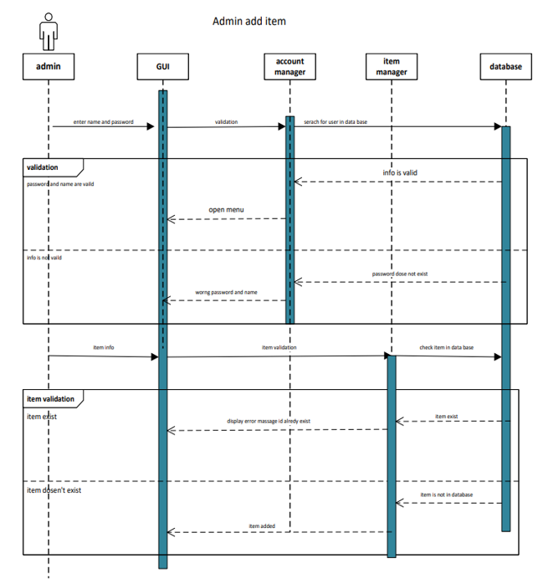
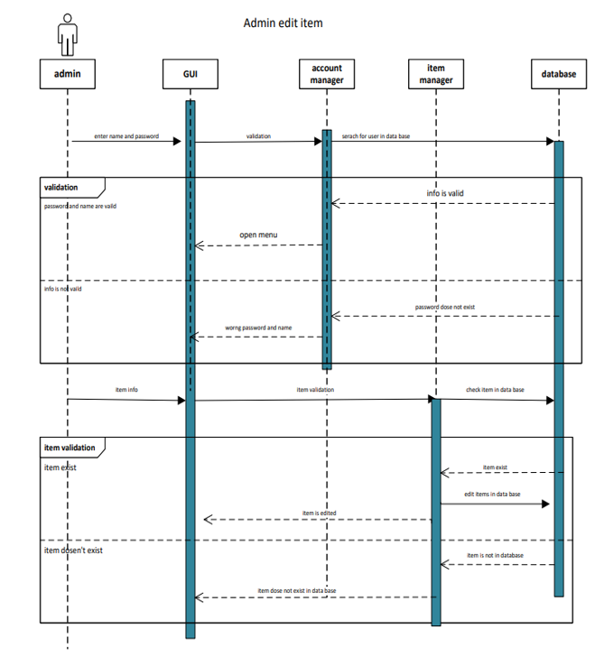

Slide 14
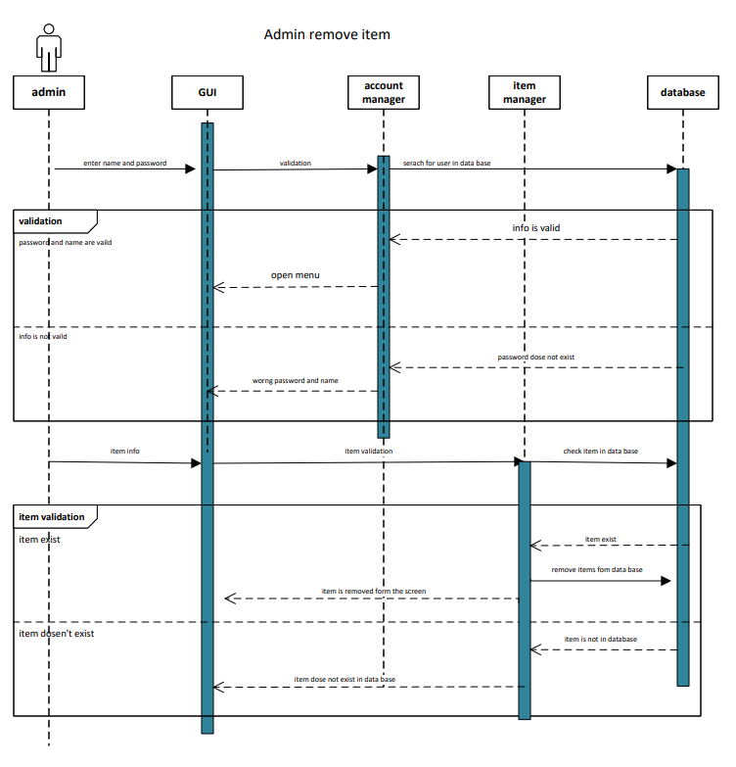
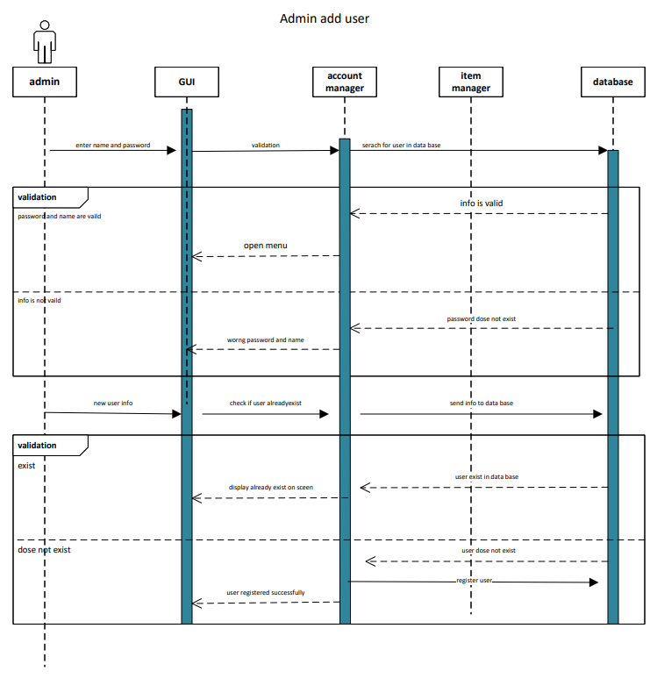

Slide 15
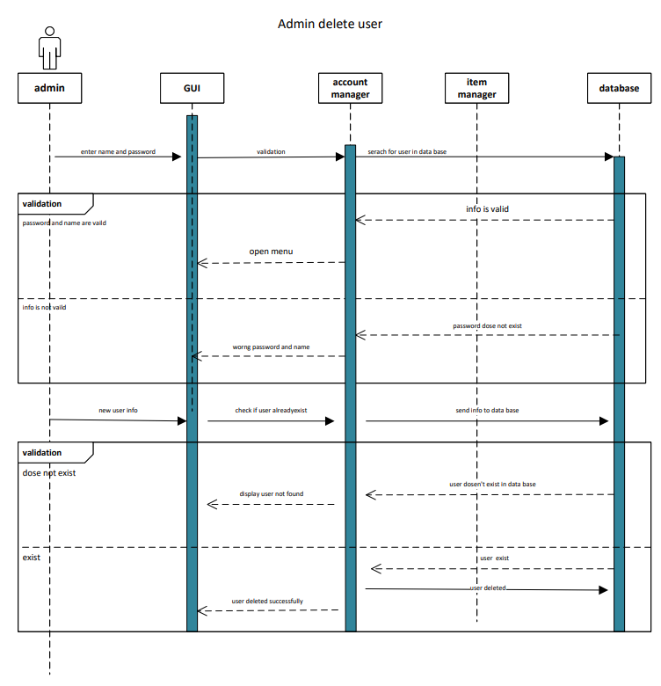
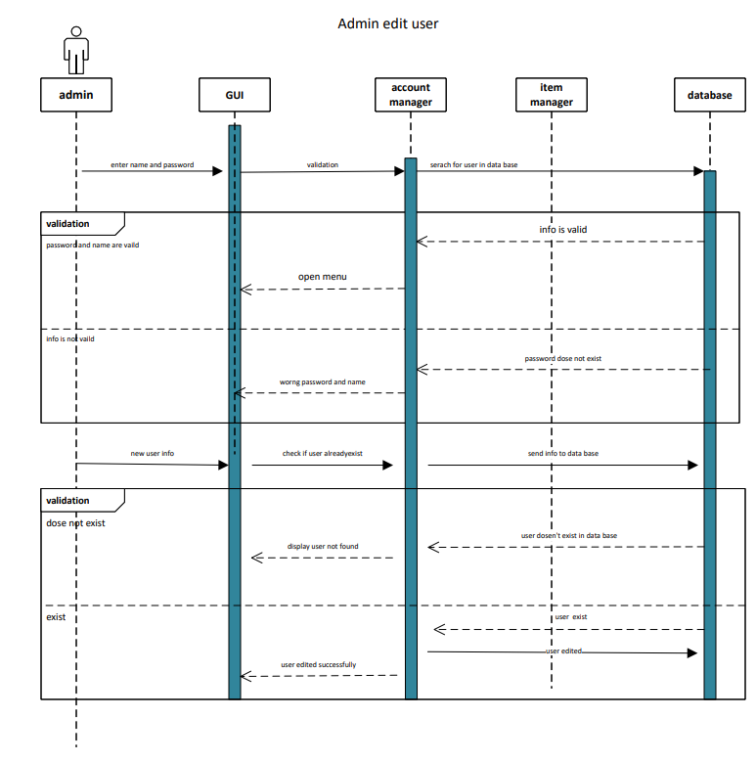

Slide 16
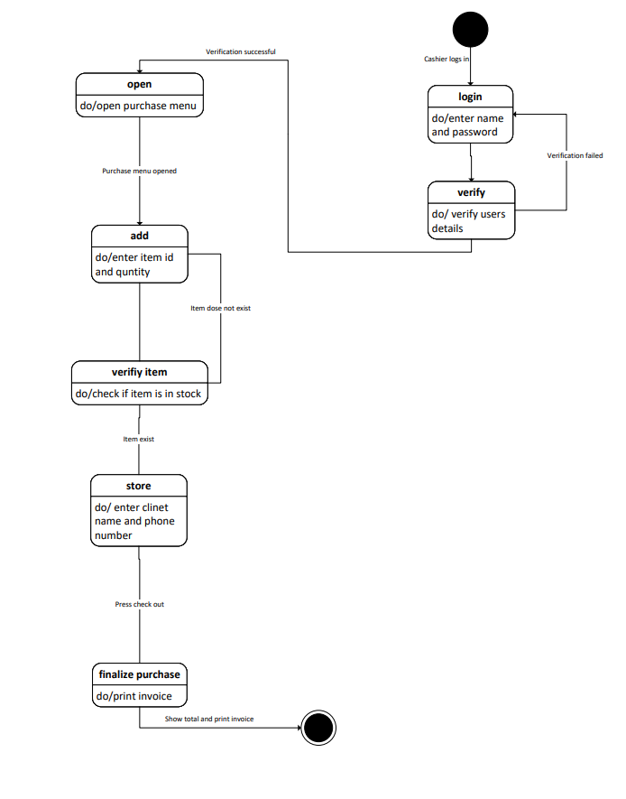
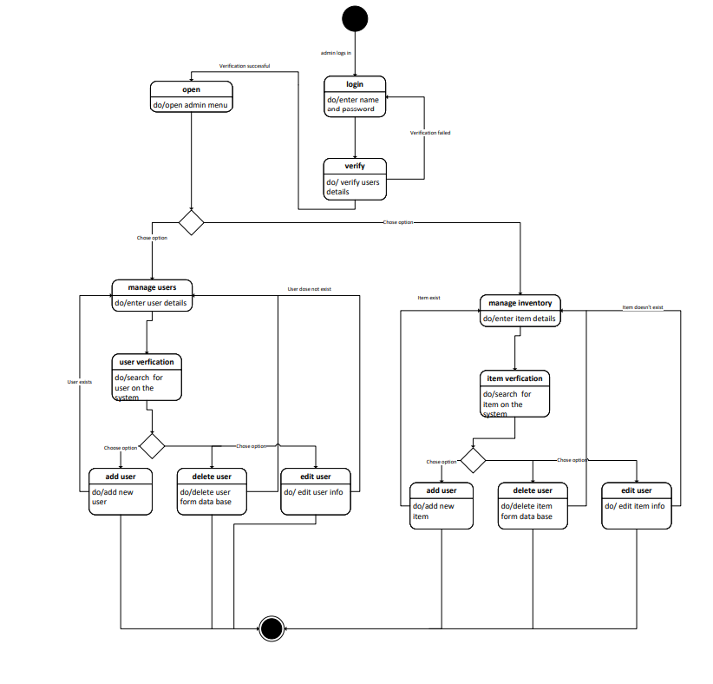
State Diagram:
Cashier state Diagram Admin state Diagram

Slide 17
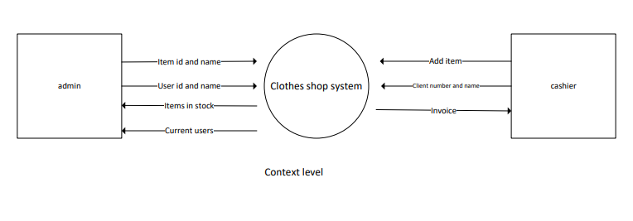
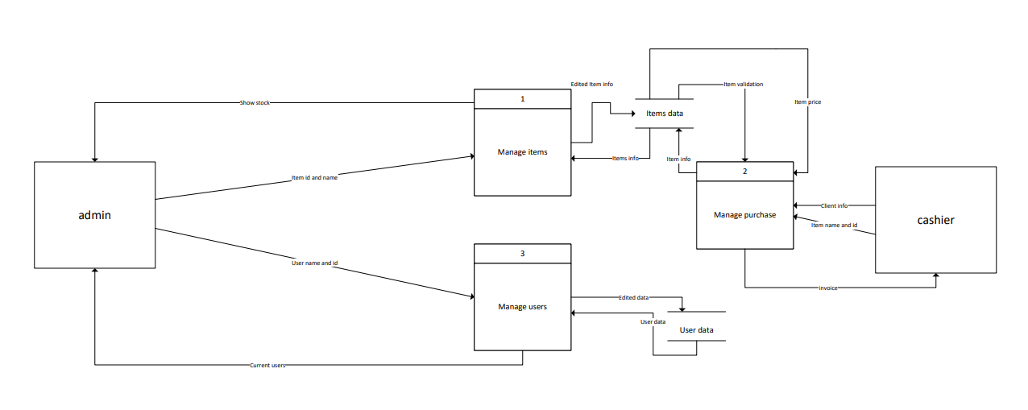
Data Flow Diagrams:
Context diagram
DFD level 0

Slide 18
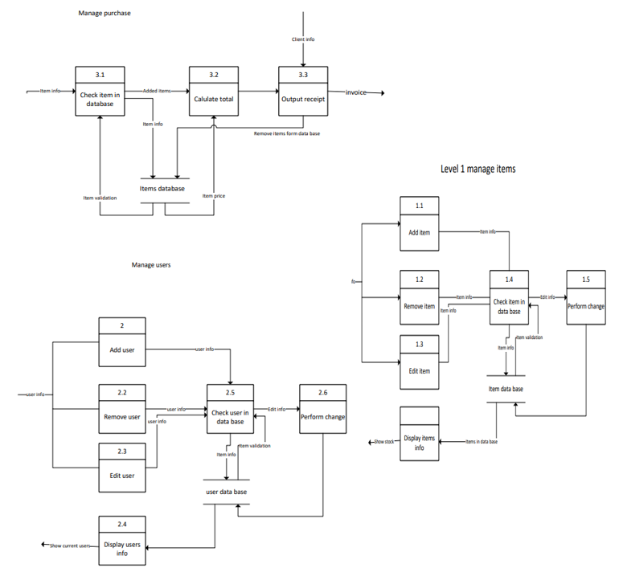
Level 1:

Slide 19
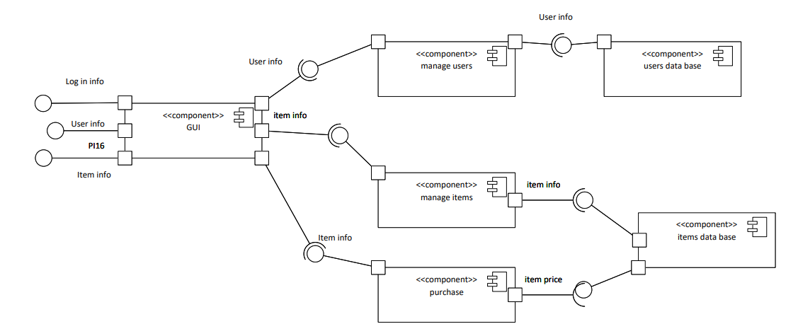
Component Diagram:
Component diagram

Slide 20
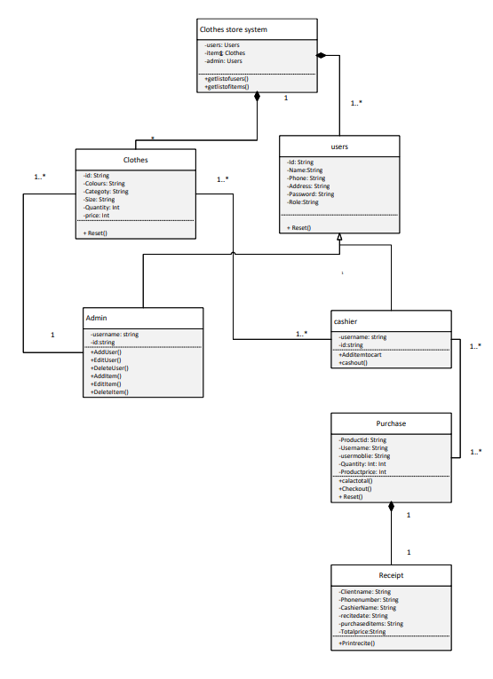
Class Diagram:
Class diagram

Slide 21
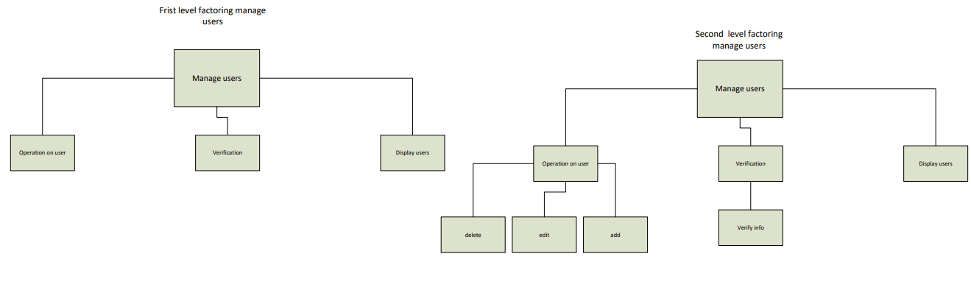
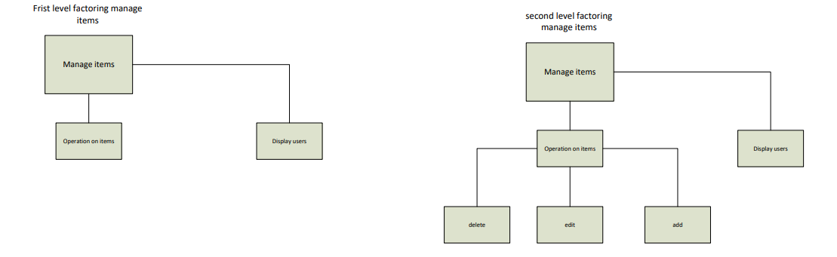
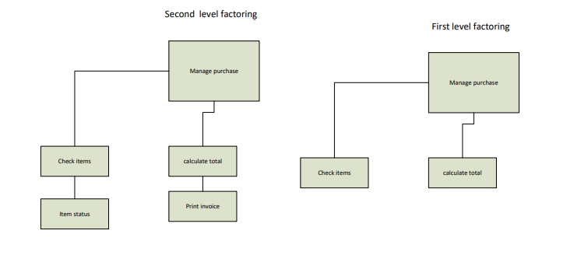
Architectural Diagram:

Slide 22
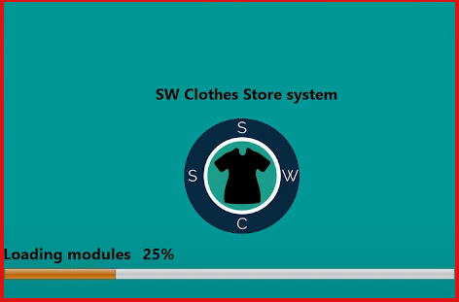
End-User Guide:
Steps:
1- Open the system and wait for loading window to complete.

Slide 23
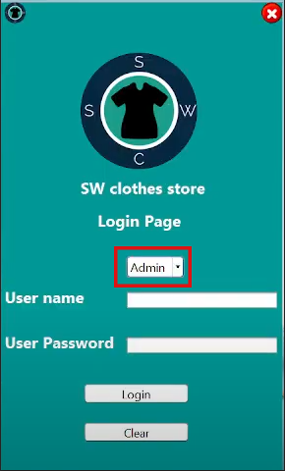
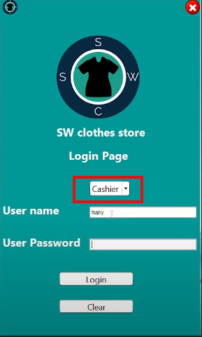
2- After loading window completed, the home page will open.
- In this page there are a selection box, from which you can choose one of the two modes to login:
Admin Mode
Cashier Mode

Slide 24
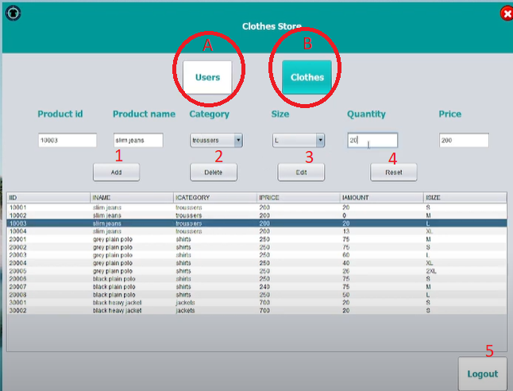
3- Select one of the two modes, enter your user name and password then press login.
4- If you select the Admin mode:
- If you entered invalid user name or password, a message “Wrong user name or password” will warn you.
- If you entered a valid user name and password, your page will open. This page contains two options: A (Users)/ B (Clothes).
Login with the default admin user name: ahmed and password: lolbiglol.

Slide 25
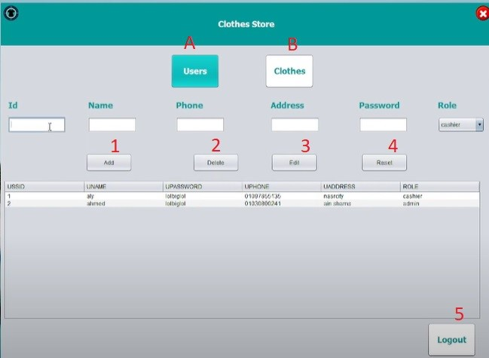
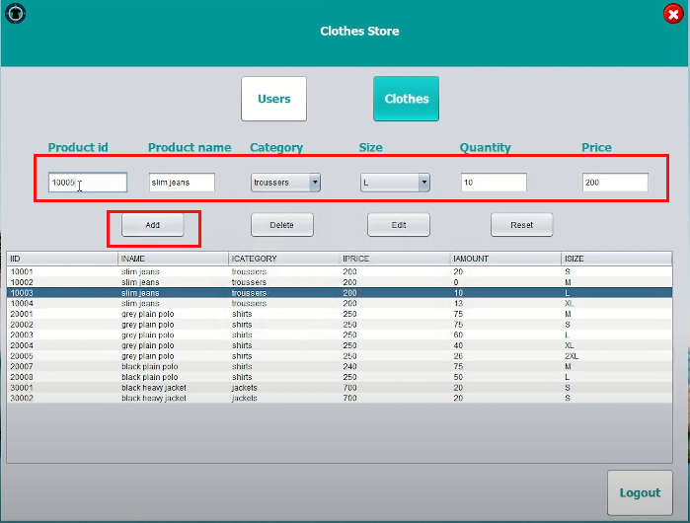
In Clothes page (option B), the administrator will be able to Add, Delete and Edit the clothes data by their ids, he also will be able to Reset the written data. the page may have a text area that contains: Product id, Color, Category, Size, Quantity and the Unit price.
In Users page (option A), the administrator will be able to Add, Delete and Edit any data of the users by their ids, he also will be able to Reset the written data. it may have a text area that contains: User id, Name, Phone Number, Address and Password.

Slide 26
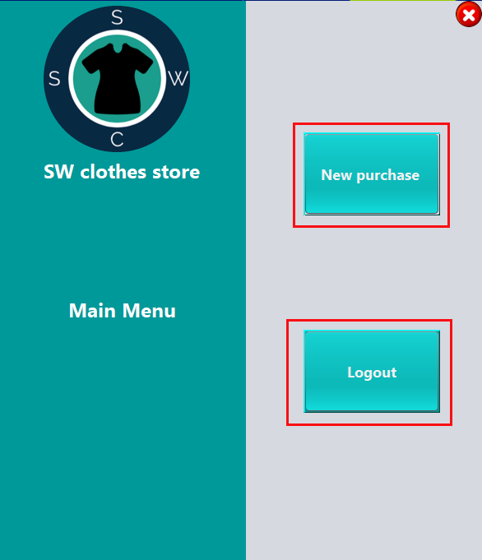
5- If you select cashier mode, you will have to option: new purchase/logout.

Slide 27
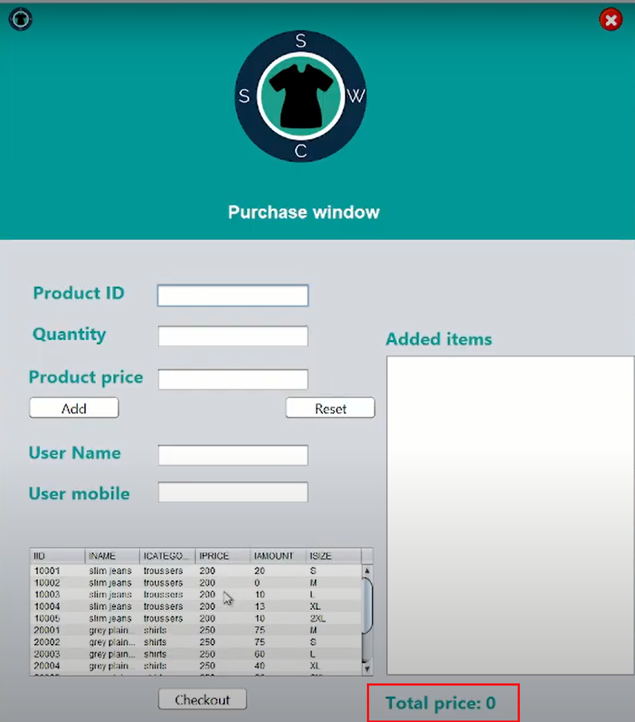
If you select new purchase option, this window will be opened with a total price zero as no products added yet:

Slide 28
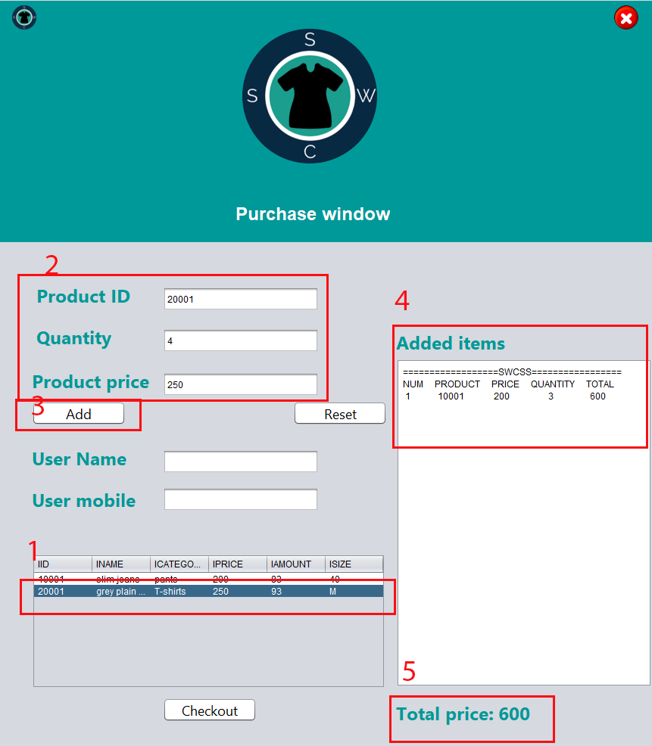
If you want to add a product choose it from table step (1), then enter its data step (2), then choose add step (3), so quantity of item you choose appear in added items box (4) and the total price appear below added item box (5).

Slide 29
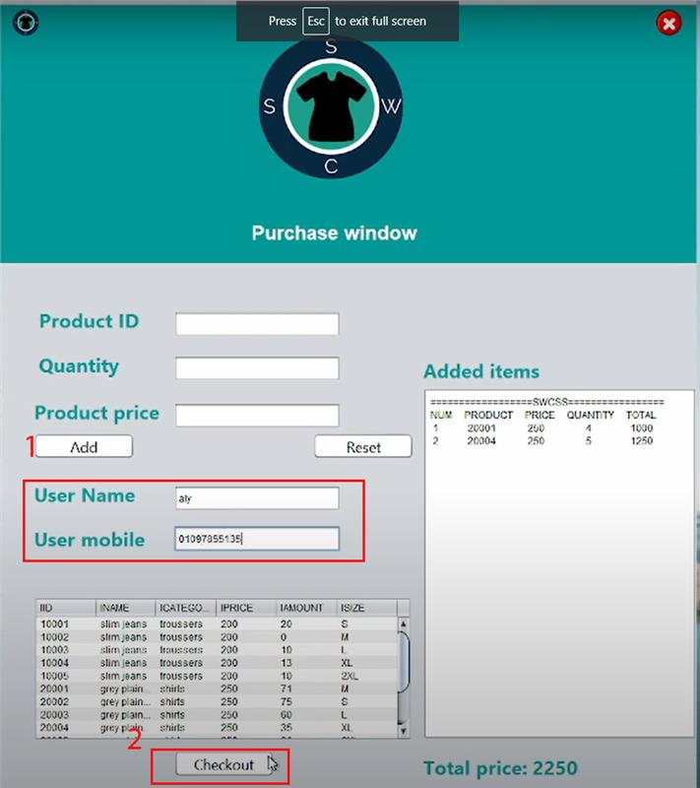
Before you choose checkout (2), you should enter user name and user mobile (1).

Slide 30
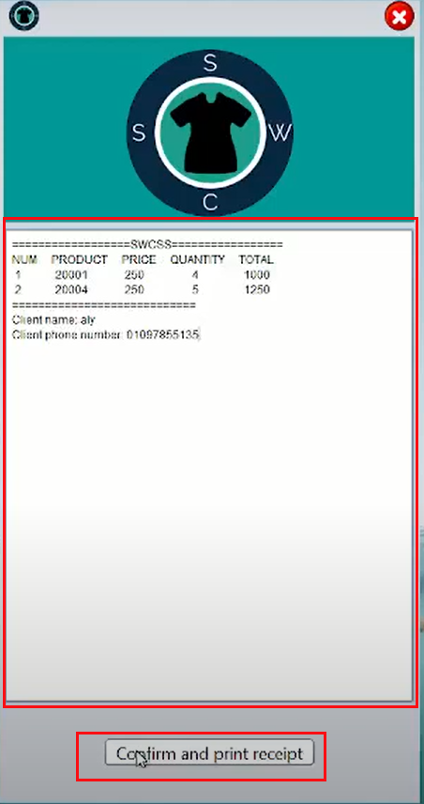
After you choose checkout, this window will appear.

Slide 31
Conclusion:
This document starts by an introduction which summaries what is the system we develop, then the user requirements which contains what does the user want (functional and nonfunctional requirements). Then followed by Feasibility study, we discuss in this part the financial, technical, resource and time constrains.
From the user requirements we concluded the system requirements, divided it into functional and nonfunctional requirements, then we built requirement traceability matrix and source traceability matrix.
Then we discussed all the diagrams: use case, swinlane ,component, sequential, data flow, class and architectural diagrams. then finally we introduce the end user guide.

