Slide 1


AOIFE’S GP PRACTICE
STREAMLINING PRACTICE OPERATIONS WITH R
PRESENTATION
Nur Alya Maisarah Abd Karim
A00268252

Slide 2

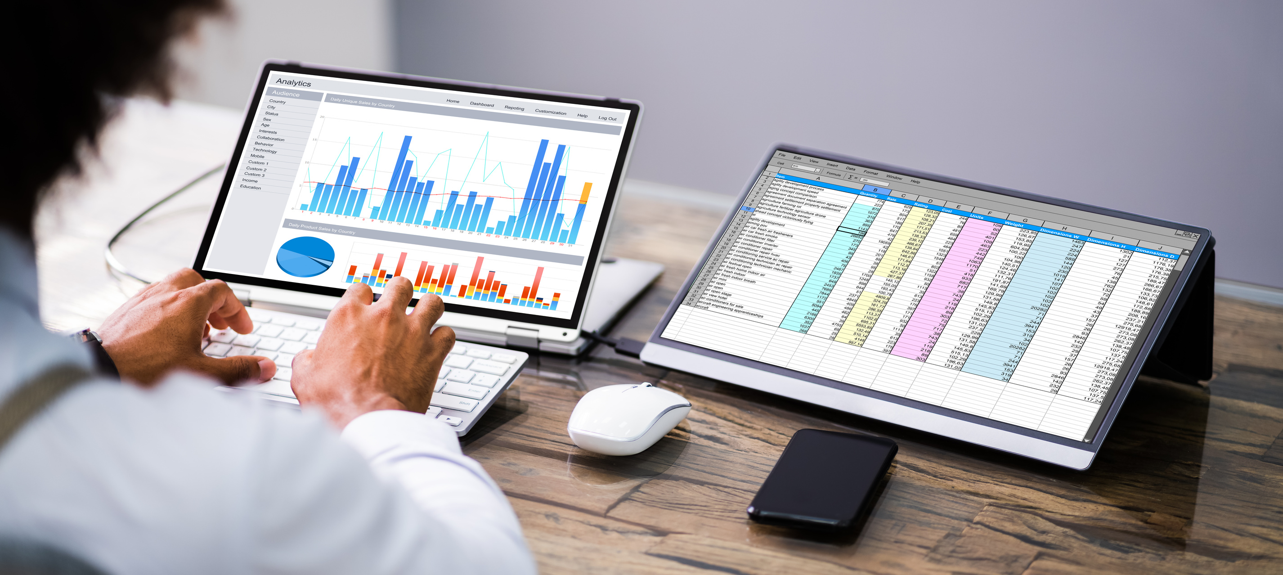
Aoife’s GP Practice
Agenda
•Introduction
•Challenges Faced by the Practice
•Centralizing and Cleaning Data
•Automating Reporting Tasks
•Data Analysis and Visualization
•Interactive Dashboards with Shiny
•Broader Impact for the Practice
•Conclusion

Slide 3

Aoife’s GP Practice
Introduction
Brief overview: To highlight the role of R in improving operations for Aoife's practice
Key objective: Showcase tools and methods to reduce manual effort, improve data management, and enhance compliance

Slide 4

Aoife’s GP Practice
CHALLENGES
FACED BY THE PRACTICE
Data Management Issues: Data is scattered and difficult to analyze efficiently
Manual Reporting Effort: Reimbursement claims and tax summaries take time and are prone to errors
Compliance And Monitoring: Ensuring accuracy in reporting to healthcare and regulatory bodies

Slide 5


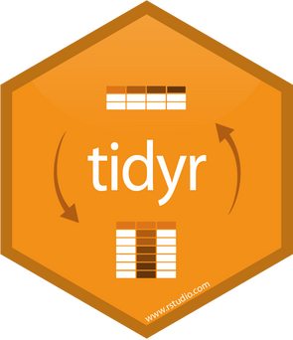
Aoife’s GP Practice
Centralizing and Cleaning Data
Tool Mentioned: R packages (dplyr, tidyr)
How It Helps:
Consolidates data into one structured format
Eliminates duplication and inconsistencies
Example:
Combines patient, appointment, and billing data into a single system for analysis

Slide 6
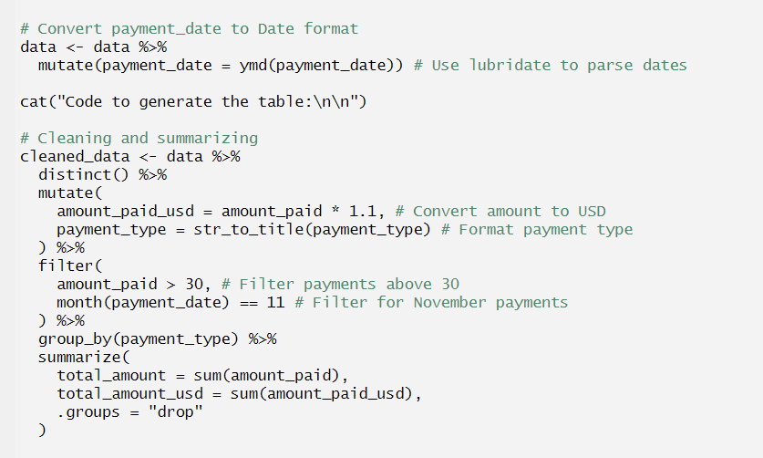
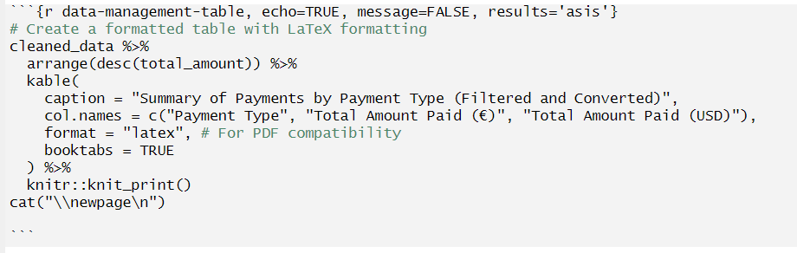

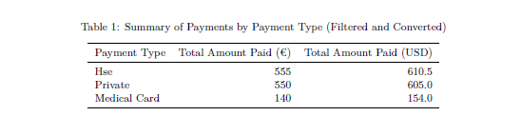
Aoife’s GP Practice
Centralizing and Cleaning Data

Slide 7
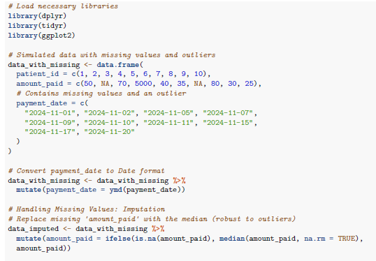
Aoife’s GP Practice
Centralizing and Cleaning Data

Slide 8


Aoife’s GP Practice
Data Analysis and
Visualization
Tool Mentioned: ggplot2
How It Helps:
Transforms complex data into easy-to-understand visuals
Example Visuals:
Bar charts of GP performance
Pie charts of revenue sources
Benefit:
Supports better operational decisions with clear insights
www.reallygreatsite.com

Slide 9
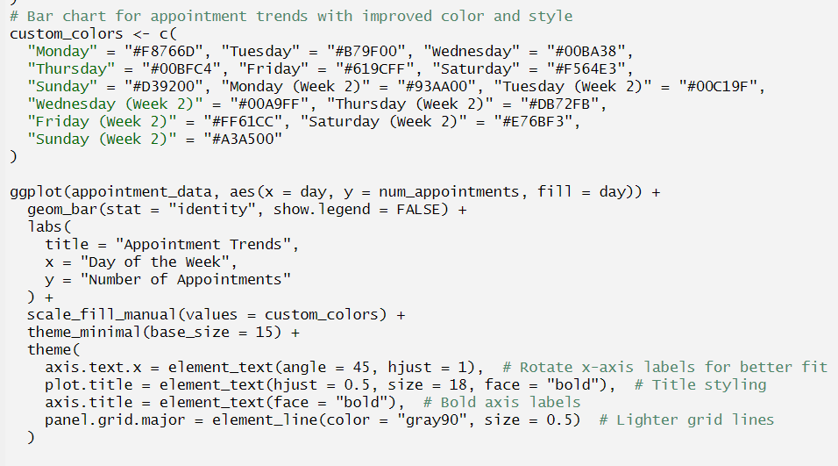
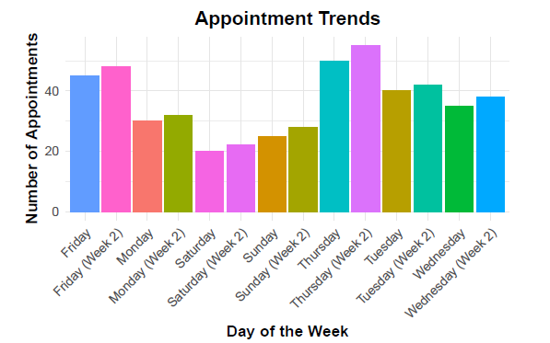
Aoife’s GP Practice
Data Analysis and
Visualization

Slide 10
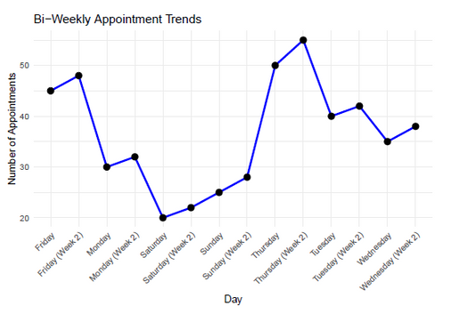
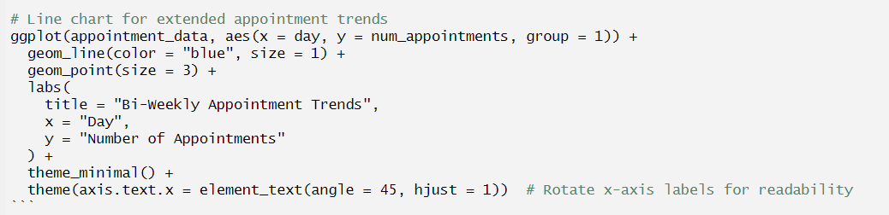
Aoife’s GP Practice
Data Analysis and
Visualization

Slide 11


Aoife’s GP Practice
Automating and
Reporting Tasks
Tool Mentioned: R scripts for automation using functions like mutate(), summarise(), and kable()
How It Helps:
Generates regular reports such as HSE reimbursements or tax summaries automatically
Benefit:
Saves staff time and reduces error rates
Example:
A reproducible script that calculates monthly HSE claims accurately

Slide 12
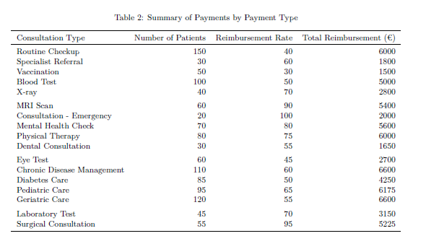
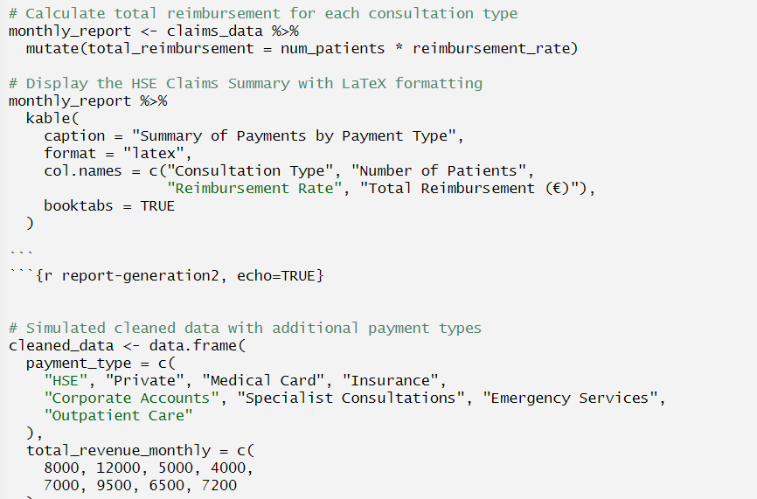
Aoife’s GP Practice
Automating and
Reporting Tasks

Slide 13


Aoife’s GP Practice
Interactive Dashboards with Shiny
Tool Mentioned: Shiny for real-time dashboards
How It Helps:
Allows the team to view trends dynamically
Offers real-time tracking of key metrics like appointments or financial data
Example Dashboard Features:
Interactive charts for patient appointments and compliance metrics
Financial performance visualizations

Slide 14

Aoife’s GP Practice
Broader Impact For
the Practice
Operational Efficiency Gains:
Less time on admin tasks, more time on patient care
Improved Decision-Making:
Using data to support thoughtful planning and strategy
Compliance Assurance:
Automated checks reduce errors in reporting to regulators

Slide 15

Aoife’s GP Practice
Summary:
R can transform practice operations, enabling better data management, automation, and compliance
Final Takeaway:
By using R, it can empower Aoife’s team to focus on what matters most: quality patient care and strategic growth
Conclusion

