Slide 1



SARAH’S REPORT
PREPARING PROPERTY DATA FOR PRICE PREDICTION: A COMPREHENSIVE DATA CLEANING AND FEATURE ENGINEERING APPROACH
PRESENTATION
Nur Alya Maisarah Abd Karim
A00268252

Slide 2

Lists of
CONTENT
Executive Summary
Introduction
Data Cleaning
Removing Outliers
Creating Additional Columns
Visualization
Conclusion

Slide 3
EXECUTIVE SUMMARY
Objective: Prepare PropertyDataset1 and PropertyDataset2 for predictive modeling of property prices in Ireland
Key Steps:
Data Cleaning: Addressed missing values, standardized formats, and removed outliers
Data Enrichment: Created new explanatory variables, such as year of sale and price categories
Visualization: Highlighted trends and relationships in property transactions
Outcome:
To deliver a unified and structured dataset, ready for analysis and to enable Sarah to proceed directly with modeling property prices effectively

Slide 4
INTRODUCTION
Objective:
Transform PropertyDataset1 and PropertyDataset2 into clean, structured, and enriched datasets for predictive modeling of property prices in Ireland
Datasets Overview:
PropertyDataset1: Includes additional fields like geohash and raw_address, offering precise location data for analysis
PropertyDataset2: Contains sale details, with encoding issues requiring adjustment (ISO-8859-1 for special characters)

Slide 5

Data Preparation Process
R Environment Setup: Configured CRAN mirror and installed tinytex for PDF reporting
Loading Data: Used read.csv() to load both datasets. Addressed encoding issues in PropertyDataset2 with ISO-8859-1
Initial Inspection: Examined datasets using head() to assess structure, identify inconsistencies, and highlight missing data
Standardization
Column names were standardized across both datasets for consistency, reducing errors during the merging process and ensuring seamless analysis
Libraries Used:
dplyr: Data manipulation (e.g., renaming columns, combining datasets)
ggplot2: Visualization tools for exploring trends and relationships in the data
tidyr: Reshaped and tidied the data for easier manipulation
lubridate: Used to handle and standardize date formats
stringr/stringi: Cleaned and processed textual data, including addresses and property descriptions
Challenges:
Addressed encoding issues in PropertyDataset2
Harmonized additional fields like geohash and raw_address in PropertyDataset1 for consistency

Slide 6
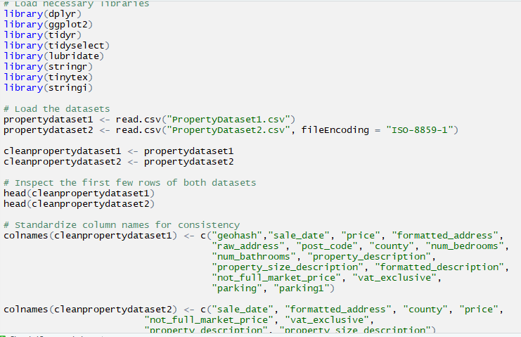

Slide 7






Cleaning Process Overview
Purpose: Ensure both datasets are clean, consistent, and suitable for merging and analysis.
Steps Taken:
Removed duplicate rows to maintain dataset integrity.
Validated and standardized data types, ensuring numeric fields (e.g., price) and date fields (sale_date) were correctly formatted.
Cleaned and formatted date entries for consistency across datasets.
Processed addresses to remove inconsistencies, standardize formatting, and handle special characters.
Packages Used: dplyr, tidyr, lubridate, stringr/stringi
DATA CLEANING

Slide 8
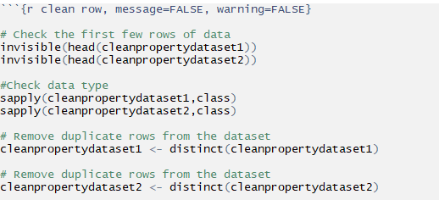

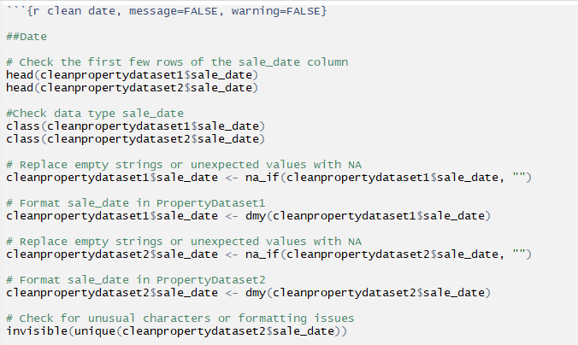
Removing Duplicates and Data Type Validation
Used dplyr::distinct() to identify and remove duplicates.
Cross-referenced duplicates using key columns like formatted_address and sale_date.
Validated data types using sapply(), ensuring sale_date was properly recognized as a date and price as numeric.
Corrected data types using mutate() and as.Date() where necessary.
Date Formatting and Cleaning
Standardized dates to YYYY-MM-DD using lubridate::dmy().
Replaced empty or invalid date entries with NA using na_if().
Extracted additional features, such as year and quarter, from sale_date for deeper analysis.
Identified and resolved corrupted date values by inspecting unique entries.

Slide 9
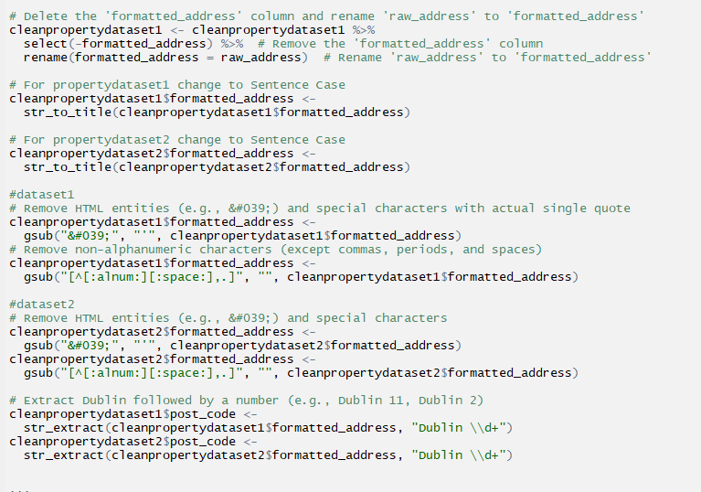
Address Cleaning and Formatting
Removed extra spaces and special characters using stringr::str_trim() and stringr::str_replace_all().
Standardized formatted_address to title case for uniformity.
Cleaned and extracted location details like Dublin postcodes using stringr::str_extract().
Addressed encoding issues in PropertyDataset2 with ISO-8859-1.

Slide 10
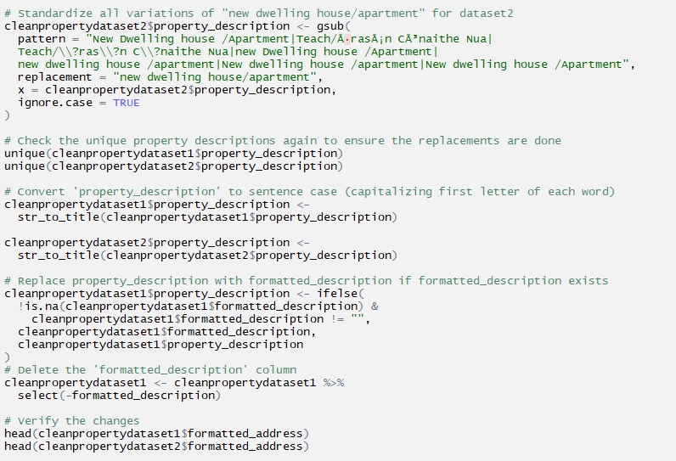
Property Description Cleaning
Goal: Standardize and simplify property descriptions for uniformity.
Steps:
Addressed inconsistencies in descriptions (e.g., variations of "second-hand dwelling house/apartment").
Replaced non-English or corrupted text with accurate English terms.
Converted descriptions to sentence case using str_to_title().
Used formatted_description (if available) to replace original descriptions for higher accuracy.
Verified and removed redundant columns after cleanup.

Slide 11
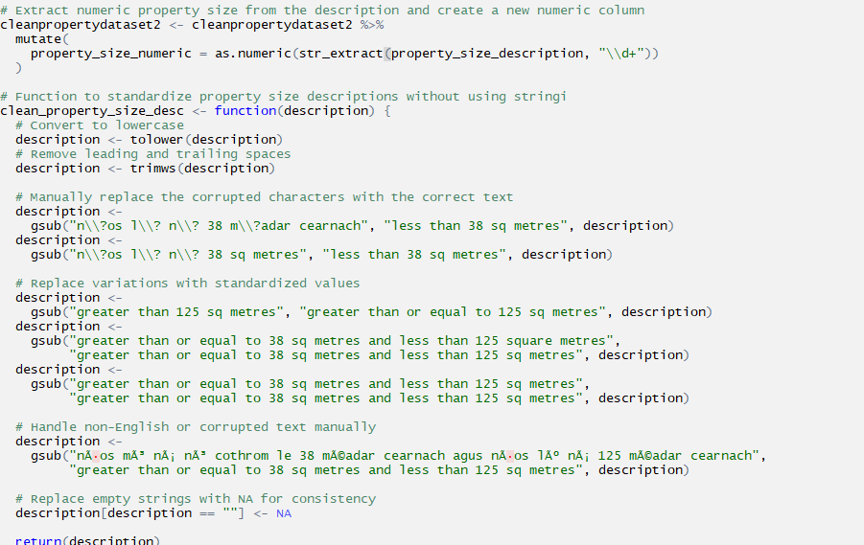
Property Size Description Cleaning
Goal: Standardize property size data and enable quantitative analysis.
Steps:
Extracted numeric size values using str_extract() for analysis (e.g., "100 sqm" → 100)
Created a new column, property_size_numeric, for direct size calculations
Developed a cleaning function to:
Normalize corrupted or varied text (e.g., "nós lú ná 38" → "less than 38 sqm").
Replace corrupted Irish text with clean, English terms.
Standardize size categories (e.g., "greater than 125 sqm")

Slide 12
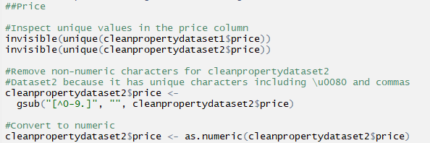
Price Cleaning Process
Non-Numeric Character Removal:
Removed unwanted characters like commas, currency symbols (e.g., €), using gsub()
Conversion to Numeric:
Converted cleaned prices to numeric format using as.numeric() for analysis
Validation:
Ensured all entries in the price column were valid numeric values with no anomalies
Key Steps Taken:
Inspected unique values to detect irregularities.
Cleared formatting issues (e.g., commas, extra symbols).
Prepared column for statistical calculations and modeling.

Slide 13
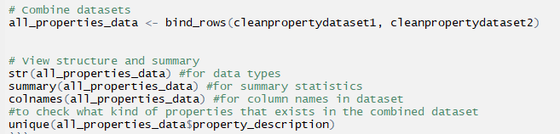
Final Dataset Integration
Steps Taken:
Used bind_rows() to merge cleanpropertydataset1 and cleanpropertydataset2 into a unified dataset (all_properties_data)
Ensured consistent column names and formats between datasets
Verified data types, summary statistics, and unique property types in the combined dataset
Validation Checks Performed:
str(): Validated data structure
summary(): Ensured correct summary statistics
unique(): Identified all unique property types for cross-verification
Outcome:
A clean, structured, and standardized dataset ready for detailed analysis and visualization.

Slide 14

Cleaning Process Overview
What Are Outliers?
Definition: Data points significantly different from the majority of values in the dataset
Impact:
Skew statistical analysis
Reduce the accuracy of predictive models
Obscure meaningful patterns
Identifying Outliers in the price Column
Method Used: Interquartile Range (IQR)
Q1: 25th percentile
Q3: 75th percentile
IQR: Q3 - Q1
Bounds:
Lower Bound = Q1−1.5×IQRQ1 - 1.5 \times IQRQ1−1.5×IQR
Upper Bound = Q3+1.5×IQRQ3 + 1.5 \times IQRQ3+1.5×IQR
Outliers lie outside these bounds
REMOVING OUTLIERS

Slide 15
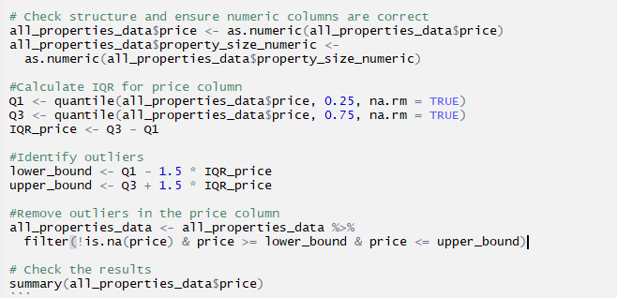
Functions Used
dplyr:
Functions:
filter(): Remove rows that meet certain conditions.
%>%: Pipe operator to streamline data transformations.
base R:
Functions:
quantile(): Calculate percentiles (Q1 and Q3).
summary(): Summarize data.
as.numeric(): Convert columns to numeric format.

Slide 16


ADDITIONAL
COLUMNS
Purpose: Add derived variables for advanced analysis, such as time trends, regional insights, and price segmentation
Steps Taken:
Extracted sale_year and sale_month for time-based analysis.
Calculated distances using latitude and longitude.
Categorized prices into price_category bins (low, medium, high).
Added lagged variables to track price trends.
Defined market_condition based on sales trends.
Packages: geohashTools, geosphere, dplyr, tidyr, sf, ggplot2
Functions: year(), month(), distVincentySphere(), cut(), lag(), case_when()

Slide 17


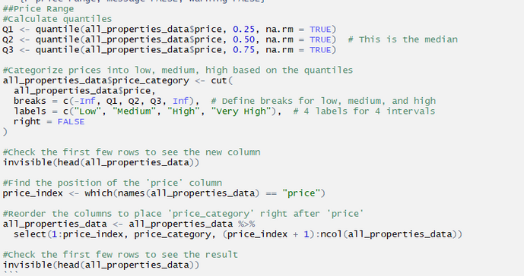
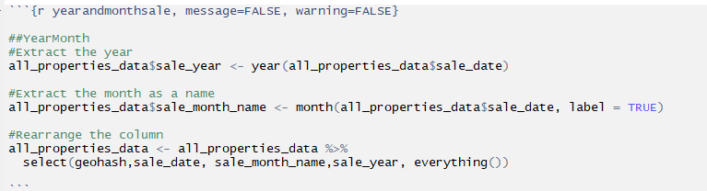
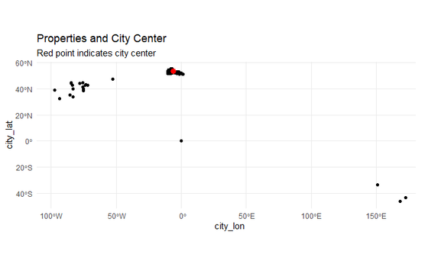
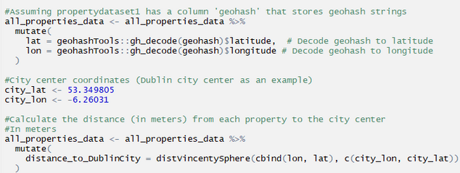
Price Trend (price_trend)
Purpose: Track price evolution.
Packages: dplyr
Functions: lag() for comparing yearly prices.
Year of Sale (sale_year)
Purpose: Analyze temporal trends and market dynamics over time.
Packages: dplyr
Functions: year() from sale_date, month() with label = TRUE.
Geolocation Features
Lat/Lon: Decoded using geohash.
Distance to Dublin (distance_to_DublinCity): Calculated via distVincentySphere().
Purpose: Examine spatial factors affecting prices.
Packages: geohashTools, geosphere, sf
Functions: distVincentySphere(), gh_decode().

Slide 18
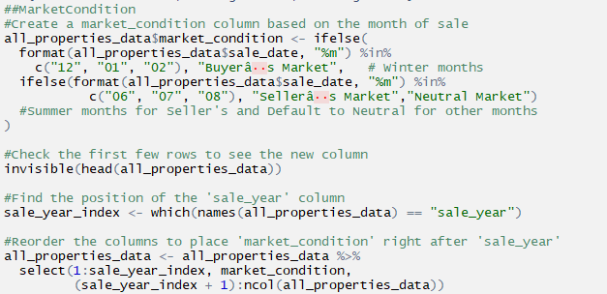
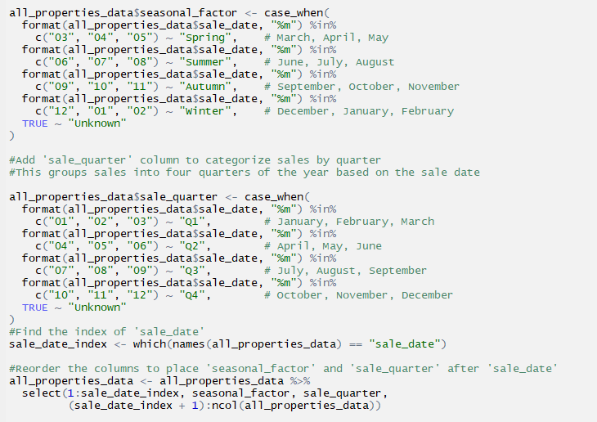
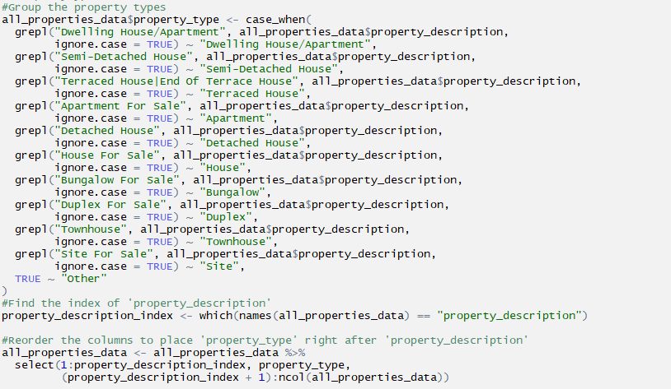

Seasonal Factors
seasonal_factor: Spring, Summer, Autumn, Winter.
sale_quarter: Q1 to Q4.
Purpose: Seasonal analysis of sales trends.
Packages: dplyr
Functions: case_when() for grouping.
Market Condition (market_condition)
Purpose: Analyze the impact of seasonal demand.
Packages: dplyr
Functions: ifelse() to classify months.
Property Type Classification (property_type)
Purpose: Analyze price variations across property types.
Packages: dplyr
Functions: case_when() from property_description.

Slide 19



VISUALIZATION
Purpose: Provide visual insights into property trends, regional variations, and market dynamics
Steps Taken:
Created density plots to show price distribution across property_type
Visualized yearly price trends using line charts
Used box plots to compare price across market_condition
Bar plots highlighted average price by county
Pie charts displayed sales distribution by county
Heatmaps explored average price segmented by county and price_category
Packages Used: ggplot2, dplyr, scales.

Slide 20
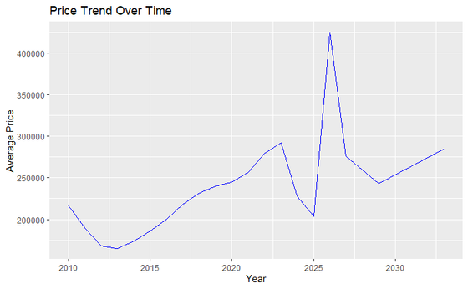

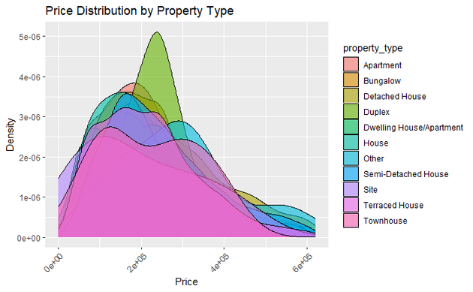
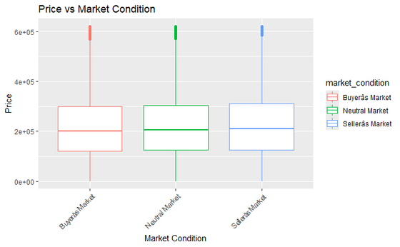
Price Distribution by Property Type
Chart: Density Plot
Purpose: Compare price distributions across property types (e.g., detached, apartment)
Packages: ggplot2
Functions: geom_density(), aes(), theme_minimal()
Key Features:
aes(fill = property_type) for color differentiation
alpha = 0.6 for transparency
Rotated x-axis labels for readability
Price Trend by Time (By Year)
Chart: Line Plot
Purpose: Observe average property price trends over time
Packages: ggplot2
Functions: stat_summary(fun = "mean"), theme_minimal()
Key Features:
Average price computed using fun = "mean"
Line aesthetics controlled with color
Market Condition vs. Price
Chart: Box Plot
Purpose: Compare price ranges across market conditions (e.g., buyer's/seller's market)
Packages: ggplot2
Functions: geom_boxplot(), aes(), theme_minimal()
Key Features:
Colors assigned using aes(color = market_condition)
X-axis label rotation for clarity

Slide 21
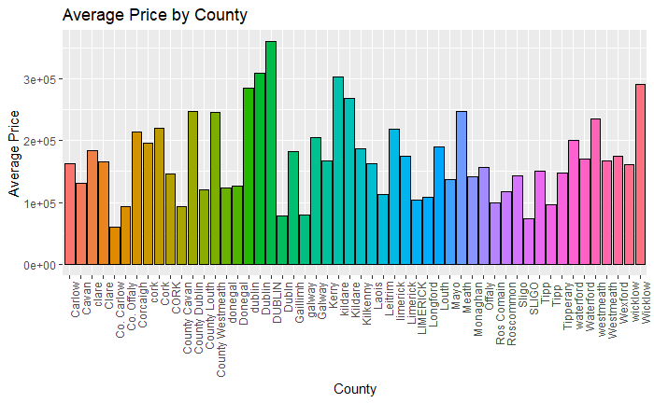
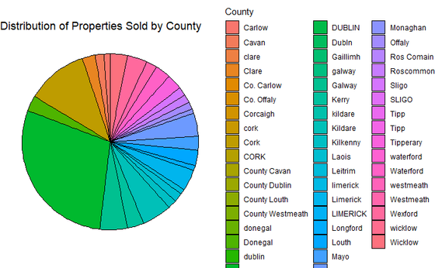


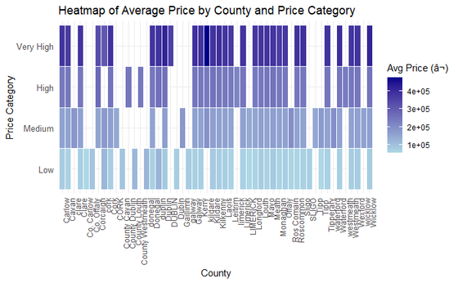
Price Distribution by County
Chart: Bar Plot
Purpose: Compare average property prices across counties
Packages: ggplot2, scales
Functions: stat_summary(fun = "mean"), theme_minimal()
Key Features:
Unique colors assigned with scale_fill_manual()
X-axis labels rotated for better readability
Distribution of Properties Sold by County
Chart: Pie Chart
Purpose: Visualize sales volume proportions for each county
Packages: ggplot2, scales
Functions: geom_bar(), coord_polar(), theme_void()
Key Features:
Distinct colors with scale_fill_manual()
Clean layout using theme_void()
Heatmap: Average Price by County and Price
Category
Chart: Heatmap
Purpose: Show average prices across counties segmented by price categories
Packages: ggplot2, dplyr
Functions: geom_tile(), scale_fill_gradient()
Key Features:
Gradient colors to indicate price intensity
Borders between tiles for clear visualization

Slide 22
CONCLUSION
The project enhanced data consistency by addressing duplicates, standardizing formats, and ensuring reliable data structures. Outliers were identified and managed to improve the integrity and accuracy of the dataset. Additional columns were created to enrich the data and support meaningful analysis. Visualizations were developed to effectively highlight trends, distributions, and relationships, providing clear insights for decision-making.

Slide 23
THANK YOU

