Slide 1

Life Expectancy In the Twin Cities Metro
Alynda Her
James Dale
Kat Heron

Slide 2
What factors impact life expectancy in the Minnesota Twin Cities metro counties?
Data was cleaned to only include Anoka, Carver, Dakota, Hennepin, Ramsey, Scott, and Washington counties.

Slide 3
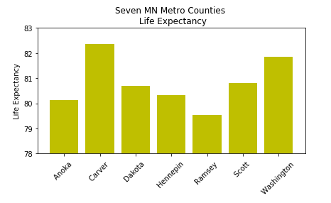
Life Expectancy
The CDC defines ‘Life Expectancy at Birth’ as “the average number of years that a hypothetical group of infants would live at each attained age if the group was subject, throughout its lifetime, to the age-specific death rates prevailing for the actual population in a given year.” https://www.cdc.gov/nchs/products/databriefs/db244.htm#ref1
Our data came from National Center for Health Statistics, National Vital Statistics System, US Small-area Life Expectancy Estimates Project (USALEEP)
https://www.cdc.gov/nchs/nvss/usaleep/usaleep.html

Slide 4
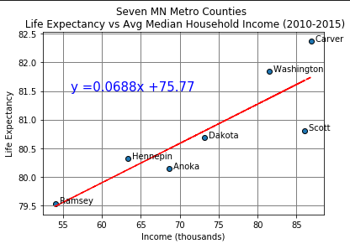
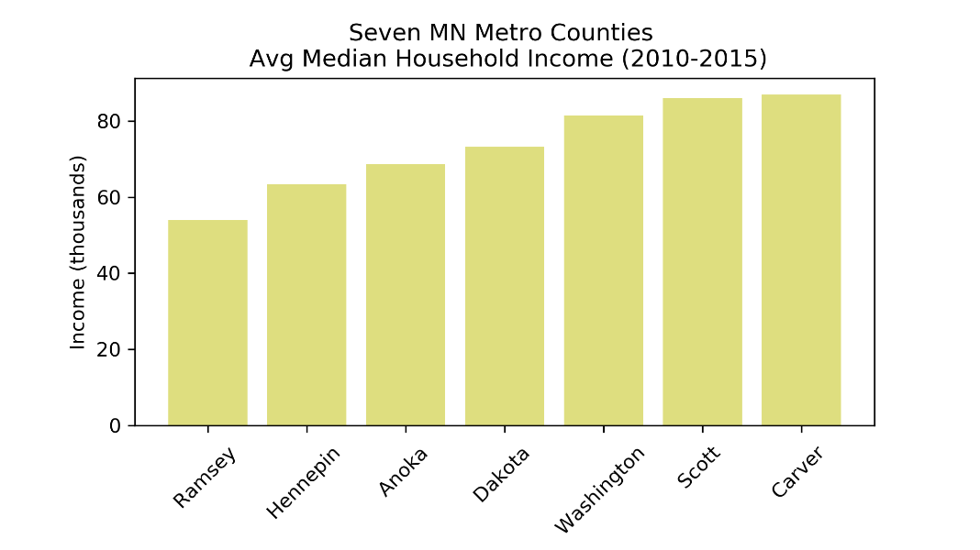
Median Household Income https://www.census.gov/programs-surveys/saipe/data/datasets.2010.html

Slide 5
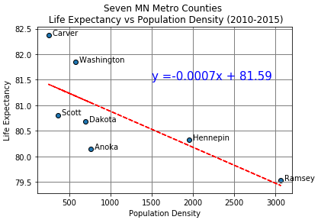
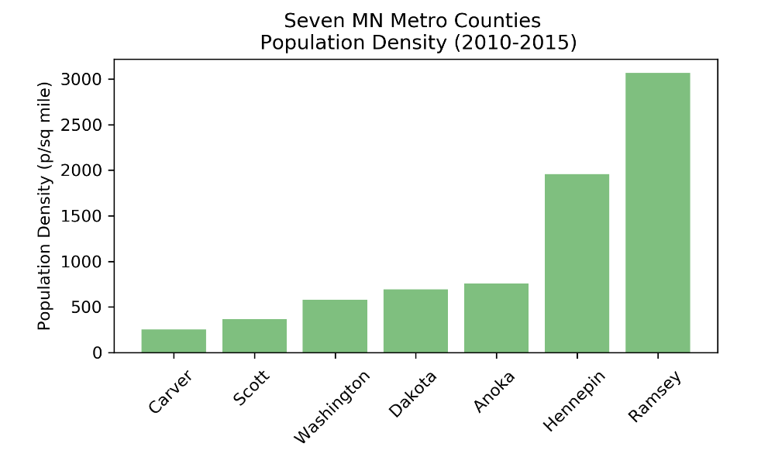
Population Density https://mn.gov/admin/demography/data-by-topic/population-data/our-estimates/

Slide 6
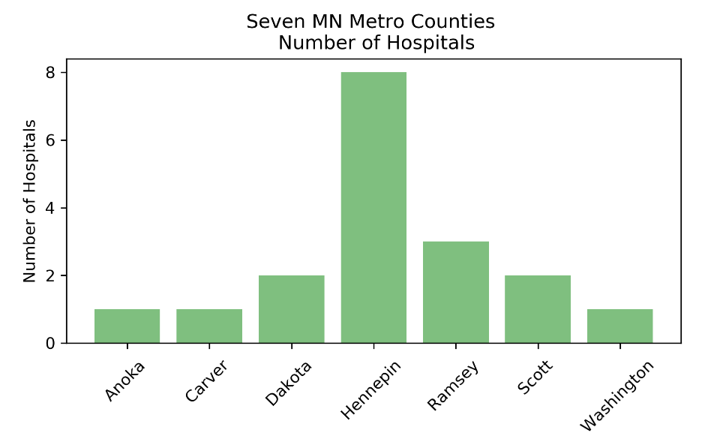
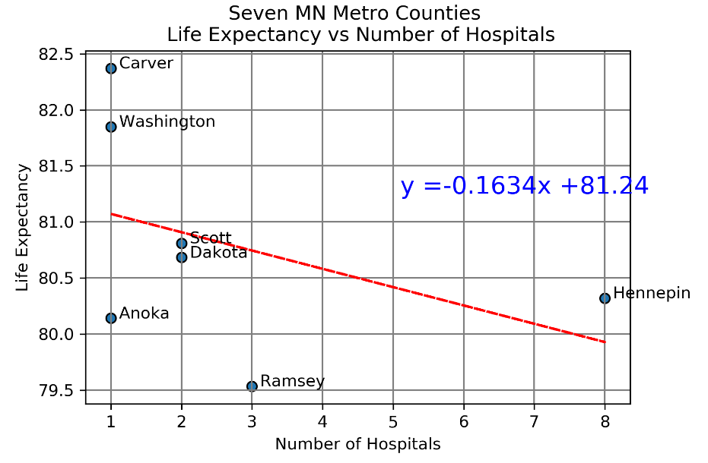
Number of Hospitals https://data.medicare.gov/data/hospital-compare

Slide 7
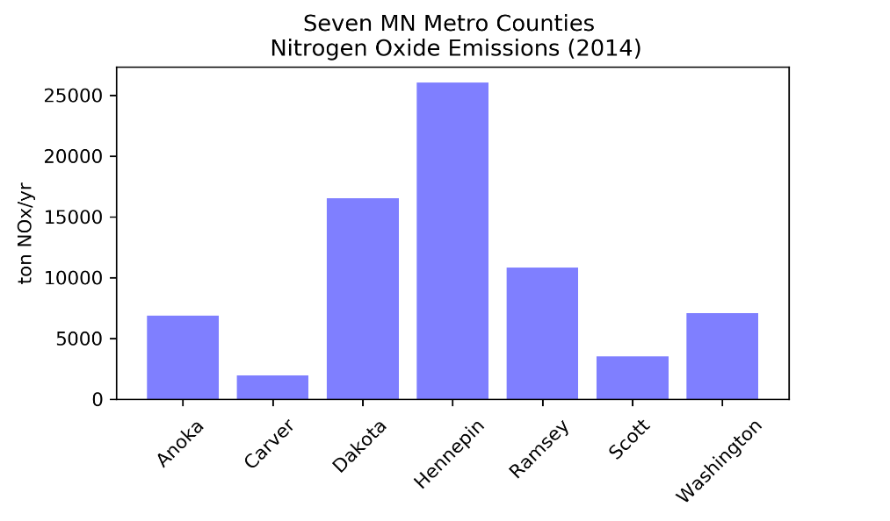
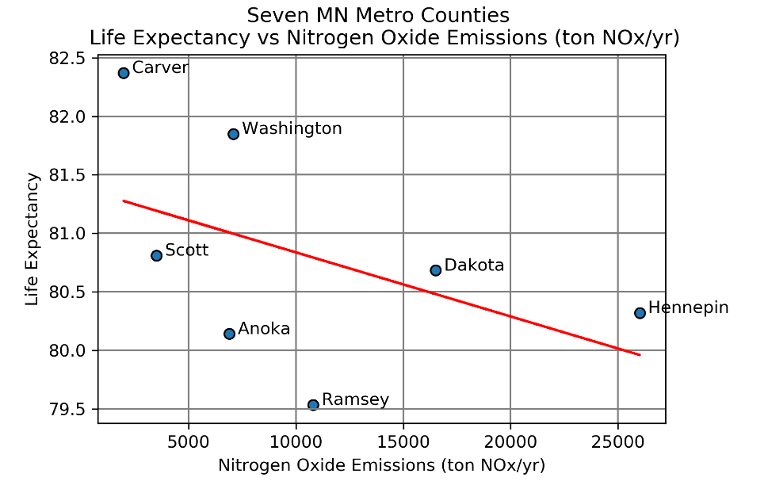
Nitrogen Oxide Emissions https://www.pca.state.mn.us/air/statewide-and-county-air-emissions

Slide 8
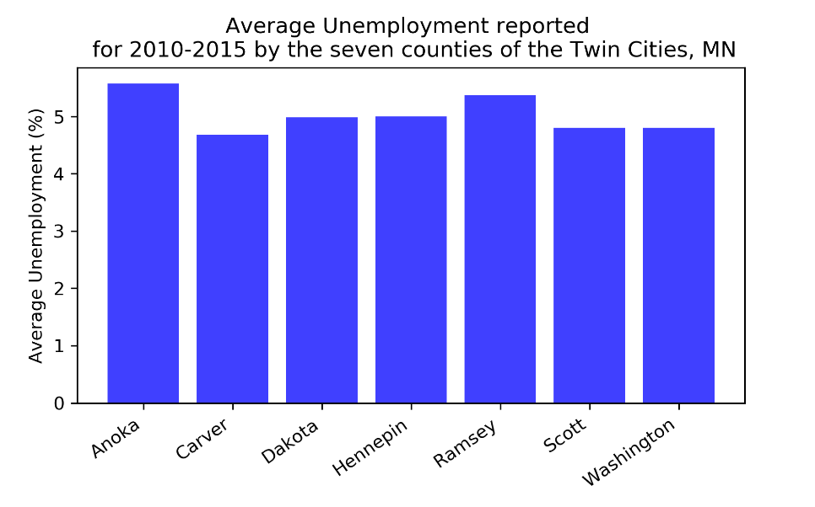
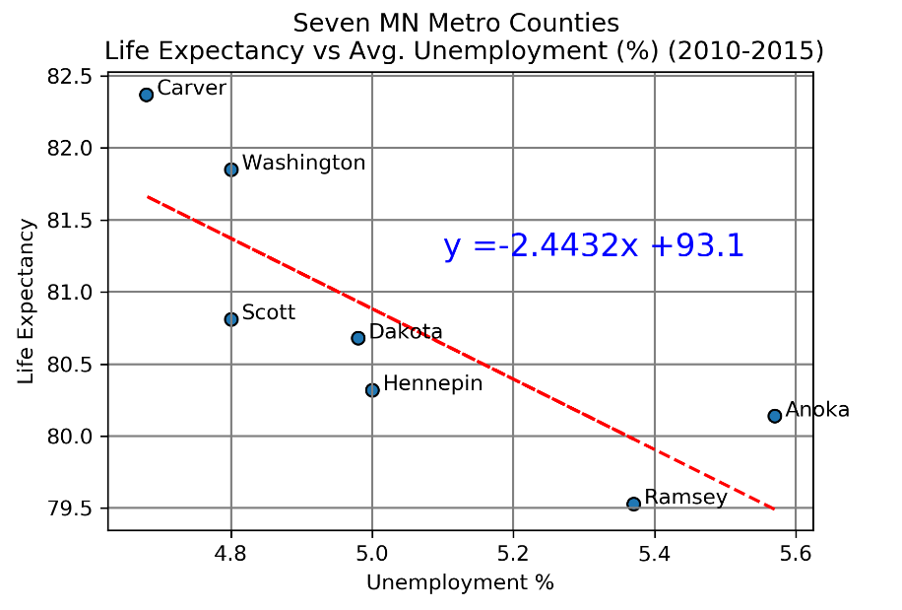
Unemployment https://apps.deed.state.mn.us/lmi/laus/Results.aspx?geog=2704000003%2c2704000019%2c2704000053%2c2704000123%2c2704000139%2c2704000163&adjusted=0&periodtype=03&resultset=3&startyear=2011&endyear=2020

Slide 9
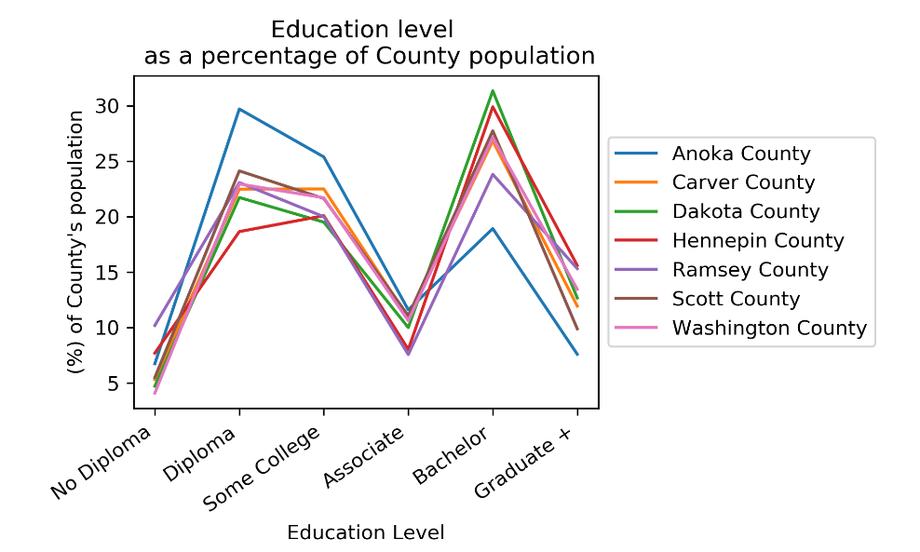
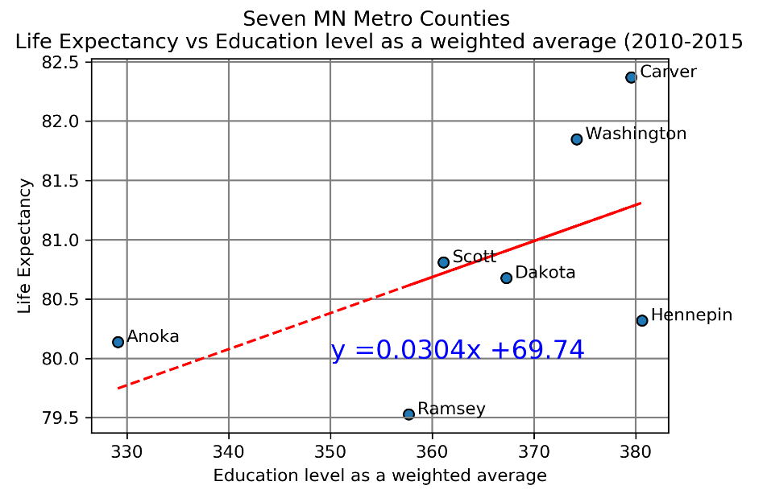
Highest Education Level Attained https://stats.metc.state.mn.us/data_download/DD_Years.aspx?datasource=cen&comms=&subjects=%27POPEDULEV%27&level=region

Slide 10
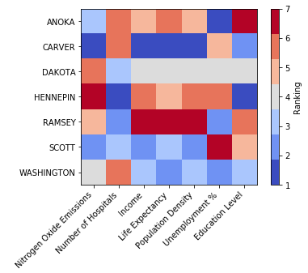
Ranking by County

Slide 11
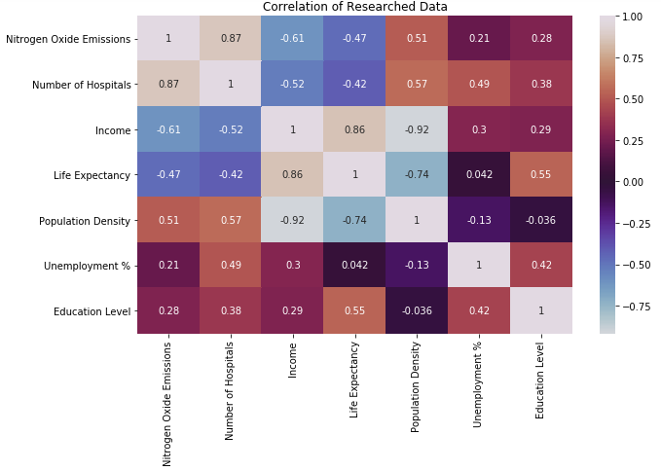

Slide 12
Overall Conclusions
Data | Hypothesis | R-value | P-value | Standard Error | Conclusion
Median Household Income | Positive | 0.8558 | 0.014 | 0.0186 | Strong positive correlation
Education | Positive | 0.5471 | 0.2038 | 0.0208 | No correlation
Number of Hospitals | Positive | -0.4151 | 0.3545 | 0.16018 | No correlation
Emissions | Negative | -0.466 | 0.292 | 5.00E-05 | No correlation
Population Density | Negative | -0.7373 | 0.0586 | 0.00029 | No correlation
Unemployment | Negative | -0.8068 | 0.0283 | 0.8002 | Strong negative correlation
Of the factors that we researched, average income has the strongest positive correlation to life expectancy and unemployment is the strongest negative correlation to life expectancy.

Slide 13
Questions?

