Slide 1


A new way to share your stories and experiences

Slide 2





is a social media site for anyone with an experience/story who is looking for a real discussion or some real feedback.
Instead of Liking
We Inspire
Instead of Commenting
We Discuss

Slide 3
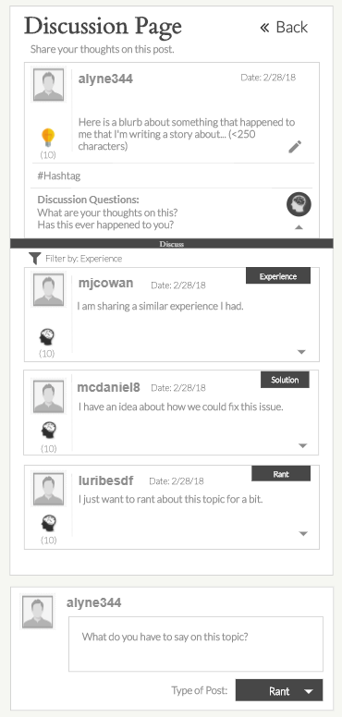

User could be…
A student who wants feedback on a report/essay
A politician who is sharing an opinion
Your neighbor who is ranting about the local grocery store
Or YOU just wanting to be heard about something
Other users will respond with:
Similar Experiences
Feedback
Recommendations
Solutions
Questions
Thoughts
Opinions
Rants

Slide 4
Front End Development
Design: UXPin
Framework: Foundation
Handlebars
Font Awesome/Bootstrap

Slide 5
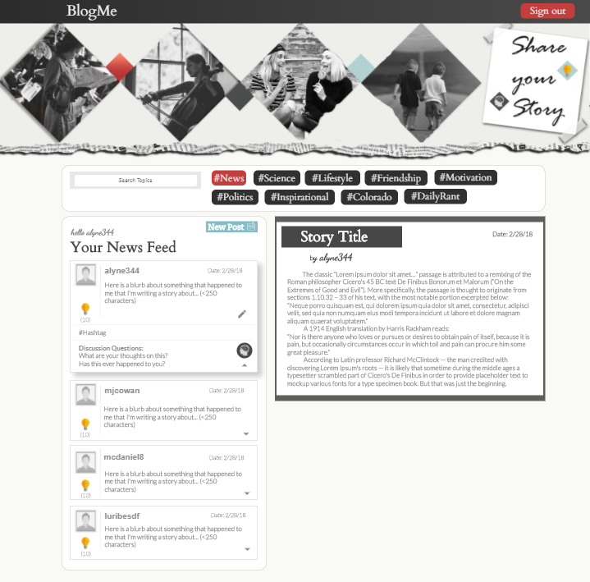

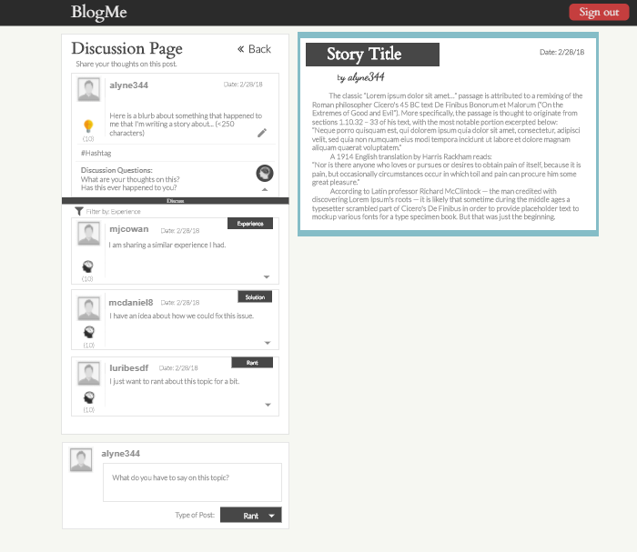
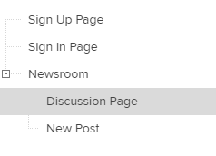
UXPin Drafts

Slide 6
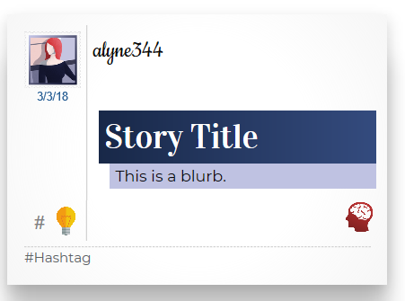
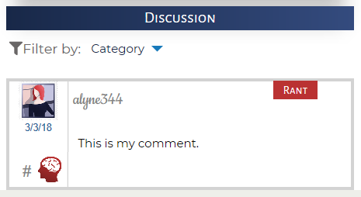
“Postcard” Design
Story Title of interest
Posts organized by Hashtags
Inspire button for “up votes” on Postcards
Comments organized by Category
Brain button for “up votes” on Comments

Slide 7
Back End Development
nodeJS
expressJS
Sequelize ORM
MySQL
Passport for Login

Slide 8
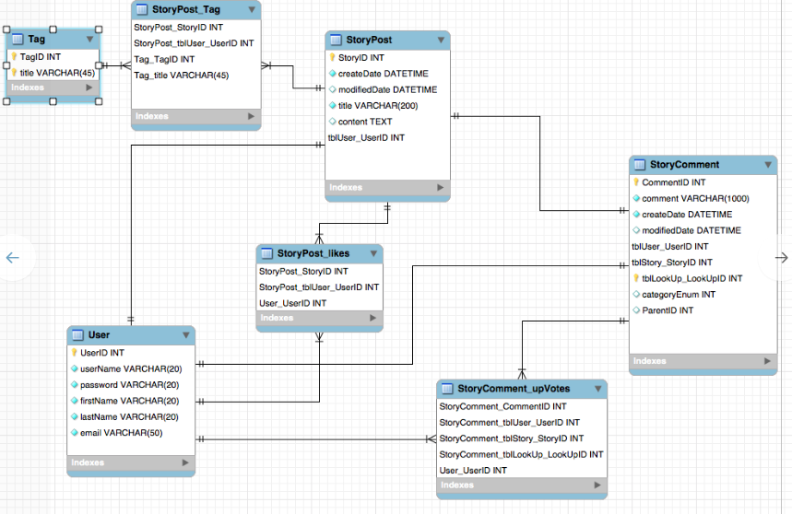
QuickDBD

