Slide 1

UCM Course Catalog & Registration Manager
Alyssa Phouangpanya, Aman Kalkat
https://github.com/alyph000/CSE-111-Project

Slide 2
synopsis
A system that allows students and academic advisors to view and manage courses offered by UC Merced
Users can search for courses and view relevant information such as course prerequisites, instructors, and available sections
Academic advisors can manage student enrollment for different course sections

Slide 3
USE Cases
Can search courses
  Filter by department, location, meeting times, instructors
  View prerequisites for each course
  View linked sections (labs, discussions, exams)
Can manage student enrollment
  Check capacity of course sections
  Enroll/unenroll students

Slide 4
Use case diagram

Slide 5
e/r diagram

Slide 6
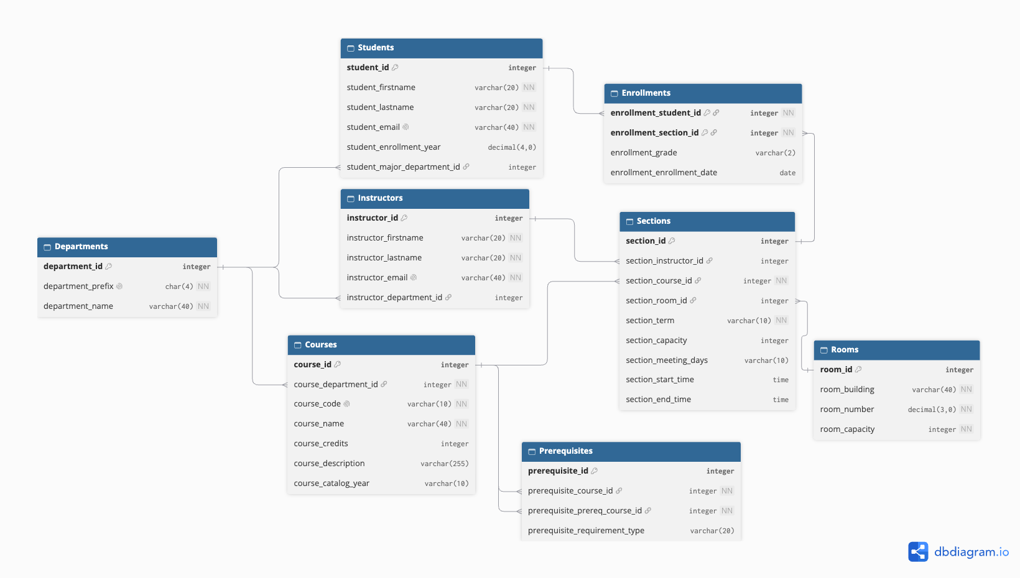
Relational schema

Slide 7
Questions?

