Slide 1
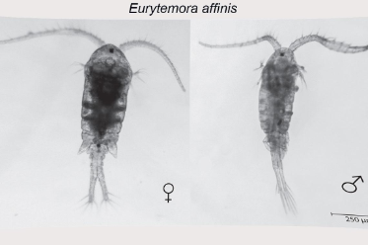
Bay–Delta Science Conference • September 2026
UNDERSTANDING THE DRIVERS OF
Zooplankton abundance and spatial patterns
San Francisco Bay–Delta
Eurytemora as a case study
A biological link between changing hydrology and ecosystem response
Alyse Lacey
Advisors: John Durand, Jon Walter
USBR Collaborators:
Andrea Hamilton
Lilly McCormick
Josh Israel
STORY
SYSTEM
DATA
RESULTS
IMPLICATIONS
ACKNOWLEDGEMENTS
Notes:
The previous talks in this session are asking how we can improve our ability to predict a changing Bay-Delta system. My project picks up one step downstream: once we predict how the physical system changes, how do we predict what happens to organisms living in that system? I’m focusing on zooplankton, with Eurytemora as my first case study.

Slide 2
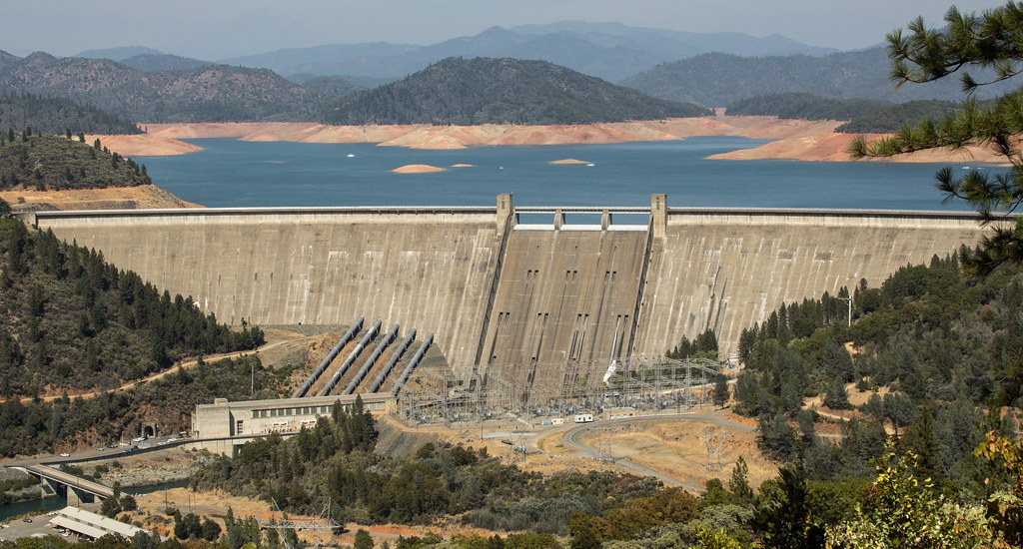
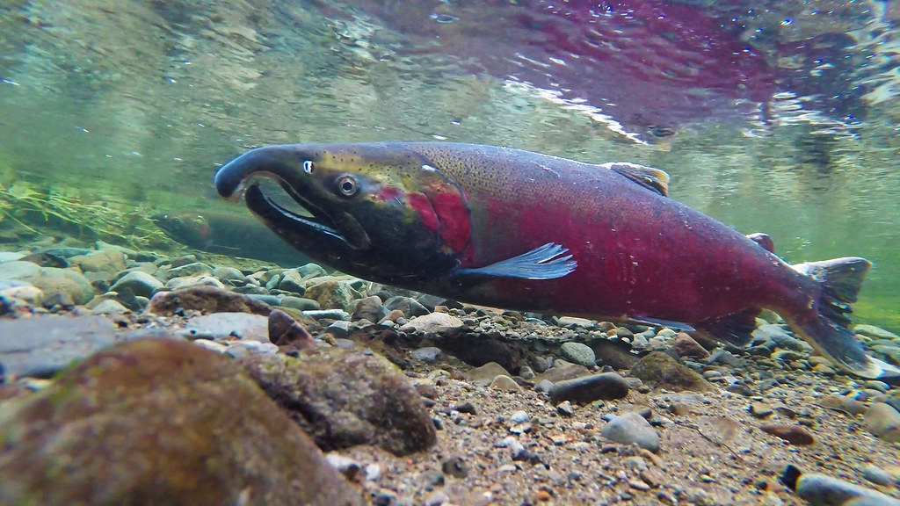
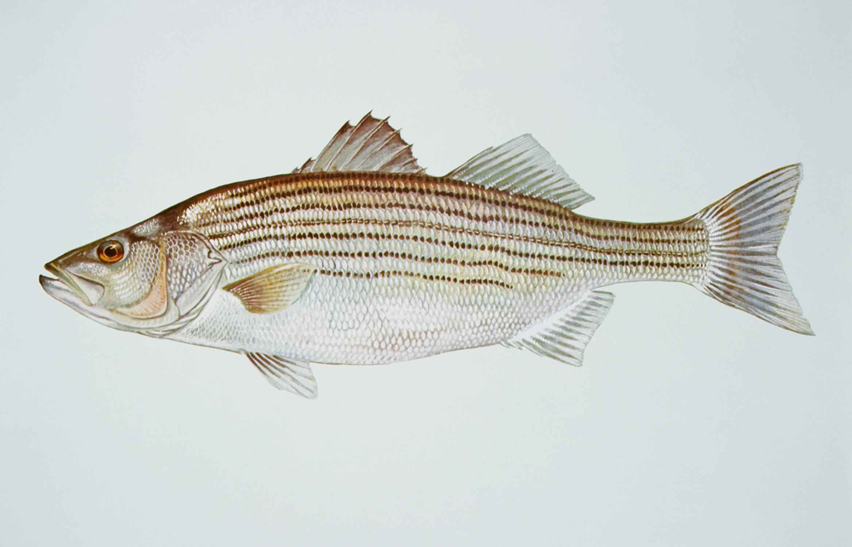
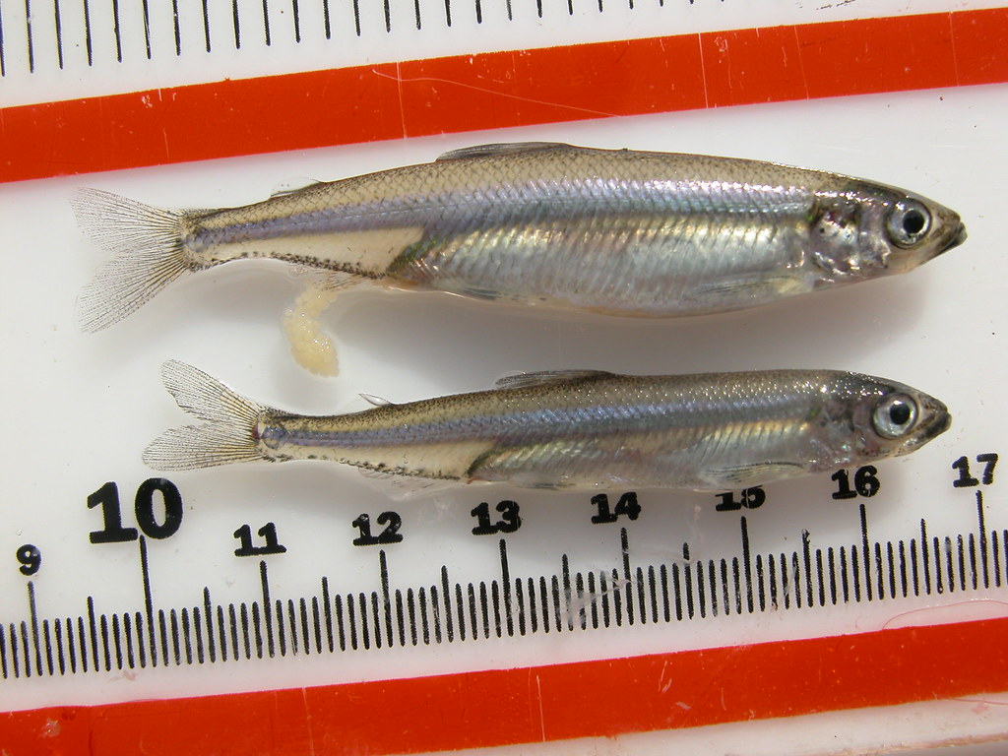
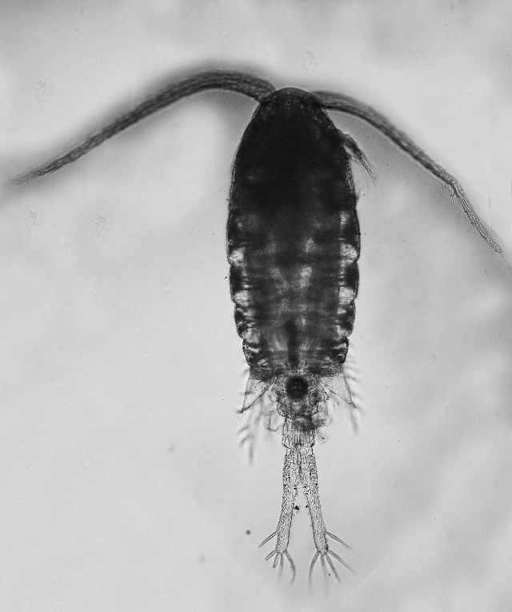
Where this talk fits in the session
Different projects address different links in the same decision-support chain.
1
2
3
4
5
CALSIM3
ECO-PTM
Predation
Prey + salinity
THIS TALK
Hydrologic forecasts
& operations
Experimental
survival mechanisms
Zooplankton +
environmental drivers
Fish movement
& survival
Delta smelt prey
relationships
COMMON THREAD
Models need biological relationships that are current, interpretable, and connect across disciplines.
STORY
SYSTEM
DATA
RESULTS
IMPLICATIONS
ACKNOWLEDGEMENTS
Notes:
CalSim3 addresses system conditions and management scenarios. ECO-PTM and the predation work address fish movement and survival. The prey-and-salinity work asks how Delta smelt prey respond to an important environmental gradient. My work asks how zooplankton respond to a broader set of environmental and temporal conditions. These are complementary pieces of the same decision-support problem.

Slide 3
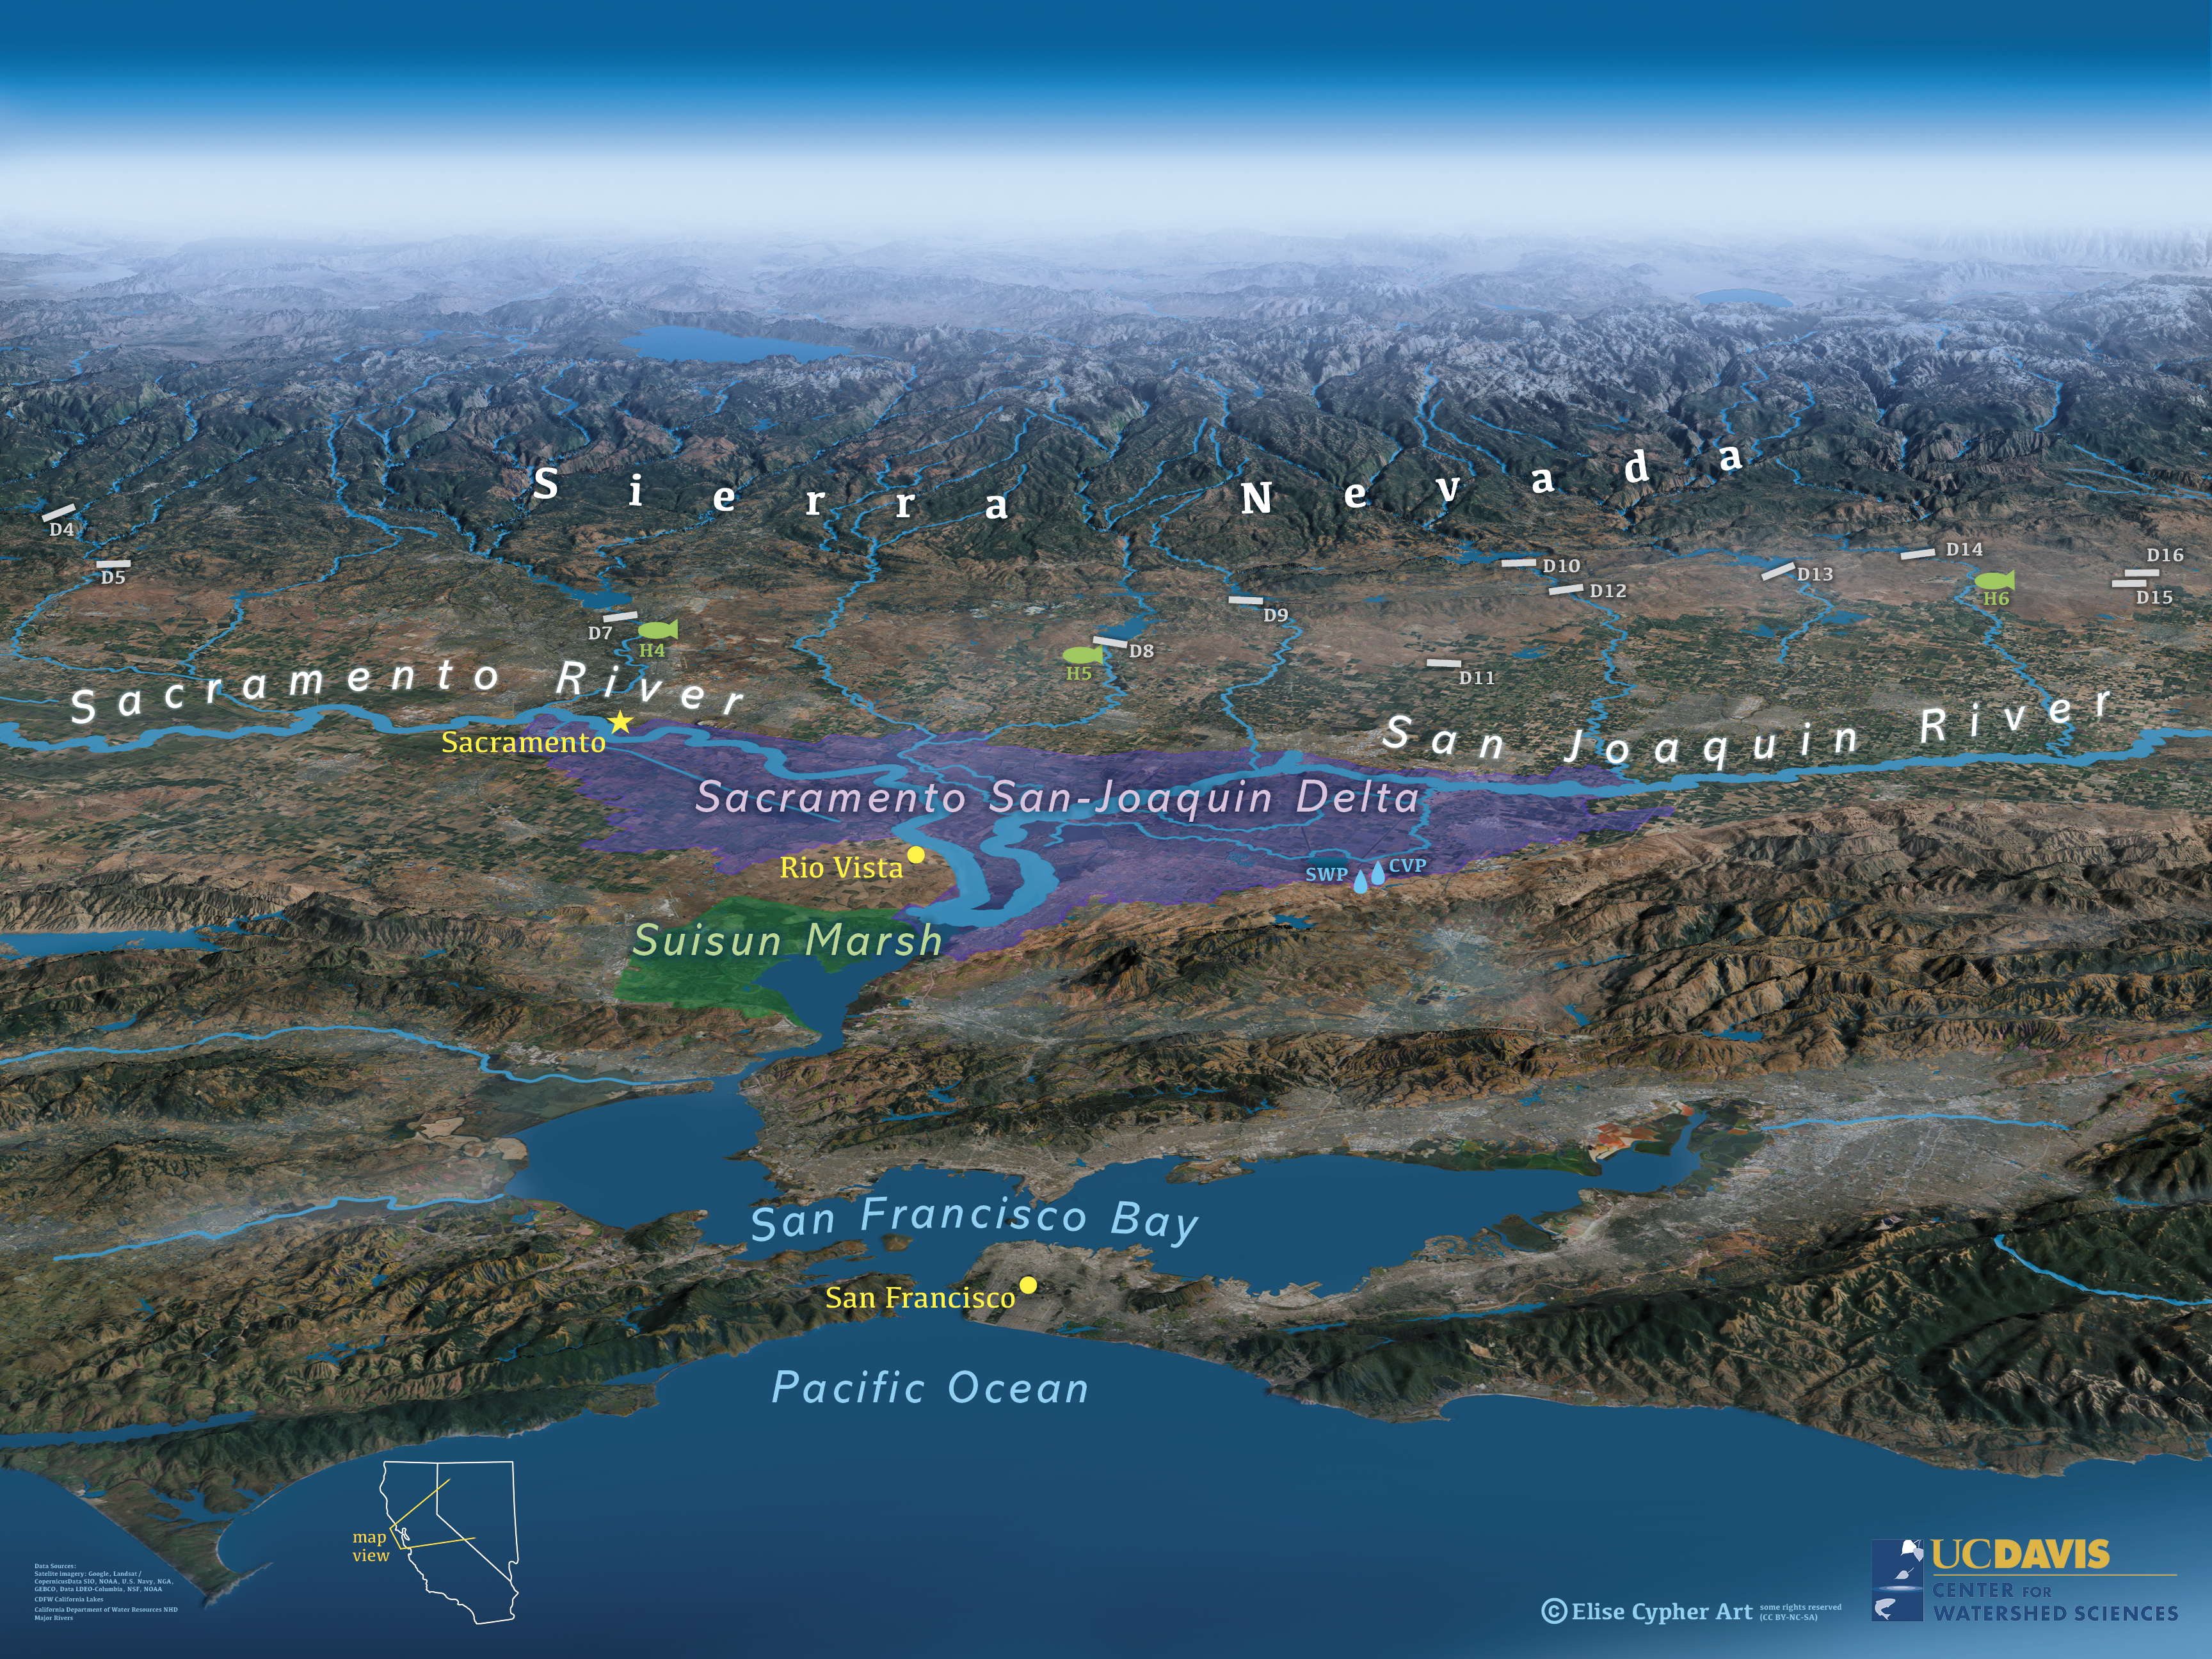

Slide 4
From water conditions to food web
Why zooplankton are the biological bridge
If management changes the environment, what does that mean for the organisms at the center of the food web?
Notes:
Zooplankton are useful because they sit in the middle of the food web. They respond to environmental conditions, but they are also food for fish. That makes them a measurable biological link between physical conditions and higher trophic levels.

Slide 5
Why zooplankton?
THE FOOD WEB
1
They respond to environmental conditions
Phytoplankton
Salinity, temperature, food availability, turbidity, and water quality can shape abundance and distribution.
↓
Zooplankton
↓
2
They transfer energy through the food web
Changes in abundance or distribution alter the prey field available to fish.
Small fish
↓
Predators
3
They can connect to decision models
Quantified relationships provide a potential bridge from predicted environmental conditions to biological response.
STORY
SYSTEM
DATA
RESULTS
IMPLICATIONS
ACKNOWLEDGEMENTS
Notes:
I’m looking across the Sacramento–San Joaquin Delta from Sacramento to San Pablo Bay. That is important because conditions are not uniform across this system. There are strong spatial gradients, and those gradients interact with seasonal and year-to-year variation.

Slide 6
Why Eurytemora?
Ab
Primary Prey for Native Fish
High Data Density
Critical food source for endangered Delta Smelt (Hypomesus transpacificus) and Longfin Smelt (Spirinchus thaleichthys) larvae/juveniles.
Over ~14,000 observations in the long-term Interagency Ecological Program (IEP) Zooplankton Dataset spanning 1972–present.
Nobriga (2002); Slater & Baxter (2014)
IEP Monitoring Program (2024)
Highly responsive to freshwater outflow, X2 position changes, and historical food web shifts.
Brackish & Low-Salinity Adaptation
Sensitive Flow & Ecosystem Indicator
Highly responsive to freshwater outflow, X2 position changes, and historical food web shifts.
Prefers the Low Salinity Zone (LSZ, 0.5–6 PSU) and freshwater-brackish interface, aligning perfectly with Delta flow management.
Kimmerer et al. (1994);
Winder & Jassby (2011)
Kimmerer (2002, 2004); Lee (2000)
STORY
SYSTEM
DATA
RESULTS
IMPLICATIONS
ACKNOWLEDGEMENTS

Slide 7
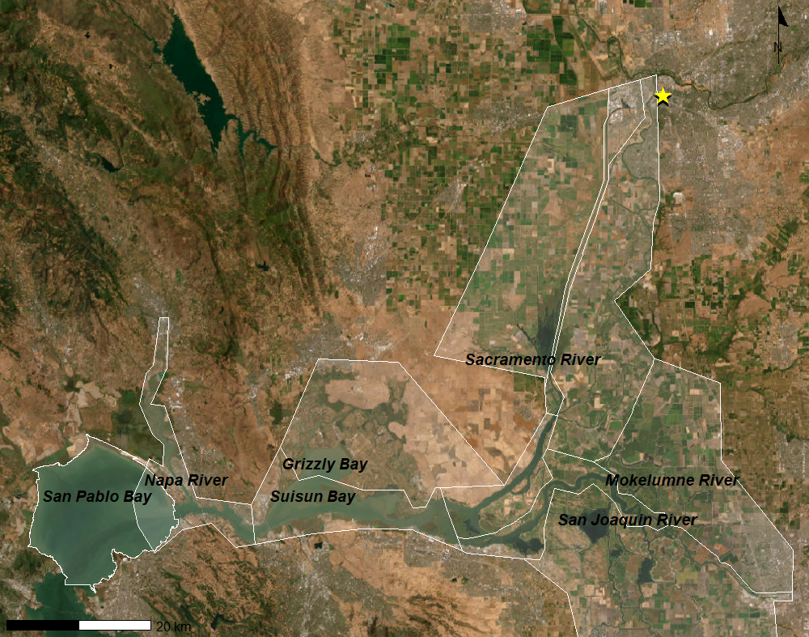
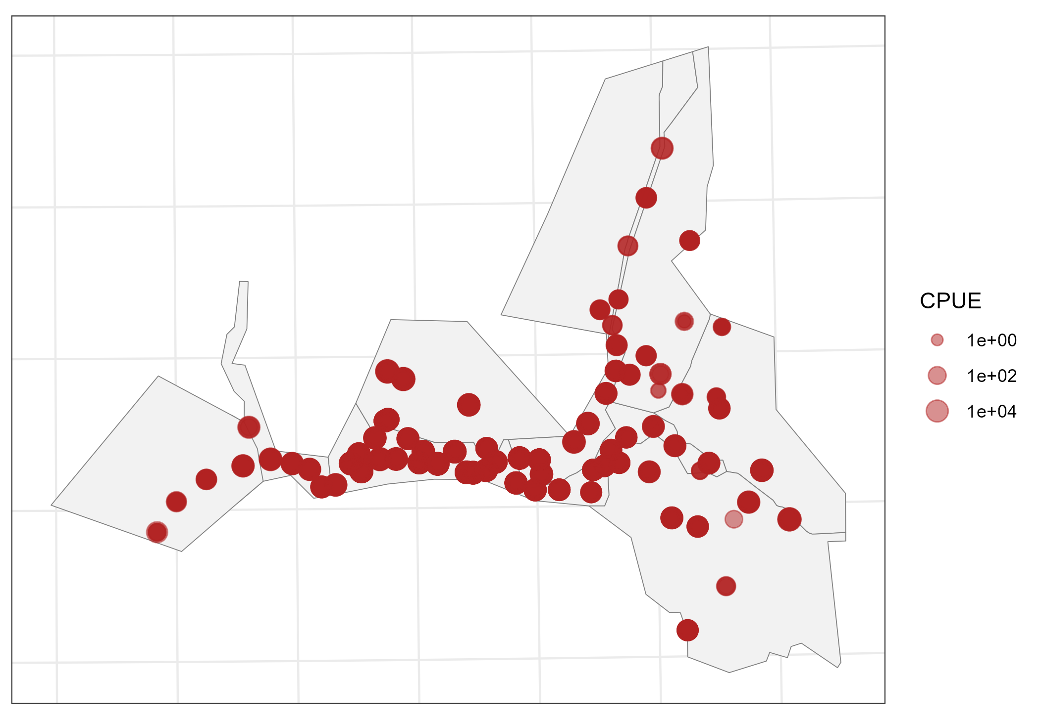
Study system
Sacramento → San Pablo Bay
San Pablo Bay
Pre-1994
Eurytemora Abundance
STORY
SYSTEM
DATA
RESULTS
IMPLICATIONS
ACKNOWLEDGEMENTS
Notes:
I’m bringing together eleven predictors. Some are directly related to hydrology, like X2 and Jersey Point Flow. Others describe water quality or habitat, including salinity, temperature, turbidity, chlorophyll-a, dissolved oxygen, pH, and Secchi depth. Month captures recurring seasonal structure.

Slide 8
Environmental Factors
Twelve predictors, all grouped by what they represent.
Hydrology
Water quality
Productivity / light
X2
pH
Dissolved oxygen
Chlorophyll-a
Jersey Point Flow (JPF)
Temperature
Turbidity
Secchi
Salinity
Time
GOAL
Surface salinity
Month
Determine which conditions are associated with Eurytemora distribution, and abundance.
Bottom salinity
Years
STORY
SYSTEM
DATA
RESULTS
IMPLICATIONS
ACKNOWLEDGEMENTS
Notes:
The major advantage is the time span. I’m taking advantage of decades of monitoring rather than trying to answer this question from one field season. For the Eurytemora case study, I have more than fourteen thousand observations.

Slide 9
The data
Decades of monitoring give us breadth that a single field season cannot.
1970s
1990s
2000s
2020s
A
Multiple monitoring programs
B
Long time span
Strength = breadth
Limitation = the record is not uniform
Zooplankton observations are paired with environmental measurements where coverage allows.
Decades of observations capture substantial environmental variability.
STORY
SYSTEM
DATA
RESULTS
IMPLICATIONS
ACKNOWLEDGEMENTS
Notes:
The major advantage is the time span. I’m taking advantage of decades of monitoring rather than trying to answer this question from one field season. For the Eurytemora case study, I have more than fourteen thousand observations.

Slide 10
To answer the question for Eurytemora
WHY A GAM?
Let the data estimate the
shape of the relationship
What environmental conditions
are associated with Eurytemora
abundance?
Instead of assuming a straight line,
a GAM can reveal patterns such as:
Thresholds
Peaks
Plateau
And does that relationship change across the Delta?
Goal: identify interpretable empirical response patterns, not assume causation.
STORY
SYSTEM
DATA
RESULTS
IMPLICATIONS
ACKNOWLEDGEMENTS
Notes:
For Eurytemora, the question is straightforward: what environmental conditions are associated with abundance, and how does that relationship vary across the system? I’m particularly interested in relationships that may not be linear.

Slide 11
Eurytemora results
The first case study
Now we move from the framework to the relationships estimated from the historical record.
Notes:
This is the first actual results step of the project. I would walk through each smooth one at a time rather than showing the audience a table of model coefficients. For each variable, I want to answer three questions: what is the shape, where does abundance change, and what does that mean ecologically? I would emphasize the observed range and avoid interpreting relationships outside the data.

Slide 12
How to read the results
I am asking four questions of every relationship.
SHAPE
DIRECTION
1
2
Plateaus? Threshold? Peak? Nonlinear?
Where does abundance increase or decrease?
CONTEXT
LIMITS
3
4
Does the pattern make ecological sense?
What does the monitoring record prevent us from concluding?
Important: association ≠ causation.
STORY
SYSTEM
DATA
RESULTS
IMPLICATIONS
ACKNOWLEDGEMENTS

Slide 13
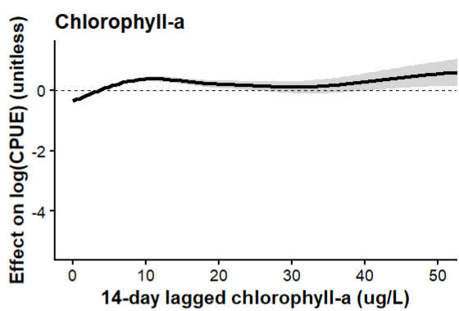
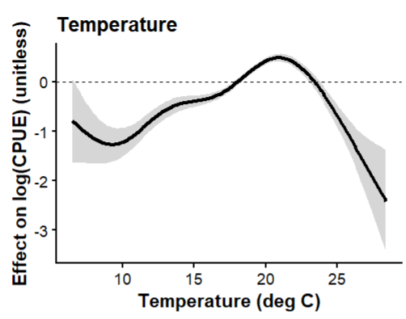
Eurytemora results 1972-1994 Part.1
Case-study model: historical environmental relationships
Typical Range
Chlorophyll-a
Eurytemora affinis growth is food-limited below ~10 µg/L. Incorporating a two-week lag captures the trophic response time needed for primary production to translate into increased copepod biomass.
Mueller-Solger et al. (2002); Heinle & Flemer (1975)
Temperature
Typical Range
Eurytemora affinis achieves optimal growth and reproduction between 12°C and 20°C in the Delta. Above 22°C, thermal stress rapidly increases mortality, making summer water warming a key population constraint.
Hammock et al. (2015); Devreker et al. (2009)
STORY
SYSTEM
DATA
RESULTS
IMPLICATIONS
ACKNOWLEDGEMENTS
Notes:
I’m treating these results as empirical associations, not experimental proof of causation. The value is that they identify relationships that can be tested, compared across taxa, and eventually translated into predictive response functions.

Slide 14
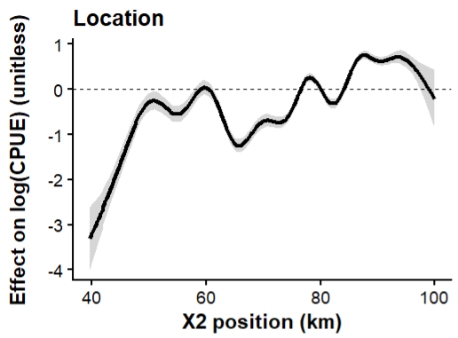
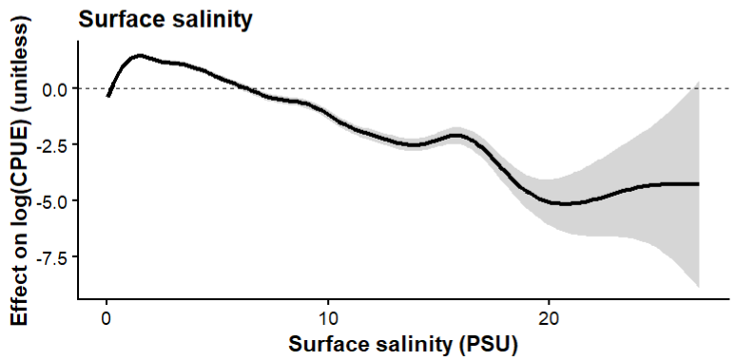
Eurytemora results 1972-1994 Part.2
Case-study model: historical environmental relationships
Typical Range
X2 represents the distance in kilometers from the Golden Gate Bridge to the 2-PSU bottom salinity location, When freshwater outflow pushes X2 downstream (lower kilometer value), Eurytemora affinis habitat expands into Suisun Bay, driving higher overall population abundance.
X2
Jassby et al. (1995); Kimmerer (2002)
Surface salinity
Typical Range
Eurytemora affinis in the Delta is ecologically centered in the Low Salinity Zone (0.5–6 PSU). This brackish zone provides essential habitat that shields the copepod from marine predators and invasive clam grazing.
Kimmerer (2002); Kimmerer et al. (1994)
STORY
SYSTEM
DATA
RESULTS
IMPLICATIONS
ACKNOWLEDGEMENTS
Notes:
I’m treating these results as empirical associations, not experimental proof of causation. The value is that they identify relationships that can be tested, compared across taxa, and eventually translated into predictive response functions.

Slide 15
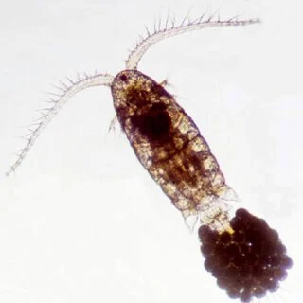
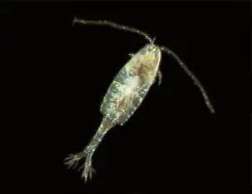
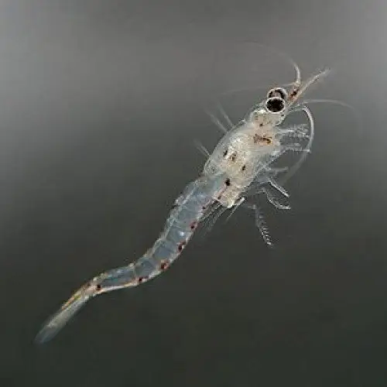
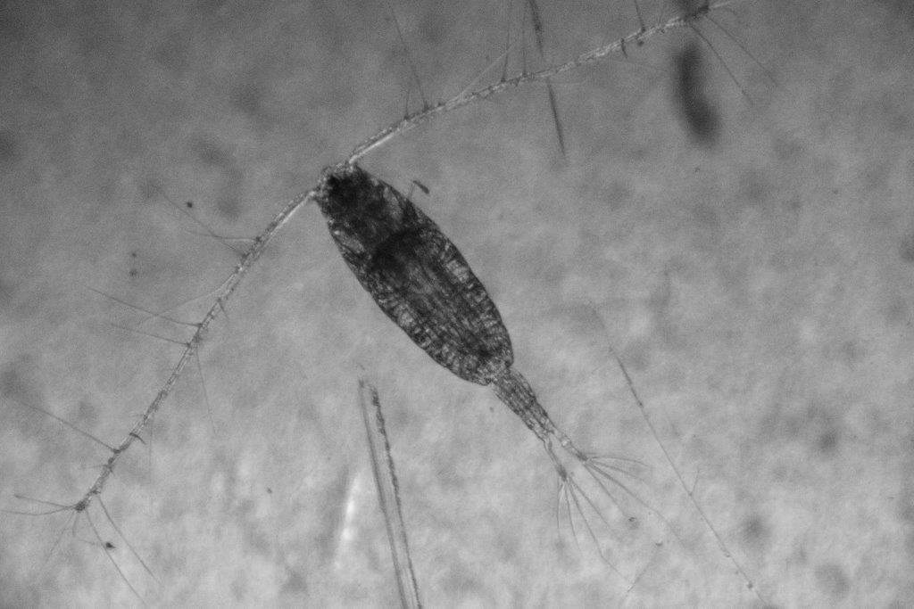
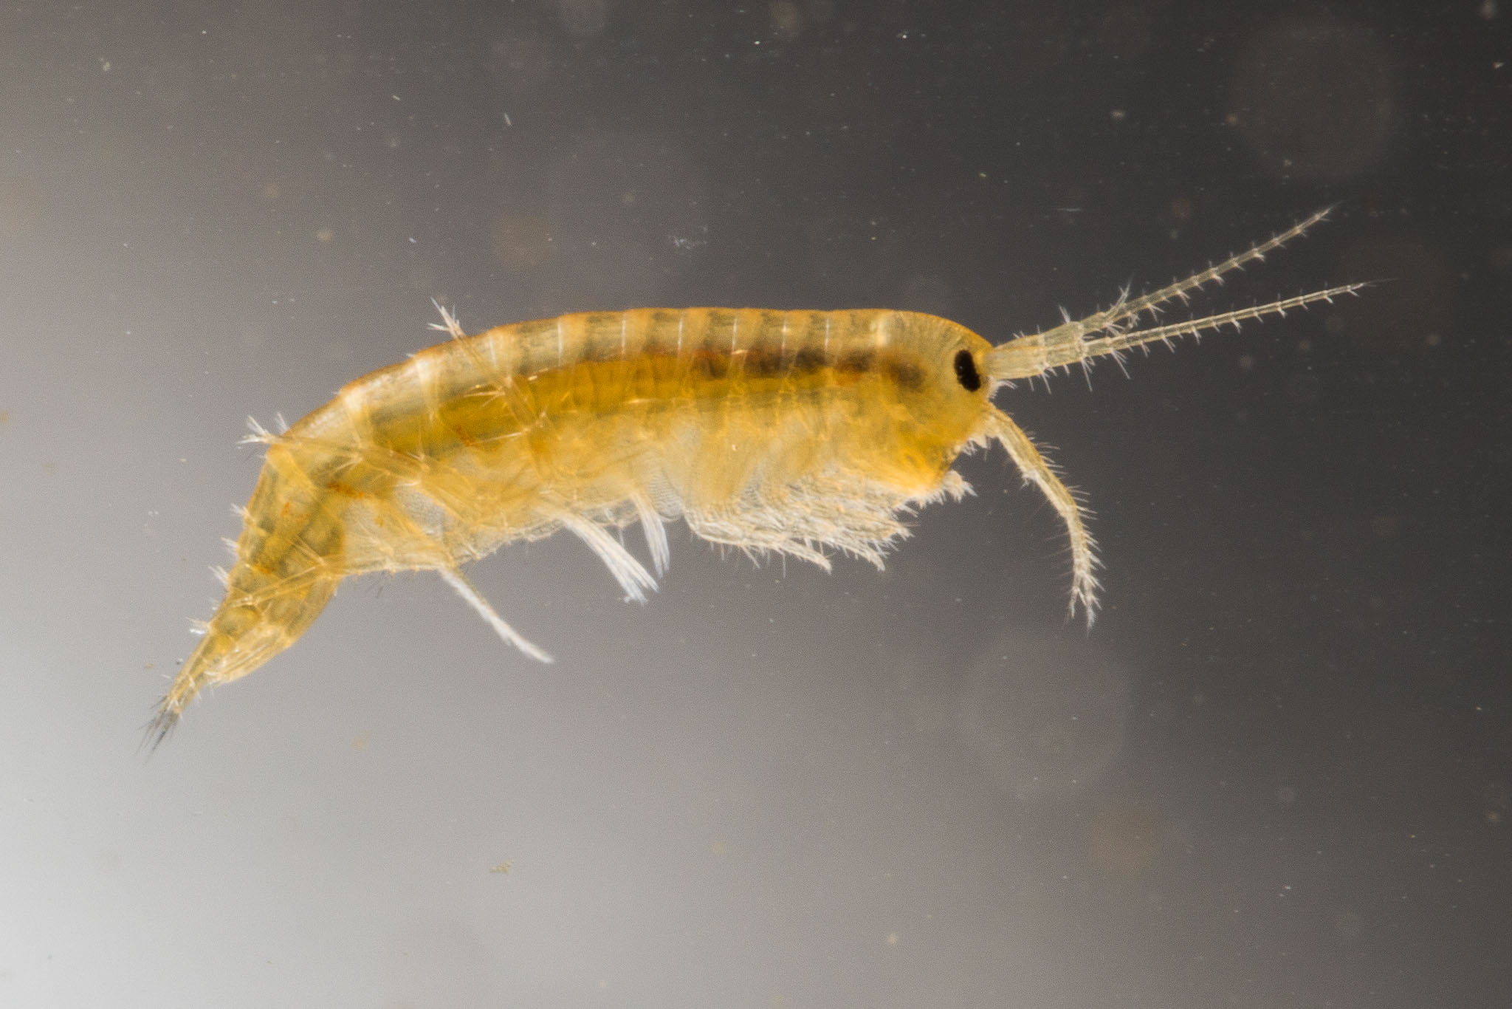
From one genus to a broader framework
Eurytemora is the first case study, not the endpoint.
1
2
3
4
5
Eurytemora
Pseudodiaptomus
Mysids
Acartiella
Gammarus
STAGE 1
STAGE 2
STAGE 3
Historical relationships
Predict abundance
Connect to management
Five target genera
Different environmental conditions + time periods
Water-management scenarios → ecological response
STORY
SYSTEM
DATA
RESULTS
IMPLICATIONS
ACKNOWLEDGEMENTS
Notes:
This is also why I think the projects in this session fit together. Hydrology gives us environmental scenarios. Fish models and experiments give us mechanisms for movement and survival. Zooplankton work gives us information about the prey field. Together, these lines of evidence can eventually answer questions that no single model can answer alone.

Slide 16
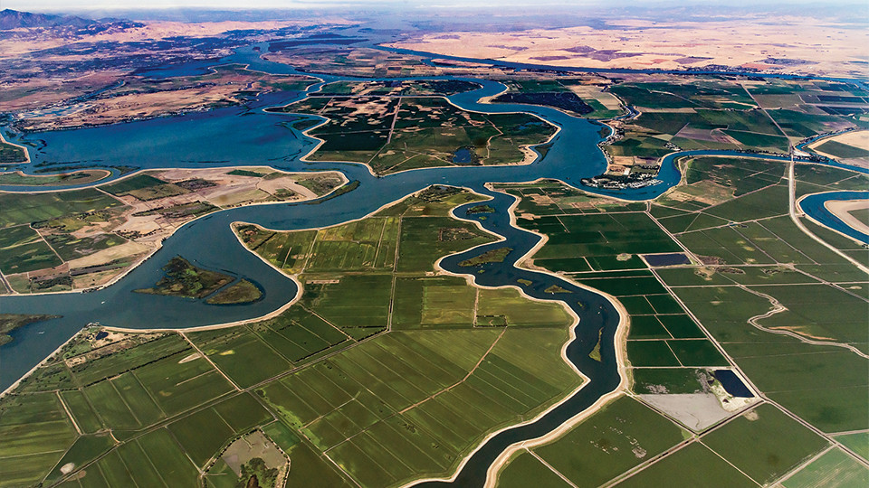
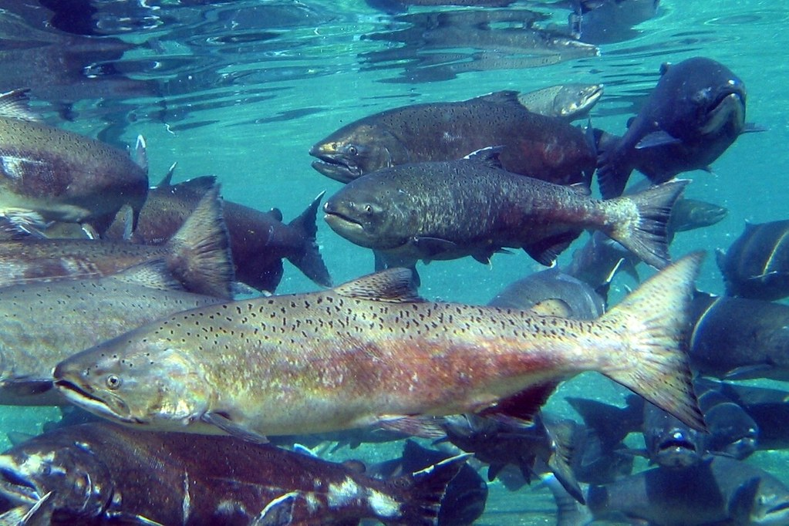
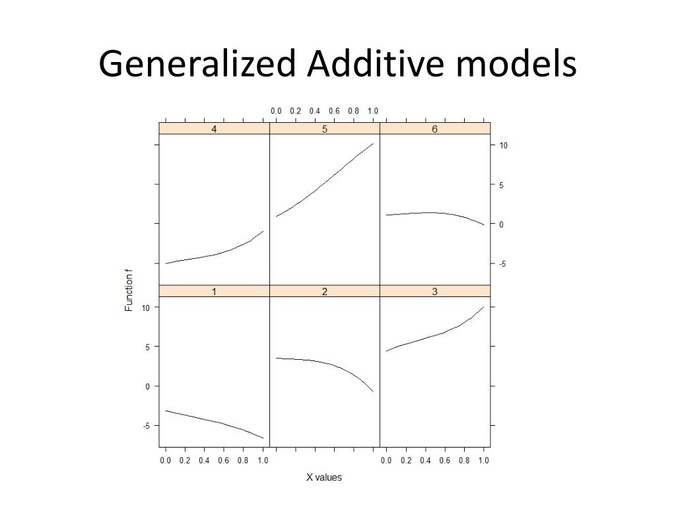
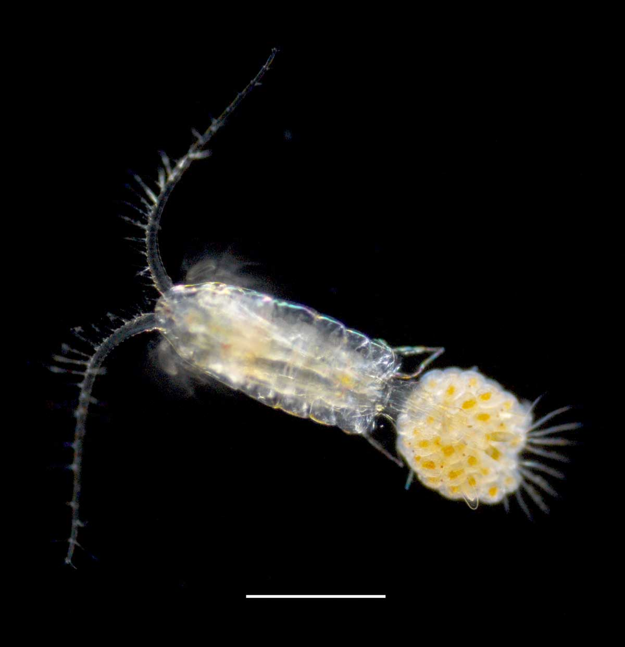
Take-home messages
1
Water conditions are ecological conditions.
Changes in flow, salinity, and water quality create the environment organisms experience.
2
Zooplankton are a biological bridge.
They connect environmental conditions to the food available to fish.
3
Long-term data can reveal response relationships.
Even imperfect monitoring records can be used when model structure respects data availability.
4
Eurytemora is the first step.
The larger goal is a multi-taxon biological framework that can interact with water-management models.
Ultimately: predict not only what happens to the water, but what those changes could mean for the ecosystem.
STORY
SYSTEM
DATA
RESULTS
IMPLICATIONS
ACKNOWLEDGEMENTS
Notes:
My three take-home points are: water conditions are ecological conditions; zooplankton provide a measurable bridge between those conditions and the food web; and long-term monitoring can be used to develop biological response relationships when we respect its limitations. Eurytemora is the first step toward a broader framework for connecting water-management scenarios to ecosystem response.

Slide 17


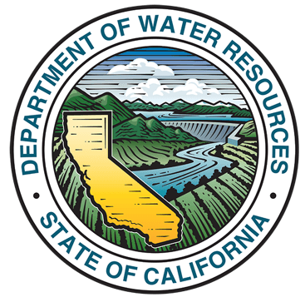

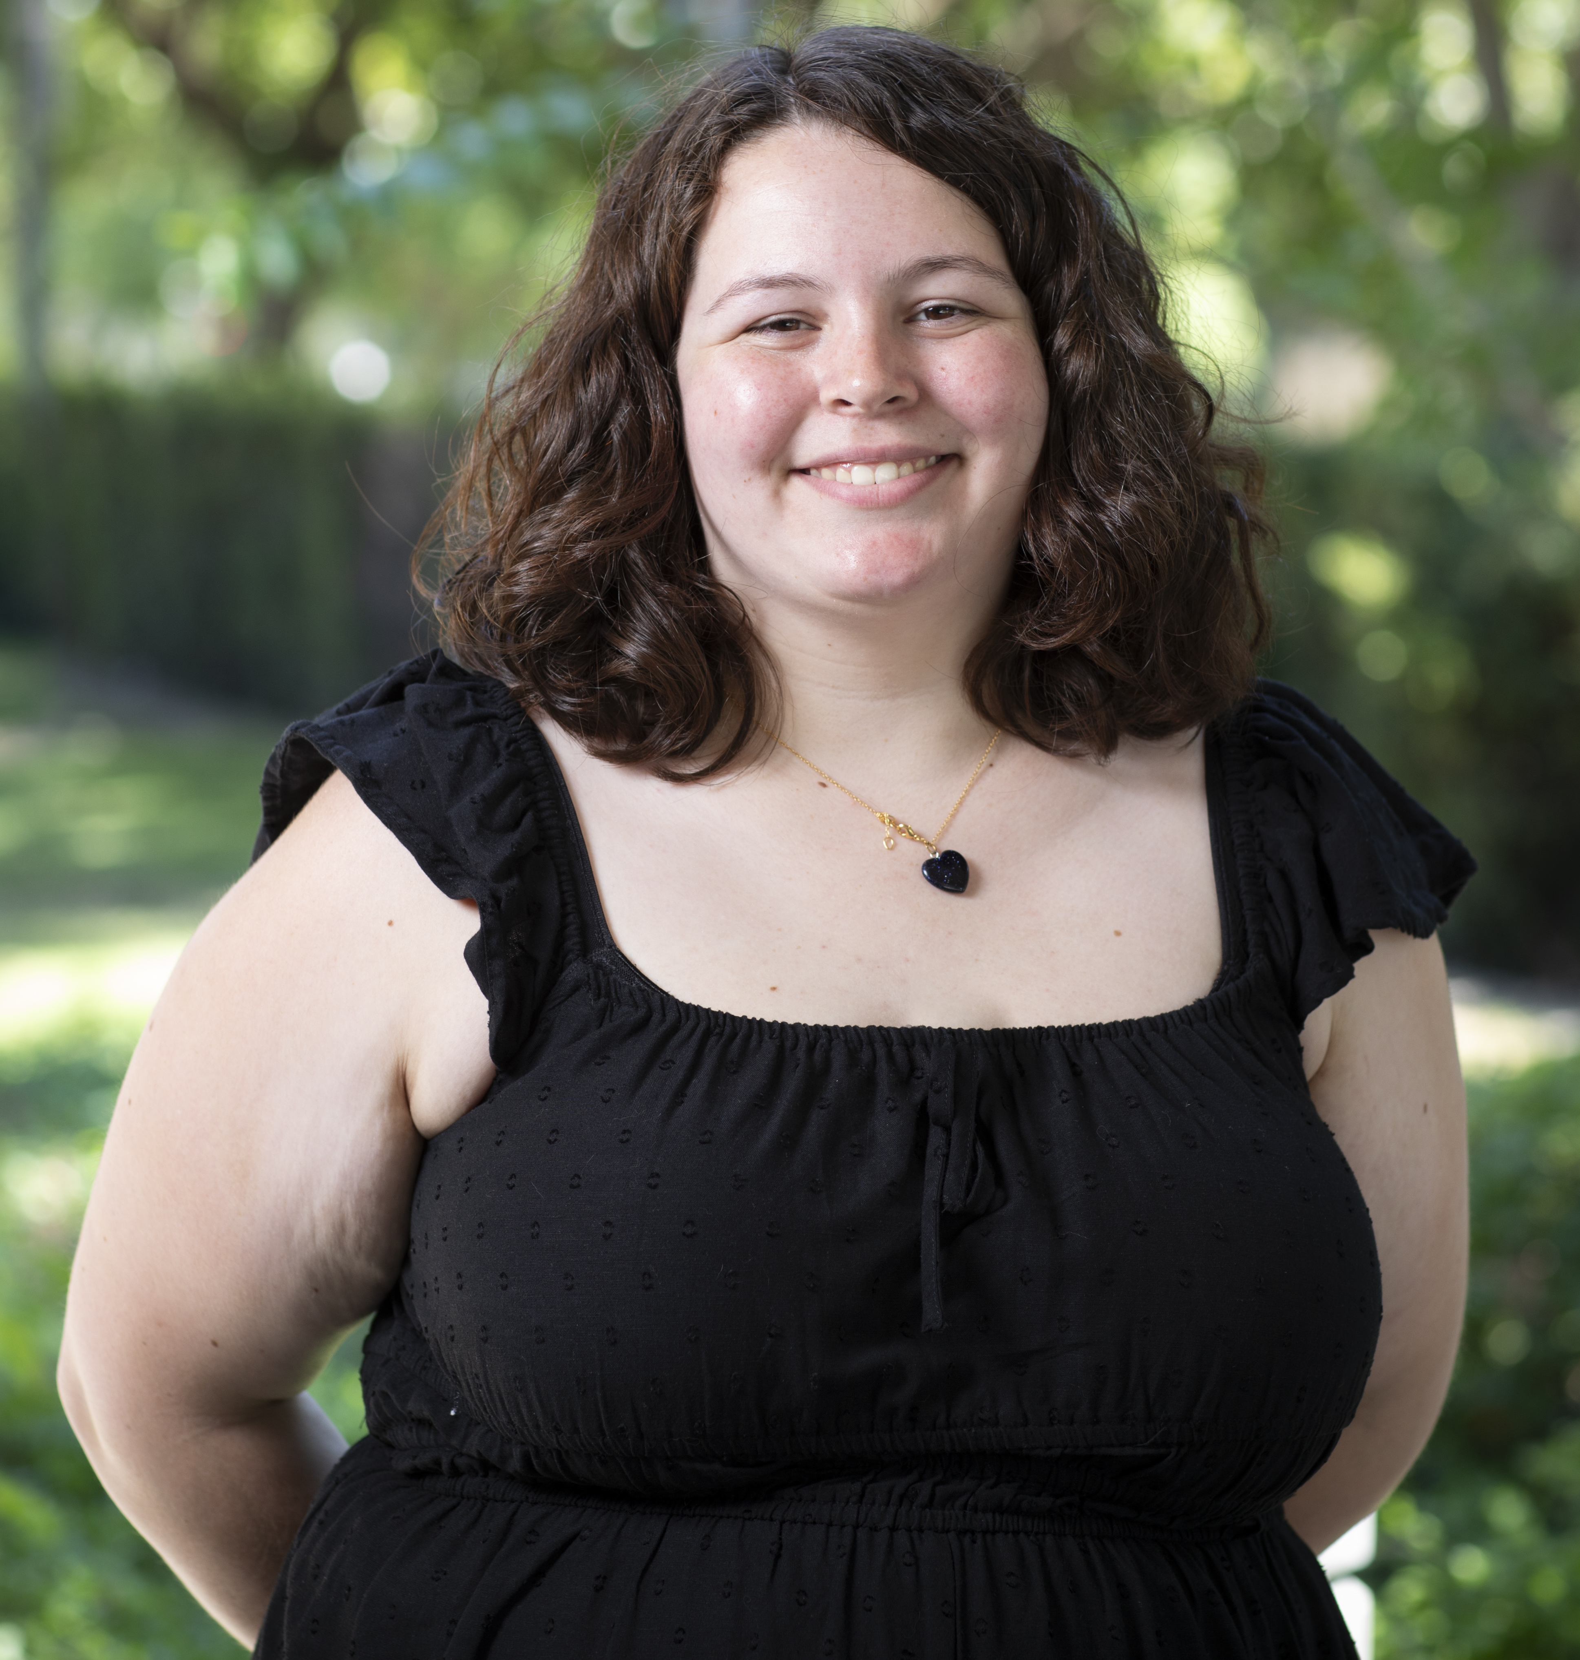
Acknowledgements
A special thank you to:
Reclamation, Bay-Delta Office
UC Davis Center for Watershed Sciences
Interagency Ecological Program
Department of Water Resources
Contact:
alacey@ucdavis.edu

Slide 18
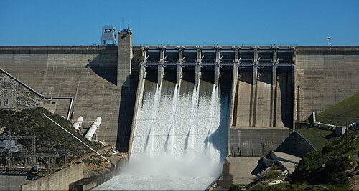
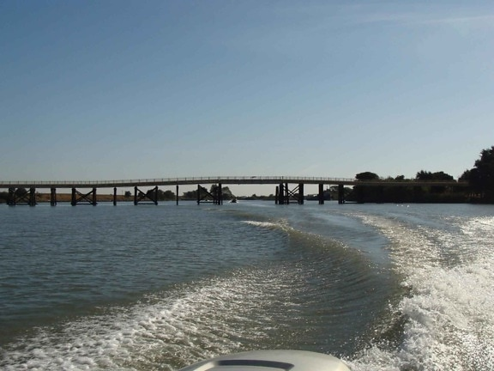
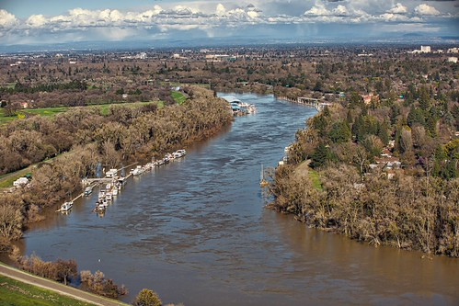
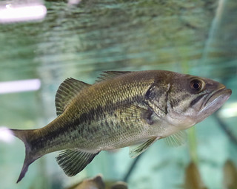
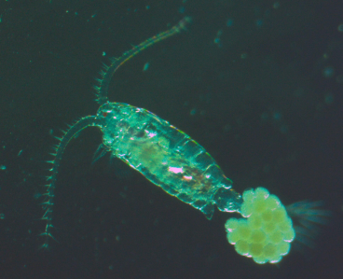
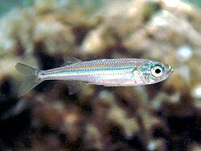
Connecting the projects
Think of the session as a chain, not a collection of separate models.
MANAGEMENT
SCENARIOS
FLOW /
SALINITY
HABITAT /
MOVEMENT
PREDATION /
SURVIVAL
PREY /
ZOOPLANKTON
FISH /
ECOSYSTEM
CALSIM3
Hydrology
ECO-PTM
Experiments
This work
Synthesis
No single model captures the whole system.
The value comes from connecting complementary lines of evidence.
STORY
SYSTEM
DATA
RESULTS
IMPLICATIONS
ACKNOWLEDGEMENTS
Notes:
Management scenarios affect flow and salinity. Those conditions affect habitat, movement, predation, and the prey field. My project is focused on that food-web portion of the chain.

Slide 19
The modeling problem
Predicting water conditions is not the same as predicting ecosystem response.
MANAGEMENT
ENVIRONMENT
BIOLOGY
Flow • exports • salinity
Conditions organisms experience
Abundance • distribution • survival
MY QUESTION
How do environmental conditions relate to zooplankton abundance and spatial distribution?
STORY
SYSTEM
DATA
RESULTS
IMPLICATIONS
ACKNOWLEDGEMENTS

Slide 20
What this adds to the modeling chain
The immediate product is a biological response relationship.
CALSIM3
ENVIRONMENT
ZOOPLANKTON
FISH FOOD WEB
Predicted system conditions
Flow • salinity • temperature • food
Empirical response
Potential downstream response
The goal is to provide information about how an organism responds to environmental conditions.
STORY
SYSTEM
DATA
RESULTS
IMPLICATIONS
ACKNOWLEDGEMENTS

Slide 21
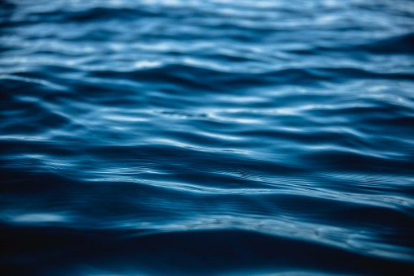
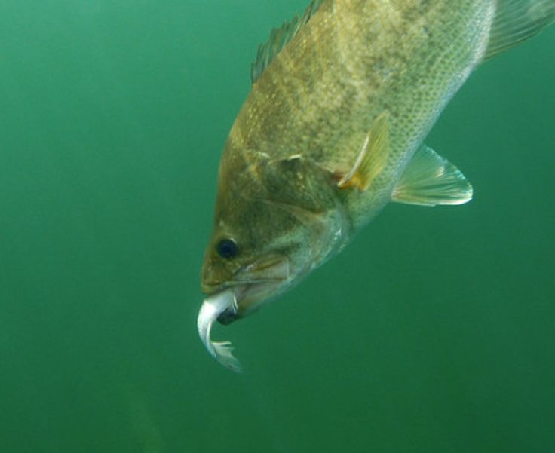
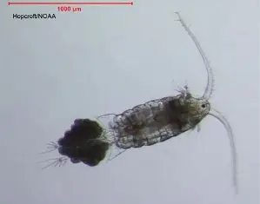
Why this matters for this session
3
1
2
HYDROLOGY
MECHANISMS
FOOD WEB
What conditions will management scenarios create?
How do fish move, survive, and interact with prey?
How does the prey field respond to those conditions?
Each of these parts combine to help us understand the whole Delta Ecosystem
STORY
SYSTEM
DATA
RESULTS
IMPLICATIONS
ACKNOWLEDGEMENTS
Notes:
The management relevance is not that one Eurytemora curve will immediately change operations. The nearer-term value is better understanding of current trophic linkages and developing biological relationships that can eventually be used alongside quantitative water-management models.

