Slide 1
How Rising Costs Outpaced Income (2009–2023)
The Affordability Squeeze
Alysha Nadeem | Camden Davis | Gerrit Mitchell | Thrisha Jawahar
STA 518 • Grand Valley State University
Notes:
Camden

Slide 2
Overview
The Question
Data Sources
Between 2009 and 2023, the U.S. CPI rose ~42%, reshaping household budgets nationwide. Did income growth keep pace — and did the burden fall equally across all communities?
U.S. Census ACS (2009–2023)
3,000+ county-level observations per year
Income, rent, home costs, poverty rates
BLS CPI-U (2000–2024)
Monthly CPI aggregated to yearly averages
Used to adjust all dollar figures to 2024 $
Key Finding: High-poverty counties experienced meaningfully lower inflation-adjusted income growth, widening the gap with wealthier communities over the study period.
Source: U.S. Census Bureau ACS | Bureau of Labor Statistics CPI-U
Notes:
Thrisha

Slide 3
Data Pipeline & Key Transformations
01
02
03
04
05
Load & Clean
CPI Aggregation
Joins
Inflation Adjust
Derived Variables
Standardized FIPS codes with str_pad(). Removed duplicates and impossible values. Filtered to 2009–2023.
Parsed date strings with lubridate::ymd(). Averaged 12 monthly CPI-U values into annual averages.
Merged census county-year data to CPI yearly averages. All 45,000+ rows preserved.
Created 2024-dollar versions of income, rent, and home cost using the CPI ratio formula.
Extracted state and county via str_extract(). Assigned poverty quartile tiers with ntile(). Computed rent-to-income ratio.
stringr: str_pad, str_squish, str_detect, str_extract, str_remove | lubridate: ymd(), year()
Notes:
Thrisha

Slide 4
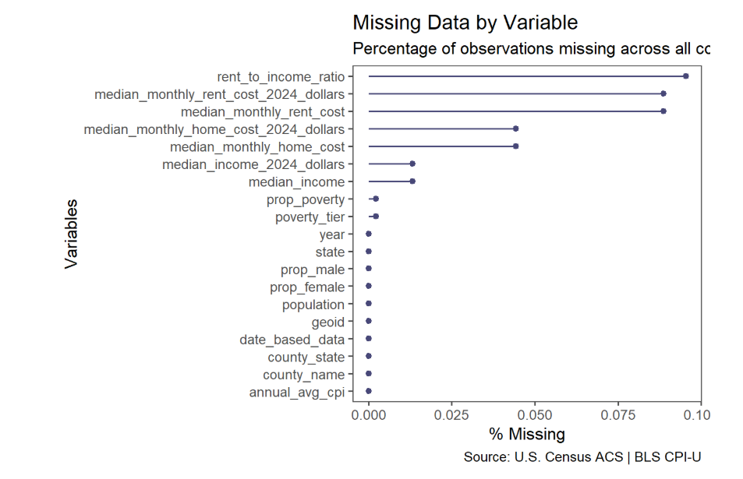
Patterns of Missingness
Visualized with naniar::gg_miss_var().
Notes:
Thrisha

Slide 5
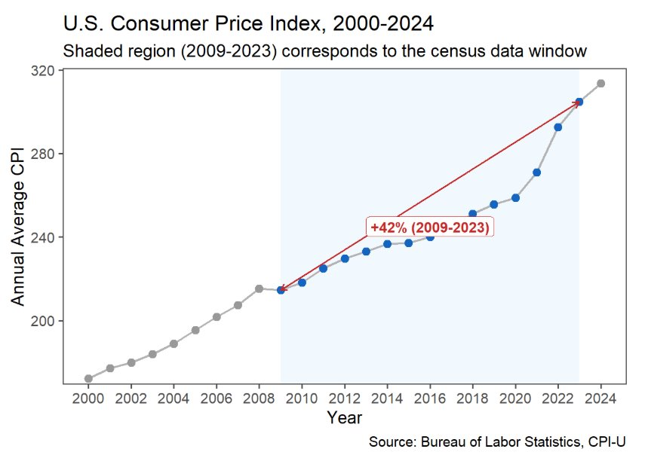
Section 1: The Inflation Context
+42%
CPI increase
2009–2023
214 → 305
CPI index
points
Post-2020
Inflation
accelerated
U.S. CPI trend from 2000 to 2024. The shaded region marks the 2009-2023 study window. Source: Bureau of Labor Statistics.
Notes:
Camden

Slide 6
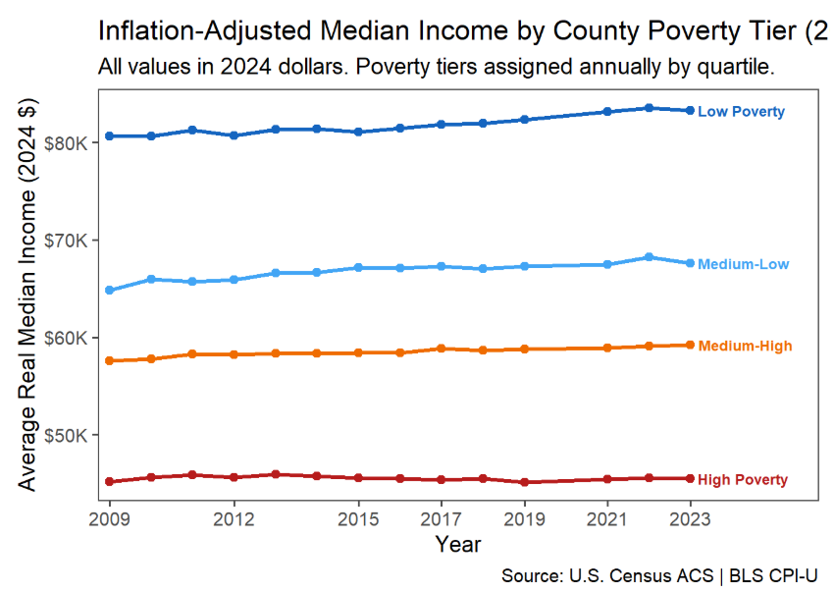
Section 2: Did Incomes Keep Up?
Key Takeaway
All tiers grew in real terms — but the gap widened.
Low Poverty counties surged post-2020 as labor markets tightened.
High Poverty counties saw minimal gains and ended 2023 further behind in real terms than they started.
The squeeze was not shared equally.
Notes:
Gerrit

Slide 7
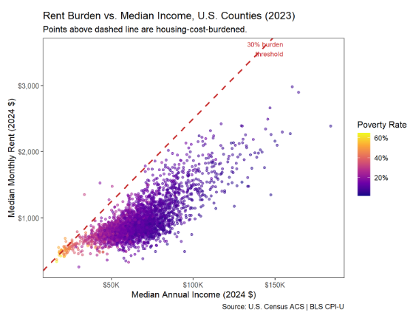
Section 3: The Housing Burden
The 30% Rule
Households spending more than 30% of gross income on rent are considered housing-cost-burdened.
% of counties above the 30% rent-to-income threshold by poverty tier. Source: U.S. Census ACS | BLS CPI-U. 2023 data.
Notes:
Gerrit

Slide 8
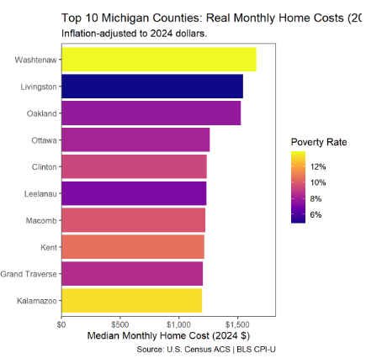
Section 3: The Housing Burden
Michigan
Michigan's most expensive counties — Ottawa, Washtenaw, Leelanau — are among the state's lowest-poverty areas.
High housing costs reflect rising market prices, not income deprivation.
This is a different housing crisis from what high-poverty counties face.
% of counties above the 30% rent-to-income threshold by poverty tier. Source: U.S. Census ACS | BLS CPI-U. 2023 data.
Notes:
Camden

Slide 9
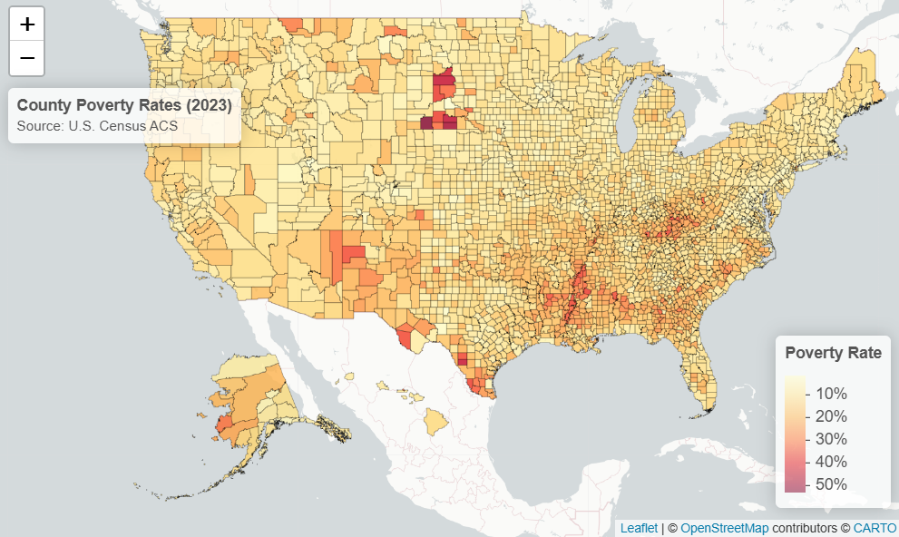
Section 4: Where It Hurts Most
Two Different Geographies of Hardship
MAP A: Poverty Rate (2023)
Concentrated in some states
Persistent, structural poverty regions where incomes have chronically lagged behind national averages.
Interactive Leaflet maps in the HTML report. Static choropleth for rent burden. Source: U.S. Census ACS | BLS CPI-U.
Notes:
Alysha

Slide 10
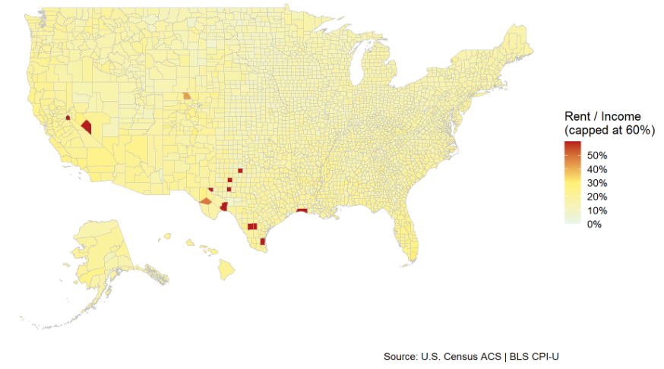
Section 4: Where It Hurts Most
Two Different Geographies of Hardship
MAP B: Rent-to-Income Ratio (2023)
Concentrated in:
Coastal metros
Mountain resort counties
High-demand urban areas
A different crisis: rent outpaces income here regardless of poverty rate; driven by supply constraints and market demand.
Interactive Leaflet maps in the HTML report. Static choropleth for rent burden. Source: U.S. Census ACS | BLS CPI-U.
Notes:
Alysha

Slide 11
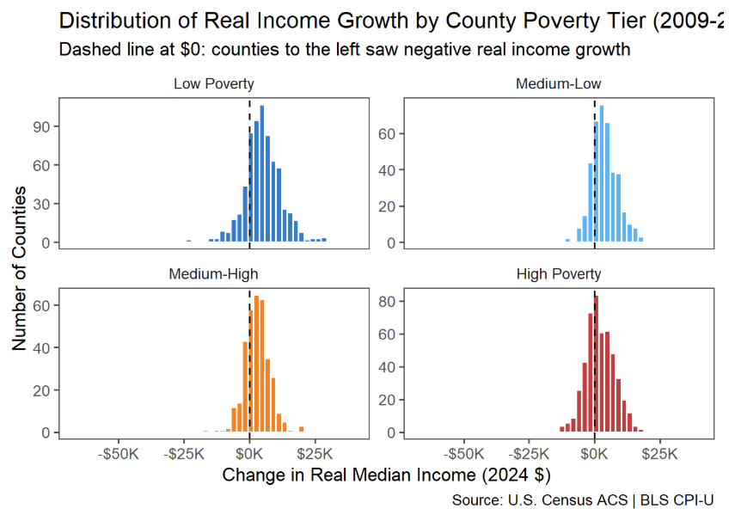
Section 5: Income Growth Distribution by Poverty Tier
Distributional view of real income growth (2009–2023) per county, split by poverty tier.
Notes:
Alysha

Slide 12
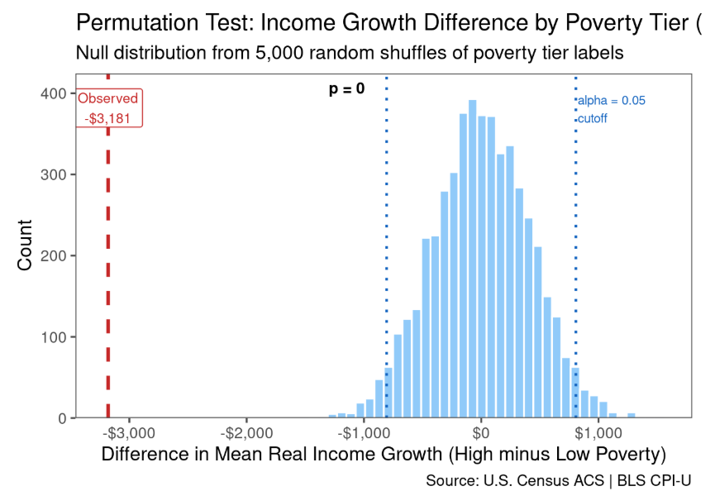
Permutation Test: Is the Gap Statistically Significant?
Hypotheses
H₀: Mean real income growth is the same for High and Low Poverty counties. H₁: Mean real income growth differs between the two groups.
Results
5,000 permutations | Seed: 518 p-value < 0.0001 Reject H₀ — the gap is not due to chance.
← Observed gap far outside null distribution
Two-sided permutation test. Test statistic: mean(High Poverty growth) − mean(Low Poverty growth). Source: U.S. Census ACS | BLS CPI-U.
Notes:
Alysha

Slide 13
Conclusions & Takeaways
01
Prices rose 42% from 2009 to 2023, accelerating sharply after 2020.
02
Incomes grew in all tiers — but the gap between Low and High Poverty counties widened in real terms.
03
Housing cost burden is concentrated in high-poverty counties, with 67% above the 30% threshold.
04
Geography matters: poverty concentrates in the South and Appalachia; rent burden is a coastal phenomenon. Two distinct crises.
05
The income growth gap is statistically significant (p < 0.0001). The squeeze was systematically worse for the most vulnerable.
Notes:
Gerrit

Slide 14
Appendix
GitHub
Notes:
https://github.com/alyshain/sta518-project

