Slide 1

Resampling Methods
CAPT David Ruth, USN
Mathematics Department, United States Naval Academy
Conference on Applied Statistics in Defense
27 October 2016

Slide 2
Outline
Overview of resampling methods
Bootstrapping
Cross-validation
Permutation tests

Slide 3
Overview of resampling methods
“Re-”sampling methods => methods applied to an existing sample.
Gist:
Sample from existing sample to obtain new sample(s).
Bootstrapping: Sample WITH replacement, treating original sample as a proxy for the population of interest.
Cross-validation and permutation tests: Sample WITHOUT replacement, using exchangeability assumptions for inference.

Slide 4
Bootstrapping

Slide 5
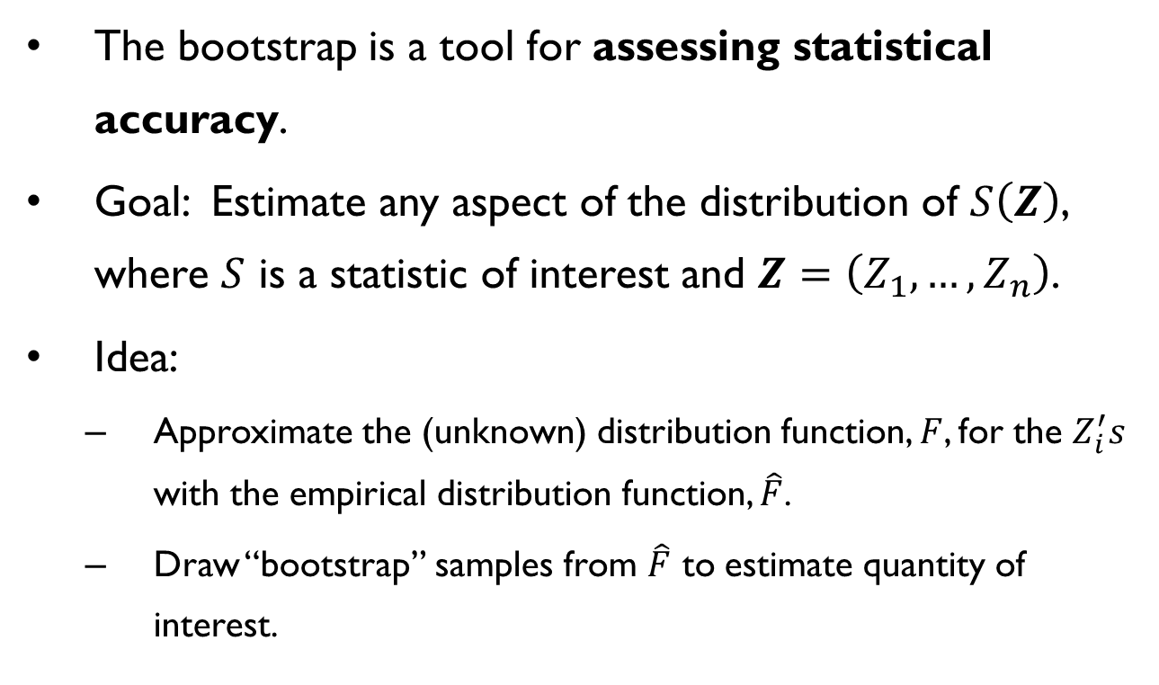
Bootstrapping
The bootstrap is a tool for assessing statistical accuracy.
Goal: Estimate any aspect of the distribution of $S\left(Z\right)$, where $S$ is a statistic of interest and $Z=\left(Z_{1},…,Z_{n}\right)$.
Idea:
Approximate the (unknown) distribution function, $F$, for the $Z_{i}^{′}s$ with the empirical distribution function, $\hat{F}$.
Draw “bootstrap” samples from $\hat{F}$ to estimate quantity of interest.

Slide 6
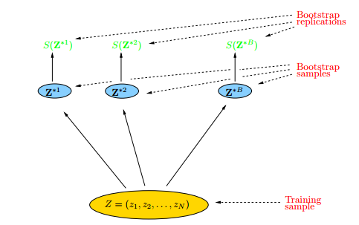
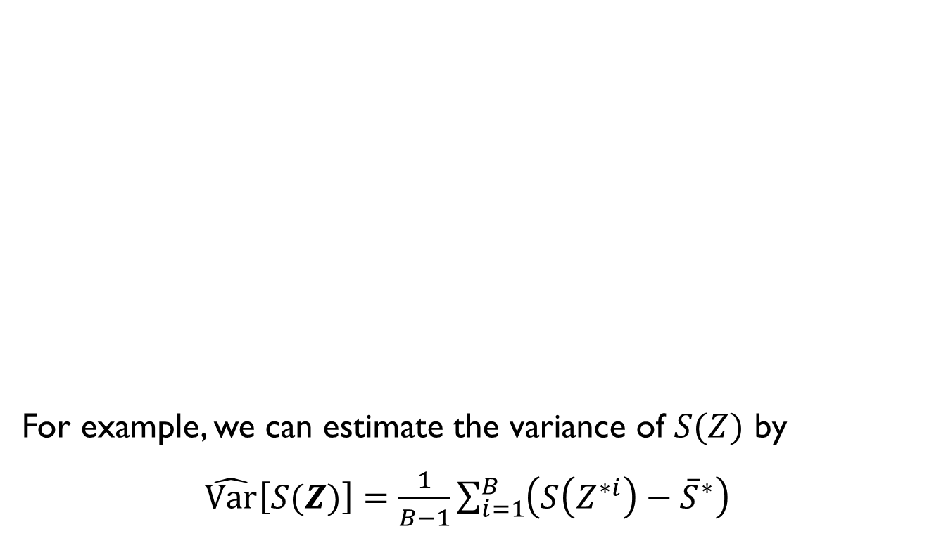
Bootstrapping
For example, we can estimate the variance of $S(Z)$ by $\hat{Var}\left[S(Z)\right]=\frac{1}{B−1}\sum_{i=1}^{B}{\left(S\left(Z^{∗i}\right)−{\overline{S}}^{∗}\right)}$

Slide 7
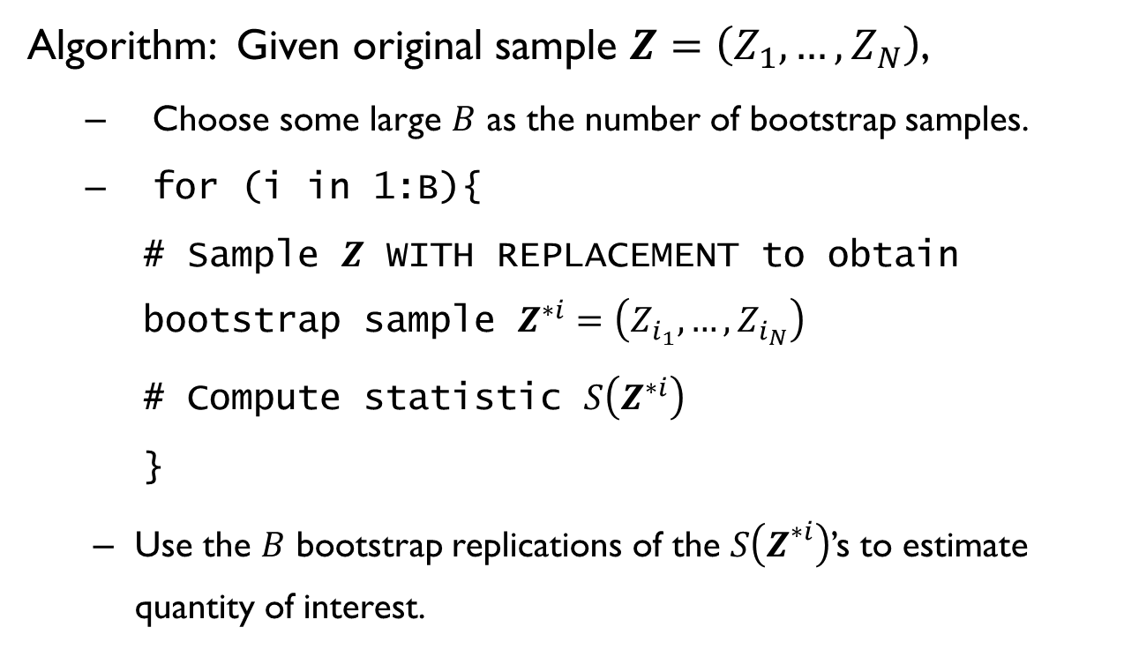
Bootstrapping
Algorithm: Given original sample $Z=\left(Z_{1},…,Z_{N}\right)$,
Choose some large $B$ as the number of bootstrap samples.
for (i in 1:B){
# Sample $Z$ WITH REPLACEMENT to obtain bootstrap sample $Z^{∗i}=\left(Z_{i_{1}},…,Z_{i_{N}}\right)$
# Compute statistic $S\left(Z^{∗i}\right)$
}
Use the $B$ bootstrap replications of the $S\left(Z^{∗i}\right)$’s to estimate quantity of interest.

Slide 8
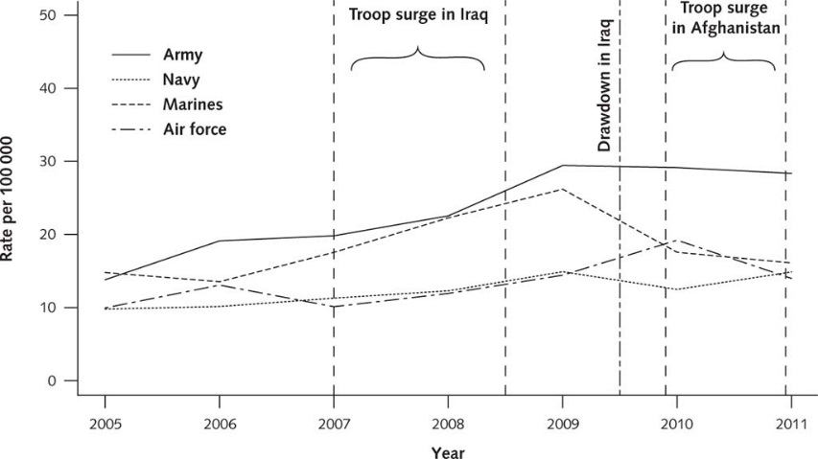
Bootstrapping

Slide 9
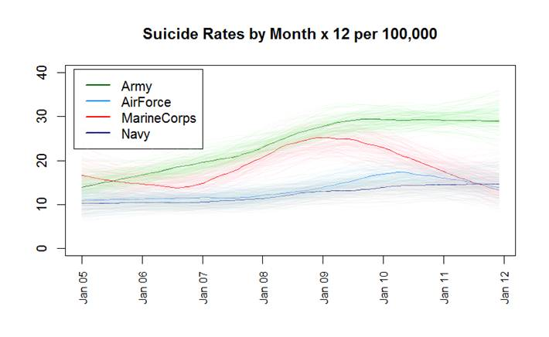
Bootstrapping

Slide 10
Bootstrapping
R

Slide 11
Cross-validation

Slide 12
Cross-validation
One of the simplest and most widely used methods for estimating prediction error.
If we had enough data, we might set aside a “test set” or “validation set” to assess a fitted prediction model’s performance.
Why not just use training data as test data?
OVERFITTING!

Slide 13
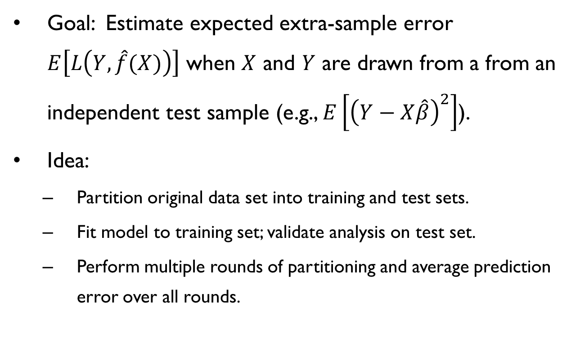
Cross-validation
Goal: Estimate expected extra-sample error $E\left[L\left(Y,\hat{f}(X)\right)\right]$ when $X$ and $Y$ are drawn from a from an independent test sample (e.g., $E\left[{\left(Y−X\hat{β}\right)}^{2}\right]$).
Idea:
Partition original data set into training and test sets.
Fit model to training set; validate analysis on test set.
Perform multiple rounds of partitioning and average prediction error over all rounds.

Slide 14
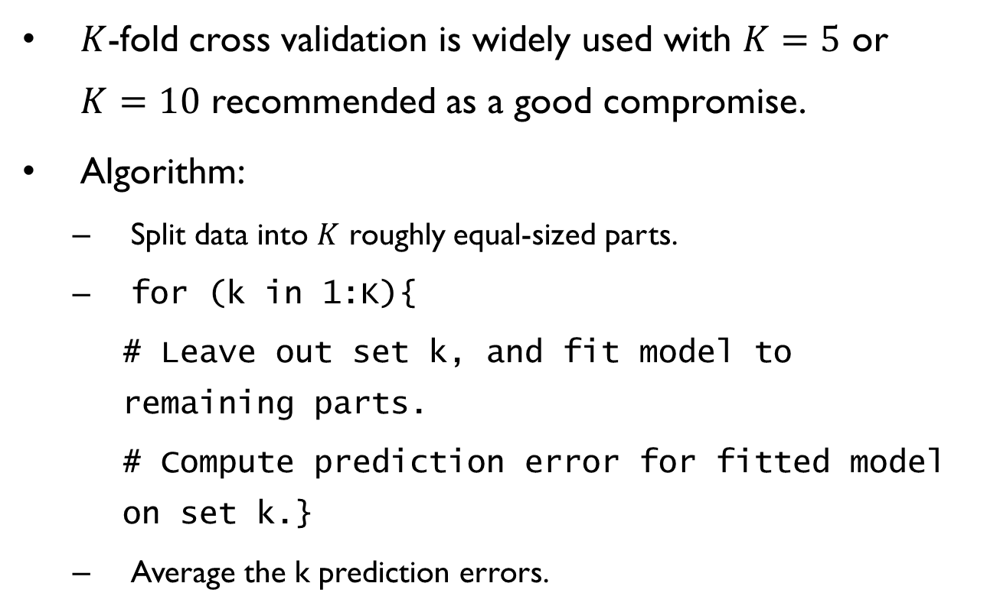
Cross-validation
$K$-fold cross validation is widely used with $K=5$ or $K=10$ recommended as a good compromise.
Algorithm:
Split data into $K$ roughly equal-sized parts.
for (k in 1:K){
# Leave out set k, and fit model to remaining parts.
# Compute prediction error for fitted model on set k.}
Average the k prediction errors.

Slide 15
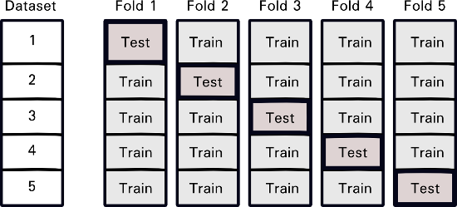
Cross-validation

Slide 16
Real-world example: Heart data
Data: heart disease diagnosis for 303 patients at the Cleveland Clinic Foundation, plus 75 other attributes
We consider 5 quantitative and 8 categorical explanatory variables with separate binary response (presence of heart disease; evident in 139 of 303 patients):
age sex cp trestbps chol fbs restecg thalach exang oldpeak slope ca thal
1 63 1 1 145 233 1 2 150 0 2.3 3 0.0 6.0
2 67 1 4 160 286 0 2 108 1 1.5 2 3.0 3.0
3 67 1 4 120 229 0 2 129 1 2.6 2 2.0 7.0
4 37 1 3 130 250 0 0 187 0 3.5 3 0.0 3.0
Data available from the UCI Machine Learning Repository at http://archive.ics.uci.edu/ml/datasets/Heart+Disease

Slide 17
Cross-validation
R

Slide 18
Permutation tests

Slide 19
Permutation tests
Permutation tests may be used to test for a distributional difference among groups.
Under the assumption that observations are exchangeable, the distribution of a test statistic may be approximated by its empirical distribution under all possible label permutations.
“All possible” may be rather large, so…
RESAMPLE!

Slide 20
Permutation tests
Simple example: difference in resting blood pressure from heart data (univariate)
Noisy example: difference in resting blood pressure from heart data with tainted labels (univariate)
MCC example: difference in resting blood pressure from heart data with tainted labels (multivariate)

Slide 21
Permutation tests
R

Slide 22
Mean Cross Count Test

Slide 23

Problem statement
Given:
Two sets of independent multivariate observations (with categorical or quantitative attributes, or both). Formally:
$N=m+n$independent $p$-variate observations
$$𝒜=\left\{X_{1}, …,X_{m}\right\}, ℬ=\left\{X_{m+1}, ⋯,X_{N}\right\},$$
$$X_{i} \sim F ∀i:1≤i≤m,$$
$$X_{j} \sim G ∀j:m+1≤j≤N.$$
Goal:
Develop a robust two-sample test against
$$H_{0}: F=G .$$

Slide 24
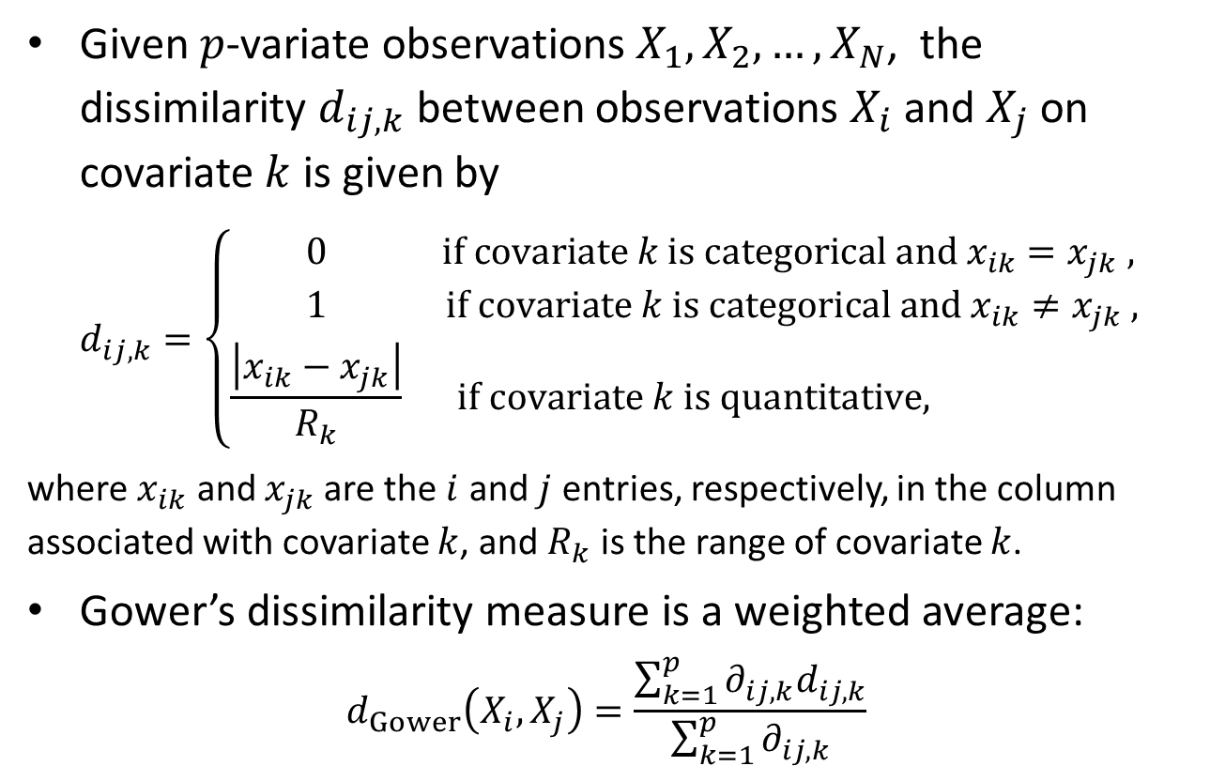
Gower dissimilarity for mixed data
Given $p$-variate observations $X_{1},X_{2},…,X_{N}$, the dissimilarity $d_{ij,k}$ between observations $X_{i}$ and $X_{j}$ on covariate $k$ is given by
$$d_{ij,k}=\left\{\begin{matrix}0 & if covariate k is categorical and x_{ik}=x_{jk} , \\ 1 & if covariate k is categorical and x_{ik}≠x_{jk} , \\ \frac{\left|x_{ik}−x_{jk}\right|}{R_{k}} & if covariate k is quantitative, \end{matrix}\right.$$
where $x_{ik}$ and $x_{jk}$ are the $i$ and $j$ entries, respectively, in the column associated with covariate $k$, and $R_{k}$ is the range of covariate $k$.
Gower’s dissimilarity measure is a weighted average:
$$d_{Gower}\left(X_{i},X_{j}\right)=\frac{\sum_{k=1}^{p}{∂_{ij,k}d_{ij,k}}}{\sum_{k=1}^{p}{∂_{ij,k}}}$$

Slide 25
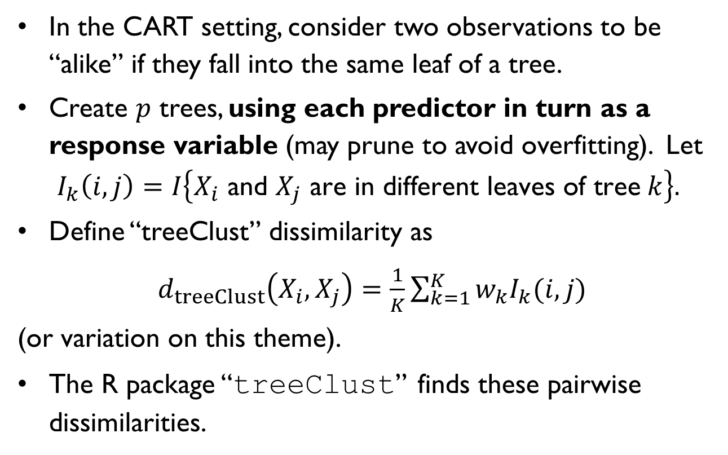
Tree-based dissimilarity
In the CART setting, consider two observations to be “alike” if they fall into the same leaf of a tree.
Create $p$ trees, using each predictor in turn as a response variable (may prune to avoid overfitting). Let
$$I_{k}\left(i,j\right)=I\left\{X_{i} \text{and} X_{j} \text{are} \text{in} \text{different} \text{leaves} \text{of} \text{tree} k\right\}.$$
Define “treeClust” dissimilarity as
$d_{treeClust}\left(X_{i},X_{j}\right)=\frac{1}{K}\sum_{k=1}^{K}{w_{k}I_{k}(i,j)}$
(or variation on this theme).
The R package “treeClust” finds these pairwise dissimilarities.
Notes:
25

Slide 26
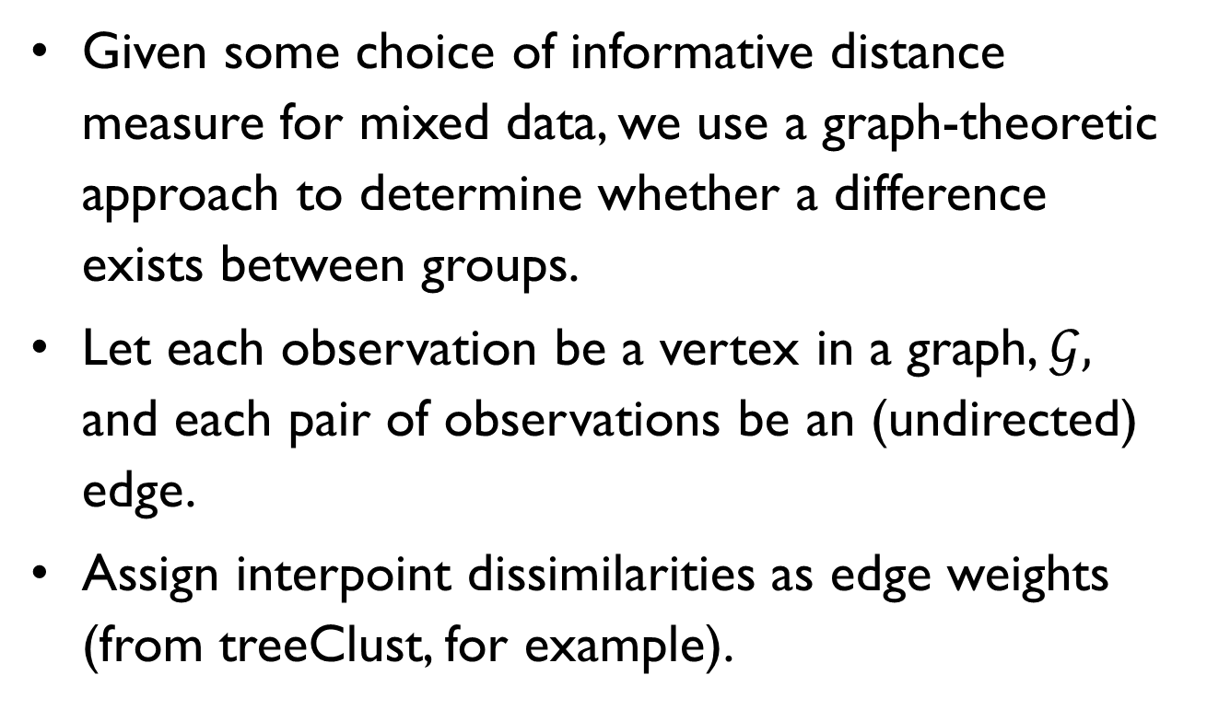
Mean Cross Count test
Given some choice of informative distance measure for mixed data, we use a graph-theoretic approach to determine whether a difference exists between groups.
Let each observation be a vertex in a graph, $𝒢,$ and each pair of observations be an (undirected) edge.
Assign interpoint dissimilarities as edge weights (from treeClust, for example).

Slide 27
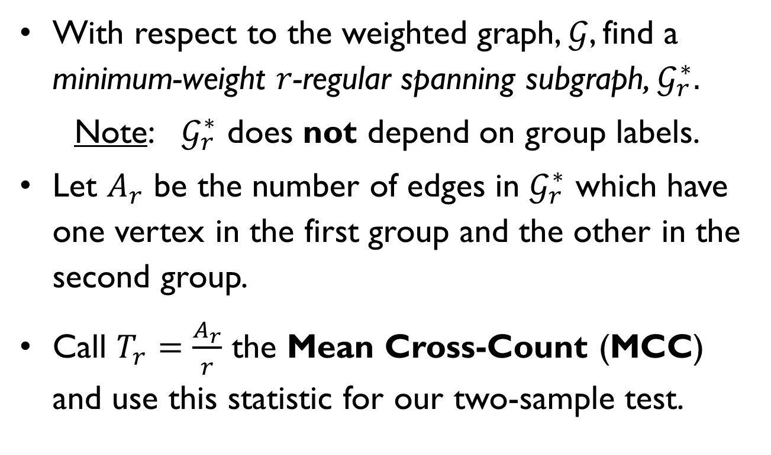
Mean Cross Count test
With respect to the weighted graph, $𝒢$, find a minimum-weight $r$-regular spanning subgraph, $𝒢_{r}^{∗}.$
Note: $𝒢_{r}^{∗}$ does not depend on group labels.
Let $A_{r}$ be the number of edges in $𝒢_{r}^{∗}$ which have one vertex in the first group and the other in the second group.
Call $T_{r}=\frac{A_{r}}{r}$ the Mean Cross-Count (MCC) and use this statistic for our two-sample test.

Slide 28
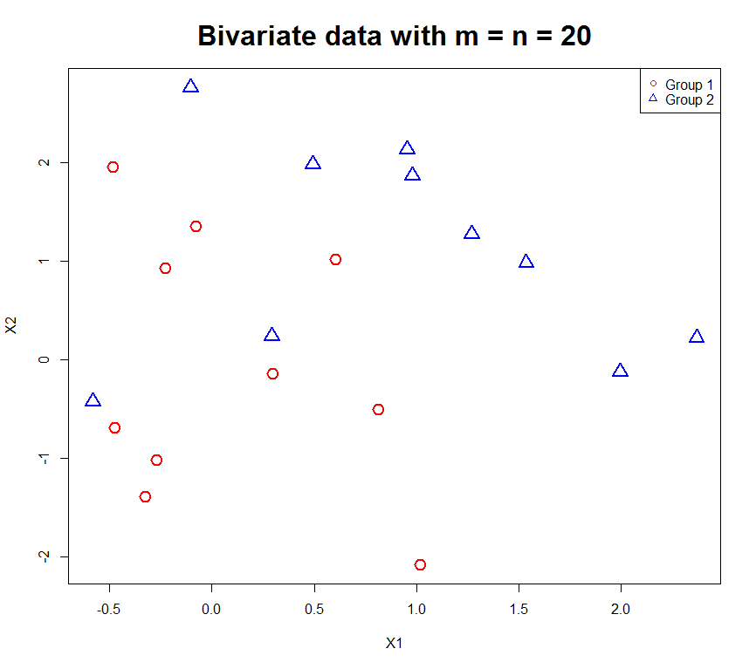
10
Notes:
28

Slide 29
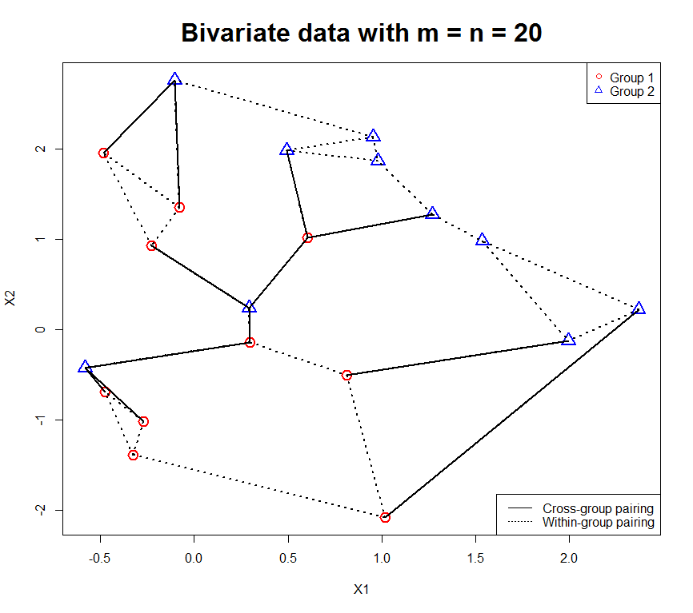
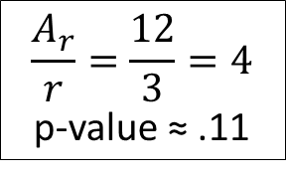
10
$$\frac{A_{r}}{r}=\frac{12}{3}=4$$
p-value ≈ .11
Notes:
29

Slide 30
Supporting R packages
treeClust (treeClustering)
produces tree-based dissimilarities
allows a number of user options
AcrossTic (A cost-minimal regular spanning subgraph with Tree clustering)
finds minimum weight regular spanning subgraphs and associated test statistic for two-sample problem
ptest performs permutation test for p-values
plot allows 2D view of spanning subgraph and MCC

Slide 31
Mean Cross Count test
R

Slide 32
References
Anglemyer, A., Miller, M., Buttrey, S., Whitaker, L. (2015), “Suicide Rates and Methods in Active Duty Military Personnel, 2005 to 2011; A Cohort Study, ” Annals of Internal Medicine, 165(3).
Blake, C. and Merz, C. (1998), UCI repository of machine learning databases, University of California, Irvine, Department of Information and Computer Sciences.
Buttrey, S. and Whitaker, L. (2015), “treeClust: An R Package for Tree-Based Clustering Dissimilarities,” R Journal, 7(2).
Friedman, J., Hastie, T., Tibshirani, R., The Elements of Statistical Learning: Data Mining, Inference, and Prediction, Springer Series in Statistics, 2009.
Ruth, D. (2014), “A New Multivariate Two-Sample Test Using Regular Minimum-Weight Spanning Subgraphs,” Journal of Statistical Distributions and Applications, 1(1).

