Slide 1

School of Computer Science and Engineering • Greater Noida
AI Web Development Internship
at InAmigos Foundation
I N T E R N S H I P P R E S E N T A T I O N
Student Name
Alyssa Suri
Enrollment Number
25SCS1003001645
Program & Semester
B.Tech CSE — Semester 3
Organization
InAmigos Foundation

Slide 2
Internship Overview
Two-week AI-assisted web development internship, remote (work-from-home)
Duration
23 July – 5 August 2026, completed fully remotely as part of the B.Tech CSE curriculum at IILM University.
i
InAmigos Foundation
Section-8 registered non-profit, licensed by the Central Government of India (Reg. No. U85300CT2020NPL010641).
Focus Area
Applying front-end web development skills alongside AI-assisted tools to support the Foundation's digital presence.
Registered under CSR-1 and holds 80G tax-exemption status.
Operates with a network of 200+ volunteers across India.
AI Tools Used
Claude (Anthropic) and Gemini were used throughout for design, coding and content-creation tasks.
Promotes arts, commerce, sports, environmental protection and community welfare.
Runs virtual internship programs in Web Development, AI, Content Writing, Digital Marketing and Graphic Design.
Internship Report | Alyssa Suri
2

Slide 3
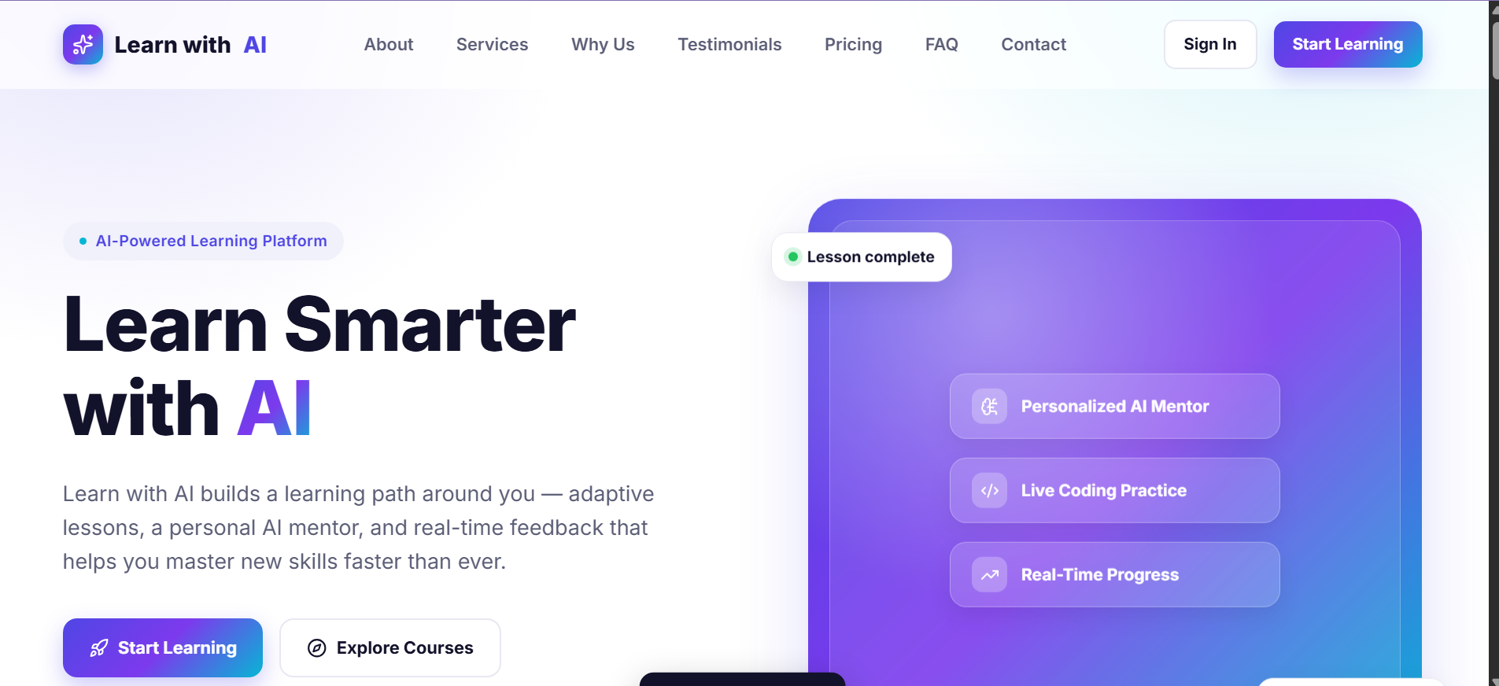
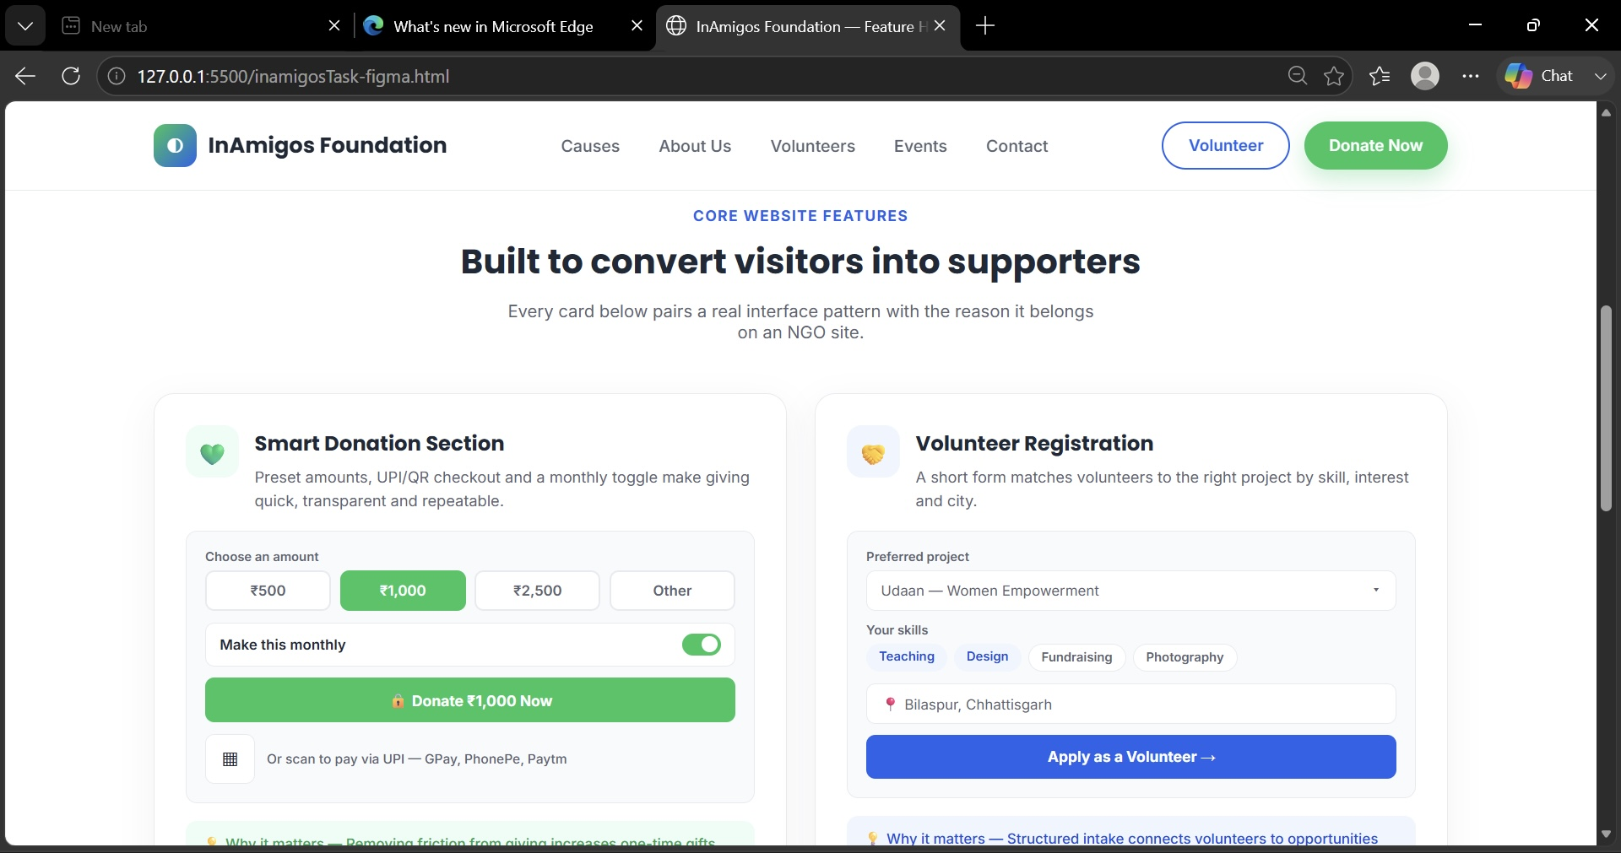
Project Objectives
05
Five goals guiding the internship, with selected deliverables
CORE OBJECTIVES
1
Portfolio Website
Selected Deliverables
Personal developer portfolio built with an AI-assisted workflow.
2
“Learn with AI” Page
Original AI-themed landing page demonstrating front-end skills.
3
UI/UX Audit
Fig. “Learn with AI” landing page — Task 3 deliverable
Structured audit of the InAmigos Foundation website.
4
Feature Prototype
Redesigned donation & volunteer-registration section.
5
Outreach Support
Shared project work and feedback with the Foundation.
Fig. Feature-highlight redesign prototype — Task 4 deliverable
Internship Report | Alyssa Suri
3

Slide 4
Methodology — Task-Based Execution
Four core tasks executed in sequence over the two-week internship period
1
Personal Portfolio Website
2
Website Analysis
TASK 1
TASK 2
Responsive portfolio (About, Skills, Projects, Contact) built with HTML, CSS, JS via Google AntiGravity; deployed on Vercel.
Section-by-section audit of the live InAmigos Foundation site — 14 issues identified and prioritized in a Change Summary document.
3
“Learn with AI” Website
4
Feature Highlight Prototype
TASK 3
TASK 4
Original AI-learning-platform landing page with hero, features, courses and testimonials; deployed on Vercel.
Top-priority audit findings translated into a working mockup: an improved donation flow and volunteer-registration section.
Outreach & Documentation: completed project links were shared on social media (tagging InAmigos Foundation), and a structured feedback form was submitted on completion.
Internship Report | Alyssa Suri
4

Slide 5
Technologies & System Architecture
Technologies & Tools Used
System Architecture — Static Front-End
HTML5, CSS3 & JavaScript (ES6)
Presentation Layer
1
Semantic HTML5 — nav, hero, about, skills, projects, contact
Google AntiGravity — AI-assisted dev environment
Claude (Anthropic) — AI-assisted planning & coding
Styling Layer
2
Responsive, mobile-first CSS3 across desktop & mobile
Figma-style HTML/CSS prototyping
Vercel — deployment & hosting
Behaviour Layer
3
JavaScript for navigation, smooth scroll & dynamic UI states
Git & GitHub — version control
Deployment Layer
4
Static hosting on Vercel — live public URL, no backend
Internship Report | Alyssa Suri
5

Slide 6
Outcomes & Conclusion
Expected outcomes of the internship, as delivered
✓
Two fully functional, deployed web projects — personal portfolio and “Learn with AI”.
✓
A prioritized, actionable UI/UX improvement document for InAmigos Foundation's website.
✓
A working prototype for the top-priority donation-flow and volunteer-registration recommendations.
✓
Practical, hands-on experience with AI-assisted development tools (Claude, Google AntiGravity).
✓
Improved understanding of UI/UX auditing, responsive development and documentation practice.
✓
A completed Internship Completion Certificate awarded by InAmigos Foundation.
The internship provided practical exposure to AI-assisted, front-end web development in a real-world, non-profit-facing context — combining independent project delivery with structured UI/UX analysis for InAmigos Foundation.

