Slide 1
What is The Best Way to Mitigate Loneliness in Modern Society?
By: Abhinn Kaushik, Xujia Shen, Yifan Qiu, Yongjun Du
*The names are listed in alphabetical order and do not reflect the extent of individual contributions.

Slide 2
Introduction
Loneliness has become an increasingly prominent issue in modern society, influencing individuals' mental health and quality of life. This research employs a multi-method approach to identify optimal solutions for alleviating loneliness. This aims to provide actionable recommendations to address loneliness in diverse societal contexts.

Slide 3
Content
Part 1
Part 2
What types of people tend to feel lonelier?
Do some of the commonly-used ways to counter loneliness actually work?
Part 3
Part 4
What is the most effective method among all effective methods identified through part 2?
Overall Summary

Slide 4
Part 1
What Types of People Tend to Feel Lonelier?
Analysis using decision tree

Slide 5
Goal: Identify people in need of help
How to measure?
LONELY_ucla_loneliness_scale_score
Factor - Age
Factor - gender
DEMO_age
DEMO_gender
Factor - immigration
Factor - Self-gender identity
DEMO_identity_newcomers
DEMO_identity_lgbtq

Slide 6
The Method Used
Method
Decision tree
How we handle categorical data?
How we build up the model
DEMO_gender: man - 0, non-binary-1, woman-2
DEMO_identity_newcomers: newcomers - 1, not selected and presented but no response - 0
70-30 train-test split
Restricting a depth of 4

Slide 7
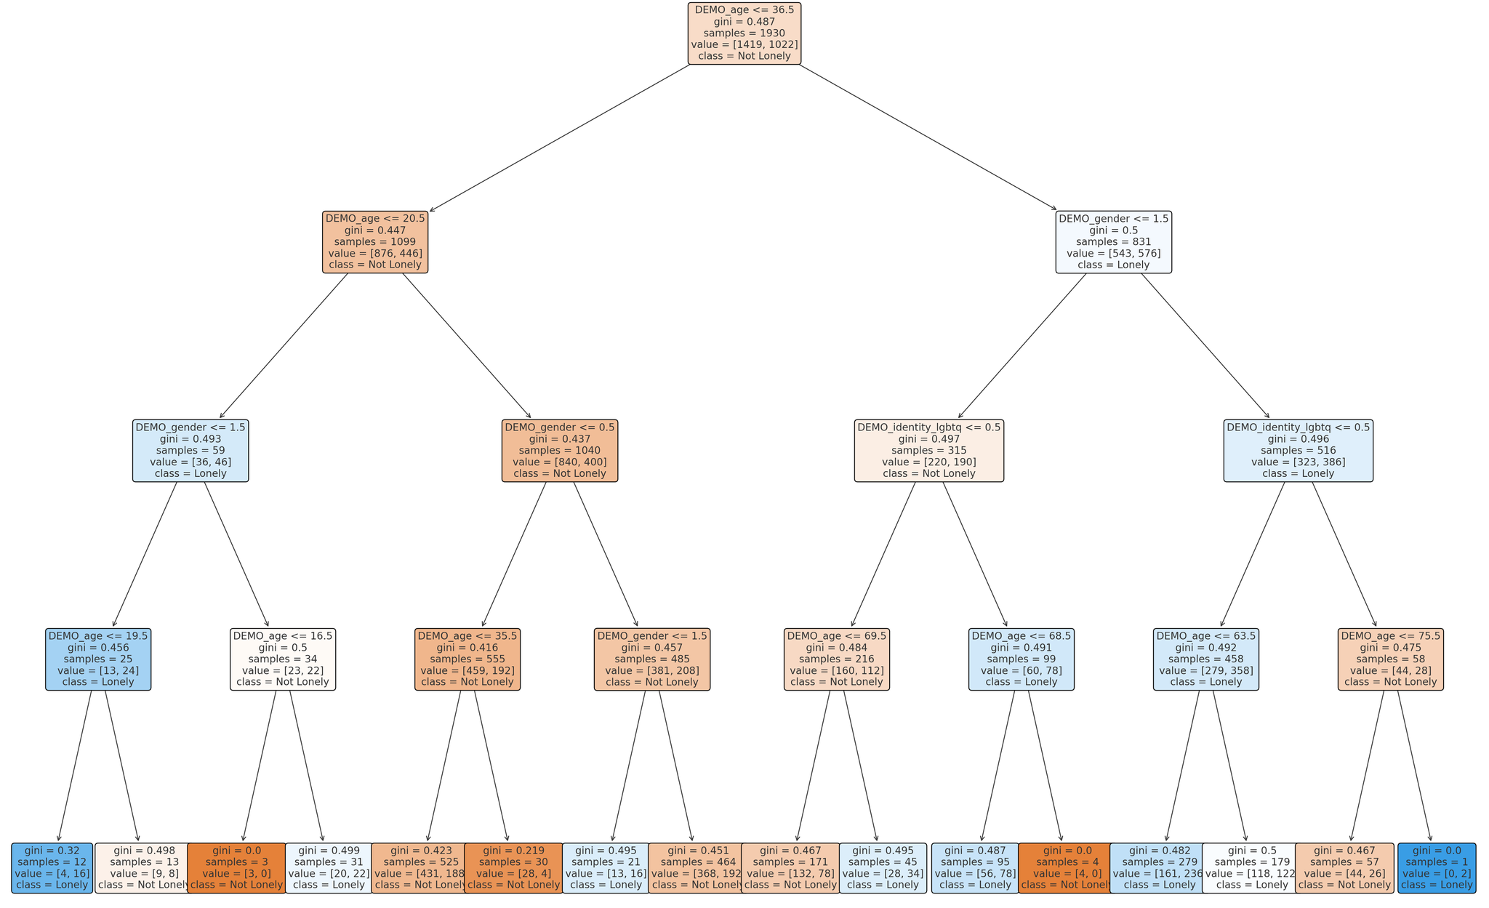
Visualized Tree

Slide 8
Results Analysis
Age
Younger individuals and the elderly are more likely to feel lonely
Gender and LGBTQ Identity
It can be seen from the tree that non-binary individuals tend to feel more lonely
Newcomer status
Newcomers have little association with loneliness

Slide 9
Evaluation of The Model
Overall accuracy
Further Thoughts
Introducing additional variables will further enhance predictive power
Overall Accuracy: 68%
Social Insights I
Social insights II
Focus on addressing the needs of LGBTQ individuals
Create age-specific interventions targeting social inclusion and mental health

Slide 10
Part 2
Do Commonly-Used Ways to Counter Loneliness Work?
Pets, Exercise, and Social Interaction

Slide 11
Part 2:Do Commonly-Used Ways to Counter Loneliness Work?
Goals
Measurement
Whether pets, exercise, and social interaction effective
LONELY_ucla_loneliness_scale_score
Pets
Social Interaction
GEO_housing_live_with_dogs “GEO_housing_live_with_cats”
CONNECTION_activities_talked_day_p3m
Exercise
Methods
CONNECTION_activities_group_exercise_p3m
Use statistical tests (t-tests, bootstrapping) to compare groups

Slide 12
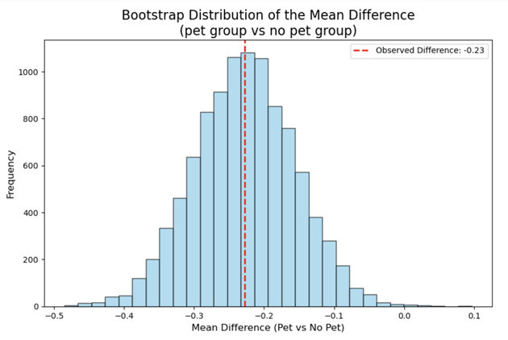
Result Evaluation

Slide 13
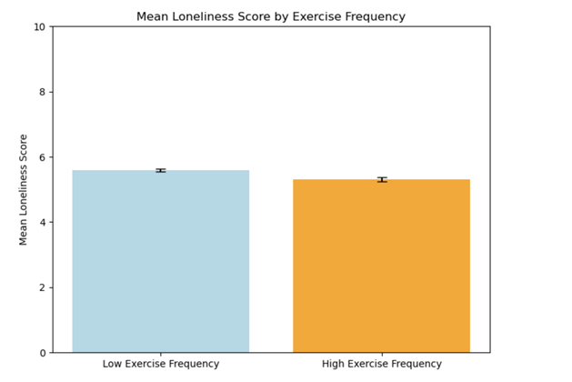
Result Evaluation

Slide 14
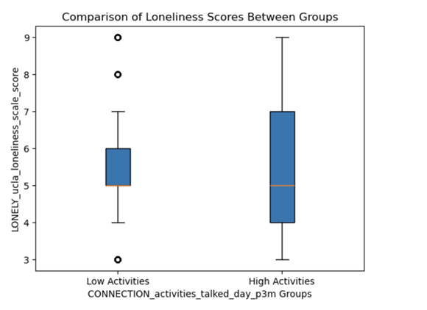
Result Evaluation

Slide 15
Testing The Effect
50.101%
Pets Accompany
99.997%
Have a pet or not do not significantly matter
High Exercise
High exercise group’s loneliness is significantly lower than low exercise group’s
99.982 %
More Interaction
High social frequency group’s loneliness is significantly lower than low frequency group’s

Slide 16
Part 3
What Is The Most Effective Method?
Use clustering to analyze which variable (talk or exercise) has the most significant impact on loneliness reduction

Slide 17
Clustering Approach and Methodology
Preparation
Talk Frequency
Categorize loneliness scores
CONNECTION_activities_talked_day_p3m
Exercise Frequency
Clustering Method
CONNECTION_activities_group_exercise_p3m
Apply K-Means Clustering to group individuals

Slide 18
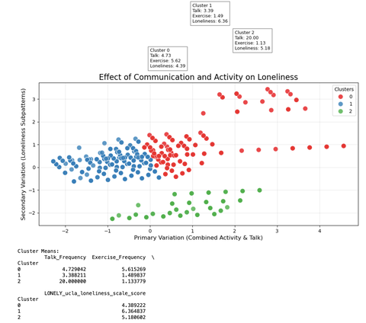
Results Analysis

Slide 19
Key Takeaways and Recommendations
Social interaction is more impactful than exercise alone in reducing loneliness
The combination of both high exercise and social interaction frequency results in the lowest loneliness scores
Focus resources on combined methods rather than individual strategies
Encourage interventions that promote both physical activity and regular social interaction

Slide 20
Limitation
Only considering cats and dogs etc.
Practical measures for alleviating loneliness
Assuming linear relationship

Slide 21

Thanks
Thank Prof Scott, Dr. Kiffer Card and Christine Ovcaric for creating and identifying this project, our TUT TA Yu Shi and all our peers, Canadian Alliance for Social Connection and Health

