Slide 1
Meeting with Soren 7/10

Slide 2
Goals for the past few weeks:
Download IDPH/CDC mortality data
Clean data to standard format (weekly)
Adapt SIR Models
Find parameters from literature
  Severe/hospitalization rates
  Death rates
Implement Seasonality

Slide 3











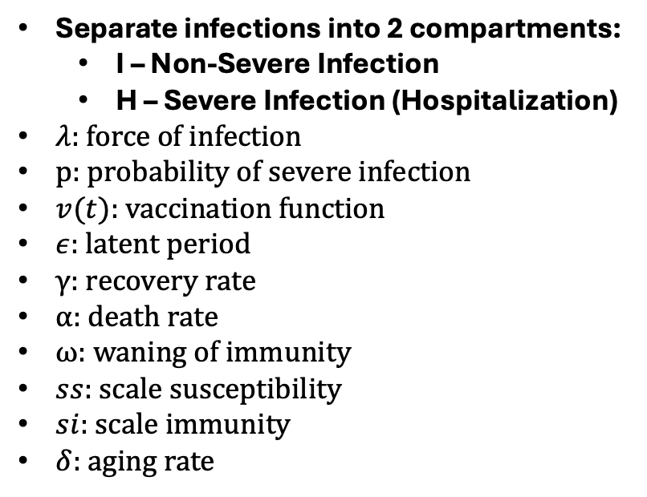



COVID/Flu/RSV SEIR Model
I1
$(1−p_{1})ϵ$
$$γ$$
Separate infections into 2 compartments:
  I – Non-Severe Infection
  H – Severe Infection (Hospitalization)
$λ:$ force of infection
p: probability of severe infection
$v(t)$: vaccination function
$ε$: latent period
$γ$: recovery rate
$α$: death rate
$ω$: waning of immunity
$ss$: scale susceptibility
$si$: scale immunity
$δ$: aging rate
S1
E1
R1
$λ$
$$\left(1−α\right)γ$$
H1
$$p_{1}ϵ$$
D1
$$α$$
$$ω$$
I2
$(1−p_{2})ϵ$
$$γ$$
R2
S2
E2
$ss∗λ$
$$\left(1−α\right)γ$$
$$p_{2}ϵ$$
H2
D2
$$α$$
$$si∙ω$$

Slide 4
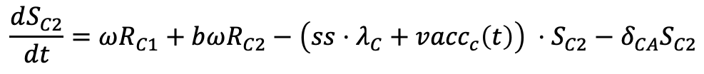
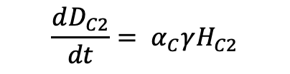
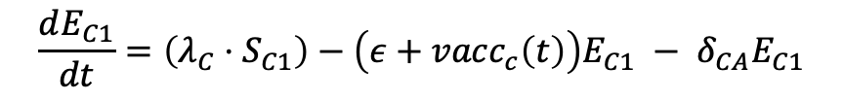
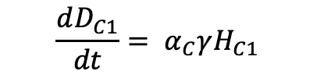
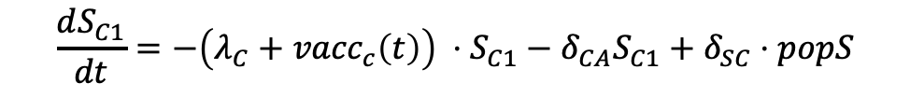
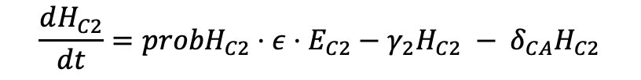
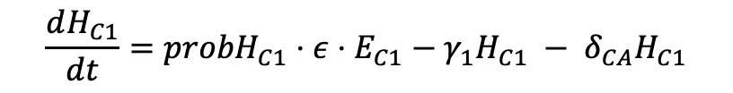
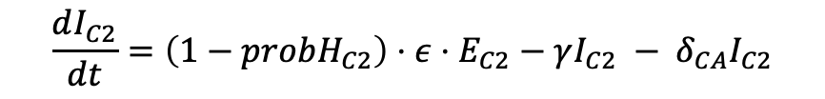
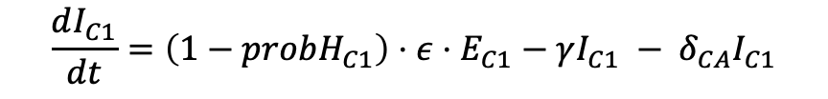
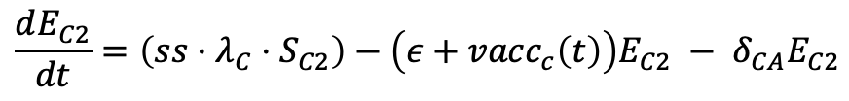
COVID/Flu/RSV SEIR Model Equations (Children Ex. )
$$\frac{dS_{C1}}{dt}=−\left(λ_{C}+{vacc}_{c}\left(t\right)\right) ⋅S_{C1}−δ_{CA}S_{C1}+δ_{SC}⋅popS$$
$$\frac{dS_{C2}}{dt}=ωR_{C1}+bωR_{C2}−\left(ss⋅λ_{C}+{vacc}_{c}\left(t\right)\right) ⋅S_{C2}−δ_{CA}S_{C2}$$
$$\frac{dE_{C1}}{dt}=\left(λ_{C}⋅S_{C1}\right)−\left(ε+{vacc}_{c}\left(t\right)\right)E_{C1} − δ_{CA}E_{C1}$$
$$\frac{dE_{C2}}{dt}=\left(ss⋅λ_{C}⋅S_{C2}\right)−\left(ε+{vacc}_{c}\left(t\right)\right)E_{C2} − δ_{CA}E_{C2}$$
$$\frac{dI_{C1}}{dt}=\left(1−{probH}_{C1}\right)⋅ε⋅E_{C1}−γI_{C1} − δ_{CA}I_{C1}$$
$$\frac{dI_{C2}}{dt}=\left(1−{probH}_{C2}\right)⋅ε⋅E_{C2}−γI_{C2} − δ_{CA}I_{C2}$$
$$\frac{dH_{C1}}{dt}={probH}_{C1}⋅ε⋅E_{C1}−γ_{1}H_{C1} − δ_{CA}H_{C1}$$
$$\frac{dH_{C2}}{dt}={probH}_{C2}⋅ε⋅E_{C2}−γ_{2}H_{C2} − δ_{CA}H_{C2}$$
$$\frac{dR_{C1}}{dt}=γI_{C1}+(1−α_{C})γH_{C1}− {\left(ω{+ vacc}_{c}\left(t\right)\right)R_{C1} − δ}_{CA}R_{C1}$$
$$\frac{dR_{C2}}{dt}={vacc}_{c}\left(t\right)⋅\left(S_{C1}+E_{C1}+R_{C1}+S_{C2}+E_{c2}\right)+γI_{C2 }+(1−α_{C})γH_{C2}−bωR_{C2} −δ_{CA}R_{C2}$$
$$\frac{dD_{C1}}{dt}= α_{C}γH_{C1}$$
$$\frac{dD_{C2}}{dt}= α_{C}γH_{C2}$$

Slide 5
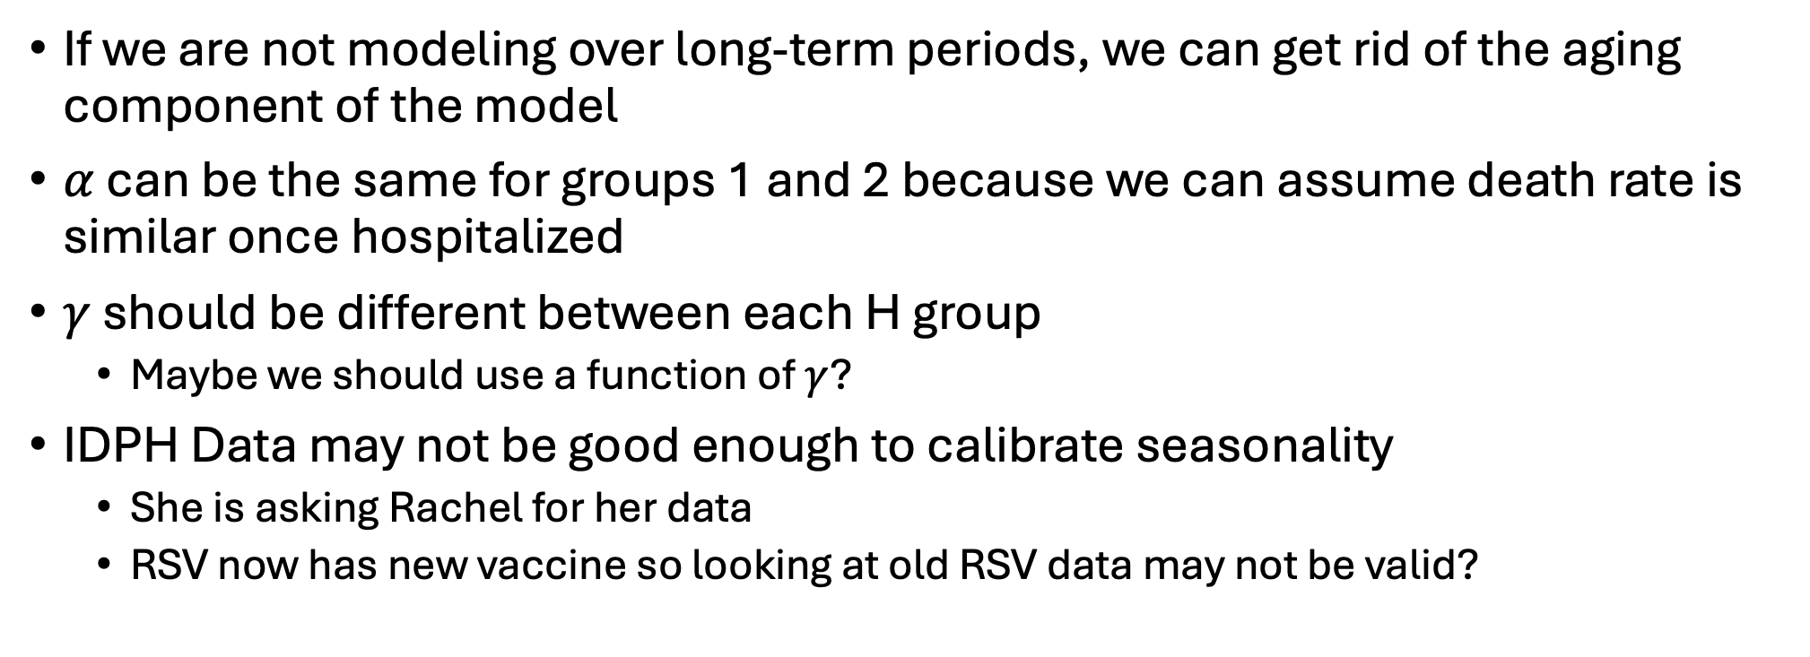
Pamela’s Suggestions
If we are not modeling over long-term periods, we can get rid of the aging component of the model
$α$ can be the same for groups 1 and 2 because we can assume death rate is similar once hospitalized
$γ$ should be different between each H group
  Maybe we should use a function of $γ$?
IDPH Data may not be good enough to calibrate seasonality
  She is asking Rachel for her data
  RSV now has new vaccine so looking at old RSV data may not be valid?

Slide 6


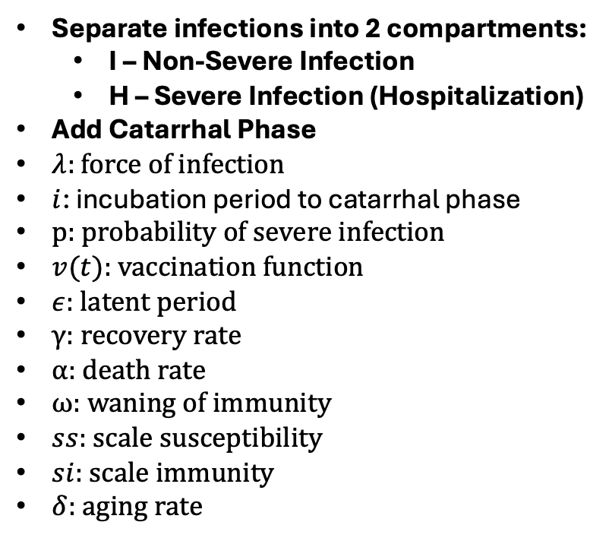












Pertussis SEIR Model
I1
$(1−p_{1})ϵ$
$$γ_{1}$$
Separate infections into 2 compartments:
  I – Non-Severe Infection
  H – Severe Infection (Hospitalization)
Add Catarrhal Phase
$λ:$ force of infection
$i$: incubation period to catarrhal phase
p: probability of severe infection
$v(t)$: vaccination function
$ε$: latent period
$γ$: recovery rate
$α$: death rate
$ω$: waning of immunity
$ss$: scale susceptibility
$si$: scale immunity
$δ$: aging rate
S1
E1
C1
R1
$λ$
$$i$$
$$(1−α)γ_{2}$$
H1
$$p_{1}ϵ$$
D1
$$α$$
$$ω$$
I2
$(1−p_{2})ϵ$
$$γ_{1}$$
S2
E2
R2
$ss∗λ$
C2
$$i$$
$$(1−α)γ_{2}$$
$$p_{2}ϵ$$
H2
D2
$$α$$
$$si∙ω$$

Slide 7
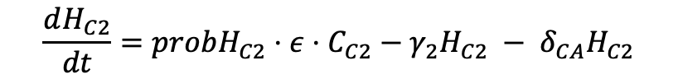
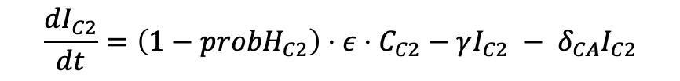
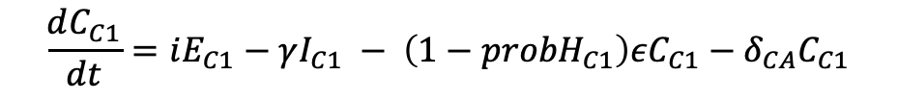
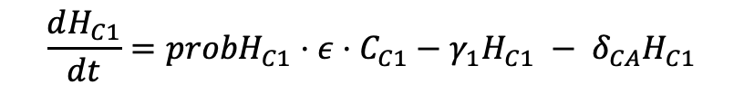
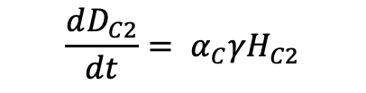
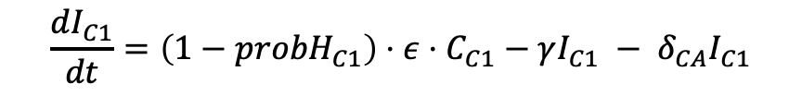
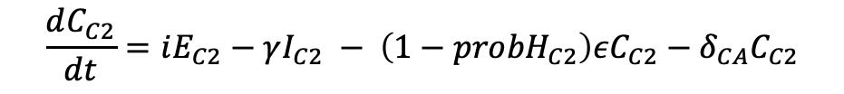
Pertussis SEIR Model Equations (Children Ex. )
$$\frac{dS_{C1}}{dt}=−\left(λ_{C}+{vacc}_{c}\left(t\right)\right) ⋅S_{C1}−δ_{CA}S_{C1}+δ_{SC}⋅popS$$
$$\frac{dS_{C2}}{dt}=ωR_{C1}+bωR_{C2}−\left(ss⋅λ_{C}+{vacc}_{c}\left(t\right)\right) ⋅S_{C2}−δ_{CA}S_{C2}$$
$$\frac{dE_{C1}}{dt}=\left(λ_{C}⋅S_{C1}\right)−\left(ε+{vacc}_{c}\left(t\right)\right)E_{C1} − δ_{CA}E_{C1}$$
$$\frac{dE_{C2}}{dt}=\left(ss⋅λ_{C}⋅S_{C2}\right)−\left(ε+{vacc}_{c}\left(t\right)\right)E_{C2} − δ_{CA}E_{C2}$$
$$\frac{dC_{C1}}{dt}=iE_{C1}−γI_{C1} − {\left(1−{probH}_{C1}\right)εC_{C1}−δ}_{CA}C_{C1}$$
$$\frac{dC_{C2}}{dt}=iE_{C2}−γI_{C2} − {\left(1−{probH}_{C2}\right)εC_{C2}−δ}_{CA}C_{C2}$$
$$\frac{dI_{C1}}{dt}=\left(1−{probH}_{C1}\right)⋅ε⋅C_{C1}−γI_{C1} − δ_{CA}I_{C1}$$
$$\frac{dI_{C2}}{dt}=\left(1−{probH}_{C2}\right)⋅ε⋅C_{C2}−γI_{C2} − δ_{CA}I_{C2}$$
$$\frac{dH_{C1}}{dt}={probH}_{C1}⋅ε⋅C_{C1}−γ_{1}H_{C1} − δ_{CA}H_{C1}$$
$$\frac{dH_{C2}}{dt}={probH}_{C2}⋅ε⋅C_{C2}−γ_{2}H_{C2} − δ_{CA}H_{C2}$$
$$\frac{dR_{C1}}{dt}=γI_{C1}+(1−α_{C})γH_{C1}− {\left(ω{+ vacc}_{c}\left(t\right)\right)R_{C1} − δ}_{CA}R_{C1}$$
$$\frac{dR_{C2}}{dt}={vacc}_{c}\left(t\right)⋅\left(S_{C1}+E_{C1}+R_{C1}+S_{C2}+E_{c2}\right)+γI_{C2 }+(1−α_{C})γH_{C1}−bωR_{C2} −δ_{CA}R_{C2}$$
$$\frac{dD_{C1}}{dt}= α_{C}γH_{C1}$$
$$\frac{dD_{C2}}{dt}= α_{C}γH_{C2}$$

