Slide 1
SHIELD Meeting 6/3/25

Slide 2
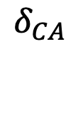




Age-Stratified SEIRD Model
Children
$$δ_{CA}$$
$$δ_{P}$$
$δ_{i}$: aging rate
Adults without Children
Adults with Children (Parents)
$$δ_{A}$$
Adults (50+)
$$δ_{A}$$
Notes:
Walk through flow
Explain 2nd group : base immunity

Slide 3




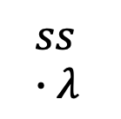






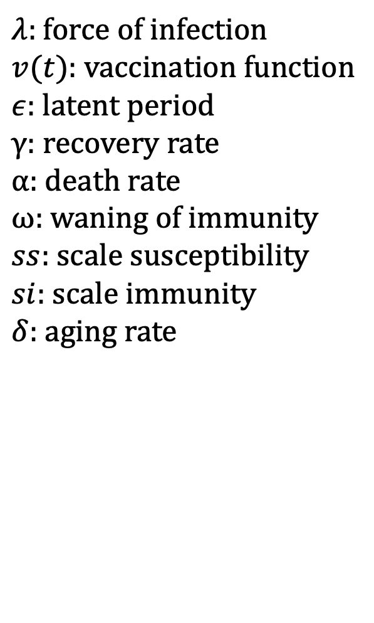




Age-Stratified SEIRD Model
D1
$$α_{1}$$
S1
$λ$
$λ:$ force of infection
$v(t)$: vaccination function
$ε$: latent period
$γ$: recovery rate
$α$: death rate
$ω$: waning of immunity
$ss$: scale susceptibility
$si$: scale immunity
$δ$: aging rate
E1
$$ϵ$$
I1
$$γ$$
$$δ$$
R1
$$δ$$
$$δ$$
$$ω$$
$$δ$$
D2
$$α_{2}$$
S2
$$ss ∙λ$$
E2
$$ϵ$$
I2
$$γ$$
$$δ$$
$$δ$$
$$δ$$
R2
$$si∙ω$$
$$δ$$
Notes:
Walk through flow
Explain 2nd group : base immunity

Slide 4
COVID-19
Age Group | Vaccination Coverage
Children (0-18) | 0%
Childless Adults (19-50) | 0%
Adults with Children (19-50) | 0%
Adults (50+) | 0%
Age Group | Vaccination Coverage
Children (0-18) | 64.23%
Childless Adults (19-50) | 69.73%
Adults with Children (19-50) | 69.73%
Adults (50+) | 86.28%
Age Group | Vaccination Coverage
Children (0-18) | 69.73%
Childless Adults (19-50) | 69.73%
Adults with Children (19-50) | 69.73%
Adults (50+) | 86.28%
Notes:
Key Points: High exposed group, especially in children

Slide 5
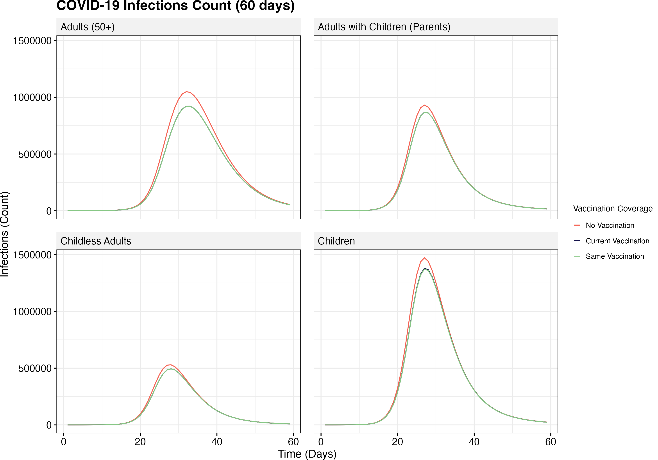
Notes:
Key Points: High exposed group, especially in children

Slide 6
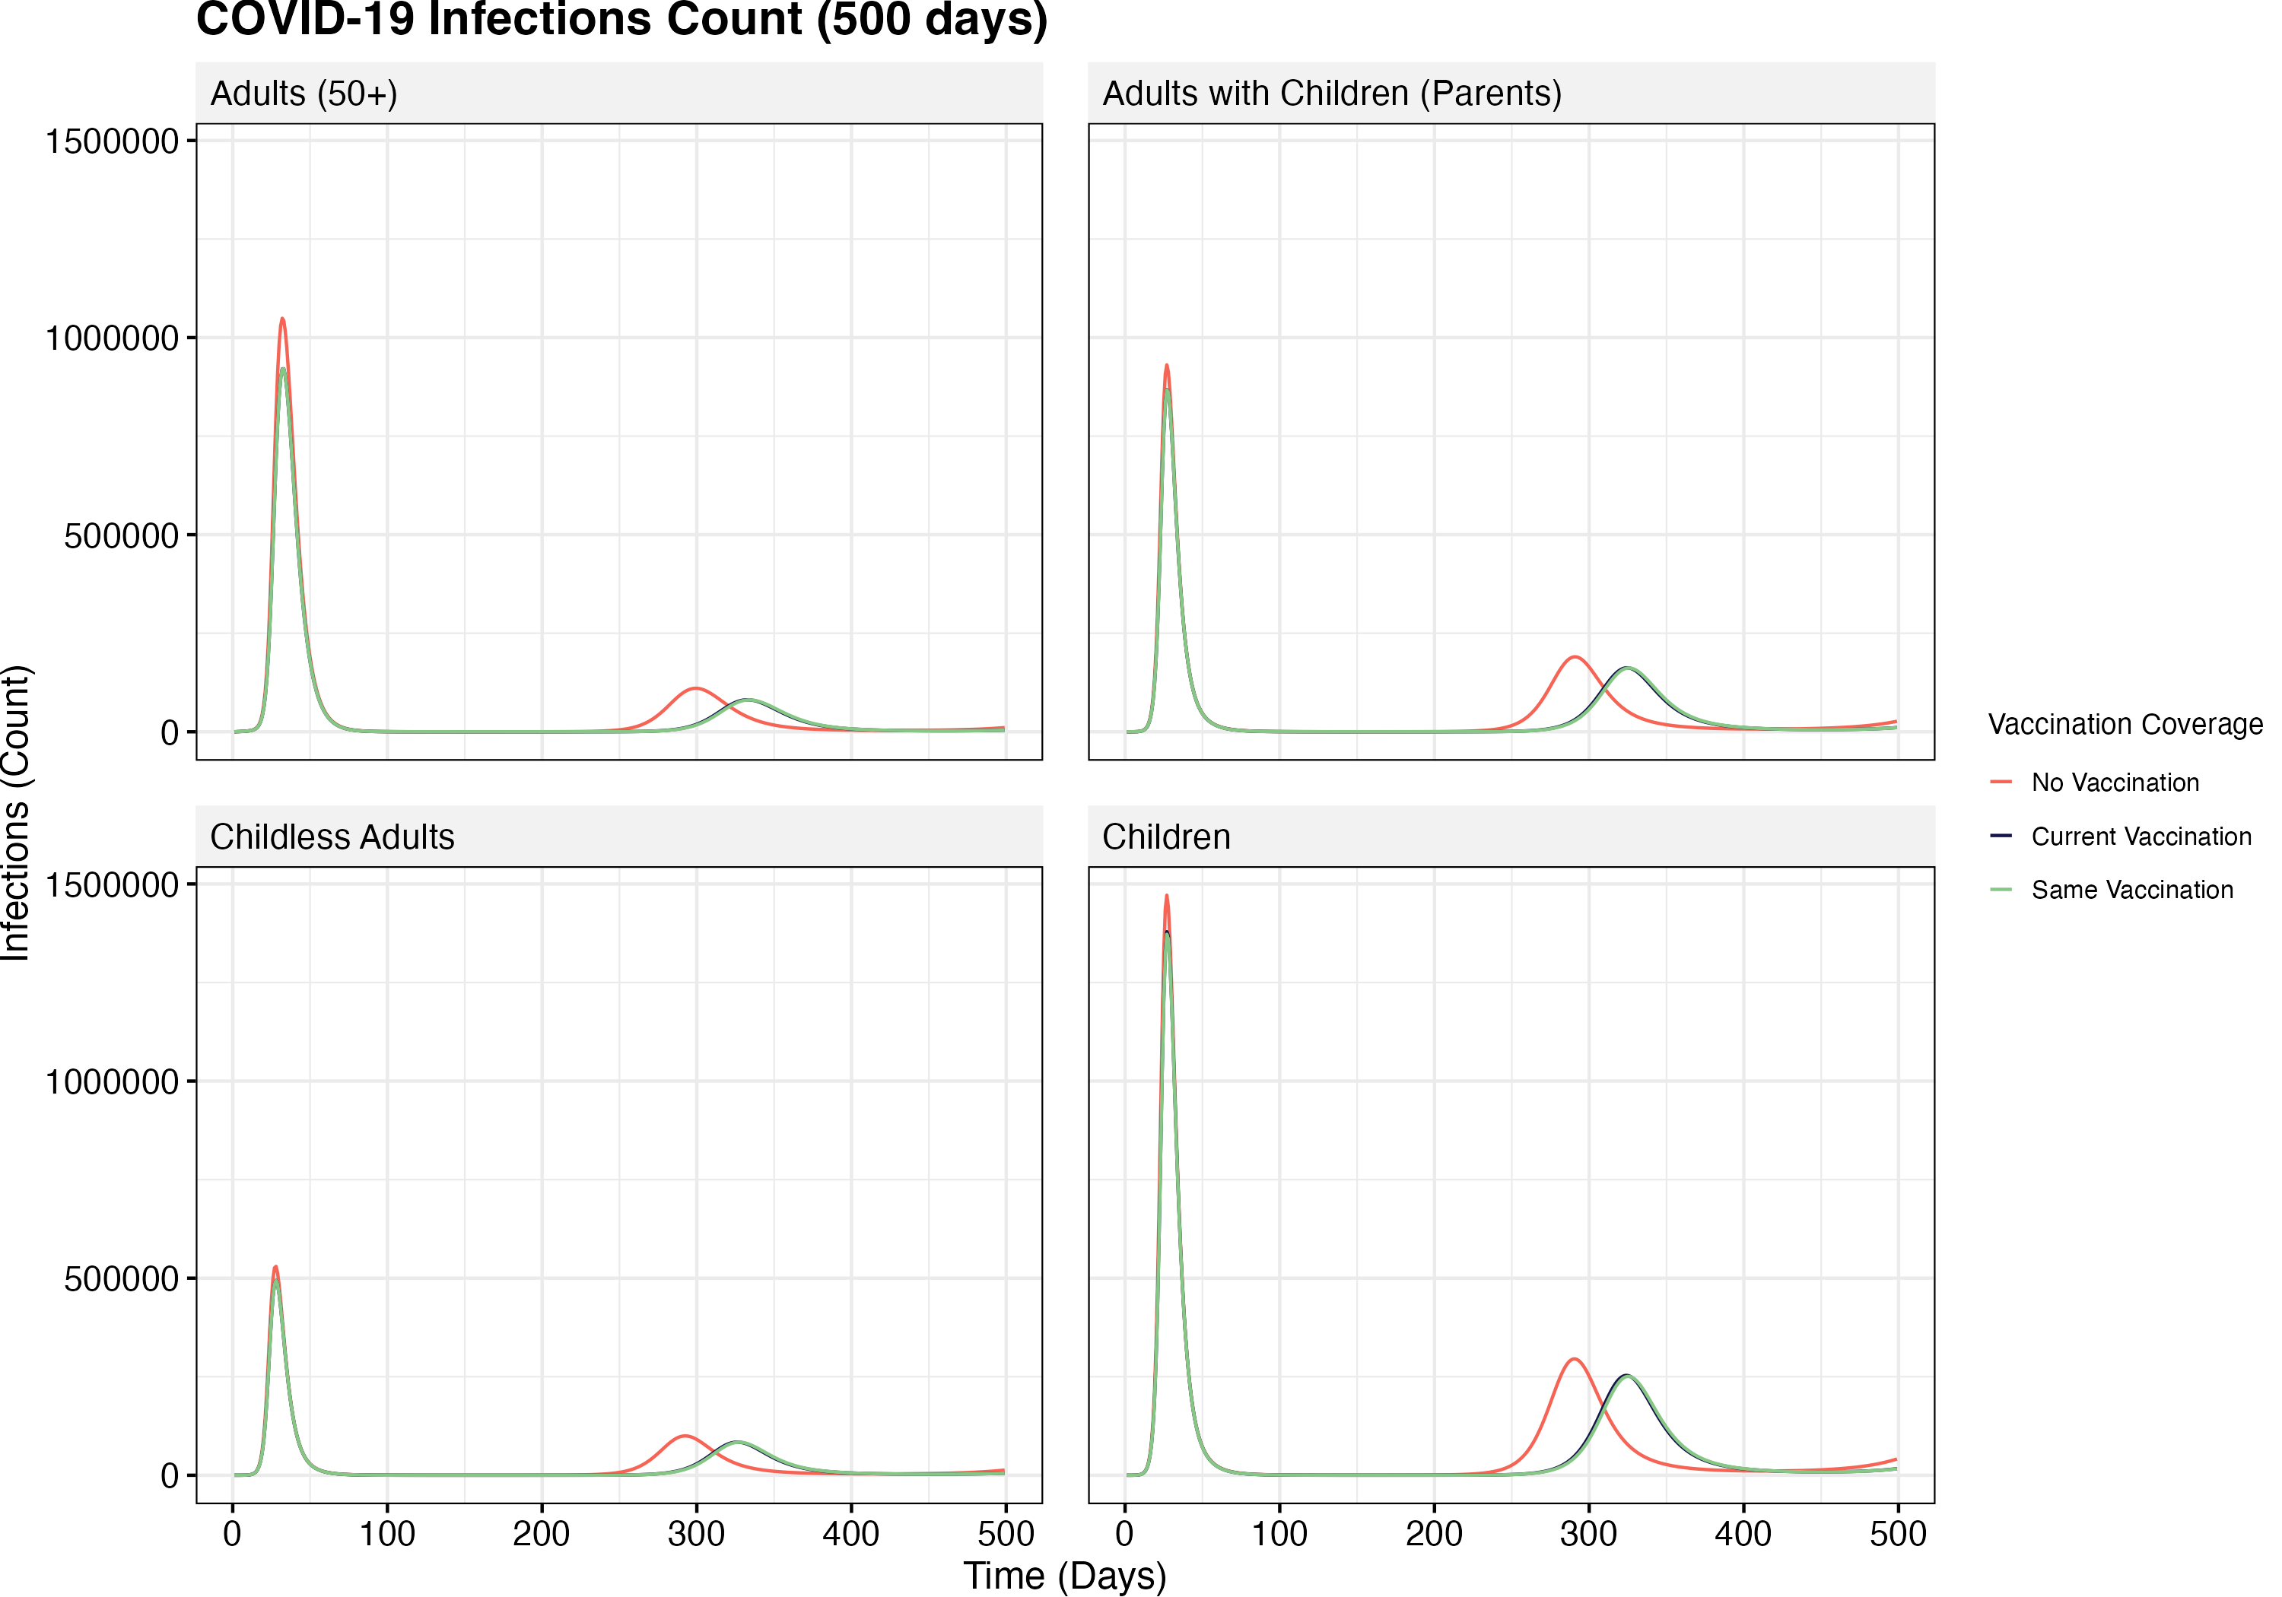
Notes:
Key Points: High exposed group, especially in children

Slide 7
Flu
Age Group | Vaccination Coverage
Children (0-18) | 0%
Childless Adults (19-50) | 0%
Adults with Children (19-50) | 0%
Adults (50+) | 0%
Age Group | Vaccination Coverage
Children (0-18) | 59.76%
Childless Adults (19-50) | 36.69%
Adults with Children (19-50) | 49.09%
Adults (50+) | 61.29%
Age Group | Vaccination Coverage
Children (0-18) | 59.76%
Childless Adults (19-50) | 59.76%
Adults with Children (19-50) | 59.76%
Adults (50+) | 61.29%
Notes:
Key Points: High exposed group, especially in children

Slide 8
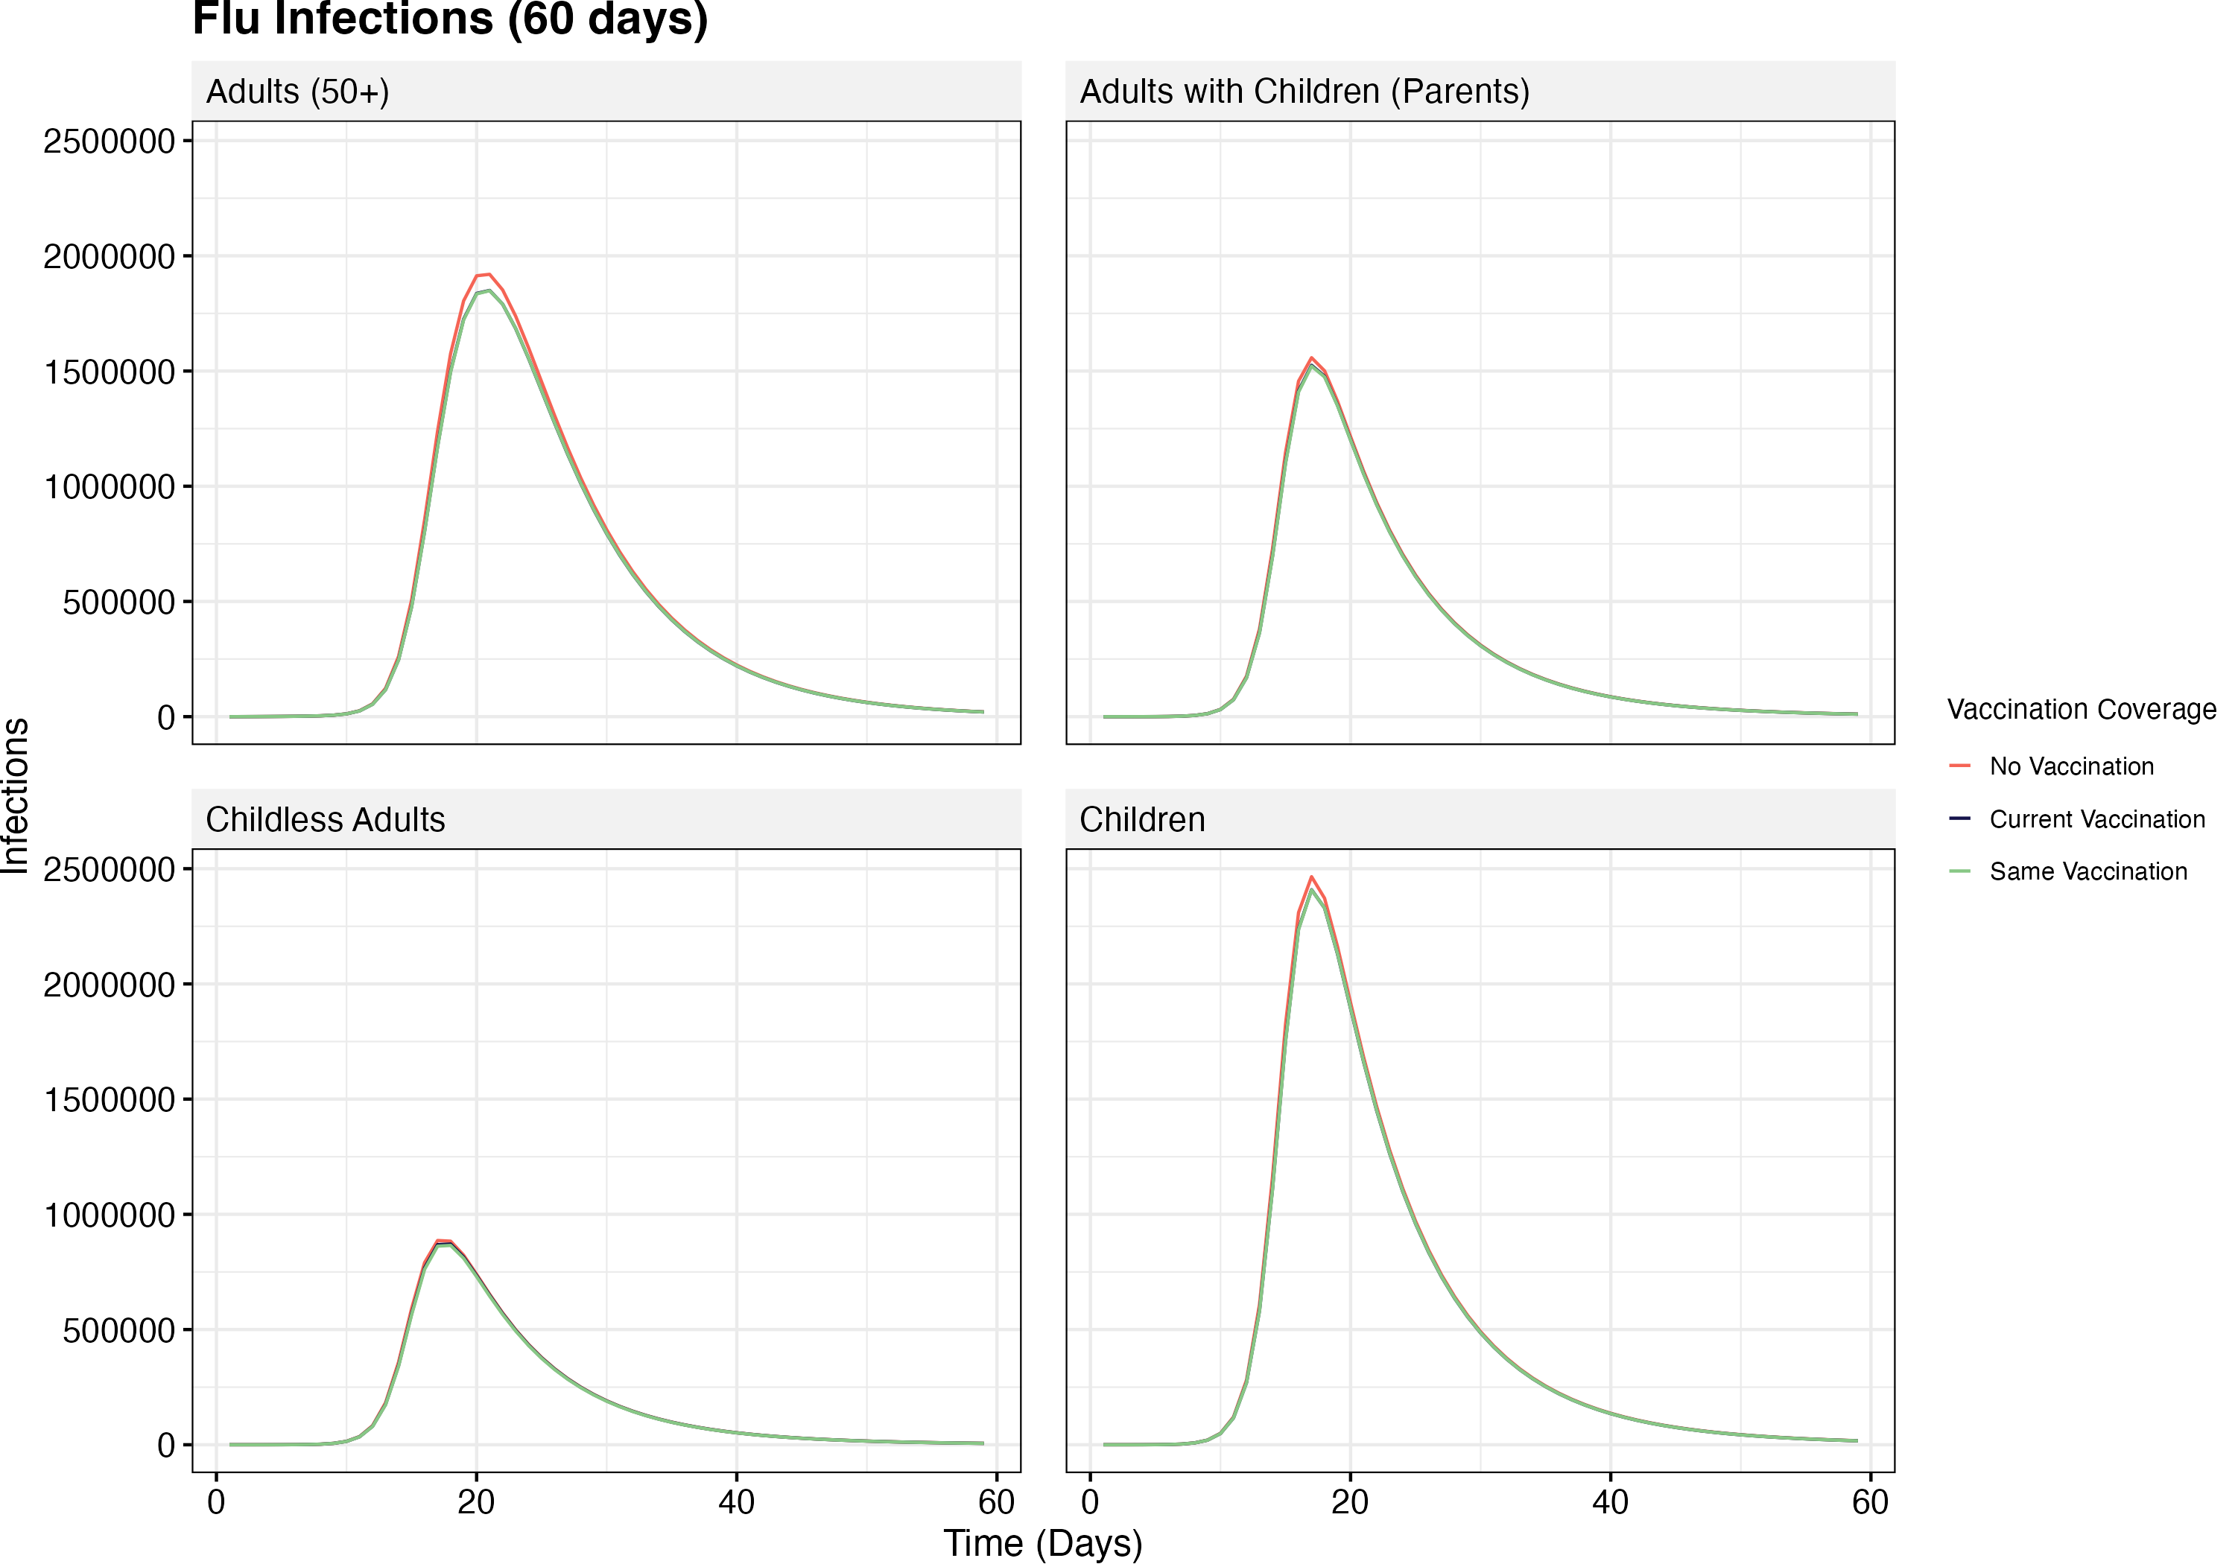
Notes:
Key Points: High exposed group, especially in children

Slide 9
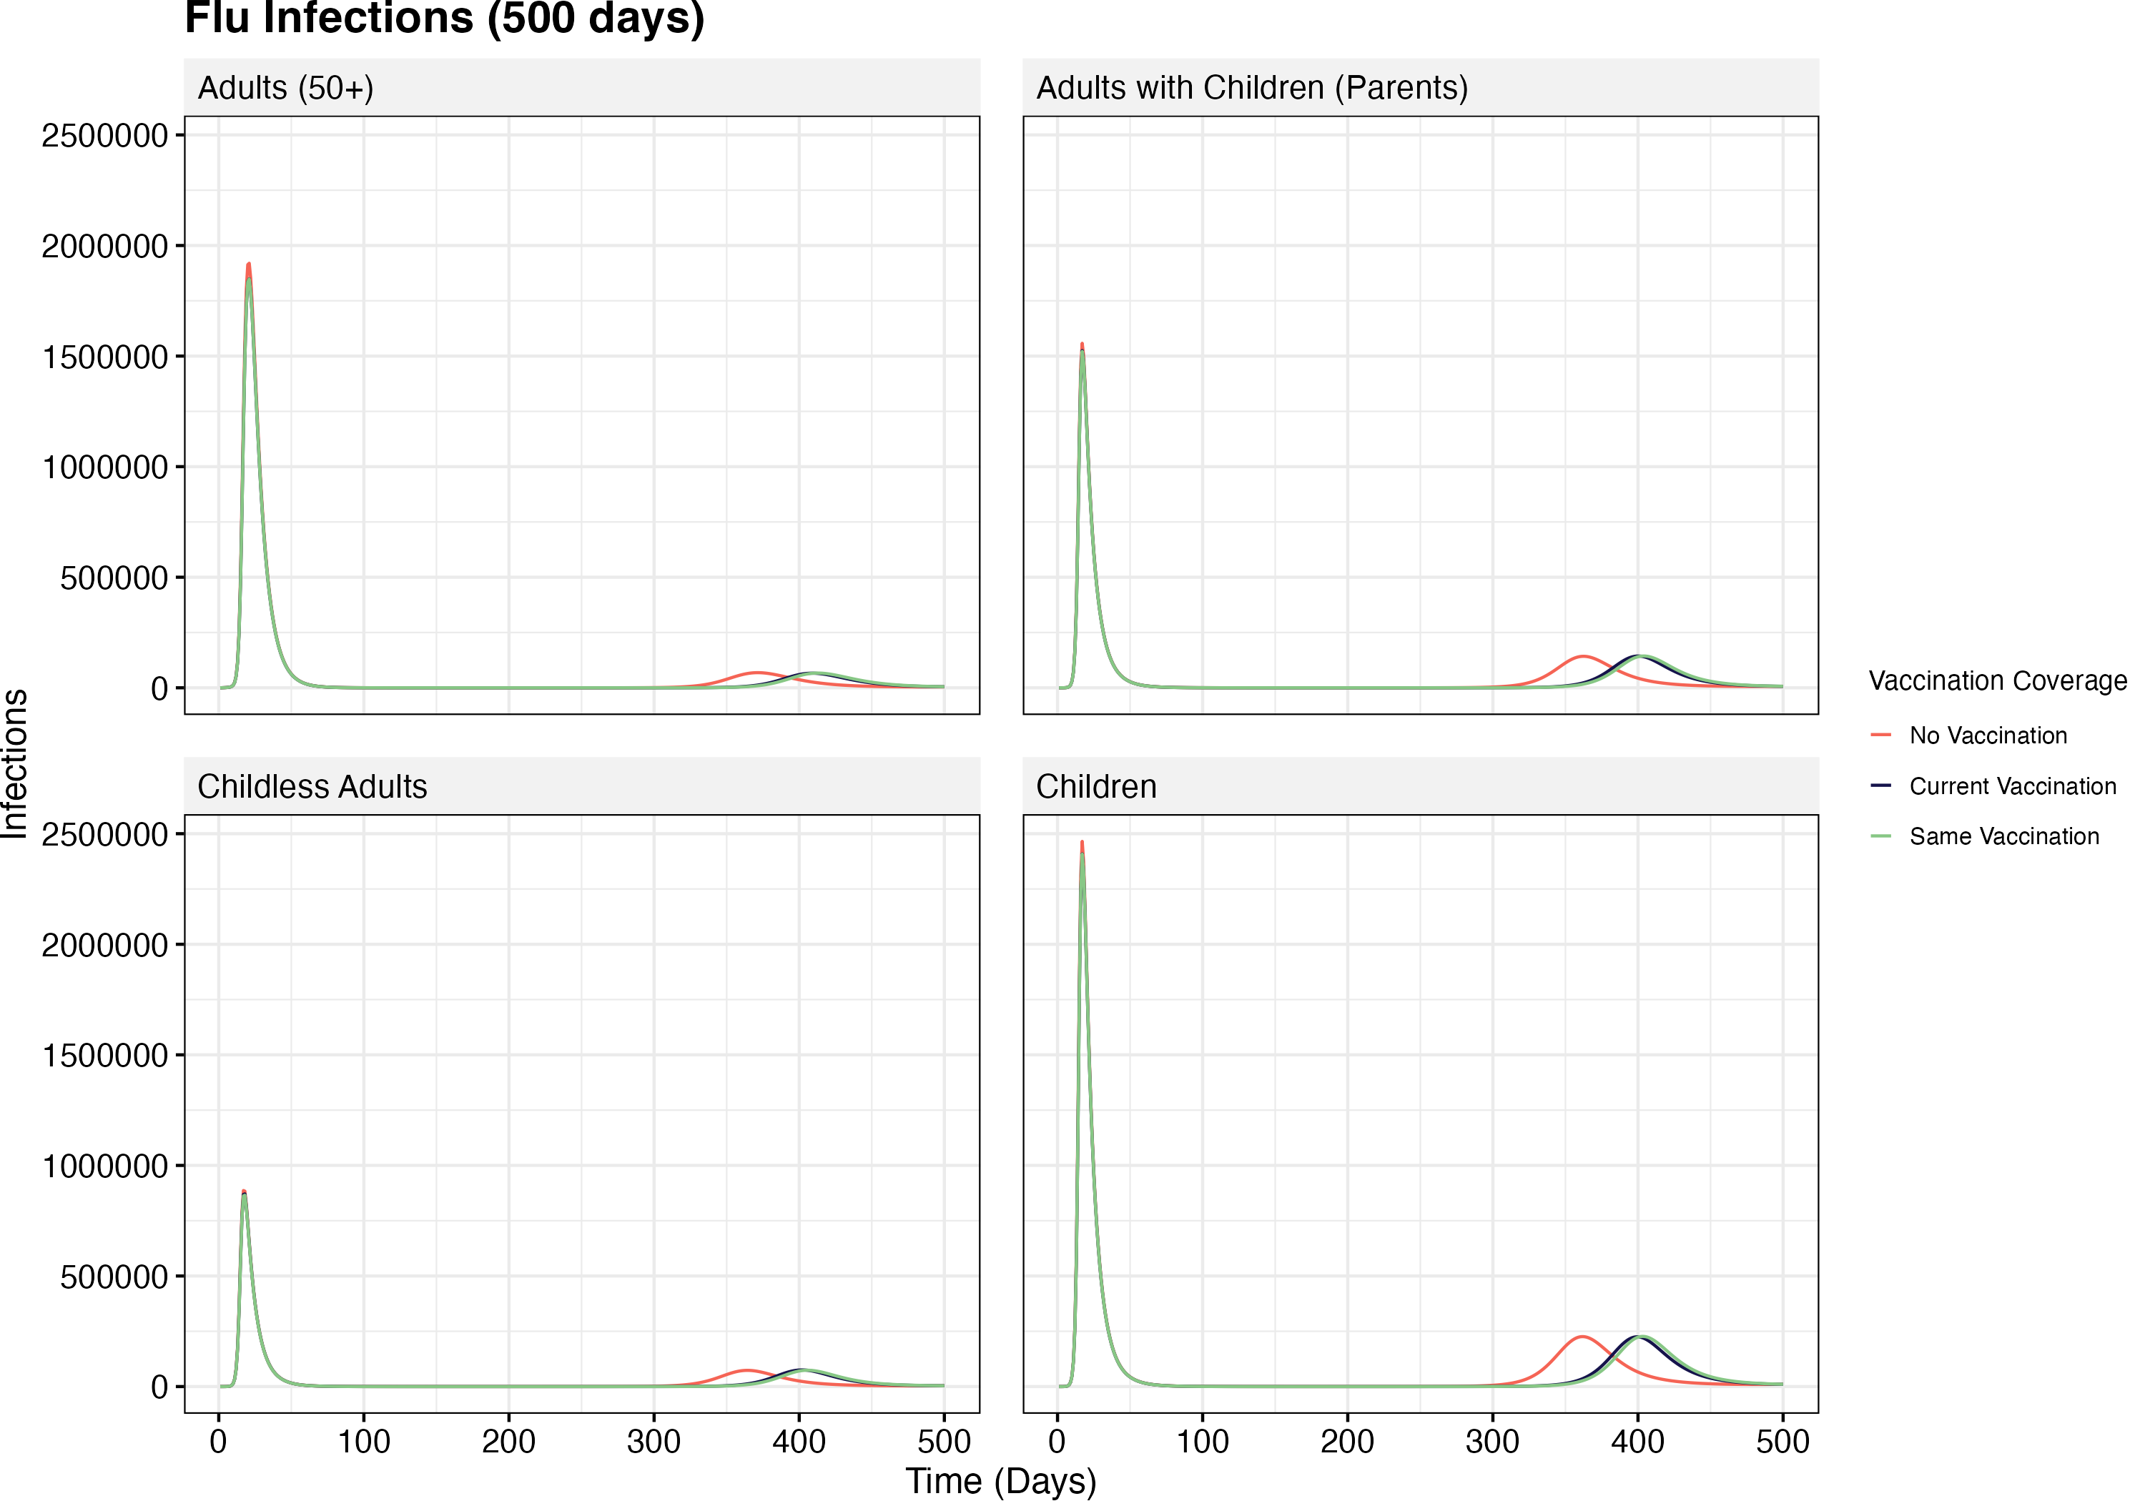
Notes:
Key Points: High exposed group, especially in children

Slide 10
RSV
Age Group | Vaccination Coverage
Children (0-18) | 0%
Childless Adults (19-50) | 0%
Adults with Children (19-50) | 0%
Adults (50+) | 0%
Age Group | Vaccination Coverage
Children (0-18) | 46.8%
Childless Adults (19-50) | NA
Adults with Children (19-50) | NA
Adults (50+) | NA
Age Group | Vaccination Coverage
Children (0-18) | 46.8%
Childless Adults (19-50) | 46.8%
Adults with Children (19-50) | 46.8%
Adults (50+) | 46.8%
Notes:
Key Points: High exposed group, especially in children

Slide 11
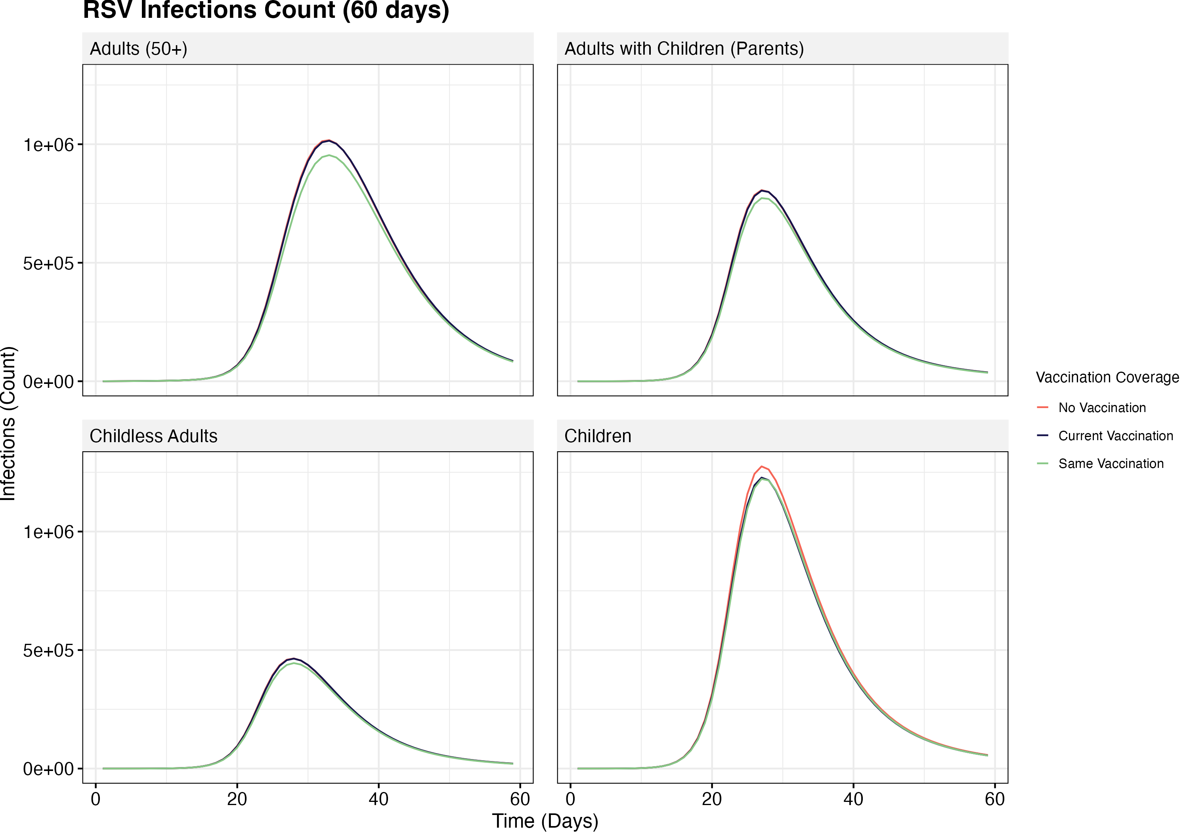
Notes:
Key Points: High exposed group, especially in children

Slide 12
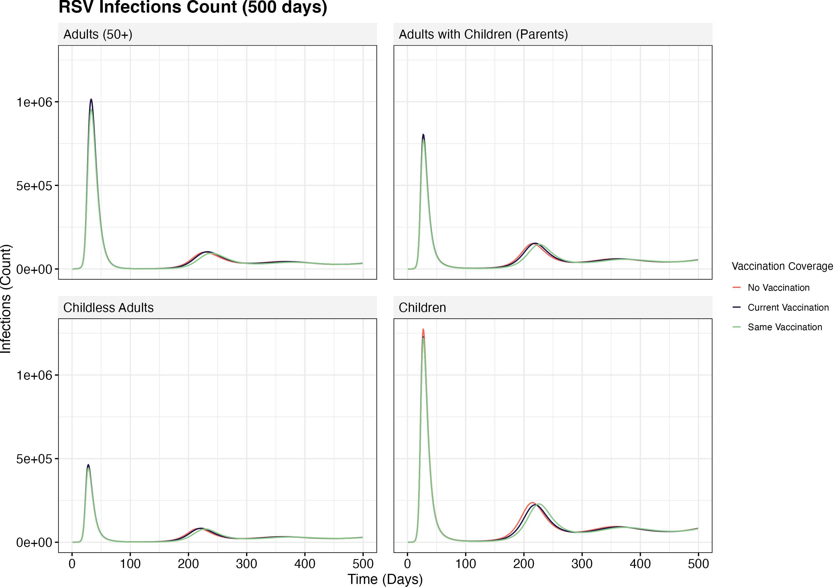
Notes:
Key Points: High exposed group, especially in children

Slide 13
Pertussis
Age Group | Vaccination Coverage
Children (0-18) | 0%
Childless Adults (19-50) | 0%
Adults with Children (19-50) | 0%
Adults (50+) | 0%
Age Group | Vaccination Coverage
Children (0-18) | 86%
Childless Adults (19-50) | NA
Adults with Children (19-50) | NA
Adults (50+) | NA
Age Group | Vaccination Coverage
Children (0-18) | 86%
Childless Adults (19-50) | 86%
Adults with Children (19-50) | 86%
Adults (50+) | 86%
Notes:
Key Points: High exposed group, especially in children

Slide 14
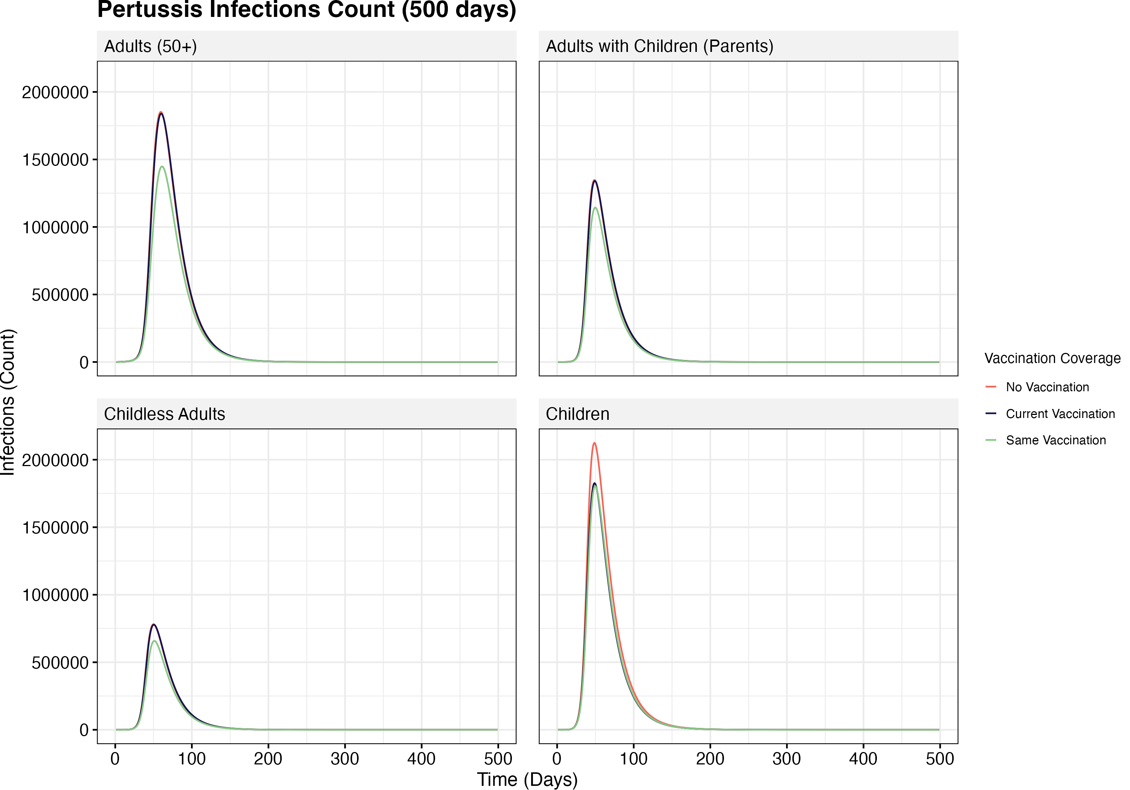
Notes:
Key Points: High exposed group, especially in children

